Slide 1

Financial Markets and Institutions
Ninth Edition
Chapter 4
Appendix 1 Models of Asset Pricing
Copyright © 2018, 2015, 2012 Pearson Education, Inc. All Rights Reserved
Notes:
If this PowerPoint presentation contains mathematical equations, you may need to check that your computer has the following installed:
1) MathType Plugin
2) Math Player (free versions available)
3) NVDA Reader (free versions available)

Slide 2
Benefits of Diversification (1 of 3)
Diversification makes sense!
  Don’t put all your eggs in one basket
  Holding many assets can reduce overall risk
Simple example
  Frivolous Luxuries, Inc. does well in a strong economy
  Bad Times Products thrives when the economy is weak
  Some benefit to holding both?

Slide 3
Benefits of Diversification (2 of 3)
Economy | Chance | Returns to Frivolous | Returns to Bad Times
Strong | 50% | 15% | 5%
Weak | 50% | 5% | 15%
By holding an equal investment in each stock, the return is exactly 10%. No risk!

Slide 4
Benefits of Diversification (3 of 3)
Important points about diversification:
Diversification is almost always beneficial to the risk-averse investor
Low correlation means more risk reduction from diversification

Slide 5
Diversification and Beta (1 of 6)
Consider the return of a portfolio of n assets:

Slide 6
Diversification and Beta (2 of 6)
Consider the return of a portfolio of n assets:
We can show that the portfolio variance is:
where = the covariance of the return on asset i with the portfolio’s return
= E[{R_{i} - E(R_{i})} × {R_{p} - E(R_{p})}]

Slide 7
Diversification and Beta (3 of 6)
Important point for portfolio risk: the covariance of an asset with the portfolio is more important than the individual asset’s risk.

Slide 8
Diversification and Beta (4 of 6)
This is where we develop the concept of beta – the ratio of the covariance of an asset to the portfolio’s variance:
where β_{i} = the beta of asset i

Slide 9
Diversification and Beta (5 of 6)
We can also think of the return on asset i as being made up of a market movement and a random movement:

Slide 10
Diversification and Beta (6 of 6)
Also helps with intuition:
A stocks beta tells us how sensitive the returns are to market movements.
We can estimate betas be regressing stock returns on market returns.

Slide 11
Systematic and Nonsystematic Risk (1 of 2)
Using Equation 5, we can decompose an asset’s risk into two components:
A market risk (systematic) component
Unique (nonsystematic) component

Slide 12
Systematic and Nonsystematic Risk (2 of 2)
In a well-diversified portfolio, we can shows that:
Beta is average portfolio beta
Unique (nonsystematic) component goes to zero as n (# of assets) increases

Slide 13
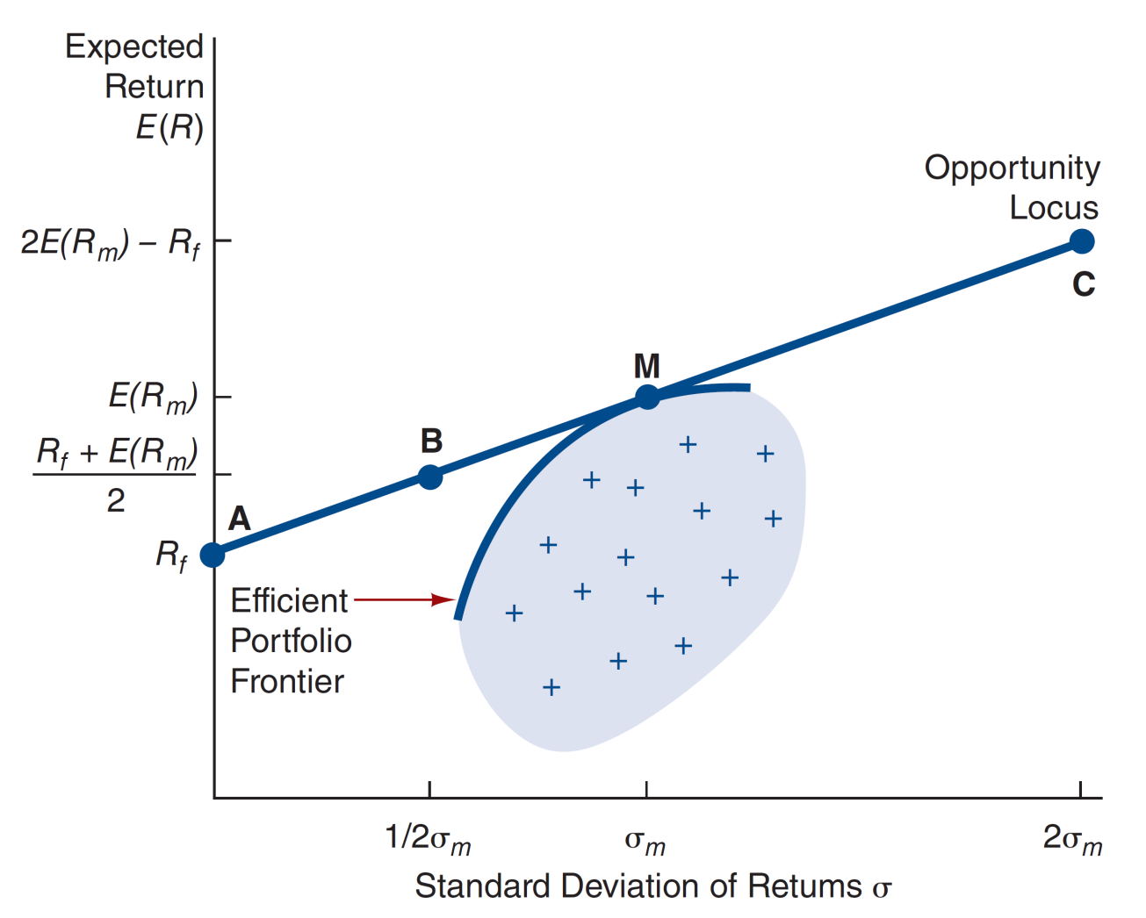
Figure 1 Risk Expected Return Trade-off

Slide 14
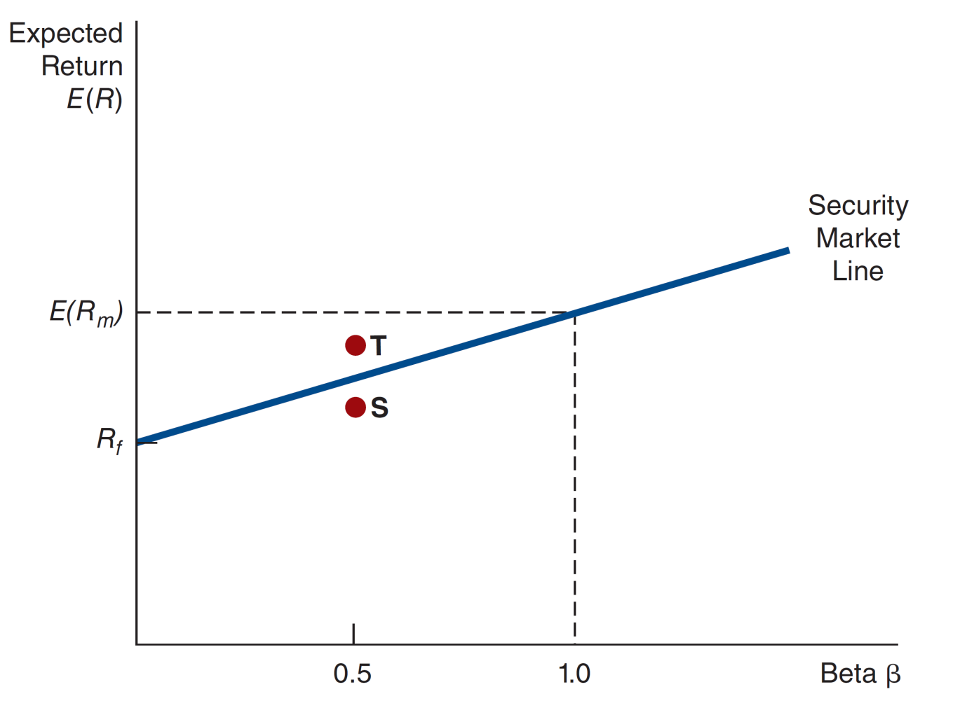
Figure 2 Security Market Line

Slide 15
Capital Asset Pricing Model
CAPM shows that:
An asset should be priced so that is has a higher expected return its systematic risk is greater.
Nonsystematic risk should not be priced.

Slide 16
Arbitrage Pricing Theory (1 of 2)
APT is an alternative to CAPM:
APT assumes there may be several sources of systematic risk.
Each factor affects asset returns.

Slide 17
Arbitrage Pricing Theory (2 of 2)
APT is an alternative to CAPM:
Expected returns should be higher for more exposure to a risk factor.

Slide 18

Copyright
Notes:
.

