Slide 1
BMSW5105_CARD
Workplace Culture and its Impact on Organisational Efficiency

Slide 2

Recap of Previous Lecture
Why focus on International Differences?
Hofstede’s Five Cultural Dimensions
The Trompenaars and Hampden-Turner Framework

Slide 3
Structure of Lecture 4
Corporate responsibility
Why does corporate responsibility matter?
The importance of principles
Ethical framework
CIPD ethical lenses
Exercises

Slide 4
Corporate Responsibility
“A responsible organisation conducts business ethically and takes account of its economic, social and environmental impact” (CIPD, 2019)

Slide 5
Areas of Corporate Responsibility
CR initiatives fall into four main areas:
  Workplace
  Market place
  Environment
  Community

Slide 6
Why does Corporate Responsibility Matter?
Most businesses traditionally driven by economic, not ethical goals
Idea that organisations are responsible for their decisions (Kaptein and Wempe, 2002)
Some corporate responsibility stems from legal requirements – health and safety (duty of care), employment law, consumer protection
Also responsibility to be moral/ethical – rise in ethical investment and ethical consumerism
Management – many decisions pose ethical questions since they deal with people issues

Slide 7
Capgemini - Video
https://www.youtube.com/watch?v=bAQS6Jou3SE

Slide 8
The Importance of Principles
Two aspects of ‘business ethics’ (Chryssides and Kaler, 1993):
  Specific situations in which ethical controversy arises
  The principals of behaviour by which it is appropriate to abide
Principles include:
Ethics of employment – pay, unions, worker’s rights, equal opportunities, non-discrimination, whistle-blowing
Ethics of accounting, finance, restructuring and investing
Ethics of information

Slide 9
Ethical Frameworks
Winstanley et al (1996) identify the following frameworks to analyse the management of people:
Basic human, civil and employment rights
Social and organisational justice
Universalism
Community of purpose
Recommended:
Employment charters
Legal regulation
Innovation in good practice
Challenge inevitability of demise of job security

Slide 10
CIPD – Eight Ethical Lenses
Fairness
Merit
Markets
Democracy
Wellbeing
Rights and Duties
Character
Handing down

Slide 11

Fairness
Everyone in an organisation should be able to agree to it, whatever their place in it.

Slide 12
Merit
Jobs and their rewards should track talent and hard work.

Slide 13
Markets
Jobs and their rewards should follow from voluntary market exchanges.

Slide 14
Democracy
No one should be subject to a regime in which they have no say

Slide 15
Wellbeing
Work should be good for us.

Slide 16
Rights and Duties
Everyone has rights to do some things and to be free of some things, and everyone has duties not to violate others’ rights.

Slide 17
Character
Each of us should work to develop the best ethical character for our roles.

Slide 18
Handing Down
We can’t reinvent or master the world, and are instead responsible for conserving and maintaining the small part of it over which we currently have stewardship, and for passing it on undamaged to our descendants.

Slide 19
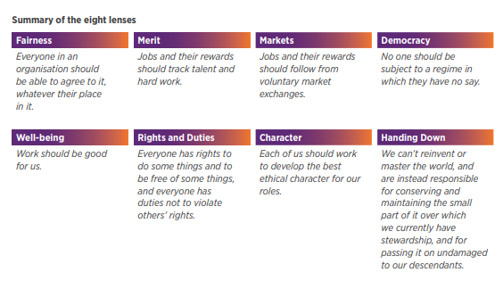

Slide 20
CIPD Podcast 144 (Jan 19)
https://www.cipd.co.uk/podcasts/trust
Exploring Trust and human connection in today’s workplaces:
“There is a really tight link between low trust cultures and cultures that struggle to innovate.”

Slide 21
Exercise: Ethical Dilemmas
In your groups consider the list of ethical dilemmas and agree what you would do in each situation.
Justify your answers.
The options are:
Do nothing – why?
Take action – what?
If you are an employee, actions include:
Tell your manager
Tell your internal audit team
Tell an external body (eg regulator)
Tell the press

Slide 22
Exercise: Building a Culture of Sustainability
In your groups, identify and discuss ways that a manager/owner of a company can encourage corporate responsibility.
Think about how to influence employee behaviour.

Slide 23
Summary of Lecture
Corporate responsibility
Why does corporate responsibility matter?
The importance of principles
Ethical framework
CIPD ethical lenses
Exercises

