Slide 1

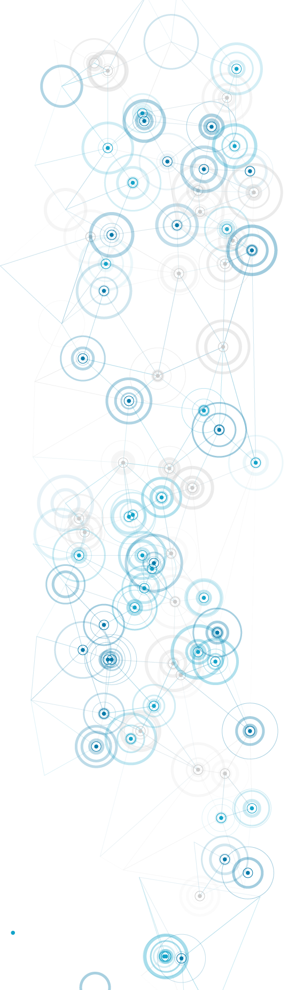


Digital Transformation for Health and Care Professionals
BMDS7008
Introduction to the FITT Framework
Dr Simona Ferraraccio

Slide 2

Contents:
Summary of BMDS7008 and bridge to BMDS7009
What is the FITT framework?
Why frameworks like FITT are necessary.
How was FITT developed?
An example of application of the FITT framework

Slide 3
So far, in this module:
The Wachter review
Digital maturity and digital excellence
Digital architecture
Interoperability
Do the technology, the people, and the tasks truly work together in practice?

Slide 4
What is the FITT framework?
Conceptual model used to analyse and optimise the interaction between people, the tasks they perform, and the technology they use.
Activities or objectives that individuals aim to accomplish using technology. Tasks can range from simple, routine operations to complex, strategic processes, each requiring specific features and capabilities from the technology.
People who interact with the technology. It includes their characteristics, such as skills, preferences, attitudes, and motivations, which influence how they perceive and use technology.
Task
Tools, systems, and applications that individuals use to complete tasks. It considers factors such as usability, functionality, and design that determine how effectively the technology supports task performance.
FIT
IT adoption
FIT
Individual
Technology
FIT
Fit between Individuals, Tasks & Technology

Slide 5






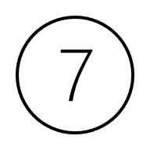
Why is a framework like FITT needed?
Bridging the gap between technology and human needs
Improving task efficiency and effectiveness
Enhancing user experience and satisfaction
Minimising resistance to technology adoption
Supporting decision-making in technology design and adoption
Facilitating adaptability in diverse contexts
Promoting holistic problem-solving

Slide 6
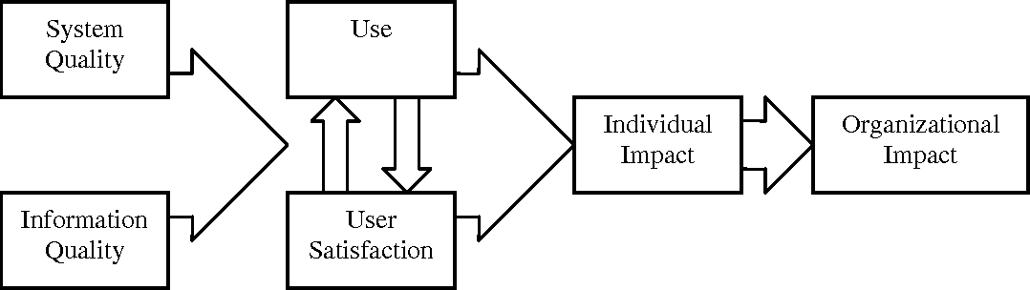
How was FITT developed?
Seminal work on Information systems success by DeLone and McLean (1992):
https://doi.org/10.1287/isre.3.1.60

Slide 7
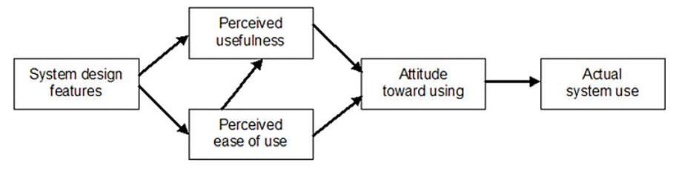
How was FITT developed?
2. Technology acceptance model (TAM) by Davis (1993):
Degree to which a person believes that using a particular system would enhance their job performance
End-point where people use the technology.
degree to which a person believes that using a particular system would be free from effort

Slide 8
How was FITT developed?
3. Task-Technology Fit model (TTF) by Goodhue and Thompson (1995):
The physical and cognitive actions and processes a user performs in a given environment
Task
User evaluation
Task – Technology – Fit
(TTF)
The features and usability of the technology
Technology
The user's abilities at a specific point in time
Individual
Performance
FIT between Task & Technology
FIT between User & Technology
NO FIT between User & Task

Slide 9
4. Unified Theory of Acceptance and Use of Technology (UTAUT) by Venkatesh V. (2003):
How was FITT developed?
Performance expectancy
Effort expectancy
Social influence
Facilitating conditions
(Venkatesh V. et al., 2003)

Slide 10
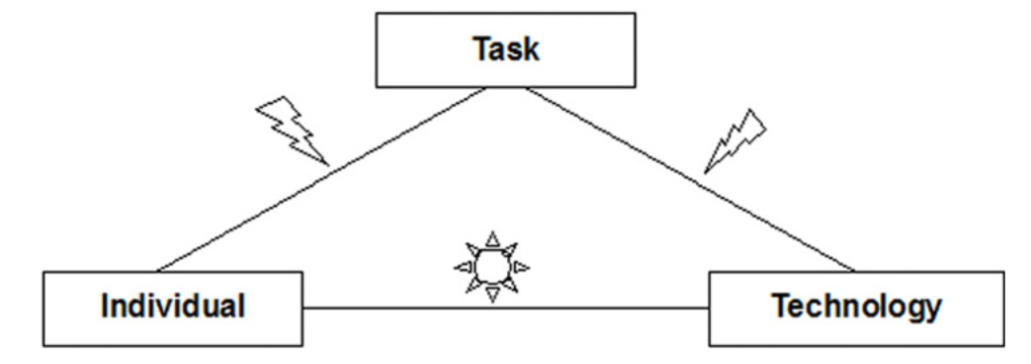
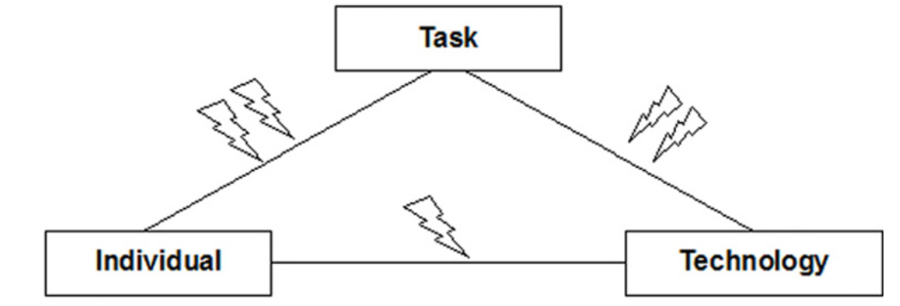
How is FITT better than previous models?
All preceding models were linear and over-simplistic.
Real world implementation (especially in health and care) is iterative, negotiated, “messy”.
Previous models did not represent sociotechnical interactions.
FITT can represent each fit as optimal, sufficient or insufficient (or however you want to).
FITT can draw upon qualitative or quantitative assessment or both.
https://doi.org/10.1186/1472-6947-6-3

Slide 11
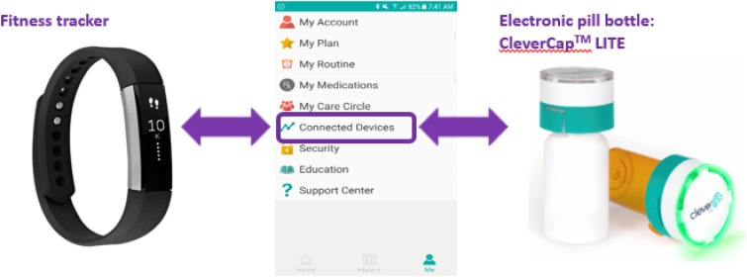
Example of application of FITT framework
Intervention features:
Electronic pill bottle: recorded when opened, flashed/beeped as confirmation, transmitted data to the app.
Wise App: provided medication reminders, motivational messages, and daily health tasks (like walking goals)
Individual-Task Fit
How people’s motivation and habits aligned with the task of medication adherence:
Motivation for adherence: the system encouraged routine medication-taking
Self-efficacy: users felt more in control of their health
Engagement with reminders: push notifications helped overcome forgetfulness and routine disruptions
Task-Technology Fit
How well the technology supported the task of medication tracking:
System functionality: some syncing delays or reminder glitches created confusion
Feedback features: beeping and flashing confirmed doses taken, reassuring for most users, but confusing for few
Task
FIT
IT adoption
FIT
Individual
Technology
FIT
Individual-Technology Fit
How user characteristics matched the design and usability of the technology:
Ease of use: simple to open and transparent, users could easily see remaining pills
HIV stigma and disclosure: the unlabelled bottle helped maintain privacy about HIV status
Customisation: users appreciated setting their own medication reminder times
Design preferences: some found the flashing lights or size inconvenience, privacy concerns and portability were issues
(Cho et al., 2019)

Slide 12
How has FITT been applied?
https://www.sciencedirect.com/science/article/abs/pii/S1386505608001196
https://hijournal.bcs.org/index.php/jhi/article/view/793
https://bmjopen.bmj.com/content/10/6/e035024.abstract
https://www.sciencedirect.com/science/article/abs/pii/S1386505619305428
https://www.tandfonline.com/doi/abs/10.1080/17538157.2016.1178118
https://www.jmir.org/2020/8/e17696/
https://ebooks.iospress.nl/doi/10.3233/SHTI190322

Slide 13
Questions?

Slide 14
Group activity: Brainstorming (on Whiteboard)
Hospitals in NHS Wales are introducing EPMA to replace paper drug charts. Nurses and doctors now record prescriptions, administration times, and patient allergies electronically.
Think about good fit, mismatch and gaps:
Individual- task fit: How does the user’s capacity fit the task requirements?
Task
Task-technology fit: How does the system fit the task?
FIT
IT adoption
FIT
Individual
Technology
FIT
Individual- technology fit: How does the system fit the user?

