Slide 1


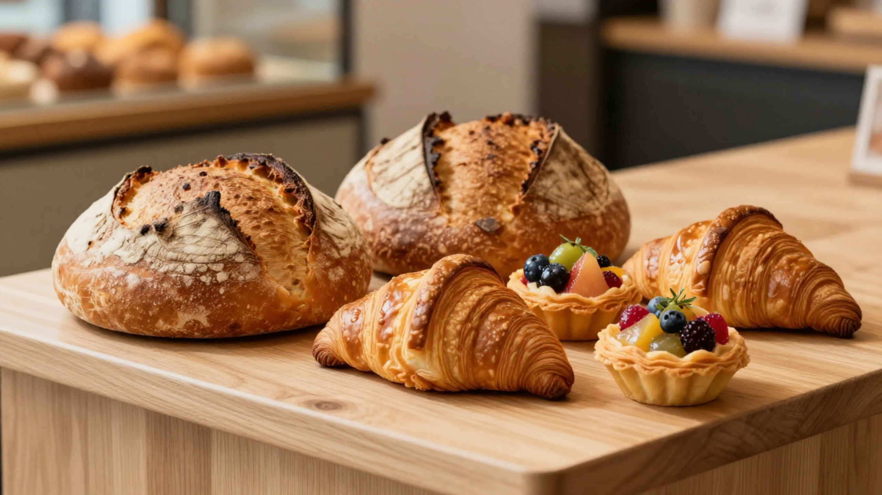


Basil's Bakery: A Business Consultant's Analysis
Identifying Issues & Delivering Strategic Insights
[Student Name] | Anilla bibi 2530123
Module Code] LCLM4004 |
Module Name]Problem solving and decision making
Mr Yohan Mendis
Date: June 2026

Slide 2















Presentation Structure and Agenda
BASIL'S BAKERY STRATEGIC ANALYSIS
01
02
03
Introduction & Case Study Context
Issues Impacting Sales Stagnation
PESTEL Analysis Framework
04
05
06
Fishbone Root Cause Analysis
Key Findings & Strategic Advice
Supporting Reference List
CONSULTANT PERSPECTIVE
Acting as a business consultant commissioned by Basil to research and present findings on the factors causing sales stagnation.

Slide 3




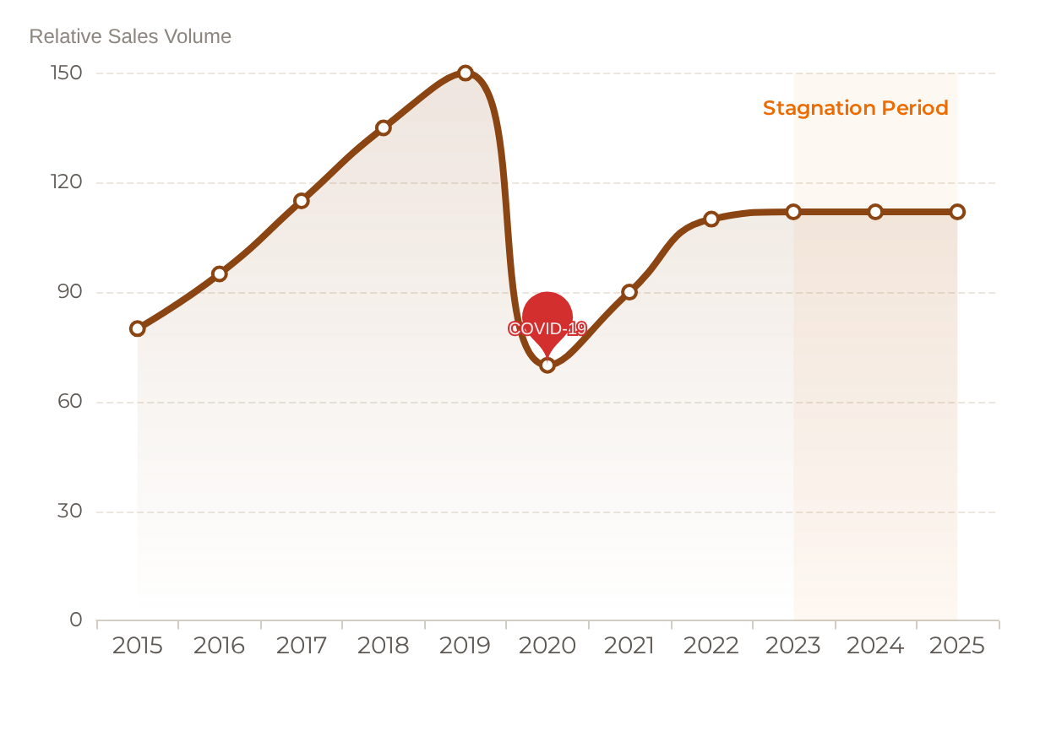






Case Study Context: Basil's Bakery
BASIL'S BAKERY STRATEGIC ANALYSIS
Business Profile
Sales Performance Timeline
Founder: Basil (Master Artisan Baker)
Location: Retail Park, Coventry, UK
Philosophy: Organic, High-Quality Artisan Goods
Key Clientele: Local shoppers, office & industrial workers
Contemporary Cakes
Artisan Breads
Fine Pastries
Organic Ingredients
Current Concern: Business Viability Questioned
Sales stagnated at ~25% below 2019 levels since 2023.

Slide 4














Primary Issues Impacting Sales Stagnation
BASIL'S BAKERY STRATEGIC ANALYSIS
Declining Park Footfall
Noticeable decline in retail park visitors post-2019. High vacancy rates with unlet units and redundancies among local shop workers have eroded the core customer base.
Absence of Delivery Service
Unmet demand from customers seeking convenience. Basil is constrained onsite by production duties, leaving a significant market gap for off-site consumers.
Remote Working Shift
Local office workers now work from home 2+ days per week. This structural shift has permanently reduced daily lunchtime commuter footfall and impulse purchases.
Friction in Pre-Ordering
Rising Operational Overheads
Reliance on phone-based orders leads to missed calls during busy periods. High wait times discourage repeat business from time-sensitive office and warehouse workers.
Sharp increases in utilities, rent, and insurance. Organic ingredient costs are increasingly unpredictable due to crop vulnerability, complicating financial budgeting.

Slide 5







PESTEL Analysis: Macro-Environmental Factors
BASIL'S BAKERY STRATEGIC ANALYSIS
Environmental
Political
Social
Climate Impact: Extreme weather affecting organic crop yields and pricing stability.
Post-Brexit Trade: Increased complexity and costs for importing organic ingredients.
Hybrid Working: Permanent shift (2+ days/week home) has decimated lunchtime footfall.
Zero-Waste: Growing regulatory and consumer pressure for sustainable packaging.
Business Rates: Post-2020 increases placing heavy pressure on retail park SMEs.
Health Conscious: Positive trend towards artisan/organic quality among locals.
Legal
Economic
Technological
FSA Compliance: Strict hygiene and labeling requirements increase operational costs.
Cost-of-Living: Squeezed disposable income leading customers to cheaper alternatives.
Delivery Platforms: Market dominance of UberEats/Deliveroo creating "service gap."
Employment Law: Rights considerations if scaling staff for delivery operations.
Inflationary Pressure: Unpredictable utility bills and volatile organic supply costs.
Digital Ordering: Lack of app-based pre-orders leads to customer friction.
Framework adapted from Johnson et al. (2023) to assess UK artisan bakery market dynamics.

Slide 6





















Fishbone Diagram: Root Cause Analysis
BASIL'S BAKERY STRATEGIC ANALYSIS
CORE ISSUE:
Stagnation of Sales (25% below 2019 levels)
People / Customers
Process / Ops
Environment
Retail park redundancies lost loyal regulars
No delivery service (Basil tied to oven)
Significant retail park footfall decline
Phone-only pre-orders (unreliable)
Neighboring shop closures / empty units
Office hybrid shift (2+ days WFH)
Single-operator dependency bottlenecks
Geographical displacement of old base
General shift to online shopping habits
Financial / Cost
Competition
Product Gap
Utility, rent, and insurance surges
Rapid growth of delivery apps
No digital pre-ordering/app solution
Unpredictable organic ingredient prices
Supermarket "artisan" range expansion
Unmet demand for local delivery
Limited online visibility to new workers
Habit shift toward at-home convenience
High fixed costs vs. low sales volume

Slide 7





Key Findings & Strategic Recommendations
BASIL'S BAKERY STRATEGIC ANALYSIS
01
Stagnation of Sales Performance
Basil's Bakery has faced a sustained 25% sales decline from the 2019 baseline, with performance stagnating since 2023. This indicates a business model that is no longer aligned with the post-COVID retail environment.
02
Environmental & Social Shifts
Declining retail park footfall and the permanent shift to remote/hybrid working have eroded the core weekday trade. Economic pressures, including rising overheads and unpredictable organic supply costs, have further squeezed margins.
03
Operational Vulnerabilities
The single-operator dependency prevents Basil from scaling. The absence of a digital pre-order system and delivery service represents a significant service gap that fails to meet modern consumer expectations for convenience.
04
STRATEGIC IMPERATIVES
Digital Transformation & Operational Agility
Implement a robust digital ordering platform to eliminate phone-based bottlenecks. Explore a localized delivery model and consider strategic staffing to decouple Basil from routine operations, allowing for business growth and market adaptation.

Slide 8













Reference List
BASIL'S BAKERY STRATEGIC ANALYSIS
AUTHOR / ORGANIZATION
YEAR
TITLE & DESCRIPTION
ACCESS / PUBLISHER
Food Standards Agency
2024
Food hygiene regulations for businesses. Regulatory compliance framework for UK food operators.
food.gov.uk
Office for National Statistics
2024
Homeworking trends in the UK. Data regarding the shift to hybrid and remote working post-pandemic.
ons.gov.uk
British Retail Consortium
2024
UK retail vacancy rates and footfall data. Analysis of high street and retail park performance trends.
brc.org.uk
CIPD
2023
Flexible and hybrid working practices in the UK. Examining the organizational impact of flexible work policies.
cipd.co.uk
Johnson, G., Whittington, R., Scholes, K., Angwin, D. & Regnér, P.
2023
Exploring Strategy: Text and Cases (13th ed.). Core theoretical framework for PESTEL analysis.
Pearson Education
Ishikawa, K.
1990
Introduction to Quality Control. Foundational text for Cause-and-Effect (Fishbone) diagram methodologies.
3A Corporation
UK Government
2024
Business rates relief and support for SMEs. Official guidance on taxation and financial support for small businesses.
gov.uk

