Slide 1
Negotiation and Settlement before Trial
Civil Litigation

Slide 2
Aims of this Lecture
Describe the procedures to be followed when a civil claim involving children or protected parties is settled
Distinguish between a consent order and a Tomlin order
Explain the effect of a Calderbank offer
Explain the key features of a Part 36 offer
Describe the formalities required in a Part 36 offer
Explain how a Part 36 offer may be withdrawn or amended
Explain the consequences of accepting a Part 36 offer (including costs), and
Explain the consequences of not accepting a Part 36 offer (including costs).

Slide 3
Resolving disputes by consent
Parties can usually agree between themselves to resolve their dispute. An agreement to resolve a dispute may be achieved as a result of an ADR process, such as negotiation or mediation or by acceptance of an offer to settle.
A settlement can be reached at any time:
before court proceedings are started; and
after court proceedings are started.

Slide 4
Does the court need to be involved in any settlement?
Generally, the parties are free to resolve their dispute in any way and on whatever terms they wish, before or after court proceedings are started. However, this is subject to two important qualifications, when the involvement of the court is needed:
if the claim involves a child or a protected party, the approval of the court is needed to any proposed settlement, even if court proceedings have not been started at the time of the proposed settlement; and
if proceedings have been started, the proceedings will continue unless and until some step is taken to end those proceedings.

Slide 5
Settlement of any claim involving children and protected parties
There is an important exception where the parties are unable to reach a settlement between themself. This is where, at the date of the proposed settlement, the claim is made:
by or on behalf of a child – that is, a person under the age of 18;
against a child;
by or on behalf of a protected party – that is, a person lacking sufficient mental capacity, under the Mental Capacity Act 2005 (MCA 2005) to conduct litigation; or
against a protected party.
In these circumstances, any settlement, compromise or payment (including voluntary interim payment) is not binding and valid unless and until the proposed settlement has been approved by the court (r21.10(1)).
This applies even where the parties, through their representative (i.e. their litigation friend) and legal representatives, are content to the terms of proposed settlement reached.
It also applies whether or not court proceedings have been started in the claim.
When a proposed settlement is reached by or on behalf of a child or protected party before court proceedings are issued in the claim, the court’s approval is sought by the claimant issuing proceedings under Part 8 (r21.10(2)).

Slide 6
Settling a dispute before proceedings have started
Disputes are often settled by agreement between the parties before court proceedings are started. Unless one of the parties is a child or protected party, the parties can settle their dispute before proceedings in any way and on whatever terms they wish by:
an agreement reached between themselves; and
a party accepting a pre-action Part 36 offer to settle made by another party to the dispute.

Slide 7
An agreement reached between parties
If the parties reach an agreement to settle the dispute, then the agreement will be a contract, and subject to the ordinary principles of contract law. The agreement can be oral or in writing, although it is much more sensible for the agreement to be in writing or recorded in writing, to improve certainty and to avoid disputes about the terms. The extent of the agreement is for the parties, and could include:
an oral agreement;
one party accepting a written offer to settle (other than a Part 36 offer to settle), such as a Calderbank offer or an offer without prejudice save as to costs made by another party; and
an exchange of letters or emails indicating agreement.

Slide 8
In some cases, legal representatives prepare a separate document commonly known as a settlement agreement or “compromise agreement” including all agreed terms. This agreement, in effect, creates a legally binding contract between the parties which, if breached, enables a claim to be pursued for breach of the agreement against the defaulting party – most likely as a Part 7 claim in which a prompt application for summary judgment would be made (and which would be likely to succeed).
It is important to consider the costs provisions of the settlement as there is no strict entitlement to any costs in the absence of an express agreement. If the settlement concluded that one party would pay the other party’s costs, but the terms of settlement have not confirmed the sum of those costs or a method by which they will be settled, the receiving party can issue costs only proceedings.
One significant advantage of an agreement reached between the parties to settle their dispute is their freedom to include in their contract any terms which they wish, subject to the ordinary restrictions in contract law. This means that parties could include obligations to continue within a business relationship, of publicity regarding the dispute (or, more likely, obligations not to disclose the terms of any settlement). That flexibility is lost if the parties reach a settlement using the other method of settling disputes before proceedings are started.

Slide 9
CPR 36 Offers
CPR 36 are offers to settle a claim.
CPR 36 offers are more commonly known as Part 36 offers.
A Part 36 offer can be made at anytime, by either party.
A part 36 offer is not an admission of liability.
As with most offers, a Part 36 is intended as a compromise and reflects the risks of going to trial.
A Part 36 offer can also be used to put pressure on an opponent
Notes:
The other main type of offer, Part 36 offers, can be made before or after court proceedings are started. They are governed by a set of rules in Part 36. In most cases, acceptance of Part 36 offers carries near-automatic consequences and there is often no separate need to translate an acceptance into an order for the court to approve. The process and consequences of accepting a Part 36 offer to settle is not subject to the ordinary law of contract. Instead, these are regulated by the provisions of Part 36, which has been described as a “self-contained code” which does not import principles from ordinary contract law. These apply whether the Part 36 offer to settle is made before or after proceedings are started. We consider those consequences of accepting a Part 36 offer to settle later.
One significant advantage of a accepting a Part 36 offer to settle is the near-certainty of outcomes set out specifically in Part 36. A potential disadvantage arises from the lack of freedom to include in a Part 36 offer terms which the parties might otherwise wish to include, subject to the ordinary restrictions in contract law. There are limits on the scope of Part 36 offers. That flexibility is traded off against the certainty of outcomes when a lost if the parties reach a settlement using the other method of settling disputes before proceedings are started.
If a Part 36 offer is accepted before proceedings are issued, a claimant is entitled to recover their pre-action costs for steps taken in contemplation of proceedings up to the date of acceptance. The claimant can apply to the court to have their costs assessed in “costs-only proceedings” pursuant to r46.14. The claimant must issue a Part 8 claim form following which there will be a detailed assessment.

Slide 10
CPR 36 Definitions
CPR 36.3 states that the:
  Party making the offer is the offeror.
  Party to whom the offer is made is the offeree.
  A Part 36 offer must be open for acceptance for at least 21 days or until the end of trial if sooner. This is known as the relevant period.

Slide 11
Form and Content of a CPR 36 Offer
CPR 36.5 states a Part 36 offer must:
  be in writing;
  make clear that it is made pursuant to Part 36;
  specify a period of not less than 21 days within which the defendant will be liable for the claimant’s costs in accordance ... if the offer is accepted;
  state whether it relates to the whole of the claim or to part of it or to an issue that arises in it and if so to which part or issue; and
  state whether it takes into account any counterclaim.

Slide 12
Consequences if a Claimant Accepts a Defendants CPR 36 Offer
A notice of acceptance is to be sent to the defendant and to the court.
Proceedings are then stayed.
The defendant must pay settlement sum offered in the Part 36 within 14 days of the claimants acceptance, unless agreed otherwise.
If the defendant fails to make payment within 14 days the claimant may enter judgment.
The defendant is to pay the claimant’s costs on the standard basis.

Slide 13
Consequences if a Claimant Rejects a Defendants CPR 36 Offer
If the claimant “beats” the defendant’s offer:
  The offer is irrelevant.
  The claimants costs will be decided in the usual way.
If the claimant fails to obtain a judgment more advantageous:
  There is usually a split order for costs, unless it is unjust to do so.
  The defendant pays claimant’s costs up until the end of the 21 day period.
  The claimant pays defendant’s costs thereafter together with interest.

Slide 14
Consequences if a Defendant Accepts a Claimants Part 36 Offer
A notice of acceptance is to be sent to the claimant and to the court.
Proceedings are then stayed.
The claimant is entitled to his costs on the standard basis up to date of the defendant’s acceptance.

Slide 15
Consequences if a Defendant Rejects a Claimants CPR 36 Offer
If the claimant fails to equal or beat his own offer at trial, the costs will be decided in the usual way.
If the claimant is awarded a sum that is the same or greater than his Part 36, then as per CPR 36.17 (4) the claimant is entitled to:
  ‘Interest on the whole or part of any sum of money (excluding interest) awarded, at a rate not exceeding 10% above base rate for some or all of the period starting with the date on which the relevant period expired’

Slide 16
Consequences if a Defendant Rejects a Claimants CPR 36 Offer Continued
  Costs ... on the indemnity basis from the date on which the relevant period expired
  Interest on those costs at a rate not exceeding 10% above base rate
  ...an additional amount, which shall not exceed £75,000, calculated by applying the prescribed percentage... to an amount which is—
    (i) the sum awarded to the claimant by the court; or
    (ii) where there is no monetary award, the sum awarded to the claimant by the court in respect of costs.’

Slide 17
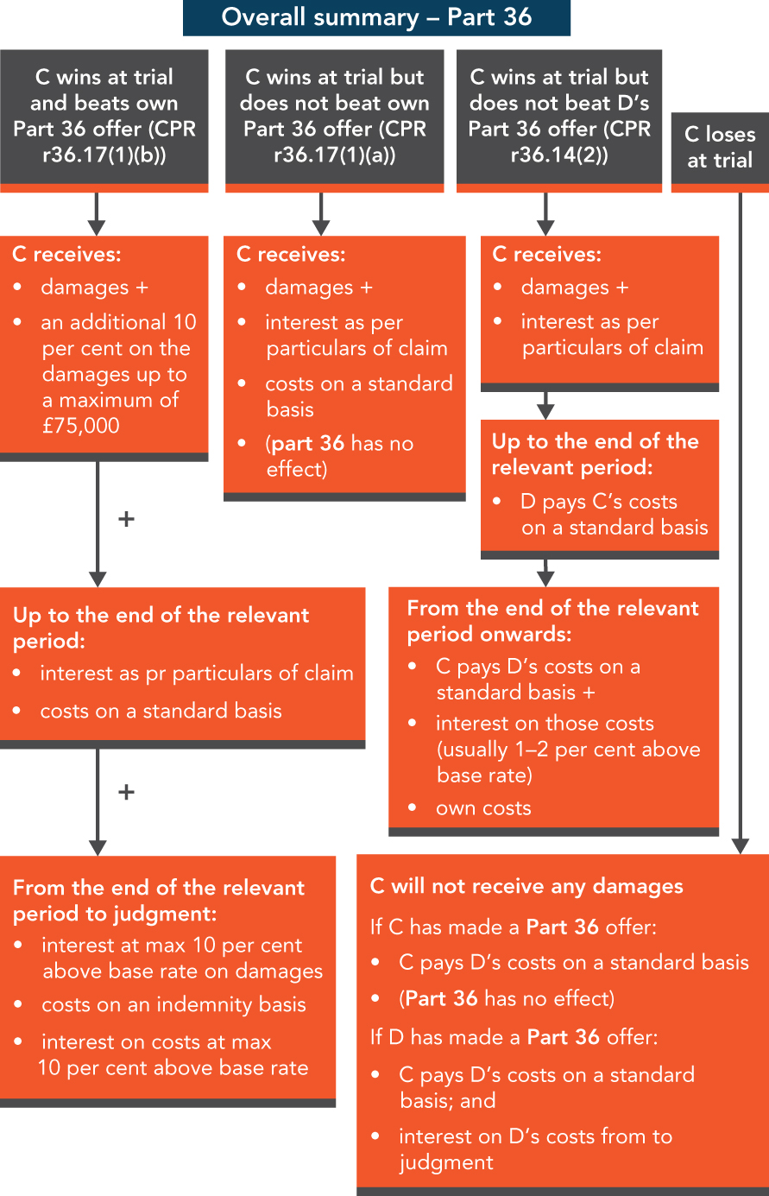

Slide 18
Consent Orders
A consent order is an order of the court, made by the court with the consent of all the parties, which resolves the court proceedings.
One of the proposed parties will prepare a draft consent order, which aims to record the terms of the settlement reached between the parties. The terms of the draft consent order must be matters which are within the powers of the court to order. The draft consent order is approved by all parties affected by the settlement and sent to the court, along with an application fee and a request that the court approve the terms of the draft order. The application is usually considered by the court (often by a court officer rather than a judge) on paper without a hearing, and the terms of the draft order are usually approved. It is rare for the court to interfere in the terms of settlement. The order is then dated, sealed by the court, and returned to the parties. If a party fails to comply with the terms of the consent order, it is enforceable as any other order of the court.
One disadvantage of consent orders is that they are potentially public documents in court proceedings which may be made available to non-parties. This is unlike Tomlin orders.

Slide 19
Link to Practice
Practitioners regularly submit consent orders to the court which are rejected by the judge because they contain provisions which the court cannot order. A common example is “The claimant accepts the sum of £X from the defendant in full and final settlement.” While it is perfectly acceptable to record that in a letter or in a compromise agreement, the court cannot order a claimant to accept a sum in settlement from the defendant! Such an order will not be approved by the court and is likely to be returned with a covering letter suggesting that an amended consent order be submitted. The amended consent order could either state that “Judgment be entered for the claimant in the sum of £X” or it could be in the form of a Tomlin order.

Slide 20
Tomlin Orders
A Tomlin order is another type of order of the court, made by the court with the consent of all the parties, which resolves the court proceedings. Unlike a consent order, a Tomlin order enables the parties to record terms of settlement which are agreed between the parties, but which cannot directly be ordered by the court.
It contains two parts.
The first part is the order itself. This contains the parts of the settlement which the court does have power to order, such as what happens to the court proceedings and one party being liable to pay the costs of another. Typically, the first part of the order merely states that:
the parties have agreed terms of settlement;
all further proceedings are stayed (put on hold);
the stay is based on the terms set out in the schedule being complied with;
if the terms in the schedule are not complied with, the innocent party can make an application to the same court where the proceedings were issued and ask the court to allow it to enforce the terms agreed in the schedule (liberty to apply); and
there is a provision for the payment and assessment of costs.

Slide 21
The schedule (or sometimes a settlement agreement) is the second part of the Tomlin order and is annexed to the order. This contains the parts of the settlement which the court does not have power to order directly, such as terms about confidentiality. Typically, where the agreement involves the payment of money, the schedule sets out:
who is responsible for paying any sum of money;
the sum of money payable, and whether it is payable in a lump sum or by instalments;
when payment is due;
that the agreement is in full and final satisfaction; and
a default provision on interest should the money not be paid.
If a party fails to comply with the terms of a Tomlin order, it is enforceable as any other order of the court.
There are two distinct advantages of Tomlin orders. First, only the first part is a potentially public document in court proceedings which may be made available to non-parties. The schedule is confidential. Second, a Tomlin order can also be a useful way to achieve the same practical outcome for a claimant (the payment of a sum of money) without the defendant formally having the possibility of a court judgment registered against them. This is unlike consent orders.

Slide 22
Link to Practice
Tomlin orders are frequently used in litigation to record settlement of terms. They are often used when a payment is to be made at some time in the future or where the defendant does not agree to judgment being entered against them, or when the settlement does not involve payment of money. Their main advantage is that should the terms of the schedule be breached, then like a Part 36 settlement there is no need to issue fresh proceedings for breach of the agreement. The liberty to apply clause in the order enables a party to go back into the original set of proceedings and ask the court by way of an application, probably without notice, for permission to proceed straight to enforcement.

Slide 23
Offers to settle (other than Part 36 offers to settle)
Parties to a dispute may reach a binding contract to settle their dispute following negotiations about the terms of settlement, reflected in an exchange of correspondence or a settlement agreement.
Where the approval of the court is not needed, one common method of resolving a dispute is by a party accepting an offer to settle made by the other party to the dispute. An offer to settle can be made as:
a Part 36 offer to settle, which is regulated by Part 36 and are considered later in this chapter; and
an offer to settle that does not comply with and is not regulated by Part 36. These include Calderbank offers.

Slide 24
Calderbank offers
A Calderbank offer (also known as an offer made without prejudice save as to costs.) It is an offer in which a party offers to settle the whole of a dispute or an issue in the dispute.
It is stated to be without prejudice save as to costs and is named after the case of Calderbank v Calderbank [1976].
The party making the offer can set out the proposed consequences if the offer is accepted.

Slide 25
Offers to settle which are accepted
Offers to settle that are made outside the scope of Part 36 and which are accepted will comprise a binding contract to settle the dispute.
They are regulated by the ordinary law of contract, including on matters such as the incorporation, status and interpretation of terms and the consequences which may follow from breach.

Slide 26
Offers to settle which are not accepted
Clearly, if the offer is not accepted, then there will not be any concluded settlement of the dispute, and the dispute will continue to trial unless resolved or determined. However, certain consequences flow from an offer which is not accepted:
An offer made without prejudice save as to costs will remain confidential between the parties and must not be disclosed beyond the parties, except to the court – and even then, not before the court has determined issues in dispute between the parties except (save as to) the question of costs. This is so that the parties are free to negotiate and make offers and counter-offers between themselves without others knowing their contents; and that a trial judge will not be prejudiced about the strengths and weaknesses of any parties case by knowing about any offers to settle they have made.
If the dispute continues to trial, then after the court has resolved all other issues in the dispute, the court must consider any offers made without prejudice save as to costs which are drawn to its attention when it determines the appropriate order for costs to be made between the parties (r44.2(c)). The court has a complete discretion as to what weight and consequences should flow from an offer to settle which is not made in accordance with Part 36 – which are nearly automatic. For example, the court can consider a party’s unreasonable refusal to accept an offer which may have caused the dispute to last longer and the parties to incur more costs, when deciding whether that party should be ordered to pay the other side’s costs from the date that the offer should have been accepted.

Slide 27
Summary
The court will expect the parties to attempt to settle a case; often this is on agreed terms, subject to approval of the court. This is known as “by consent”.
Alternatively, a party can agree terms under a Tomlin order, which allows enforcement of the terms within the current proceedings instead of putting the burden on the innocent party to bring fresh enforcement proceedings.
Part 36 offers represent one of the most important tactical steps a party to a dispute can take.
Both claimants and defendants can make Part 36 offers.
If a defendant’s offer is accepted, that sum must be paid in a single sum to the claimant within 14 days of acceptance. If it is not paid, the claimant can enter judgment.
The form a Part 36 offer should take is prescribed by the rules.

Slide 28
Any offer must specify a period of not less than 21 days (the relevant period) within which the defendant will be liable for the claimant’s costs if the offer is accepted within the relevant period, provided the offer is for the whole of the claim (unless it is less than 21 days before the start of the trial).
The trial judge is not usually informed of any offer until the issues of liability and quantum have been decided.
If a Part 36 offer is accepted, proceedings are stayed.
If a Part 36 offer is not accepted, different costs consequences apply depending upon the outcome of the case.
When considering the effect of Part 36 in personal injury matters, the court will take into account that certain state benefits will be deducted from the damages.

Slide 29
If a defendant’s Part 36 offer is not accepted, the issue on costs is whether the award at trial exceeds the offer:
If it does, costs are decided under the usual principles, with the winner usually being awarded costs against the loser.
If it does not, the offer should have been accepted, and costs from 21 days after making the offer must be awarded to the defendant (unless it would be unjust).
If a claimant’s Part 36 offer is not accepted, and if the award at trial is the same or better for the claimant than the offer, the court must (unless it would be unjust to do so) award the claimant:
(a) an additional percentage on damages in monetary claims (or costs in non-monetary claims);
(b) enhanced interest on damages;
(c) indemnity basis costs; and
(d) enhanced interest on those costs.
If you are acting for a defendant who is offering to pay a sum of money in settlement and this is formulated in a Part 36 offer, you must explain to the client that the payment of damages is not the end of their liability to their opponent as there is an implicit duty to pay the opponent’s costs up to the date of acceptance on the standard basis.

Slide 30
It is the client’s decision to decide whether to accept not to accept a Part 36 offer. The role of the legal representative is to ensure that the client has all the necessary information before them to enable them to make that decision on an informed basis.
As Part 36 offers can be accepted at any time if they have not been withdrawn or amended, it is important that you keep your own client’s offers under review and withdraw them if appropriate. Therefore, it is important to consider at all key stages whether these offers should be made, accepted, withdrawn or revised and if withdrawn, to ensure your client understands that the offer then loses the costs implications of a Part 36 offer.
If settlement is concluded after litigation has started by a method other than by accepting a Part 36 offer, it is important to ensure that the correct consent order or Tomlin order is agreed and drafted.

