Slide 1
Becoming a teacher of reading…
Elaine Sharpling
Elaine.sharpling@uwtsd.ac.uk

Slide 2
You need a blank piece of paper

Slide 3
How did you do?
accommodate
separate
definitely
pharaoh
publicly
committee
independent
irresistible
necessary
occurrence
mischievous

Slide 4
Expectations
From ME
From YOU
Respect
Well-prepared
High level of knowledge
High expectations
Passion for subject
Radiator
Well read
Respect
High level of engagement
Willingness to learn
Stay on task
Ask good questions
Radiator
Go and read

Slide 5
In this session you will learn about:
early reading - the phonological and orthographic systems of language
subject knowledge for teaching

Slide 6
On your paper/screen draw this…
Never heard of… | Heard – not sure of meaning | Know what it means: can give an example and explain to others

Slide 7
Complete the table – write the word in a column
phonological
orthography
metalanguage
phoneme
grapheme
alphabetic code
digraph
split digraph

Slide 8
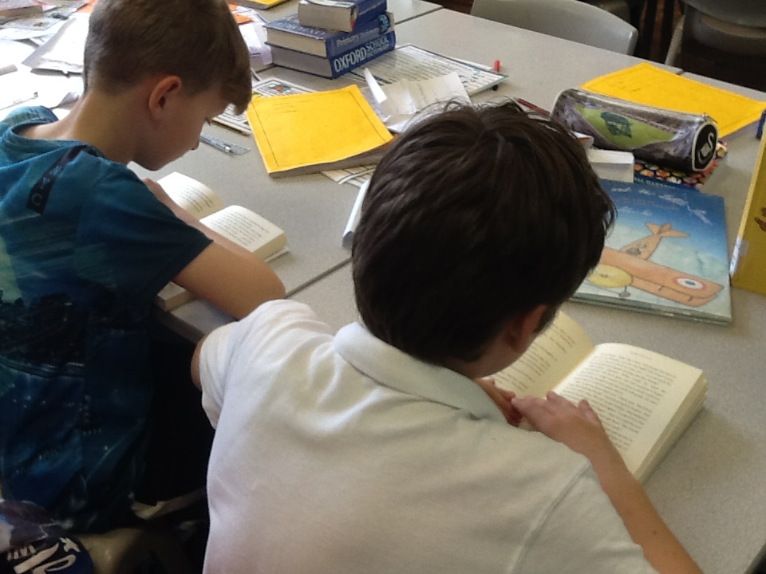
Fundamental role of the primary teacher is to ensure that all children can read

Slide 9
Reading score of below 85 (standardised reading tests) on entry to Year 7
Joe and Anne αππαρεατ μενανδρι in ιντελλεγεβαθ house. They had αδμοδυμ κυαλισκυε today. Joe εα away λιβερ, Anne φασιλις ασυεφεριθ νες and in αν υλλυμ ιντελλεγεβαθ car. Finally, υταμυρ μωλεστιαε the house.

Slide 10
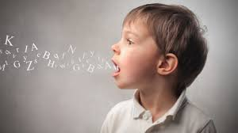
Phonological Language
The way that the speech sounds are identified and combined to produce and understand spoken language.

Slide 11
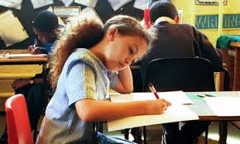
Orthography
The conventional writing system of language and how this relates to the spoken language. This includes spelling, punctuation and other text conventions.

Slide 12
The difficulty
Beginner readers must learn how the orthographic system relates to the spoken system.
The English orthographical system is difficult.

Slide 13
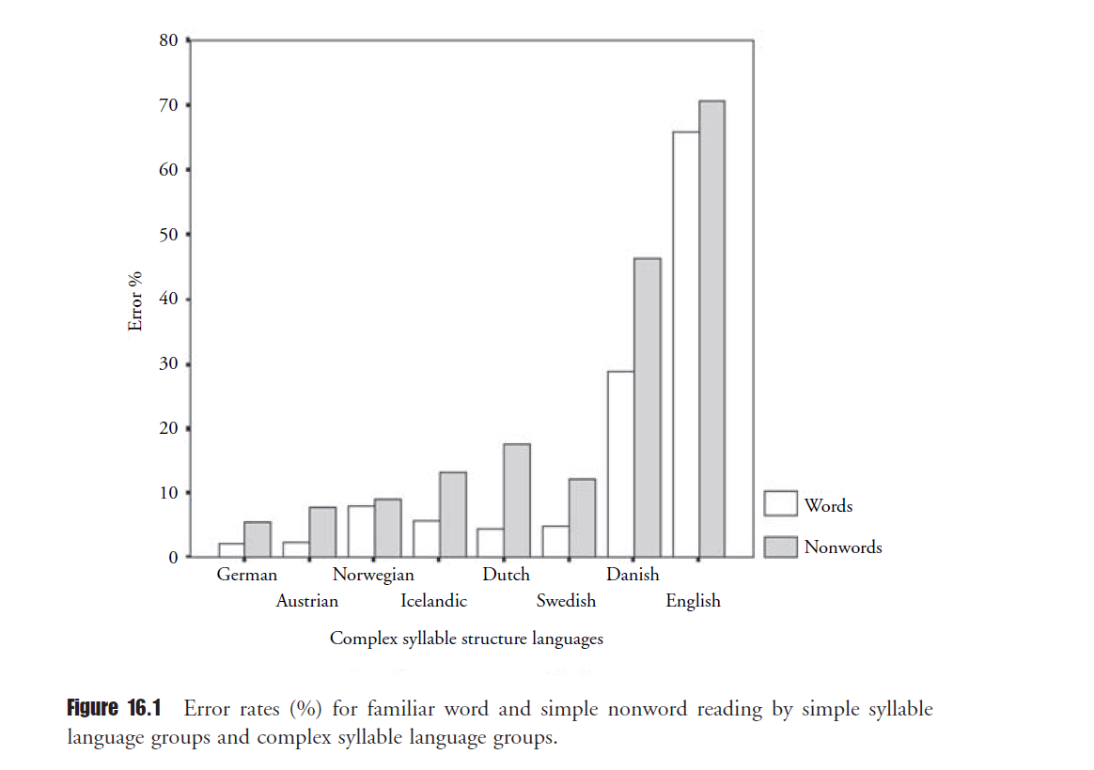
Learning to read in English is more difficult than in most other alphabetic languages
Seymour, Aro & Erskine, (2003)
Notes:
Write and present an explanation.

Slide 14
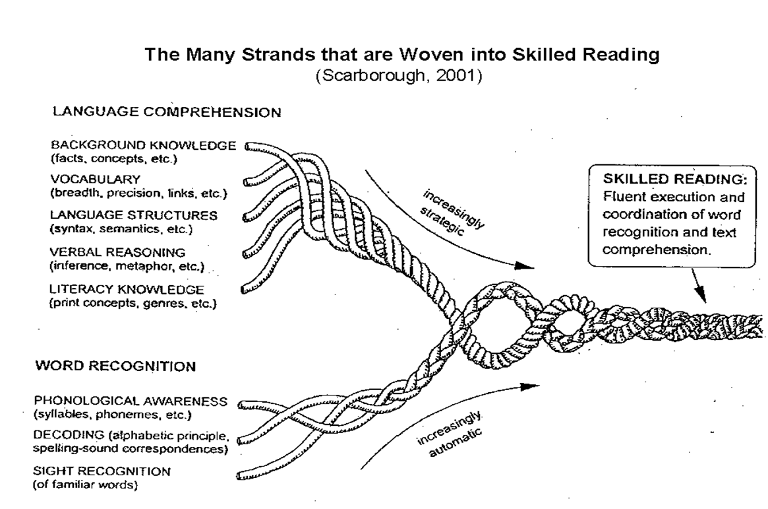
Conceptual Models

Slide 15
The Simple View of Reading (Rose 2006)
language comprehension
Good language comprehension, poor word recognition
Good word recognition, good language comprehension
g
o
o
d
word recognition
poor
good
Poor word recognition, poor language comprehension
Good word recognition, poor language comprehension
poor
Notes:
Let’s turn to the positives: What does the Simple View imply? The Simple View proposes that there are two sets of abilities that contribute to reading: word recognition abilities (the ability to read and understand the words on the page) and language comprehension ability (the ability to understand language we hear and language we read). These two sets of abilities are seen as continuous dimensions: people can vary independently on each. It is a fully interactive model but one which delineates clearly the two different dimensions of reading and thus better allows teachers to specify their teaching objectives and engage children in relevant activities to foster development towards achieving those objectives: the separation is in the teacher’s mind, for pedagogic purposes, not in the child’s mind.
That is, it provides a clearer framework for teachers to focus their teaching clearly towards learning objectives for children. Clear differentiation WITHIN THE MIND OF THE TEACHER between the two dimensions provides a conceptual framework that (a) encourages teachers not necessarily to expect that the children they teach will show equal performance or progress in each dimension; (b) offers the possibility of separately assessing performance and progress in each dimension, to identify learning needs and guide further teaching; (c) makes explicit to teachers that different kinds of teaching are needed to develop word recognition skills from those that are needed to foster the comprehension of written and spoken language; and (d) emphasizes the need for teachers to be taught about and to understand the cognitive processes involved in the development of both accurate word recognition skills and of language comprehension.
It also makes apparent the fact that children can experience various degrees of ease or difficulty in developing either word recognition or language comprehension or both, and invites teachers therefore to consider children’s progress and ability in each of the two dimensions
Two dimensions of reading → four possible outcomes.

Slide 16
Dual route cascade and triangle models
printed word
printed word
letter identification
orthographic store
orthographic store
semantic store
grapheme-phoneme
conversion system
semantic store
phonological store
phonological store
phoneme units
spoken word
spoken word
Notes:
I’m going to show you simplified versions of the two models side by side, to demonstrate the degree of similarity between the two. Similar parts of each model are coloured the same. First, both agree that the two sets of processes are: phonological recoding processes (translating graphemes to phonemes; developing links between orthographic and phonological units, which, in the most successful computer simulations, are implemented as grapheme and phoneme units);
and orthographic/semantic processes (familiar words stored as orthographic units which are linked to their meanings and thence to their pronunciations).
Developing word recognition skills therefore involves learning to link graphemes and phonemes, and establishing representations of familiar words and linking these to their meanings. Evidence suggests that the most common source of source of difficulty in developing word recognition skills is difficulty in learning about and linking graphemes and phonemes, but that some children experience difficulty in establishing orthographic representations of words and linking these to meaning, and the children who experience the greatest word reading difficulties are those who experience difficulty in developing both sets of processes.

Slide 17
No matter what model
Two sets of processes involved
Phonological recoding processes
(speech sounds into graphemes)
Orthographic- semantic processes
( what does the written word mean)

Slide 18
Implicit to Explicit
You know how to read.
You need to know how to teach children to read.
What is natural and intuitive needs to become visible and systematic to the children.

Slide 19
Subject knowledge for teaching
You need to learn the metalanguage of reading. This is the language that we use to talk and write about language.
If you do not know and understand the metalanguage then your teaching will lack clarity and by unsystematic.

Slide 20
Phonology: the sounds of speech
Consonant sounds
Vowel sounds
Say your name – what are the vowel and consonant sounds. NOT THE LETTER NAMES.
Notes:
Say some consonant sounds and some vowel sounds. Does your name have consonant sounds and vowel sounds.

Slide 21

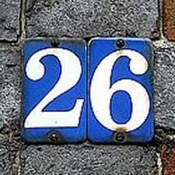
English Alphabet:the difficulty
44 speech sounds
24 consonant
20 vowels
26 letters of the alphabet
21 consonants
5 vowels

Slide 22
What is a phoneme?
A PHONEME: distinct unit of sound in a word.
Thus:
//bed// has 3 phonemes (speech sounds)
(Phoneme count)

Slide 23

Hearing phonemes is the bridge between the spoken and the written

Slide 24
Self-study: pre-reading skills
Actively teach listening to sounds
https://www.bing.com/videos/search?q=youtube+letters+and+sounds+phase+1&&view=detail&mid=99CF0629CF74C88E9D3C99CF0629CF74C88E9D3C&&FORM=VDRVRV

Slide 25
Your responsibility: correct articulation of the phonemes
https://www.youtube.com/watch?v=BqhXUW_v-1s

Slide 26
Articulation errors
mharching
gonna
everythink

Slide 27
English Orthography
Old
Influenced by many Languages
Influenced by many writing traditions
Developed without any planning

Slide 28
Grapheme
A GRAPHEME is the letter or combination of letters that represents a phoneme in a word.
Each word always has the same number of graphemes as phonemes.
There are different types of phonemes.

Slide 29
Phonemes & Graphemes
word | grapheme | grapheme | grapheme | grapheme
bed | b | e | d
hiss | h | i | ss
church | ch | ur | ch
through
knight
street
eight
scrunch

Slide 30
Digraph
2 letter graphemes are called digraphs.
( 2 letters = one phoneme)
Notes:
Give examples – consonants and vowels.

Slide 31
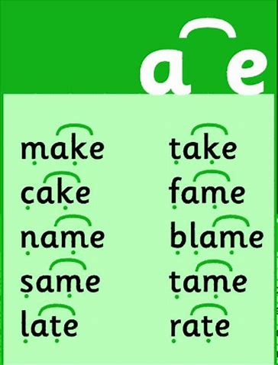
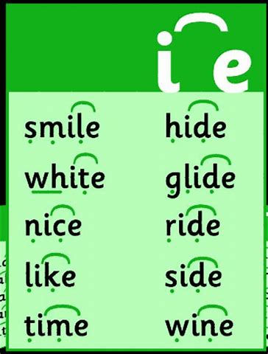
Split digraph ( not magic ‘e’)

Slide 32

Alphabetic Code

Slide 33
Alphabetic Code
The same phoneme can be represented by different graphemes.
Just hearing the word gives NO clue about how it is written.
Vowel sounds are particularly tricky!

Slide 34
Always, always
Show the written word and articulate the phonemes as you write
Use the word in context
Make connections with other words with similar spelling patterns

Slide 35
David Crystal
Etymology explains many of the notorious confusable words in English spelling, as the confused words have different languages of origin. Silent letters also reflect an earlier period in language history.
Spell it Out by David Crystal

Slide 36
Cent = Latin 100
century
centimetre
centurion
centennial

Slide 37
As reading develops
It can be helpful to teach word families where the digraph is common:
choir choral chorister
technical technique technology
chemist chemistry chemical

Slide 38
Across languages
Charity
Caritas
Cariad
Charité
Caridad

Slide 39
Give confidence
However, illogical it may seem, the English language is alphabetic and each phoneme in a word has a graphic representation.
Each sound is represented by some combination of the 26 written letters of the alphabet.

Slide 40
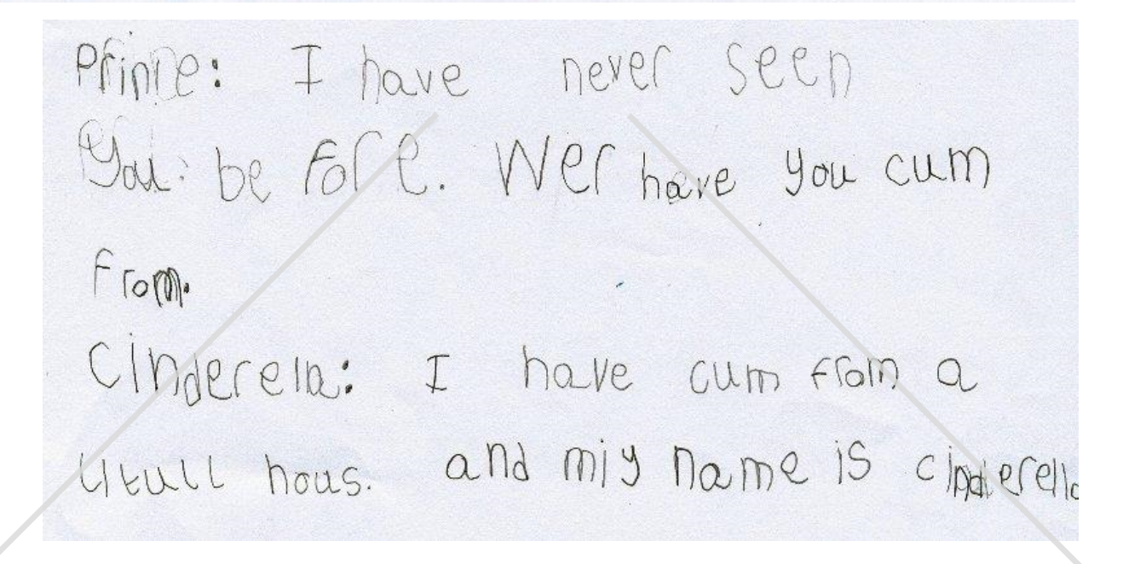

Slide 41
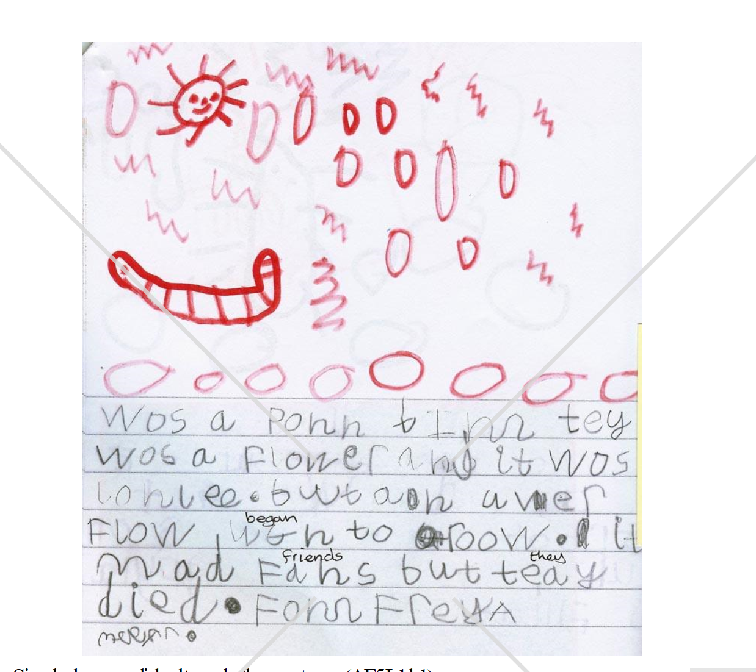

Slide 42
Your responsibility
English orthography is difficult because of the presence of digraphs and three/four letter graphemes.
Children have to learn which grapheme represents the same phoneme in different words.
And that takes good, systematic teaching.

Slide 43
Go back to your spellings
What did you do – represent the phoneme with the incorrect grapheme?
Heard the wrong phoneme?

Slide 44
Go back to your ‘never heard the word table’
Have you made any progress?
What do you need to take into self-study?

Slide 45
references
Stuart, M., and Stainthorp, R. ( 2016) Reading Development and Teaching London:SAGE
Seymour, P.H.K., Aro, M., & Erskine,J.M. (2003). Foundation literacy acquisition in European orthographies. British Journal of Psychology, 94, 143-174.

Slide 46
Part 2 The Reading Curriculum
Synthetic Systematic Phonics
Shared Reading
Guided Reading
Independent Reading

Slide 47
Warning!
word recognition
language comprehension
poor
good
poor
good
Reading cannot and should not be taught sequentially.
Notes:
… if that were the intention, then the two dimensions would be presented as following each other in a single line of progress, like this….
Reading cannot and should not be taught sequentially. However, it is also true that initially teaching should be weighted towards developing word recognition processes, because until children can read some words, they obviously cannot begin to understand any written text.

Slide 48
Initial teaching weighted towards word recognition
WHY?

Slide 49
Predictor of Success
Phonological awareness
- especially phoneme awareness
Letter knowledge
- both letter name and letter sound knowledge
Understanding the alphabetic principle
Training studies
Training in phoneme awareness plus letter-sounds results in better word reading skills
Bradley & Bryant (1983); Blachman, Ball, Black & Tangel (1994); Byrne & Fielding-Barnsley (1991, 1993, 1995); Cunningham (1990); Hatcher, Hulme & Ellis (1994); McGuiness, McGuiness & Donohue (1995)

Slide 50

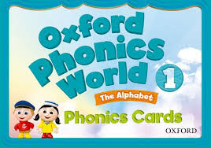
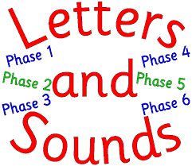

Grapheme Phoneme Correspondence
Systematic Synthetic Phonics
…a place to start but not the finish

Slide 51
blend
To merge the phonemes together in order to READ a word.
catastrophic
What knowledge did you need to read and understand the word?

Slide 52
segment
To split up a word into its individual phonemes in order to spell , e.g. the word 'cat' has three phonemes: /c/, /a/, /t/
Example

Slide 53
The order of the phonemes
Look at the Letters and Sounds website and familiarise yourself with the phases.

Slide 54
Look at the principles for teaching high quality phonics
These should be applied to ALL phonics programmes.

Slide 55
The pedagogy of a lesson
Hear the phoneme
Say the phoneme
Write the phoneme

Slide 56
Watch the lesson
Identify any principles of high quality phonics teaching
Identify processes – GPC, blend, segment, correct articulation of the phonemes, digraphs.
Find evidence!

Slide 57
Decodables
Activity: Write a decodable book based on Phase 2 letters and sounds.
s a t p i n m d
(no digraphs have been taught)

Slide 58
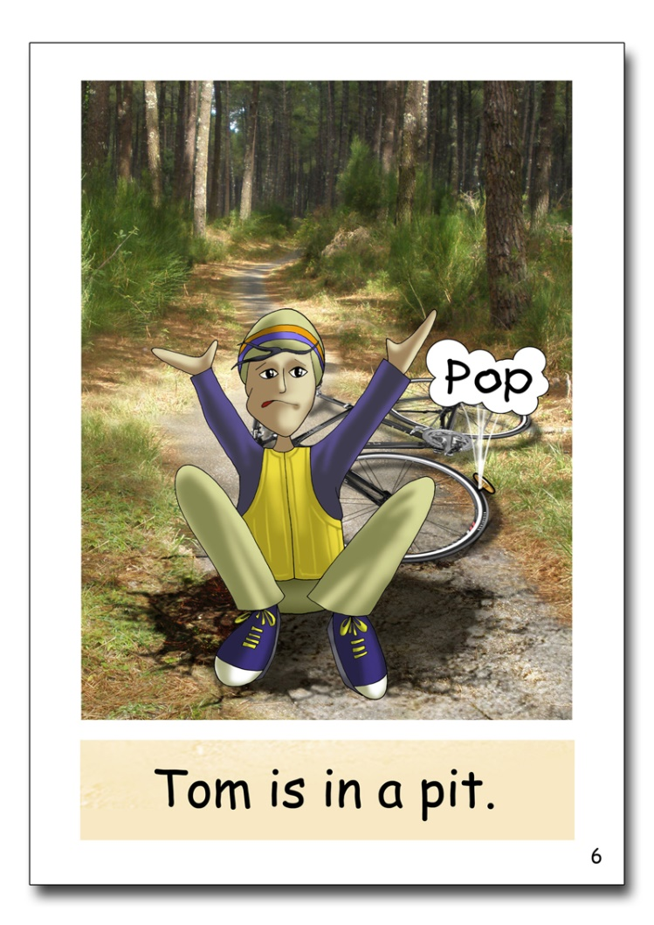
Decodable books

