Slide 1
Development of Social Policy by Heike Griffiths
SJSI4012 Week 2

Slide 2
aims
To explore historical concepts of British social policies/provision of Welfare
To make connections to recurring themes in social policy
To explore the history of human rights

Slide 3
Themes in present day and historical social policy
Understanding the significance of history allows us to see long lasting themes in social policy …..(Blakemore & Griggs, 2007: 41)

Slide 4
Themes in present day and historical social policy
Key Issues in present day social policy | Historical examples
Welfare dependency; social exclusion and creation of an underclass | Reform of the Poor Law and distinctions between ‘deserving’ and ‘undeserving poor’

Slide 5
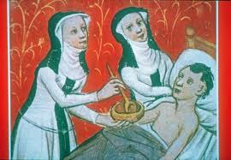
Who helped the poor historically?

Slide 6
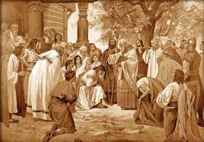
Responses to Poverty
Supporting the destitute was a problem exacerbated by King Henry VIII's Dissolution of the Monasteries, which began in 1536.
A significant source of charitable relief, and provided a good deal of direct and indirect employment.
The Poor Relief Act of 1576 went on to establish the principle that if the able-bodied poor needed support, they had to work for it.

Slide 7
Responses to Poverty
The English Poor Laws
a system of poor relief which existed in England and Wales
Developed out of late-medieval and Tudor-era laws being codified in 1587–98.

Slide 8
Responses to Poverty
The English Poor Laws
The Poor Law system was in existence until the emergence of the modern welfare state after the Second World War.
The Poor Law system was not formally abolished until the National Assistance Act 1948,] with parts of the law remaining on the books until 1967.

Slide 9
Responses to Poverty
The "Old Poor Law" was not one law but a collection of laws passed between the 16th and 18th centuries.
The system's administrative unit was the parish.
Not a centralised government policy but a law which made individual parishes responsible for Poor Law legislation
WHO DECIDES WHO IS DESERVING?

Slide 10
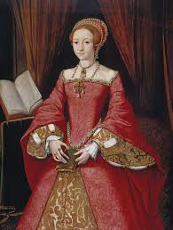
Charitable Acts become formalised

Slide 11
1597+ Poor Law – reign of Elizabeth 1
The impotent poor (people who can't work) were to be cared for in almshouse or a poorhouse.
Offered relief to people who were unable to work
who were "lame, impotent, old, blind“
THE DESERVING POOR?

Slide 12
1597+ Poor Law – reign of Elizabeth 1
The able-bodied poor were to be set to work in a House of Industry. Materials were to be provided for the poor to be set to work
ACCESS TO THE LABOUR MARKET

Slide 13
1587+ Poor Law – reign of Elizabeth 1
The idle poor and vagrants were to be sent to a House of Correction or even prison.
Prior to this Act they were flogged and moved on.
PUNISHMENT FOR THOSE WHO DON’T COMPLY ………….WITH WHAT??

Slide 14
1597+ Poor Law – reign of Elizabeth 1
Pauper children would become apprentices.
SKILLING UP THE UNDERCLASS – A MODERN CONCEPT??

Slide 15
Lasting Impact …
1834 ‘New’ Poor Law
New technology (leading to mass unemployment) to replace agricultural workers in particular, and a series of bad harvests, meant that by the early 1830s the established system of poor relief was proving to be unsustainable.
The New Poor Law of 1834 attempted to reverse the economic trend by discouraging the provision of relief to anyone who refused to enter a workhouse

Slide 16
Lasting Impact …
1834 ‘New’ Poor Law
The New Poor Law of 1834 attempted to reverse the economic trend by discouraging the provision of relief to anyone who refused to enter a workhouse

Slide 17
The workhouse test
Obliged anyone seeking poor relief to enter a workhouse and undertake a set amount of work
usually for no pay , the Act helped prevent irresponsible claims of a parish's poor person.

Slide 18
Outdoor Relief – Indoor Relief
Outdoor relief means support provided within the individual’s own setting
Indoor Relief means provision is made in a workhouse
In 1840 Carmarthen had a workhouse with 180 inmates, and 34000 people living in the parish.
The inmates included men, women and children.
They were punished frequently.

Slide 19
WORKHOUSE
many parishes expected to earn money from the labour of the poor in workhouses
The vast majority of people in workhouses were ill, elderly, or children
combined the functions of creche, and night shelter, geriatric ward, mental asylum and orphanage
The inmates’ labour proved largely unprofitable

Slide 20
Deterrent Effect
Degradation
‘stigmatization’
‘to go on the parish’
Dependent on public welfare
  (Blakemore & Griggs, 2007: 42)

Slide 21
Other concepts/values
Public welfare
Embedded link between work and respectability
Deep rooted idea that paid work demonstrates responsibility as a citizen
WELFARE TO WORK IN THE 21ST CENTURY?
  (Blakemore & Griggs, 2007: 42)

Slide 22
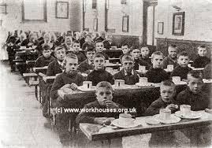
Concepts -Workhouse
Contribution to keep
Moral aim to ‘correct laziness and reform the character’
Example to others ….

Slide 23
Deserving
Charitable support for those deemed deserving…
Informal practice of giving a ‘dole’ of bread or equivalent payment to low paid labourers and families
CONCEPT OF NEED- OF ENTITLEMENT?
  (Blakemore & Griggs, 2007: 43)

Slide 24
Eligibility
Categories …..
Abandoned or orphaned
Women who had been widowed
Disabled
Chronically ill
Law accepted no responsibility for reducing inequality and poverty ….
  (Blakemore & Griggs, 2007: 42)
CONCEPT OF NEED?

Slide 25
Workhouse PRINCIPLES
Workhouses run to centrally defined rules
Principle of less eligibility
Specialised….
Infirmaries or hospitals
Older people
  (Blakemore & Griggs, 2007: 43-44)
Lose of freedom and civil rights
Entry to Poor Law institution
Families split
Outdoor relief no longer an option (?)

Slide 26
A NEW eRA
Early decades of 20th century policy model emerging with interventionist principles
Insurance against risks of illness, unemployment and low income
CONTRIBUTION BASED
(Blakemore & Griggs, 2007: 49)

Slide 27
A NEW eRA
Improvements in pensions, health and unemployment insurance extended in 1920’s and 1930’s (Blakemore & Griggs, 2007: 49)

Slide 28
Beveridge Report
William Beveridge perceived as the ‘architect’ of the welfare system
‘Social Insurance and Allied Services’ 1942
Revised social security system
Established the need for policies of full employment
and a national health service
Suggested universal coverage of the whole population
(Blakemore & Griggs, 2007: 49)

Slide 29
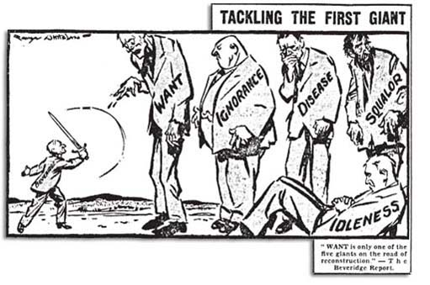
Lifelong care
Notion of care from the ‘cradle to the grave’
Five giants …
Want
Ignorance
Squalor
Disease
Idleness

Slide 30
Acts
Reforms implemented by Attlee’s Labour Government
  National Insurance Act 1946
  National Assistance Act 1948
Sickness and unemployment benefits
Retirement pensions (men at 65 and women at 60)
Maternity benefits, widow’s benefits and death grant
National Assistance Board to replace the Poor Law
(Blakemore & Griggs, 2007: 50-51)

Slide 31
Tensions
Flat rate contributions and benefits ….
Poverty persisted as benefits for older people, disabled and long term unemployed set at low levels
Recourse to National Assistance benefits – means tested
Gendered nature of welfare
Which groups were not covered by the insurance scheme?

Slide 32
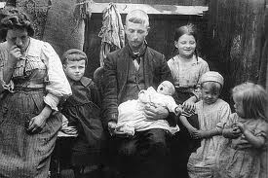
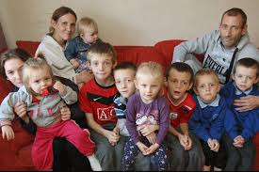
Influences from the past
‘Britain’s welfare system represents an interesting
mix of principles and influences from the past …’
(Blakemore and Griggs, 2007: 56)

Slide 33
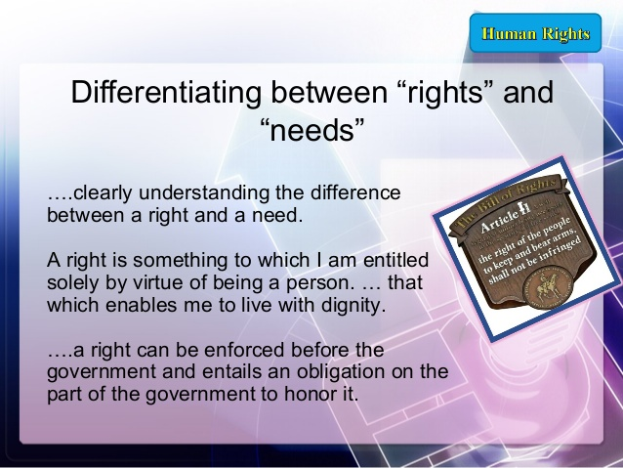
(Pia, 2014)

Slide 34
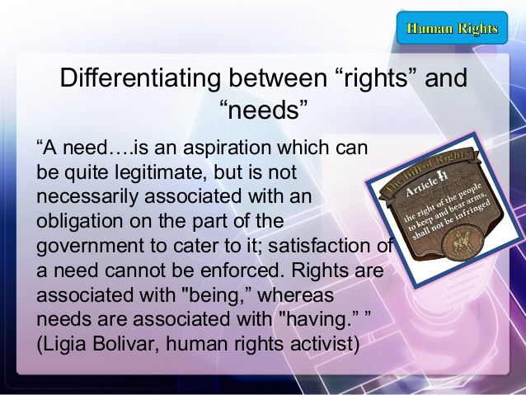
(Pia, 2014)

Slide 35
Needs and Rights
Which aspect of social policy in the UK is needs based and which is rights based? Think about
Education
Benefits
Social Care
Housing
Anything else?
http://www.humanrights.com/what-are-human-rights/brief-history/

Slide 36
Directed Study
Did you find today interesting?
Please choose one of the following areas:
Race
Disability
Gender
And find out some statistical facts.
Make a note of your sources.

Slide 37
Bibliography
Berg and Ostry, "Inequality and Unsustainable Growth: Two Sides of the Same Coin, 2011
Blakemore, K. and Griggs, E. Social Policy: An Introduction, Maidenhead: Open University Press
Ferragina, E. and Seeleib-Kaiser, M. (2011). Welfare regime debate: past, present, futures. Policy & Politics: 39: 4 (2011). p. 584 "Welfare state."
Higginbotham, Peter. "The Workhouse in Guisborough, Yorkshire, N. Riding" workhouses.org.uk.
Levitas, R. (2005) The inclusive society? Social exclusion and new labour, Basingstoke: Palgrave Macmillan
Lister, R. Poverty, (2009) Cambridge: Polity Press
O’Hara, Encyclopedia of Political Economy. Routledge, 1999. p. 1245
Percy-Smith, J. (2002) Policy Responses to Social Exclusion: towards inclusion? Maidenhead: Open University Press

Slide 38
Bibliography
Pia, A.(2014). Rights Based Perspective, https://www.slideshare.net/markallanestabillopia/right-based-approach [accessed 04.08.2017)
Pickett and Wilkinson (2011), The Spirit Level: Why More Equal Societies Almost Always Do Better
Pierson, J. (2010)Tackling Social Exclusion, London: Routledge
Pierson, J. (2010)Tackling Social Exclusion, London: Routledge
Spicker, P. (2007) The Idea of Poverty, Bristol: Policy Press
Spicker, P. (2007) The Idea of Poverty, Bristol: Policy Press
United for Human Rights (2017). A brief history of Human Rights, http://www.humanrights.com/what-are-human-rights/brief-history/
www.Britannica.com: Britannica Online Encyclopedia, ‘Welfare State’ [accessed 03.10.2014]

Slide 39
Bibliography
Images:
http://history.powys.org.uk/school1/llanfyllin/treat.shtml
http://openlearn.open.ac.uk/mod/oucontent/view.php?id=398028&section=1.2

