Slide 1
Hydrotreated Vegetable oil
By
Andrew Thorn

Slide 2
HVO Fuels
The hydrotreating of vegetable oils (HVO) and animal fats is a new process
It is based on oil refining know-how and is used for the production of biofuels for diesel engines
In the process hydrogen is used to remove oxygen from the triglyceride vegetable oil molecules and to split the triglyceride into three separate chains

Slide 3
HVO Fuels
These chains are hydrocarbons which are similiar to existing diesel fuel components
Traditionally, diesel components produced from vegetable oils are made by an esterification process
The products are called fatty acid methyl esters (FAME) or biodiesel

Slide 4
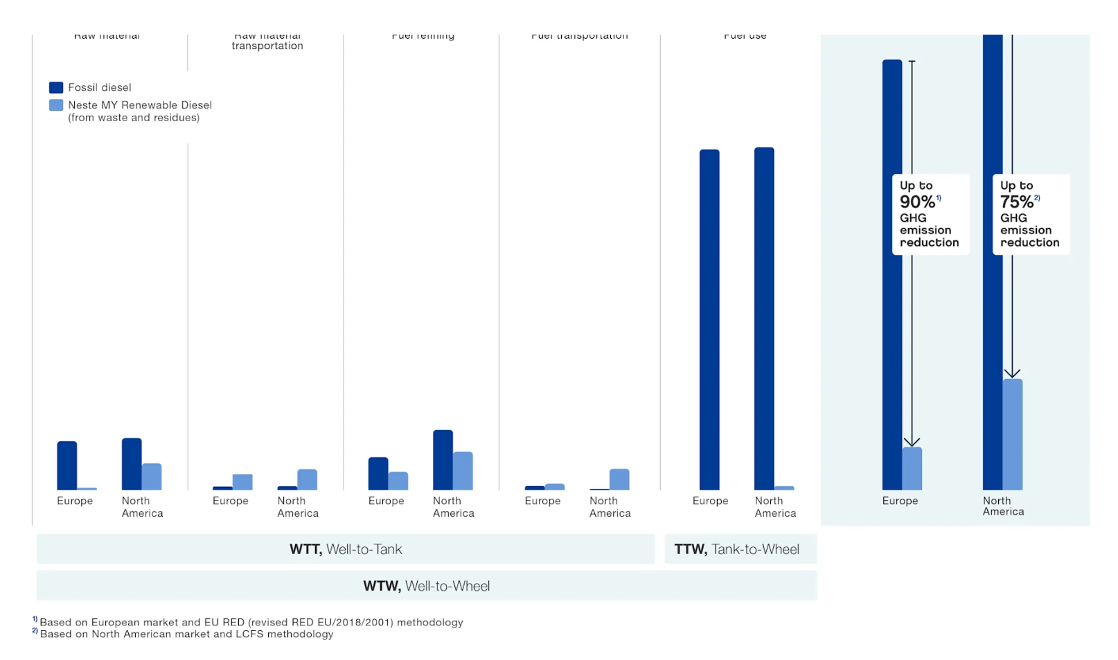

Slide 5
Feedstocks Used in HVO Production
Vegetable oils: - Rapeseed oil, palm oil, and sunflower oil are among the most frequently used
Animal fats: by-products from the meat industry, such as tallow, can also be converted into HVO
Waste products: - used cooking oils and other waste materials provide sustainable feedstock options, supporting circular economy principles

Slide 6
HVO Advantages
In terms of performance, HVO is virtually the same as diesel
It can be produced from a broad range of raw materials including a lot of low-quality waste products that cannot be used in biodiesel
It has the same climate benefits as biodiesel and depending on the materials used in its production – for example bio-oils- It’s well-to-wheel carbon emissions can be even lower still

Slide 7
HVO Advantages
It can be used in vehicles as a direct replacement for diesel. No modifications are needed
It is free of biodiesel’s technical limitations- such as solidifying in cold weather or producing harmful organisms in the fuel tank
Oil refineries can be converted to HVO production as demand for fossil fuel decreases

Slide 8
HVO Advantages
HVO has a high Cetane Number compared to fossil fuel diesel, meaning it ignites more easily and burns more efficiently in a engine
Better combustion quality particularly in colder climates where biodiesel may face issues with fuel gelling

Slide 9
HVO Reduction in Greenhouse Gas Emissions
The primary reason for the growing interest in HVO is its ability to significantly reduce carbon dioxide and other harmful emissions
Studies have shown that HVO can reduce lifecycle CO₂ emissions by up to 90% compared to fossil diesel, depending on feedstock use and production methods
HVO can lower particulate emissions by up to 80% and NO_{X} emissions by approximately 8% helping to improve air quality

Slide 10
Improved Engine Performance and Lower Maintenance Costs
HVO is sulphur and aromatic free, it burns more cleanly than conventional diesel
This results in less wear and tear on fuel injectors and exhaust systems
Cleaner combustion leads to extended maintenance intervals, reduced engine wear, longer oil life and reduced overall maintenance costs

Slide 11
Disadvantages of HVO
High production costs
Volatility in feedstock prices and availability
Regulatory and supply chain challenges
Market dynamics and regulatory overview
Regulatory considerations

Slide 12
High Production Costs
The hydrogeneration process used to produce HVO is energy-intensive and requires advanced infrastructure
HVO production costs are about 10 – 15% higher than fossil diesel, depending on the feedstock
Capital expenditure (CAPEX) for hydrogeneration, equipment is significantly hugher due to the need for specialised equipment that can handle high-pressure hydrogenation

Slide 13
Volatility in Feedstock Prices and Availability
HVOs production relies heavily on specific feedstocks, such as vegetable oils, animal fats, and used cooking oils
However, the availability of these raw materials is subject to market fluctuations, which can lead to price volatility
A commonly used feedstock, palm oil- has been the subject of environmental and ethical concerns with some regions banning its use due to its association with deforestation

Slide 14
Volatility in Feedstock Prices and Availability
HVO producers are increasingly turning to waste products, like used cooking oil, to create more sustainable resilient supply chains
However, overall availability of these waste products is limited, raising concerns about whether HVO can scale up to meet rising demand
This is also concerning for other modes of transport, such as shipping and aviation who are also looking to decarbonise

Slide 15
Regulatory and Supply Chain Challenge
The EUs Renewable Energy Directive 11 (RED) emphasises the use of second-generation biofuels like HVO, but also places restrictions on the use of certain feedstocks, such as palm oil, due to their indirect land-use change (ILUC) risks
In addition, feedstock competition with other industries, such as cosmetics may constrain the availability of feedstocks impacting HVO production volumes and market growth

Slide 16
Market Dynamics and Regulatory Overview
The HVO market is on a trajectory, with production capacity projected to double by 2030, expected to reach £40 billion, up from £14.5 billion in 2022
This growth is fuelled by increasing environmental regulations and government incentives, especially in Europe
For example, the EUs RED11 directive mandates a 14% renewable energy target for transport by 2030

Slide 17
Regulatory Considerations
In Europe, the RED11 directive mandates the gradual elimination of biofuels linked to high indirect land-use change (ILUC), such as palm oil, by 2030
While HVO offers substantial environmental and operational benefits, its higher production costs and regulatory challenges must be carefully managed
HVO is a promising renewable fuel that offers significant environmental benefits and is already being used successfully by companies

Slide 18
Regulatory Considerations
By integrating HVO into their decarbonisation strategies, monitoring technological advancements, and aligning with regulatory changes, companies can position themselves for long-term success

Slide 19
Regulatory Considerations
HVOs role as a transitional fuel ensures its continued relevance as the industry evolves, making it a critical part of the logistics industry’s journey toward reducing emissions

Slide 20
HVO Benefit Vs Biodiesel
Consistent product
A true diesel fuel
No storage concerns
No heating or recirculation required during storage
Will not block filters in cold temperatures
Can be mixed in all proportions with mineral diesel
Fully sustainable and renewable

Slide 21
HVO Benefit Vs Diesel
Non-blended- consistency of quality and structure
No aromatics- improved burn
Reduced health and environmental risk
Particulate matter and NO_{X} reductions
Fully sustainable and renewable

Slide 22
Alternative Fuels- Checklist
Total Cost of Ownership
Isn’t as simple as comparing prices
If one fuel is cheaper but less efficient it could turn out to be more expensive
Will fuel savings cover the cost of additional equipment and vehicles?
Will you be affected by tax incentives, service and maintenance costs
Will you be affected by resale value, insurance or payload capacity?

Slide 23
Alternative Fuels- Checklist
Drive Cycles
Some fuels will only deliver their full benefits if the vehicle is operating in certain conditions so ask if they apply to you
For example, LNG might be good choice if you are in the long-haul business whereas an electric vehicle could be suitable in urban distribution

Slide 24
Alternative Fuels- Checklist
Infrastructure
Will new refilling stations be required, and if so, are any such investments forthcoming?
Will you need to invest in any new facilities or equipment on your sites?
If so, take these costs into consideration in your calculations

Slide 25
Alternative Fuels- Checklist
Availability
How secure is the fuel source going forward, and are you confident that there will always be a ready supply
Reliability
How well-established is the fuel source?
Unproven technology comes with increased risk

Slide 26
Alternative Fuels- Checklist
Consider both current and upcoming legislation
Are there any restrictions being proposed on diesel-powered vehicles?
Or government subsidies and incentives for using alternative fuels

Slide 27
GHG Emissions Performance

