Slide 1

Session 9: Ethics in Leadership
BMSW6101 Emergent Leadership Skills

Slide 2

EXERCISE AND DEBATE
What Does Ethics Mean to You?
2. Company policy forbids co-workers to become romantically involved. You are in the same Tennis Club as someone from another department, and you find yourself becoming attracted to this person. As a leader, do you pursue the relationship? Why? Why not?

Slide 3
EXERCISE AND DEBATE
3. Have You Ever…
. . . lied to your boss? the IRS? Regulators?
. . . lied so you wouldn’t hurt someone’s feelings?
. . . lied to get out of a business or social engagement?
. . . fudged figures on a report to make the results look better?
. . . taken a sick day when you weren’t sick?
. . . lied to a customer (“we sent your order yesterday”) or creditor (“the check’s in the mail”)?
. . . cut corners on quality control?
. . . blamed someone else for something you knew you were partly responsible for?
. . . put inappropriate pressure on others?

Slide 4
Introduction
Leadership has a moral dimension because leaders influence the lives of others.
There is an obligation to work for the common good.
Despite this there have been a number of leadership scandals in the business and the public sectors.
Ethical leadership is the influence of a moral person who moves others to do the right thing in the right way for the right reasons (Ciulla, 2003).
Notes:
Engage in ethical leadership: The assumption we are making is that if you understand the nature of ethical leadership, you will be better equipped to engage in ethical leadership.

Slide 5
Leadership Ethics Explained
Ethical leadership: influence of a moral person.
Accomplishing a common good.
Desirable values and morals.
Ethics decide use of power.
Notes:
Ethical leadership is the influence of a moral person who moves others to do the right thing in the right way for the right reasons.
Accomplishing a common good: Ethical leadership is a process by which a good person rightly influences others to accomplish a common good: to make the world better, fairer, and more humane.
Desirable values and morals: Ethics is concerned with the kind of values and morals an individual or society finds desirable or appropriate.
Ethics decide use of power: Leaders often have control, power, and influence over others; their leadership affects other individuals and organizations. Hence, the leader’s ethics establish the ethical climate for an organization.

Slide 6
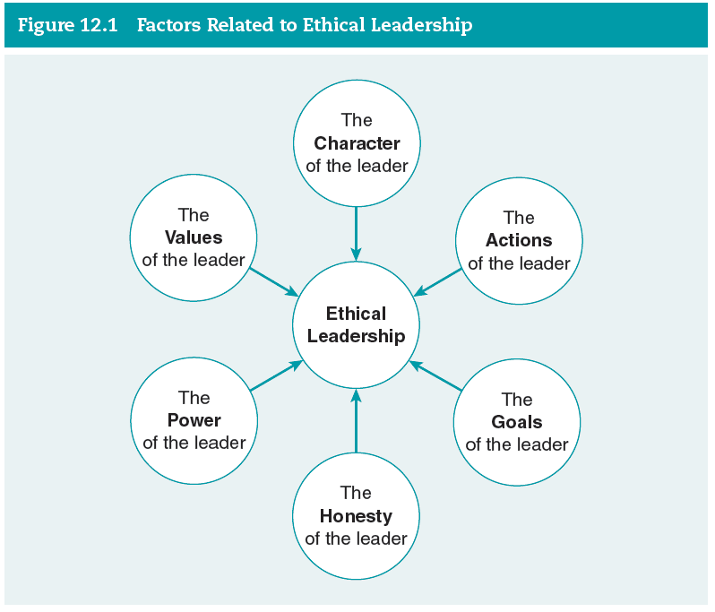
Leadership Ethics in Practice (1 of 7)
Factors related to ethical leadership
Notes:
Figure 12.1: Factors Related to Ethical Leadership.

Slide 7
Leadership Ethics in Practice (2 of 7)
The Character of the Leader
Fundamental aspect.
Qualities, disposition, and core values.
Six dimensions of character: trustworthiness, respect, responsibility, fairness, caring, and citizenship.
Notes:
The character of the leader is a fundamental aspect of ethical leadership.
The leader’s character refers to the qualities, disposition, and core values of the leader.
Instruction around six dimensions of character: trustworthiness, respect, responsibility, fairness, caring, and citizenship.

Slide 8
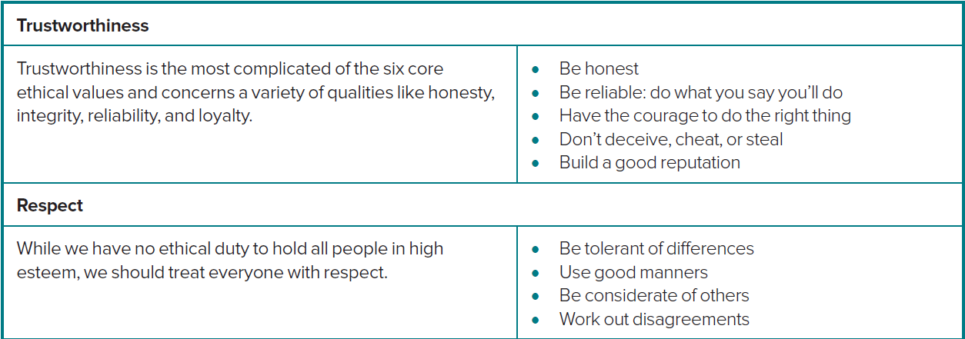
Leadership Ethics in Practice (2 of 7)
Six Dimensions of the Character of the Leader

Slide 9
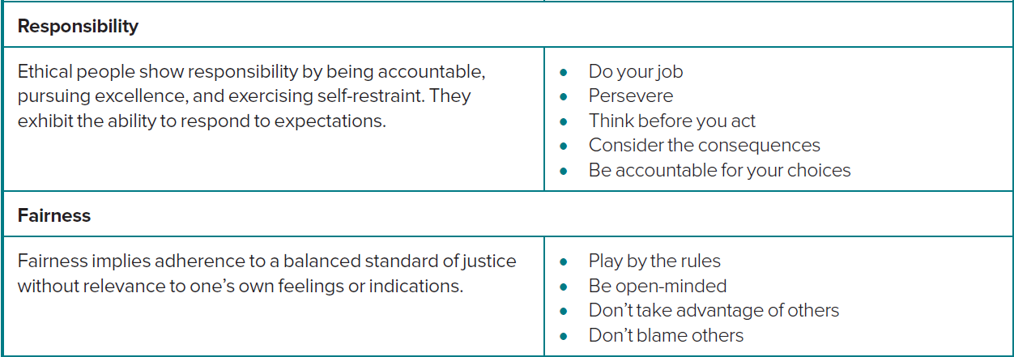
Leadership Ethics in Practice (2 of 7)
Six Dimensions of the Character of the Leader

Slide 10
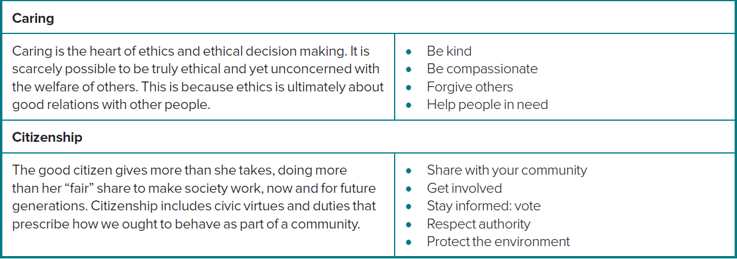
Leadership Ethics in Practice (2 of 7)
Six Dimensions of the Character of the Leader

Slide 11
Leadership Ethics in Practice (3 of 7)
The Actions of the Leader
The actions are ways to accomplish goals ethically.
Principles guiding actions of leaders:
  Showing respect.
  Serving others.
  Showing justice.
Notes:
Actions refer to the ways a leader goes about accomplishing goals.
Ways to accomplish goals ethically: A leader can act in many different ways to accomplish goals; each of these actions has ethical implications.
Showing respect: To show respect means to treat others as unique human beings and never as means to an end.
Serving others: Clearly, serving others is an example of altruism, an approach that suggests that actions are ethical if their primary purpose is to promote the best interest of others.
Showing justice: Ethical leaders make it a top priority to treat all of their followers in an equal manner. Justice demands that a leader place the issue of fairness at the center of decision making.

Slide 12
Leadership Ethics in Practice (4 of 7)
The Goals of the Leader
Using goals to influence others.
Identifying and pursuing worthy goals.
Establish goals agreeable to all.
Notes:
Using goals to influence others: How a leader uses goals to influence others says a lot about the leader’s ethics.
Identifying and pursuing just and worthy goals are the most important steps an ethical leader will undertake.
Establish goals agreeable to all: An ethical leader tries to establish goals on which all parties can mutually agree. An ethical leader with ethical goals will not impose his or her will on others.

Slide 13
Leadership Ethics in Practice (5 of 7)
The Honesty of the Leader
Synonymous with being ethical.
Dishonesty creates distrust.
  Negative effect on interpersonal relationships.
Challenge of being truthful in appropriate ways.
Notes:
Synonymous with being ethical: People want honesty in their leaders. Being honest is synonymous with being ethical.
Dishonesty creates distrust: Dishonesty is a form of lying, a way of misrepresenting reality. Dishonesty may bring with it many negative outcomes, the foremost of which is that it creates distrust.
Negative effect on a leader’s interpersonal relationships: It puts a strain on how the leader and followers are connected to each other.
Honest leadership involves a wide set of behaviors, which includes being truthful in appropriate ways.

Slide 14
Leadership Ethics in Practice (6 of 7)
The Power of the Leader
Capacity to influence or affect others.
Power: Used positively and negatively.
Fair and caring in leadership.
Be constantly vigilant and aware.
Notes:
Power is the capacity to influence or affect others. A leader has power because he or she has the ability to affect others’ beliefs, attitudes, and courses of action.
Power: Used positively and negatively: Since power can be used in positive ways to benefit others or in destructive ways to hurt others, a leader needs to be aware of and sensitive to how he or she uses power.
Fair and caring in leadership: From the smallest to the largest forms of influence, a leader needs to try to be fair and caring in his or her leadership.
Be constantly vigilant and aware: The key to not misusing power is to be constantly vigilant and aware of the way one’s leadership affects others.

Slide 15
Leadership Ethics in Practice (7 of 7)
The Values of the Leader
Three kinds of leadership values:
  Ethical values.
  Modal values.
  End values.
Notes:
Values are the ideas, beliefs, and modes of action that people find worthwhile or desirable.
Ethical values are similar to the notion of character discussed earlier in this chapter.
Modal values are concerned with the means or actions a leader takes.
End values describe the outcomes or goals a leader seeks to achieve.

Slide 16
Culture and Leadership Ethics
Globalization makes it more likely that people will work with others from different cultures.
Cultures differ in their rules of conduct and ethical views.
Resick, Hanges, Dickson, and Mitchelson (2006) found that Nordic European cultures such as Denmark and Sweden place more importance on a leader’s character and integrity defined as a leader behaving in a manner that is just, honest, sincere, and trustworthy than Middle Eastern cultures such as those in Egypt, Turkey, and Qatar.
Notes:
Different rules of conduct: Different cultures have different rules of conduct, and as a result, leadership behaviors that one culture deems ethical may not be viewed the same way by another culture.

