Slide 1
KARL SIMMONDS 2539077
LCLM 4004
Problem Solving and Decision-Making
“Basil’s Bakery“

Slide 2
Basil’s Bakery
Good morning, all, my name is Karl Simmonds.
In my presentation I will give my analysis of the situation “basils bakery” faces and provide a solution to the problem.

Slide 3

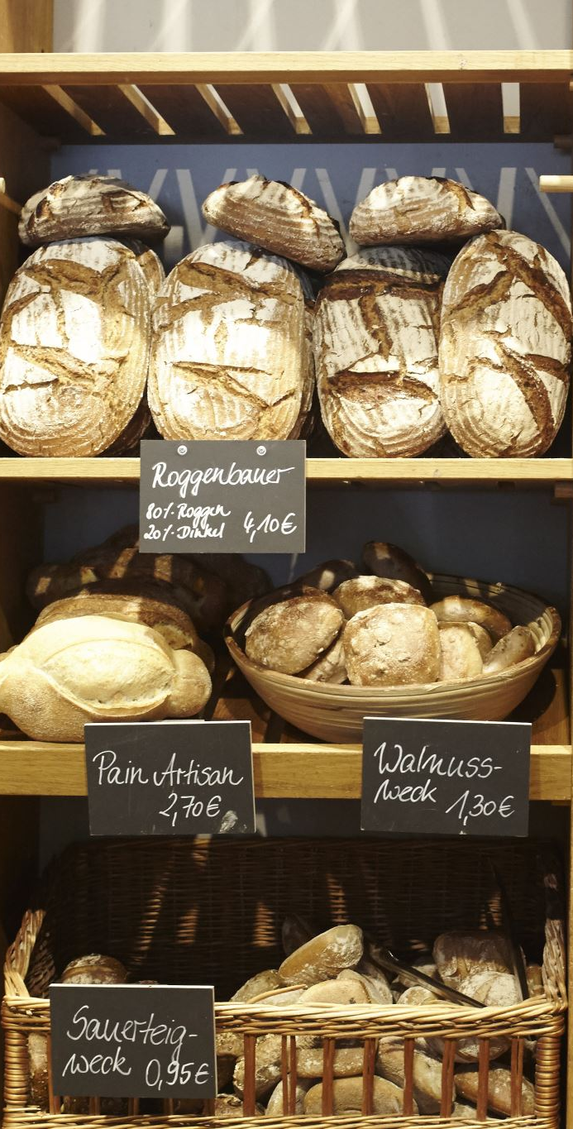
Basil’s Bakery overview
"Basil's Bakery is an independent organic bakery in a Coventry retail park, established in 2015.
Sales grew year-on-year until 2020, when Covid caused a significant drop
While Basil expected a full recovery, sales from 2023 to 2025 have remained 25% below 2019 levels. This is driven by a quieter retail park with closing shops, loss of loyal customers, and hybrid working reducing daily footfall.
At the same time, Basil faces requests for delivery and pre-orders that he cannot meet alone, plus rising rent, energy, and unpredictable organic costs. He now needs to understand if his current business model is still viable."

Slide 4
Problems Basil’s Bakery are facing
When we look at Basil's Bakery, the headline figure is that sales from 2023 to 2025 have remained 25% below 2019 levels, despite the end of Covid restrictions. There are five root causes for this stagnation. First and most importantly, external footfall decline.
The retail park is much quieter, shops are closing every few months and not being replaced, meaning Basil has lost loyal customers and passing trade. Second, a permanent change in working habits. Office workers now work from home part of the week, so they no longer come in daily for lunch. Third, an internal operational bottleneck.
Basil is the sole baker who must remain onsite, so he cannot offer the delivery service customers are asking for, and he cannot answer the phone for pre-orders during busy periods, which creates long waiting times. Fourth, a failure to adapt the business model. The bakery is still operating in its 2015 format, with no delivery or online system, despite clear customer demand.
Finally, rising costs. Rent, energy, business rates and unpredictable organic ingredient costs are all considerably higher than in 2019, putting huge pressure on margins. So, the stagnation is a mix of external decline and internal lack of capacity to adapt."

Slide 5
My Critique of the PESTAL Framework.
*1. PESTEL is Too Broad and Generic for a Micro-Business*PESTEL was designed for large corporations. For Basil's Bakery (1 owner, 1 location), factors like 'Political' or 'Technological - AI' are too high-level. It identifies _that_ footfall fell, but it doesn't tell Basil _why_ his specific customers stopped coming or _what_ to do next. It lacks local depth.
*2. It Overstates External Blame and Ignores Internal Control*The PESTEL makes it look like Basil is a victim of Environment, Social, Economic factors. But the real sales killer is internal - *Methods & Machines*. He has no delivery system and no staff. PESTEL doesn't capture that because it's an internal failure, not an external factor. It gives Basil an excuse not to act
3. Factors Overlap and Are Not Prioritised*In this case, 'Social - Hybrid Working' and 'Economic - Shop Closures' are both actually causing the same outcome: Environment - Quieter Retail Park. PESTEL lists them separately but doesn't show which is the biggest threat. For Basil, Environment (Retail park dying) is 70% of the problem, but PESTEL gives equal weight to all 6 letters.
*4. Based on Assumptions, Not Data*The PESTEL for Basil relies on Basil's _belief_ that the park is quieter. There is no actual footfall data, customer survey, or sales data by time/day. A PESTEL without Measurement is guesswork. This is why the Fishbone with Measurement was more accurate
5. It is Backward-Looking, Not Actionable*PESTEL explains what happened from 2020-2025, but it doesn't provide a solution. It won't tell Basil whether to invest in a Just Eat partnership, hire a delivery driver, or relocate. A SWOT and a full Cost-Benefit Analysis would be far more useful for his next decision

Slide 6
PESTEL DIAGRAM for Basil’s Bakery
*P - Political:* Brexit import costs for organic ingredients. Government business rates relief ending.-
*E - Economic:* Cost-of-living crisis - less disposable income. Inflation: energy +80% since 2021 (Ofgem, 2024), rent increase, organic flour price volatility.-
*S - Social:* Hybrid working = 44% of adults WFH part-week (ONS, 2023). Demand for convenience/delivery. Health trend towards organic is an OPPORTUNITY.-
*T - Technological:* Competitors using Just Eat / Deliveroo / Click & Collect apps. Basil has no tech system for pre-orders.-
*E - Environmental:* Organic crops vulnerable to climate change / crop failure. Consumers value sustainability.-
*L - Legal:* Food Safety & Hygiene Regulations, allergen labelling (Natasha's Law 2021), Employment Law if hiring delivery staff.

Slide 7
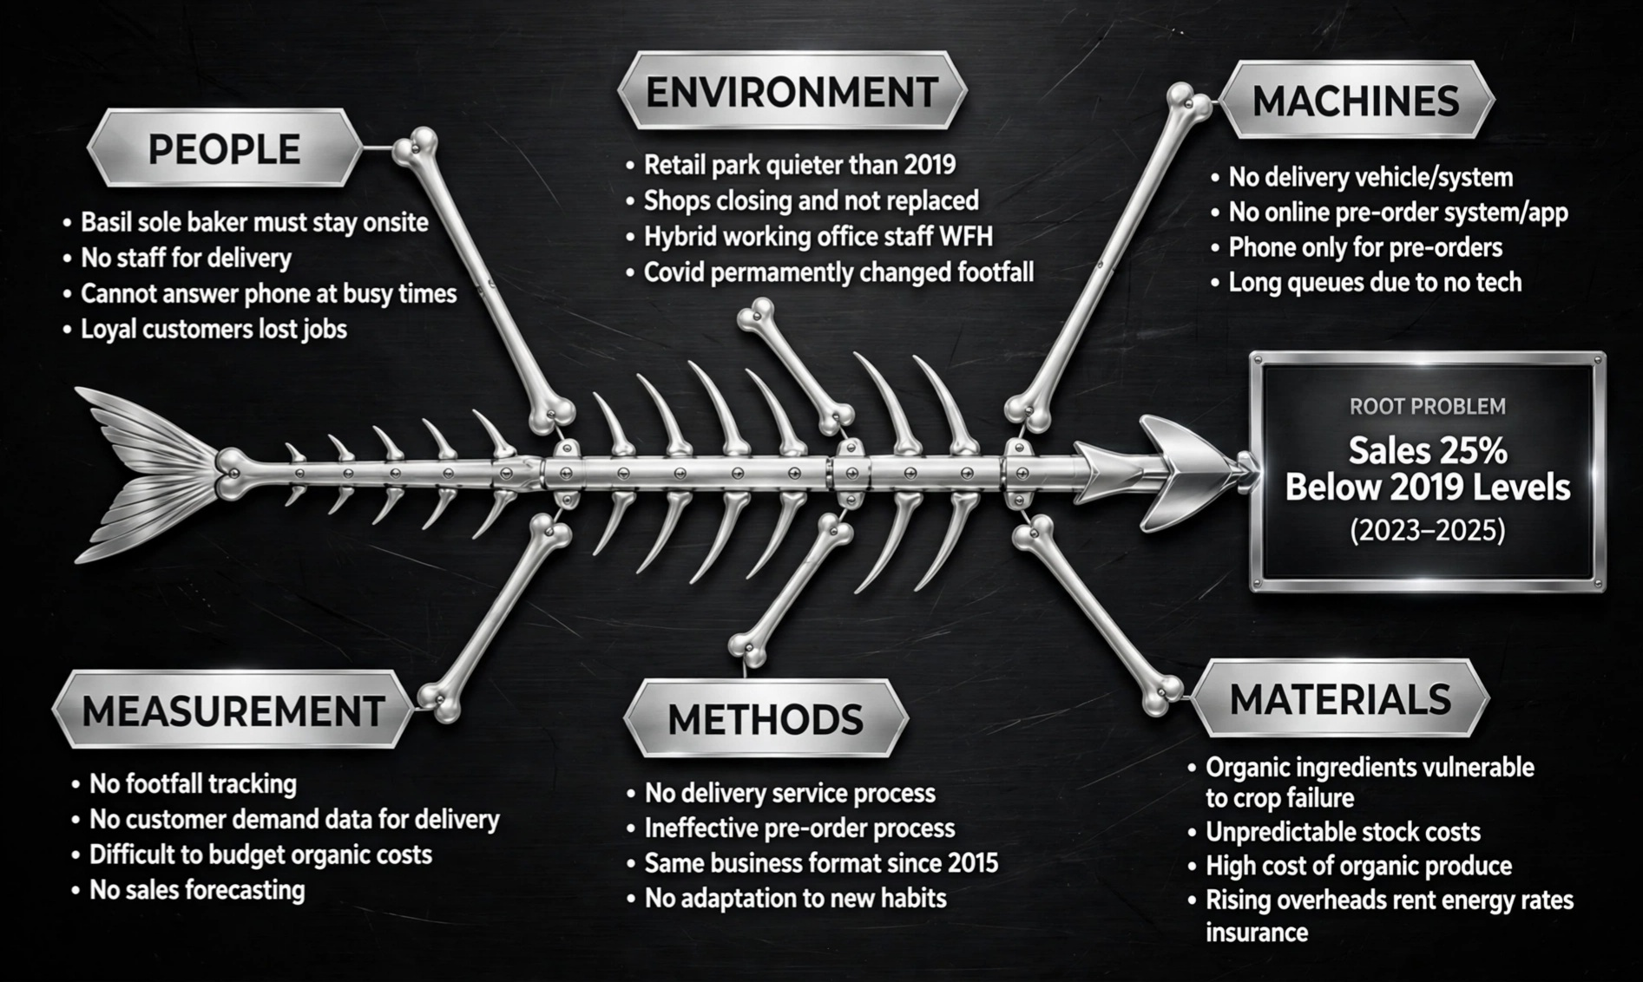
Cause-and-Effect model

Slide 8
Key Findings
Permanent Footfall Decline, Not Temporary:* The 25% sales drop is caused by structural changes - retail park decline with shops closing and not being replaced, plus hybrid working. Footfall will not return to 2019 levels on its own.
Business Model Has Not Adapted to Customer Needs:* Loyal customers are actively requesting delivery and pre-order services. Basil cannot meet this demand because he is the sole baker and must remain onsite, resulting in long queues and lost sales.
3. Operational Bottleneck is the Internal Root Cause:* The business is over-reliant on one person. No delivery system, no online pre-order app, and phone-only ordering that fails during busy periods. Methods and Machines are outdated since 2015.
4. Rising and Unpredictable Costs Are Squeezing Margins:* Overheads including rent, energy, rates and insurance are considerably higher than 2019, combined with unpredictable organic ingredient costs vulnerable to crop failure, making budgeting and pricing very difficult.

Slide 9
Reference list
Ishikawa, K. (1986) Guide to quality control. Tokyo: Asian Productivity Org., pp. 18-25, pp. 31-34.
Johnson, G. et al. (2020) _Exploring strategy: text and cases.12th edn. Harlow: Pearson, pp. 33-45.
Office for National Statistics (2023) _Retail sales and homeworking in Great Britain. Newport: ONS, p. 4, p. 9.
Ofgem (2024) Energy price cap and business energy costs report. London: Ofgem, p. 12, pp. 14-15.
DEFRA (2021) The Food Information (Amendment) (England) Regulations 2019. London: DEFRA, p. 2.
In-text:
(Ishikawa, 1986, p.22) | (Johnson et al., 2020, p.33) | (ONS, 2023, p.4) | (Ofgem, 2024, p.12)

Slide 10
Thank you for your time
"At the end of the day, this isn't just about saving a struggling bakery or the immediate checkboxes we need to tick to keep the ovens running.
It’s truly about preserving a staple of our community and bringing back the joy of artisanal baking and the long-term legacy we choose to leave behind. If we choose to commit to this path together and align our efforts,
the ultimate outcome won’t just be better metrics or hitting a survival budget on a spreadsheet.
It will be becoming a thriving, bustling neighborhood favorite where people gather and connect, creating a meaningful difference in how we operate and thrive. Let's look beyond today's challenges, embrace this opportunity, and build that future together.
Thank you for your time

