Slide 1
MBA
Financial Management
Week 3 – Additional Materials
Income Statement & Cash Flow Statement

Slide 2
2.3 The Income Statement
The income statement lists the firm’s revenues and expenses over a period of time
  Sometimes called the profit and loss statement, or “P&L”
The last or “bottom” line of the income statement shows net income
  A measure of its profitability during the period
  Also referred to as the firm’s earnings

Slide 3
2.3 The Income Statement
Earnings Calculations
  Gross Profit
    Revenues (Net Sales) - Cost of Sales = Gross Profit
  Operating Profit
    Gross Profit – Operating Expenses = Operating Profit (Operating Income)
  Net Profit
    Operating Income – Interest - Taxes = Net Income (net profit, earnings)

Slide 4
2.3 The Income Statement
Earnings per share Calculations
  Earnings per share (EPS) is the portion of a company’s profit that is allocated to each outstanding share of common stock
  EPS
    EPS = net income / (number of shares outstanding)
  Diluted EPS
    Diluted EPS = net income /(number of shares outstanding + the impact of stock options, warrants, and other dilutive securities)

Slide 5
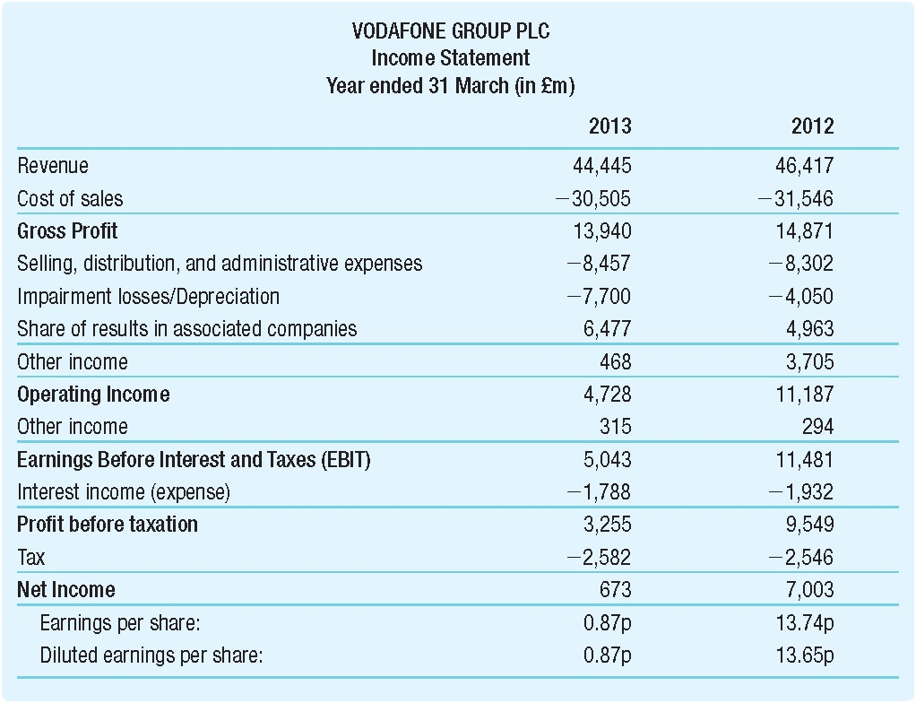
Table 2.2 Vodafone Group plc’s Income Statement Sheet for 2013 and 2012 in £m

Slide 6
2.6 The Statement of Cash Flows
The firm’s statement of cash flows uses the information from the income statement and balance sheet to determine:
  How much cash the firm has generated
  How that cash has been allocated during a set period
Cash is important because it is needed to pay bills and maintain operations and is the source of any return of investment for investors

