Slide 1
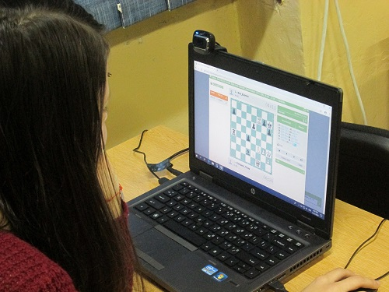
DIGITAL TECHNOLOGY
Digital technology help to find easer a job in the area witch you like most.
KIDS CAN STUDY EASYER
GADGETS MAKE LEANING BE FASTER
COMPUTERS HELP TO WORK MUCH ORGANAIZED
DIGITAL TECHNOLOGY ARE THE FUTURE
Technologies can optimize production, reduce emissions and waste, increase competitive advantage and bring new services and products to market.
This Photo by Unknown author is licensed under CC BY-SA-NC.
Marius Michea , student id:2232222

