Slide 1
BA BUSINESS MANAGEMENT
Module Title: Data Handling & Business Intelligence
Module Code: LCBB5000
Week – 1
Introduction
and
An Overview of Business Intelligence, Analytics, and Decision Support

Slide 2
Aim of the Module
To provide the student with a comprehensive understanding of how data systems work, how their benefits can be optimised.
To analyse and evaluate the information in the systems in order to obtain maximum benefit.

Slide 3
Learning Outcomes
Upon the successful completion of this module, the student should be able to:
Identify and critically evaluate the current trends in data warehousing, business intelligence, and data mining;
Demonstrate a comprehensive knowledge and systematic understanding of essential concepts and principles, by using predictive analytic software.

Slide 4
Assessments
  More information available on Moodle

Slide 5
Learning and Teaching Strategy
The study time for the module is divided as follows:
Source: UWTSD Module Descriptor
Activity Type | Hours | Percentage
Schedule Learning | 50 | 25%
Independent Learning | 150 | 75%
Placement Learning | 0 | 0%
TOTAL | 200 | 100%

Slide 6
Weekly Schedule
Week 1 | Introduction and Overview of BI
Week 2 | Data Warehouse, Data Mining
Week 3 | Data Organisation and BI Tools
Week 4 | Business Reporting and Intro to SPSS
Week 5 | Revision Workshop
Week 6 | Correlation
Week 7 | Text mining and Excel
Week 8 | Exercise Workshop
Week 9 | Exercise Workshop
Week 10 | Exercise Workshop

Slide 7
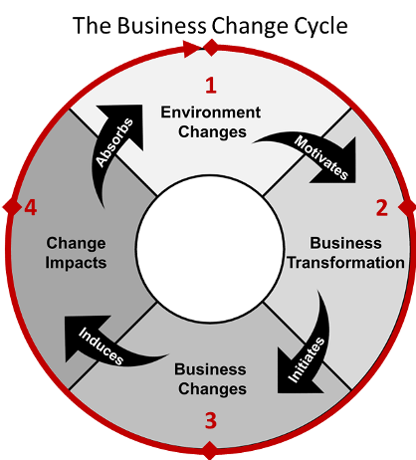
Business Environment Changes

Slide 8
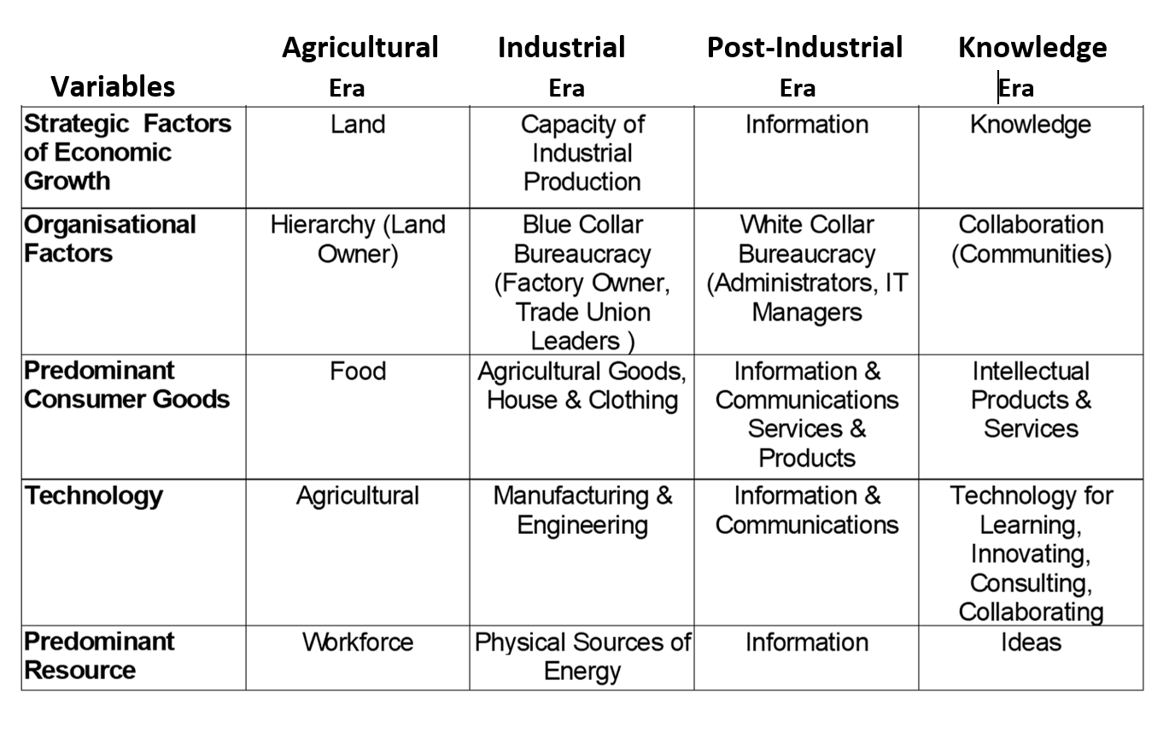
Evaluation criteria:
Changing Economic era:

Slide 9
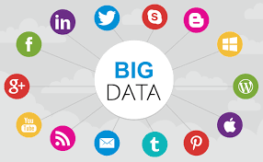
DATA VOLUME, VARIETY, AND VELOCITY
According to many experts, 90% of the data in the world today was created in the last two years alone
Much of the data now is time sensitive, and there is greater pressure to decrease the time between when it is captured and when it is used for reporting
The sources of data continue to expand. Receiving data from disparate sources further complicates things. Unstructured data, such as audio, video, and social media, and semi structured data like XML and RSS feeds must be handled differently
Volume
Velocity
Variety

Slide 10
Information or Data?
Difference between the two?
What are they/How are they measured?
Importance – why do companies/businesses need it?
Originates from?
Information/Data Flow?
Information Systems?

Slide 11
Changing Business Environment & Computerised Decision Support
Companies are moving aggressively to computerised support of their operations ⇨ Business Intelligence
Business Pressures–Responses–Support Model
  Business pressures result of today's competitive business climate
  Responses to counter the pressures
  Support to better facilitate the process

Slide 12
Definition of BI
BI is an umbrella term that combines architectures, tools, databases, analytical tools, applications, and methodologies
BI is a content-free expression, so it means different things to different people
BI's major objective is to enable easy access to data (and models) to provide business managers with the ability to conduct analysis
BI helps transform data, to information (and knowledge), to decisions, and finally to action

Slide 13
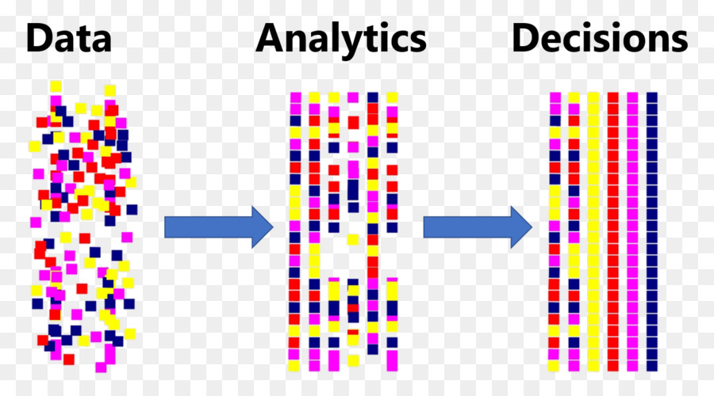

Slide 14
The Architecture of BI
A BI system has four major components
  a data warehouse, with its source data
  business analytics, a collection of tools for manipulating, mining, and analysing the data in the data warehouse
  business performance management (BPM) for monitoring and analysing performance
  a user interface (e.g., dashboard)

Slide 15
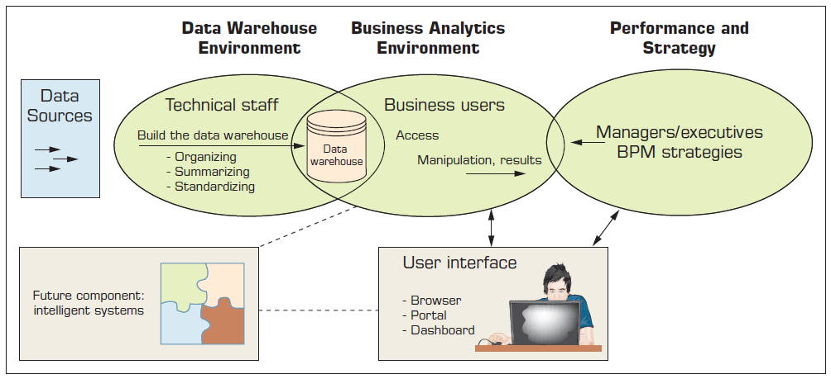
The Architecture of BI
FIGURE: A High-Level Architecture of BI

Slide 16
Components in a BI Architecture
The data warehouse is the cornerstone of any medium-to-large BI system.
  Originally, the data warehouse included only historical data that was organized and summarized, so end users could easily view or manipulate it.
  Today, some data warehouses include access to current data as well, so they can provide real-time decision support
Business analytics are the tools that help the user transform data into knowledge (e.g., queries, data/text mining tools, etc.)

Slide 17
Components in a BI Architecture (cont.)
Business Performance Management (BPM), which is also referred to as corporate performance management (CPM), is an emerging portfolio of applications within the BI framework that provides enterprises tools they need to better manage their operations (Lecture 3)
User Interface (i.e., dashboards) provide a comprehensive graphical/pictorial view of corporate performance measures, trends, and exceptions.

Slide 18
Successful BI Implementation
Implementing and deploying a BI initiative is a lengthy, expensive, and risky endeavor!
Success of a BI system is measured by its widespread usage for better decision making
The typical BI user community includes
  Not just the top executives (as was for EIS)
  All levels of the management hierarchy
    Provide what is needed to whom he/she needs it
A successful BI system must be of benefit to the enterprise as a whole…

Slide 19
BI - Alignment with Business Strategy
To be successful, BI must be aligned with the company’s business strategy
  BI cannot/should not be a technical exercise for the information systems department
BI changes the way a company conducts business by
  improving business processes, and
  transforming decision making to a more data/fact/information driven activity
BI should help execute the business strategy and not be an impediment for it!

Slide 20
Issues for Successful BI
Developing vs. Acquiring BI systems
Justifying via cost-benefit analysis
  It is easier to quantify costs
  Harder to quantify benefits
Security and Protection of Privacy
Integration of Systems and Applications

Slide 21
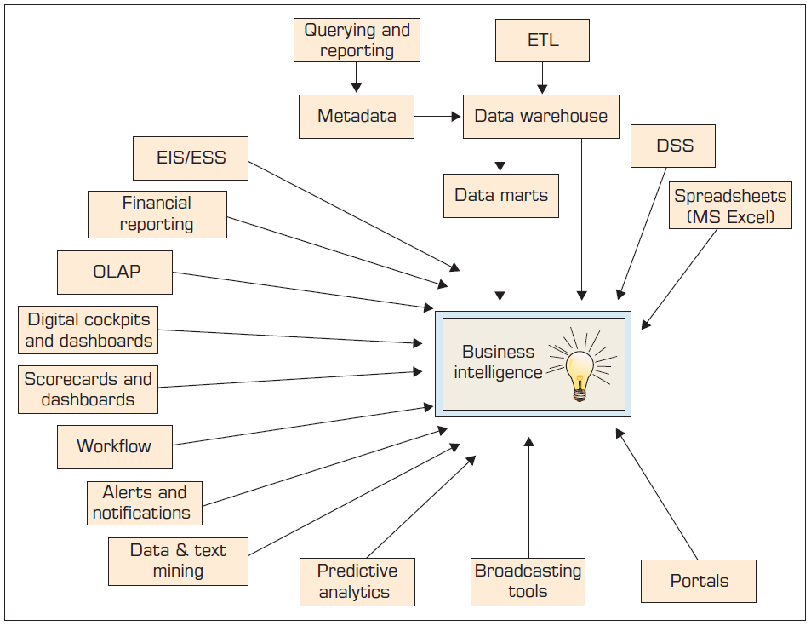
BI Framework/Evolution

Slide 22
Analytics Overview
Analytics?
  Something new or just a new name for …
A Simple Taxonomy of Analytics
  Descriptive Analytics
  Predictive Analytics
  Prescriptive Analytics
Analytics or Data Science?

Slide 23
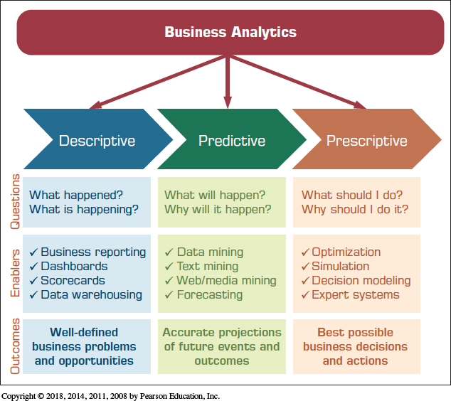
Analytics Overview
FIGURE: Three Types of Analytics

Slide 24
Descriptive Analytics
Descriptive or reporting analytics
Answering the question of what happened
Retrospective analysis of historic data
Enablers
  OLAP / DW
  Data visualization
    Dashboards and Scorecards
  Descriptive statistics

Slide 25
Predictive Analytics
Aims to determine what is likely to happen in the future (foreseeing the future events)
Looking at the past data to predict the future
Enablers
  Data mining
  Text mining / Web mining
  Forecasting (i.e., time series)

Slide 26
Prescriptive Analytics
Aims to determine the best possible decision
Uses both descriptive and predictive to create the alternatives, and then determines the best one
Enablers
  Optimization
  Simulation
  Multi-Criteria Decision Modeling
  Heuristic Programming
Analytics Applied to Many Domains
Analytics or Data Science?

Slide 27
Application Case Week 1
Eliminating Inefficiencies at Seattle Children’s Hospital
Questions for Discussion
Who are the users of the tool?
What is a dashboard?
How does visualization help in decision making?
What are the significant results achieved by the use of Tableau?

