Slide 1
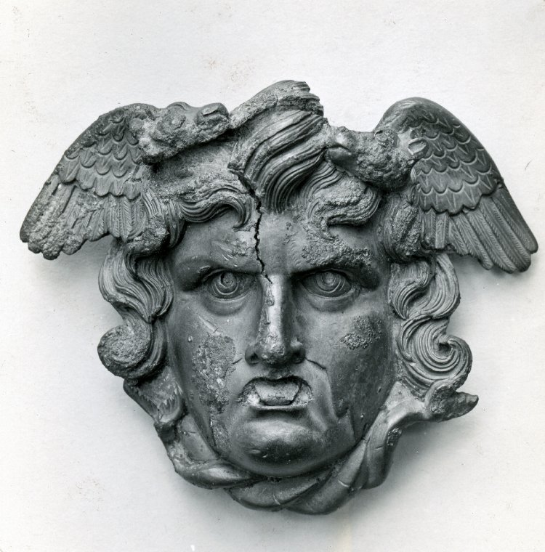
Monsters, Ghosts and Revenants
Week 1 – Conclusions

Slide 2
Conclusions
Looking back over the topics we’ve been covering
Thinking about key themes
Looking at connections between different topics

Slide 3
Course Structure
Week | Topic
1 | Introduction, theory and Definitions
2 | Monsters and Heroes
3 | Monsters and Gods
4 | Hybrid Deities
5 | Humans, Animals, Monsters
6 | Ghosts
7 | Revenants
8 | Monsters in Ethnography and Geography
9 | Monsters in Biology
10 | Revision and Exam Preparation

Slide 4
Key themes?

Slide 5
Types of monstrosity
Certain types of monsters/monstrous creatures repeatedly appear:
  Hybrids
  Excess/deficit in body parts
  Transgressions of living/dead
  Difference from parents

Slide 6
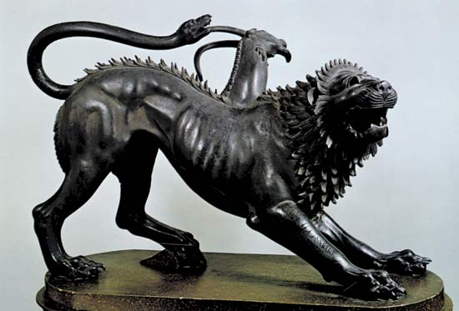
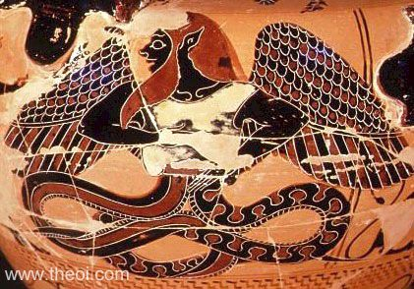
Hybrids
Opponents (heroes/gods)
As deities themselves
Transformations?
  Does a monster that is different things at different times count as a monster?

Slide 7
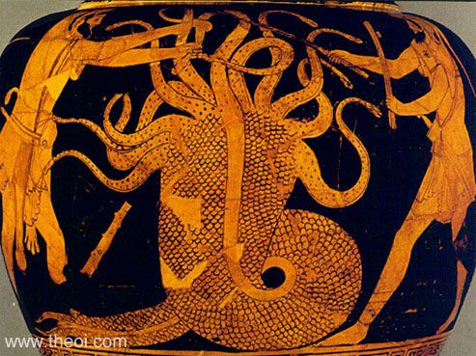
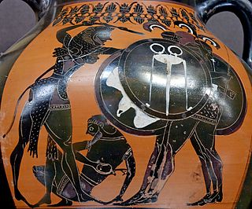
Excess deficit body parts
Opponents to gods
  Or helpers
Biology
Ethnography

Slide 8
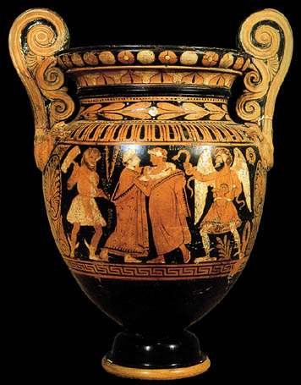
Transgression of living/dead boundary
Ghosts
Revenants
Omens
  Fish in Herodotus

Slide 9
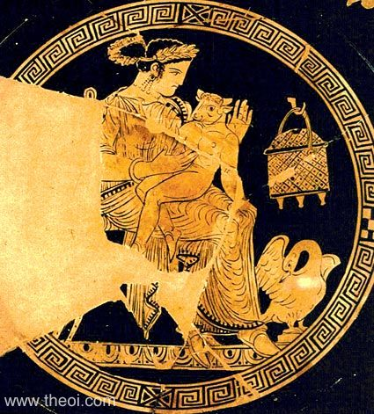
Abnormal Births
Biology
Omens
Origins of hybrids
  Minotaur
  Centaurs

Slide 10
Genre/medium
Different genres and media have
  different expectations
  different levels of suspension of disbelief
  different conventions
Monsters → abnormality
  Something can be abnormal in one genre, but not another
  e.g. birth of children different to their parents

Slide 11
Hes. Th. 126ff.
Earth first of all bore starry Sky, equal to herself, to cover her on every side, so that she would be the ever immovable seat for the blessed gods; and she bore the high mountains, the graceful haunts of the goddesses, Nymphs who dwell on the wooded mountains; and she also bore the barren sea seething with its swell, Pontus—all of them without delightful love;

Slide 12
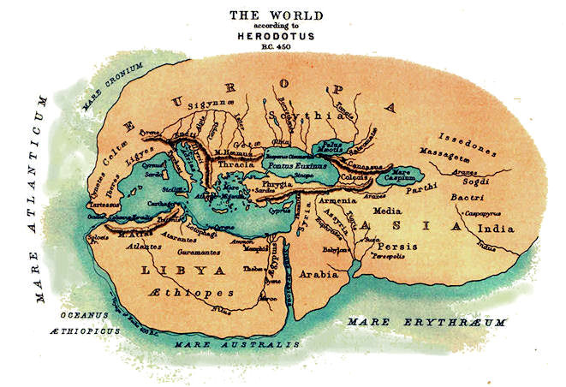
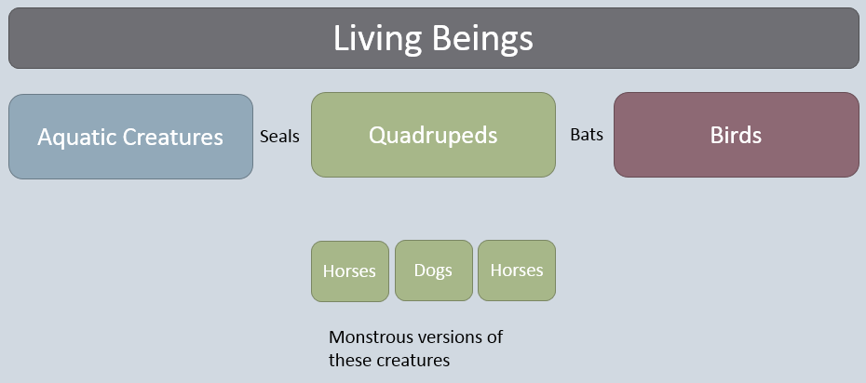
Structures
Seen various ways in which monsters contribute to some sort of structure
  Biology – species and larger groups
  Geography – in geographic/ethnographic texts and mythological narratives
  Chronology – mythological past
Monsters sit between categories
  Allows them to highlight where the boundaries are

Slide 13
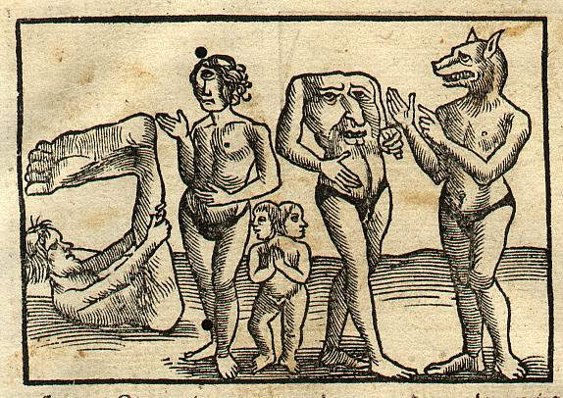
Defining Us
In being marked out as strange, monsters help to characterise what is normal
  Contrasting of ‘us’ vs ‘them’, othering
Contrasts:
  Physical
  Behavioural
  Social
Exploration of difference in a place separated from the author and audience

Slide 14
Monsters, Ghosts and Revenants
Week 1 – Essays and exams

Slide 15
Essays
Four very broad questions
  To allow you to use the source material that interests you
  Pick specific examples/focus to keep the topic manageable

Slide 16
Scholarship
Monstrosity in antiquity has not received much scholarly attention
Sources:
  Bibliography on moodle
  Weekly readings
  Books/articles etc. about the texts/artwork you are using
  Books/articles etc. about the author/artist you are using
  Books/articles etc. about the genre
  Search Jstor for the relevant passage
  Google scholar → title → our online library
  Interlibrary loans
  Other libraries (Sconul)

Slide 17
Exam
Take home exam
  9am – 3pm
Four questions
  connected to the themes of the weeks
Avoid self-plagiarism
  Pick a different topic to your essay topic

Slide 18
Preparation
Pick certain weeks you are happier writing about and prep those
4 questions / 8 weeks of primary content
Have lists of:
  Primary sources
    With links to relevant websites/bookmarks in primary texts
    Bookmark images from good websites (e.g. Met Museum, Boston MFA, BM)
  Scholarship
    Pick from the bibliography
    Find some online sources/journal articles/chapters
      Read them through in advance – keep good notes
Referencing software

Slide 19
On the day
Have everything you need set up in advance
  Check your laptop and charger are working
Plan your work
  Take the time to write a detailed plan
Keep the topic narrow
  Manageable
  Specific examples
  More depth of analysis

Slide 20
Your tips?

Slide 21
Questions?

