Slide 1
INTRODUCTION TO PUBLIC HEALTH
Assignment 1 Event Discussion Group 3
LCHS4008
Module Leader: Caroline Salami

Slide 2
STUDENT Name | STUDENT ID
Soumeya REKABI | 2513643
Cindy AGYEMAN BERKO | 2517419
Nesrin SAMI SHEN | 2512896
Jenelyn BACERO | 2514341

Slide 3
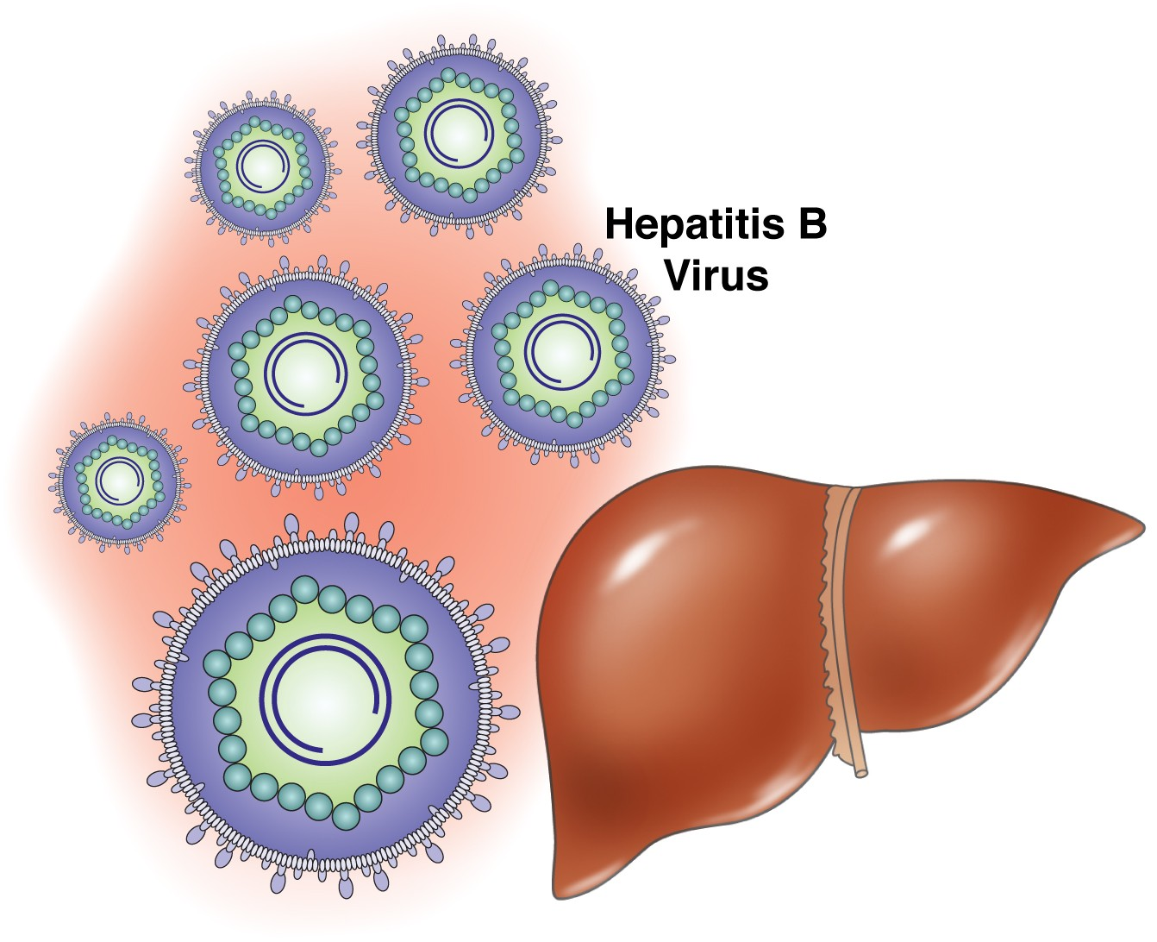

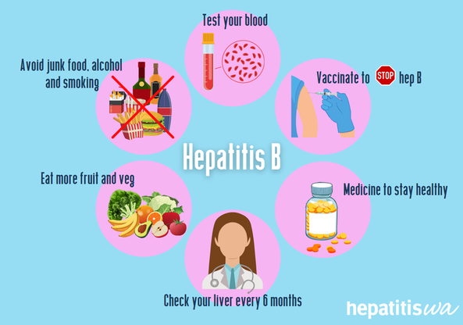

Hepatitis B in the Community
Measuring, Monitoring and Controlling the Disease
Module: Introduction to Public Health
Case Study: Hepatitis B outbreak in a community
Notes:
This is a presentation regarding Hepatitis B in society. We shall describe the concept of hepatitis B and why it is a matter of concern in terms of public health. We shall examine the measurement, monitoring and control of the disease in the UK. We shall also cover the UK policy, the implications on health and wellbeing and what education should be given to parents. This is after the case study and discussion questions in the brief.

Slide 4
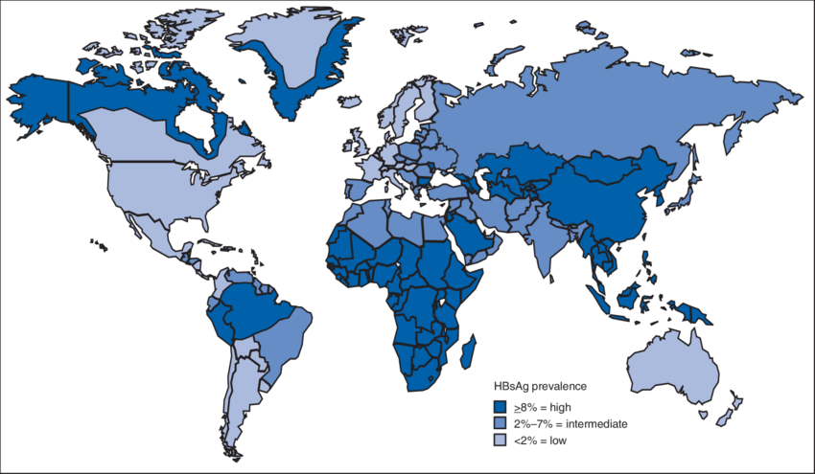
Introduction
Key aims:
Explain how hepatitis B incidence is measured, monitored and controlled
Discuss UK public health strategies
Identify factors affecting health and well-being
Provide health education for parents
Hepatitis B is a preventable viral infection, but controlling it requires accurate surveillance, vaccination programmes and early treatment (WHO, 2025).
Notes:
This is a presentation regarding Hepatitis B in society. We shall describe the concept of hepatitis B and why it is a matter of concern in terms of public health. We shall examine the measurement, monitoring and control of the disease in the UK. We shall also cover the UK policy, the implications on health and wellbeing and what education should be given to parents. This is after the case study and discussion questions in the brief.

Slide 5
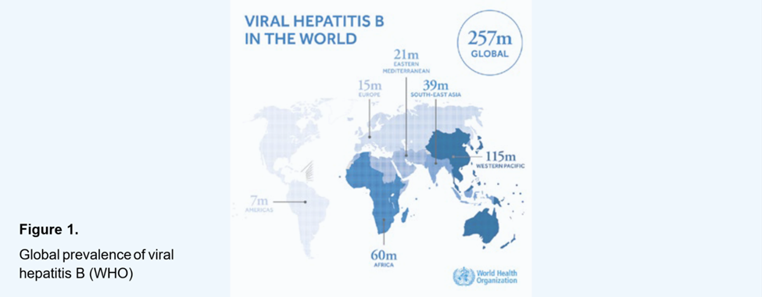
Global Overview of Hepatitis B
Hepatitis B is a liver infection caused by the hepatitis B virus (HBV). It can be acute or chronic and spreads through infected blood and body fluids, including from mother to baby at birth (World Health Organization, 2025).
Transmission occurs through:
Sexual contact
Contaminated needles
blood exposure
mother-to-child transmission during birth
Globally, hepatitis B remains a major public health problem.
254 million people live with chronic hepatitis B worldwide (WHO, 2025)
1.2 million new infections occur every year (WHO, 2025)
Figure 1. Global prevalence of hepatitis B. Source: WHO (2025).
The disease can lead to severe complications such as cirrhosis, liver cancer and liver failure.
Notes:
Hepatitis B is a liver virus. It is transmitted via infected fluids and blood. It is transmitted by means of sexual contact, needles, exposure of blood and through the mother to the baby during birth. It remains a significant health issue in the world. According to the World Health Organisation, chronic hepatitis B is a condition experienced by approximately 254 million individuals, and approximately 1.2 million infections occur annually. Unless it is prevented or treated, it may result in cirrhosis, liver cancer and liver failure (World Health Organisation, 2025).

Slide 6
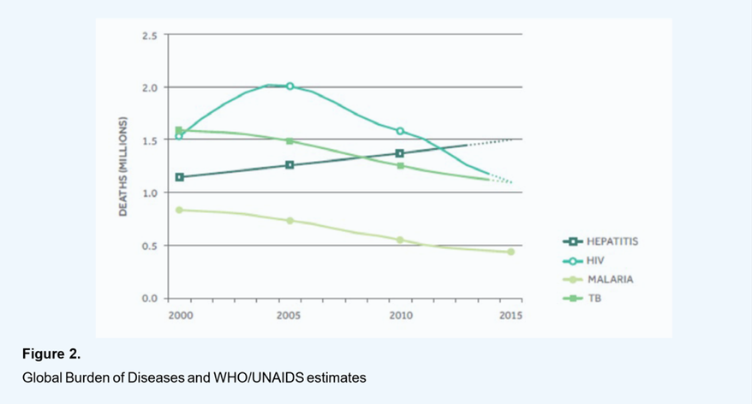
Global Disease Burden (DALYs)
Hepatitis B also creates a significant global disease burden.
DALYs (Disability Adjusted Life Years) measure:
years of life lost due to early death
years lived with disability or illness.
Research shows:
Chronic hepatitis B cirrhosis caused 13.9 million DALYs worldwide (Sun and Guo, 2025).
Hepatitis B remains one of the major causes of liver cancer globally (Choi et al., 2023).
This shows hepatitis B is not only an infectious disease but also a long-term public health challenge that affects healthcare systems and quality of life.
Figure 2. Global burden of infectious diseases, including hepatitis.
Source: Choi et al. (2023).
Notes:
Hepatitis B also has a high disease burden in the world. This can be measured by the DALYs, which are Disability Adjusted Life Years. This demonstrates the number of years of healthy life that is lost due to illness, disability or premature death. Studies indicate that chronic cirrhosis of hepatitis B was the cause of approximately 13.9 million DALYs in the world. Hepatitis B is also among the major causes of liver cancer in the world. It demonstrates that hepatitis B is a long-term health and social issue, as well as an infection (Sun and Guo, 2025; Choi et al., 2023).

Slide 7
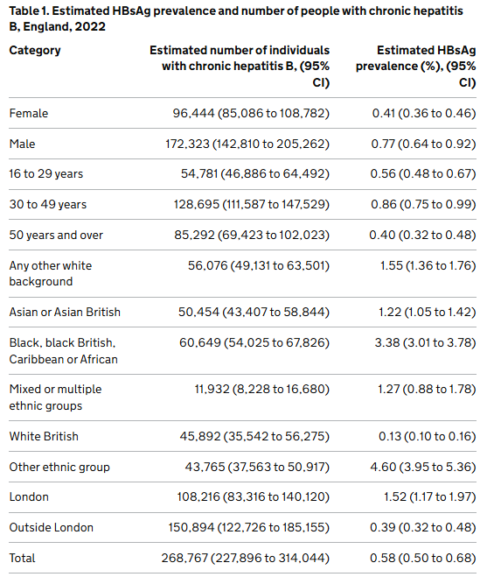
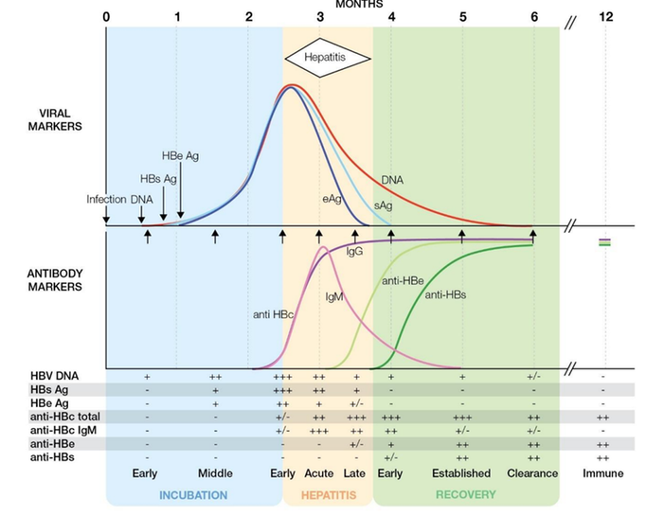
Hepatitis B in the UK
The UK is considered a low-prevalence country, but hepatitis B still affects many people.
According to UK Health Security Agency data:
268,767 people live with chronic hepatitis B in England
Estimated prevalence is 0.58% of the population (UKHSA, 2024)
However, many infections remain undiagnosed.
·Only 31–46% of infected individuals are diagnosed (UKHSA, 2024)
This means many people may carry the infection without knowing, increasing the risk of transmission.
Figure 4. Hepatitis B viral and antibody markers during infection
(UK Government, 2014).
For brief comparison, Canada reported 114 acute cases in 2021, with a rate of 0.30 per 100,000, showing a similarly low-incidence but unequal pattern (Public Health Agency of Canada, 2021).
Figure 3. Estimated prevalence of chronic hepatitis B in England (UKHSA, 2024).
Hepatitis B also creates an economic burden because late diagnosis increases the cost of treatment, hospital care and long-term liver disease management (UKHSA, 2024).
Notes:
Hepatitis B is not very common in the UK as compared to other regions in the world, but it affects a significant number of individuals. The number of individuals living with chronic hepatitis B was estimated at 268,767 in England. The prevalence was estimated to be 0.58 per cent. Nevertheless, a great number of individuals remain undiagnosed. It implies that they can be carriers of the virus without any knowledge, and this can augment the chances of spreading the virus in society. Hepatitis B is also an economic burden since when the condition is diagnosed late, the cost of treatment may be high, including hospital stay, and the management of the long-term liver disease. To make a short comparison, the incidence rates are also low in Canada in general, although, similar to the UK, the impact on some populations and communities is more significant (UK Health Security Agency, 2024; Public Health Agency of Canada, 2021).

Slide 8
Measuring Incidence of Hepatitis B
Incidence refers to the number of new cases of a disease occurring within a specific time period.
In the UK, hepatitis B incidence is measured through several strategies:
These systems allow researchers and public health officials to measure disease trends and identify outbreaks (UK Government, 2014).
1. Laboratory confirmation
HBsAg
Anti-HBc IgM
2. National surveillance systems
Managed by the UK Health Security Agency (UKHSA)
3. Mandatory reporting
Healthcare professionals must report confirmed infections to public health authorities.
Notes:
The measurement of an outbreak is one of the primary questions in the case study. Incidence refers to the cases of a disease that are new in a given time. The incidence of hepatitis B in the UK is assessed in a number of ways. To detect new infections, laboratory confirmation is involved first. Second, the surveillance systems at the national level gather information throughout the nation. Third, medical workers are to submit confirmed cases to the health agencies. Such techniques aid in the awareness of the public health teams on the number of new cases being reported and the spread of the disease (UK Government, 2014).

Slide 9
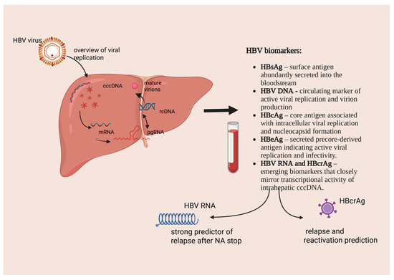
Laboratory Diagnosis of Acute Infection
Laboratory testing is essential to monitor new infections.
Important viral markers include:
HBsAg – indicates active infection
Anti-HBc IgM – indicates recent infection
HBV DNA – shows viral replication.
These markers help differentiate between:
acute infection
chronic infection
recovery or immunity.
Figure 5: HBV biomarkers source: (Bozomitu et al., 2026)
Notes:
Incidence is very significant when measured through laboratory testing. The markers of hepatitis B are checked by blood tests. The HBsAg indicates that the virus is present in the body. Anti-HBc IgM implies that the infection is new or acute. HBV DNA may also be determined in order to demonstrate viral replication. The tests assist the doctors and other health teams in determining whether the infection is new, chronic or already clearing. This is significant as precise diagnosis results in precise health statistics of the populace (UK Government, 2014).

Slide 10


Community Data Collection
Monitoring hepatitis B requires strong public health data systems.
A study analysing 419 GP practices across England found higher
Primary care data are important because they identify cases that are not always recorded in hospitals (Geretti et al., 2023).
In England, these include:
enhanced national surveillance systems
laboratory reporting networks
general practice and hospital data.
infection rates in:
London
deprived areas
minority ethnic communities.
Notes:
Another significant component of measuring hepatitis B is good community data. This is accomplished in England by the use of national surveillance systems, lab reports, GP records and hospital records. A study based on general practise data in England established that hepatitis B was more prevalent in London, in deprived regions and among minority ethnic groups. This indicates the importance of community data. By just considering the hospitals, we may fail to capture all the cases. Effective data collection can assist the staff in the public health sector in knowing which population group is the most vulnerable and where additional resources are required (Geretti et al., 2023).

Slide 11
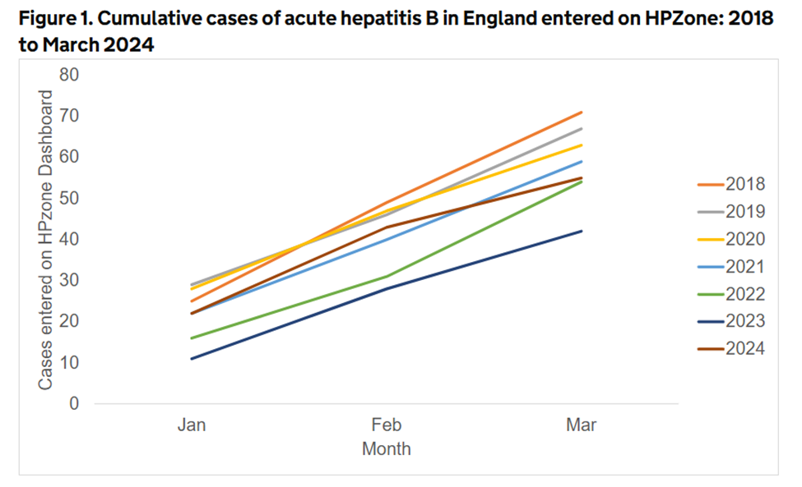
Monitoring Disease Trends
Monitoring helps public health authorities understand how disease patterns change over time.
Data sources include:
UKHSA surveillance reports
laboratory testing data
hospital records
general practice records.
Monitoring allows health authorities to:
detect outbreaks early
identify high-risk populations
evaluate prevention programmes.
Figure 6. Acute hepatitis B cases in England, 2018–2024. Source: UKHSA (2026).
Notes:
The second question of the brief is the monitoring of an outbreak. Monitoring refers to the observation of changes in disease patterns over time. In England, UKHSA surveillance reports, laboratory testing, hospital data and GP data are used as the means of monitoring hepatitis B. This allows the monitoring to assist the public health teams to know whether there is an increase or decrease, or if there is no change in the cases. It can also assist in early detection of epidemics, identification of the risk groups and monitoring of whether prevention efforts are being effective. Thus, measurement will inform us on the number of new cases, and monitoring will enable us to track the trend over time (UK Health Security Agency, 2026).

Slide 12
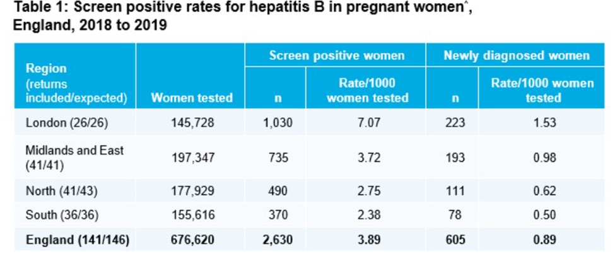
Screening and Monitoring Programmes
Prevention programmes play an important role in controlling hepatitis B.
In England:
99.8% of pregnant women are screened for hepatitis B
Babies born to infected mothers receive rapid vaccination (UKHSA, 2024).
These programmes prevent mother-to-child transmission, one of the major global transmission routes.
Figure 7. Hepatitis B screening among pregnant women in England. Source: UKHSA (2024).
Notes:
Other things that fall under monitoring are the check-up on the working of prevention programmes. Hepatitis B screening of pregnant women is done routinely in England, where it has been estimated that 99.8 per cent of pregnant women are screened. In case a mother has hepatitis B, an early birth dose and follow-up vaccine are administered to the baby to minimise the chances of infection. This is highly crucial since among the primary modes of hepatitis B transmission throughout the world is mother-to-child transmission. This demonstrates that the screening is not only a monitoring tool but also a method of protecting the health of the population (UK Health Security Agency, 2024).

Slide 13
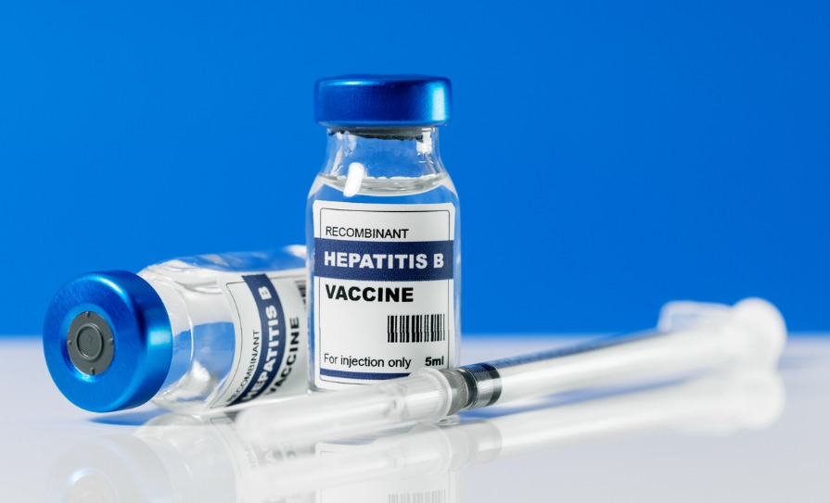
Vaccination Strategy
Vaccination is the most effective prevention strategy.
The UK introduced the 6-in-1 childhood vaccine in 2017.
This vaccine protects against:
hepatitis B
diphtheria
tetanus
pertussis
polio
Haemophilus influenzae type b.
Vaccination programmes reduce new infections and protect vulnerable populations (GOV.UK, 2024).
Notes:
The second case study question is how the disease is to be controlled. Vaccination is the best control measure of hepatitis B. In the UK, infants were introduced to the 6-in-1 vaccine in 2017. This immunises children against hepatitis B and other severe infections. Vaccination prevents new infections prior to their occurrence. It safeguards the individual, families and the community. High rates of vaccine uptake are essential to the system of public health, which can help prevent the spread of diseases and minimise complications in the long term (UK Government, 2024).

Slide 14

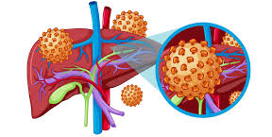
Contact Tracing and Prevention
Public health authorities also control outbreaks through:
contact tracing
post-exposure vaccination
public health education.
Close contacts of infected individuals should:
receive vaccination
undergo screening tests.
High-risk groups include:
injecting drug users
sexual partners
household contacts.
These strategies help prevent further transmission (Green Book, 2026).
Notes:
Contact tracing is another significant control measure. In case a person has been diagnosed with hepatitis B, close contacts must be found, tested and vaccinated where necessary. This can be sexual partners, domestic contacts and drug-injecting people. Prevention advice is also offered in the form of advice by the public health teams, which includes not sharing needles or personal items that might contain blood. Such measures contribute to preventing further spreading of the virus. It is one of the main aspects of outbreak management within the community (UK Government, 2026).

Slide 15



UK Public Health Policy
The UK government uses several policies to control hepatitis B:
national vaccination programmes
antenatal screening programmes
enhanced disease surveillance
NICE clinical treatment guidelines.
These strategies have significantly reduced mother-to-child transmission and improved early diagnosis.
However, challenges remain because many infections are still undiagnosed (UKHSA, 2024).
NHS England identified £20 million over 3 years for emergency department opt-out blood-borne virus testing, including hepatitis B, hepatitis C and HIV.
By February 2025, over 7 million tests had been carried out through the NHS blood-borne virus opt-out testing programme, which included hepatitis B (NHS England, 2025).
Notes:
The case study also poses the question of the availability of policy and strategies to the UK government. Hepatitis B in the UK is managed using a number of policies in the field of public health. These are the national childhood immunisation programme, antenatal screening, surveillance and the NICE guideline to diagnose and manage. These measures have assisted in the minimisation of mother-to-child transmission and detection at an early stage. NHS England has also promoted blood-borne virus opt-out testing in the emergency department, such as hepatitis B, to enhance the detection of cases and their early diagnosis. Nevertheless, there are a lot of individuals without a diagnosis, and thus, additional efforts are required (UK Health Security Agency, 2024; NHS England, 2025).

Slide 16
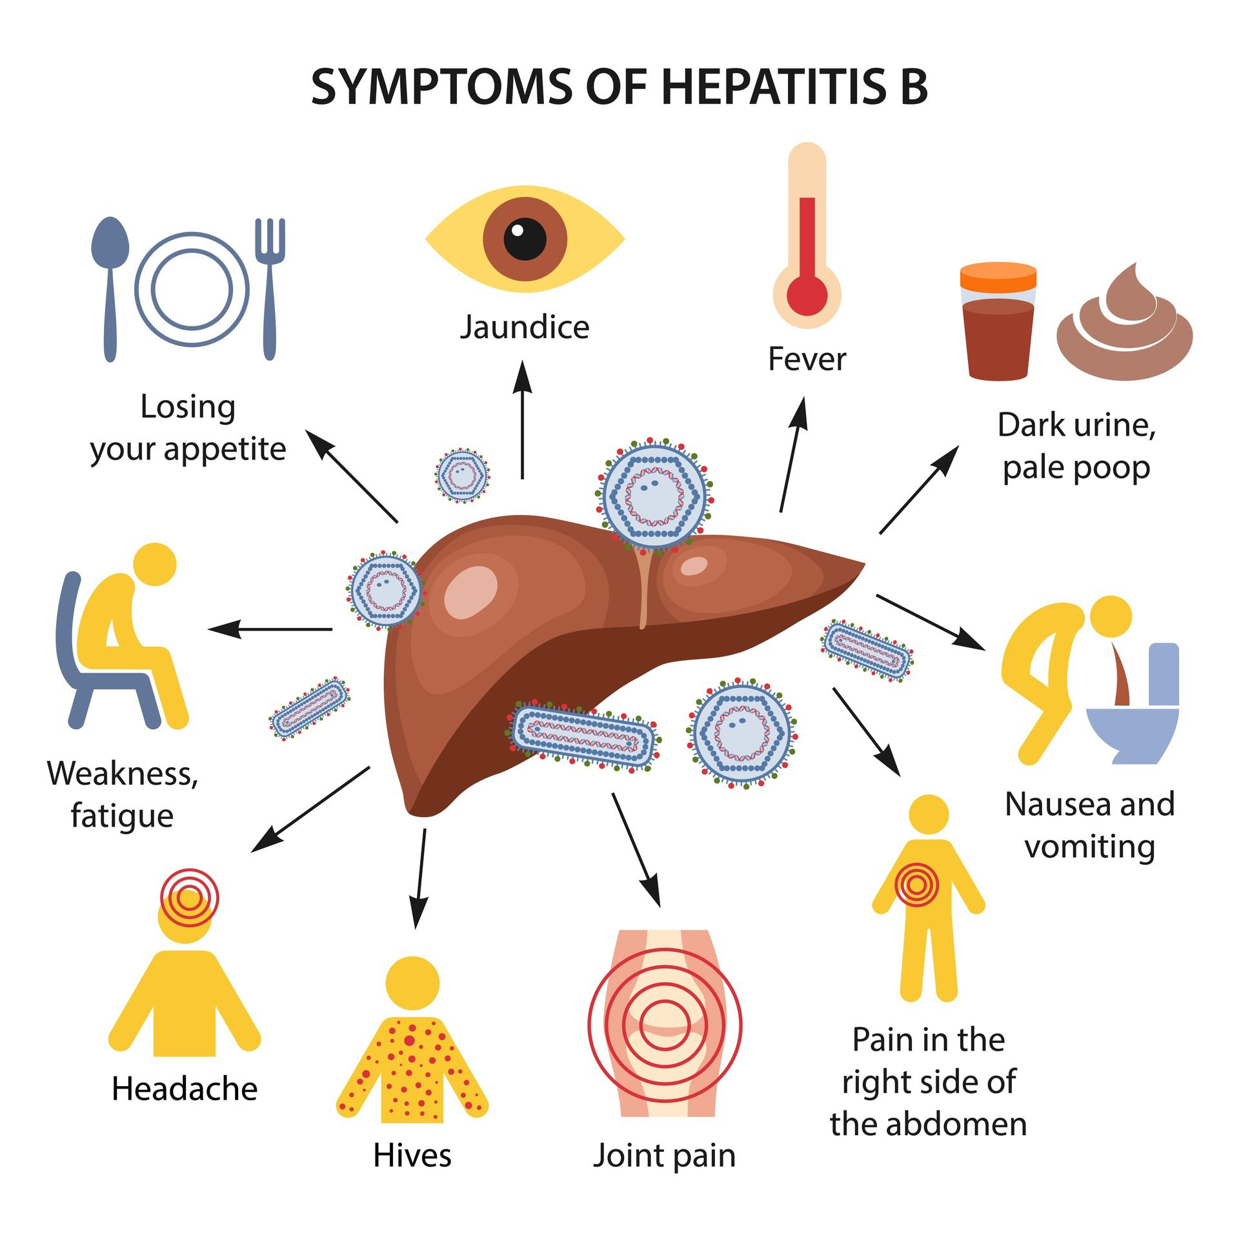
Factors Affecting Health and Wellbeing
Physical effects:
Fatigue
Jaundice
abdominal pain
liver damage.
Social effects include:
Stigma
Anxiety
reduced quality of life.
Health outcomes are also influenced by:
Poverty
Migration
healthcare access
cultural barriers.
Notes:
Another question that the brief poses to us is to discuss factors that influence health and well-being. Hepatitis B may have physical, emotional and social effects on individuals. Physical consequences may be drowsiness, jaundice, stomachache and liver damage. The social and emotional impacts might be anxiety, stress and stigma. Individuals might fear the response of other people or the possibility of falling seriously ill. Poverty, migration, culture and access to healthcare also influence health outcomes. Such broader societal influences may influence whether an individual will be tested, treated or educated about the disease correctly (Geretti et al., 2023).

Slide 17

Health Education for Parents & Conclusion
Parents play an important role in preventing hepatitis B infection.
Key health education messages include:
  ensure children receive all recommended vaccine doses
  avoid sharing personal items such as toothbrushes or razors
  practice good hygiene and safe healthcare practices
  seek medical advice if symptoms occur.
  Public health education helps reduce stigma and encourages early diagnosis.
Notes:
The last case study question is what health education should be administered to parents. It should be explained to parents that hepatitis B can be avoided. All doses of vaccines should be given to children at the right time. Toiletries such as toothbrushes, razors, etc., should not be shared between family members since they can contain blood. In case of symptoms, parents are supposed to consult the doctor and assist in testing, in case of necessity. Education is also significant to minimise the stigma and make the family aware of the spread of hepatitis B and the ways it can be managed. To sum it up, hepatitis B can be controlled by proper measurement, consistent monitoring, effective vaccination programmes, excellent public health policy and clear health education to families.

Slide 18
References
Bozomitu, L.I., Lupu, A., Lupu, V.V., Gimiga, N., Anton Paduraru, D.T., Mîndru, D.E., Mihai, M., Anton, C., Anton, E., Mitrea, M., Adam-Raileanu, A. and Forna, L. (2026). Accuracy of Diagnostic Investigations in Monitoring Hepatitis B Virus Infection: Strengths, Limitations, and Emerging Biomarkers. International Journal of Molecular Sciences, [online] 27(5), p.2464. doi:https://doi.org/10.3390/ijms27052464.
Choi, S., Kim, B.K., Yon, D.K., Lee, S.W., Lee, H.G., Chang, H.H., Park, S., Koyanagi, A., Jacob, L., Dragioti, E., Radua, J., Shin, J.I., Kim, S.U. and Smith, L. (2023) ‘Global burden of primary liver cancer and its association with underlying aetiologies, sociodemographic status and sex differences from 1990–2019: A DALY-based analysis of the Global Burden of Disease study’, Clinical and Molecular Hepatology, 29(2), pp. 433–452. Available at: https://doi.org/10.3350/cmh.2022.0316 (Accessed: 6 March 2026).
Geretti, A.M., Austin, H., Villa, G., Smith, C., Sabin, C., Tsang, R., Sherlock, J., Ferreira, F., Byford, R., Meza-Torres, B., Whyte, M. and de Lusignan, S. (2023) ‘Hepatitis B virus infection in general practice across England: An analysis of the Royal College of General Practitioners Research and Surveillance Centre real-world database’, Journal of Infection, 86(5), pp. 476–485. Available at: https://doi.org/10.1016/j.jinf.2023.03.001 (Accessed: 6 March 2026).
National Institute for Health and Care Excellence (NICE) (2012) Hepatitis B and C testing: People at risk of infection (PH43). Available at: https://www.nice.org.uk/guidance/ph43 (Accessed: 6 March 2026).
National Institute for Health and Care Excellence (NICE) (2013) Hepatitis B (chronic): Diagnosis and management (CG165). Available at: https://www.nice.org.uk/guidance/cg165 (Accessed: 6 March 2026).
Public Health Agency of Canada (2021) Hepatitis B in Canada: 2021 surveillance data update. Available at: https://www.canada.ca/en/public-health/services/publications/diseases-conditions/hepatitis-b-canada-2021-surveillance-data-update.html (Accessed: 6 March 2026).
Public Health Agency of Canada (2025) Estimated prevalence of hepatitis B and C among immigrants in Canada. Available at: https://www.canada.ca/en/public-health/services/reports-publications/canada-communicable-disease-report-ccdr/monthly-issue/2025-51/issue-6-7-june-july-2025/estimated-prevalence-hepatitis-b-c-immigrants-canada.html (Accessed: 6 March 2026).
Sun, J. and Guo, J. (2025) ‘Global, regional and national burden of chronic hepatitis B-related cirrhosis from 1990 to 2021 and projections to 2050’, Clinical and Translational Gastroenterology, 16(10), p. e00890. Available at: https://doi.org/10.14309/ctg.0000000000000890 (Accessed: 6 March 2026).
UK Government (2014) Hepatitis B: Clinical and public health management. Available at: https://www.gov.uk/guidance/hepatitis-b-clinical-and-public-health-management (Accessed: 6 March 2026).
UK Government (2024) Hexavalent DTaP/IPV/Hib/HepB combination vaccine: Information for healthcare practitioners. Available at: https://www.gov.uk/government/publications/hexavalent-combination-vaccine-programme-guidance/hexavalent-dtapipvhibhepb-combination-vaccine-information-for-healthcare-practitioners (Accessed: 6 March 2026).
UK Government (2026) Immunisation against infectious disease: Hepatitis B (The Green Book). Available at: https://www.gov.uk/government/publications/hepatitis-b-the-green-book-chapter-18 (Accessed: 6 March 2026).
UK Health Security Agency (2024) Hepatitis B in England 2024. Available at: https://www.gov.uk/government/publications/hepatitis-b-in-england/hepatitis-b-in-england-2024 (Accessed: 6 March 2026).
UK Health Security Agency (2026) Acute hepatitis B: National enhanced surveillance report January to March 2024. Available at: https://www.gov.uk/government/publications/acute-hepatitis-b-england-enhanced-surveillance-reports/acute-hepatitis-b-national-enhanced-surveillance-report-january-to-march-2024 (Accessed: 6 March 2026).
World Health Organization (2025) Hepatitis B. Available at: https://www.who.int/news-room/fact-sheets/detail/hepatitis-b (Accessed: 6 March 2026).

