Slide 1
Youth In Action Today
Gethin Cardy
2105599

Slide 2
Contexts
The Whole Leaflet.
Leaflet Broken Down.
Perspective From The Youth Worker.
The Bigger Picture.
Conclusion.

Slide 3
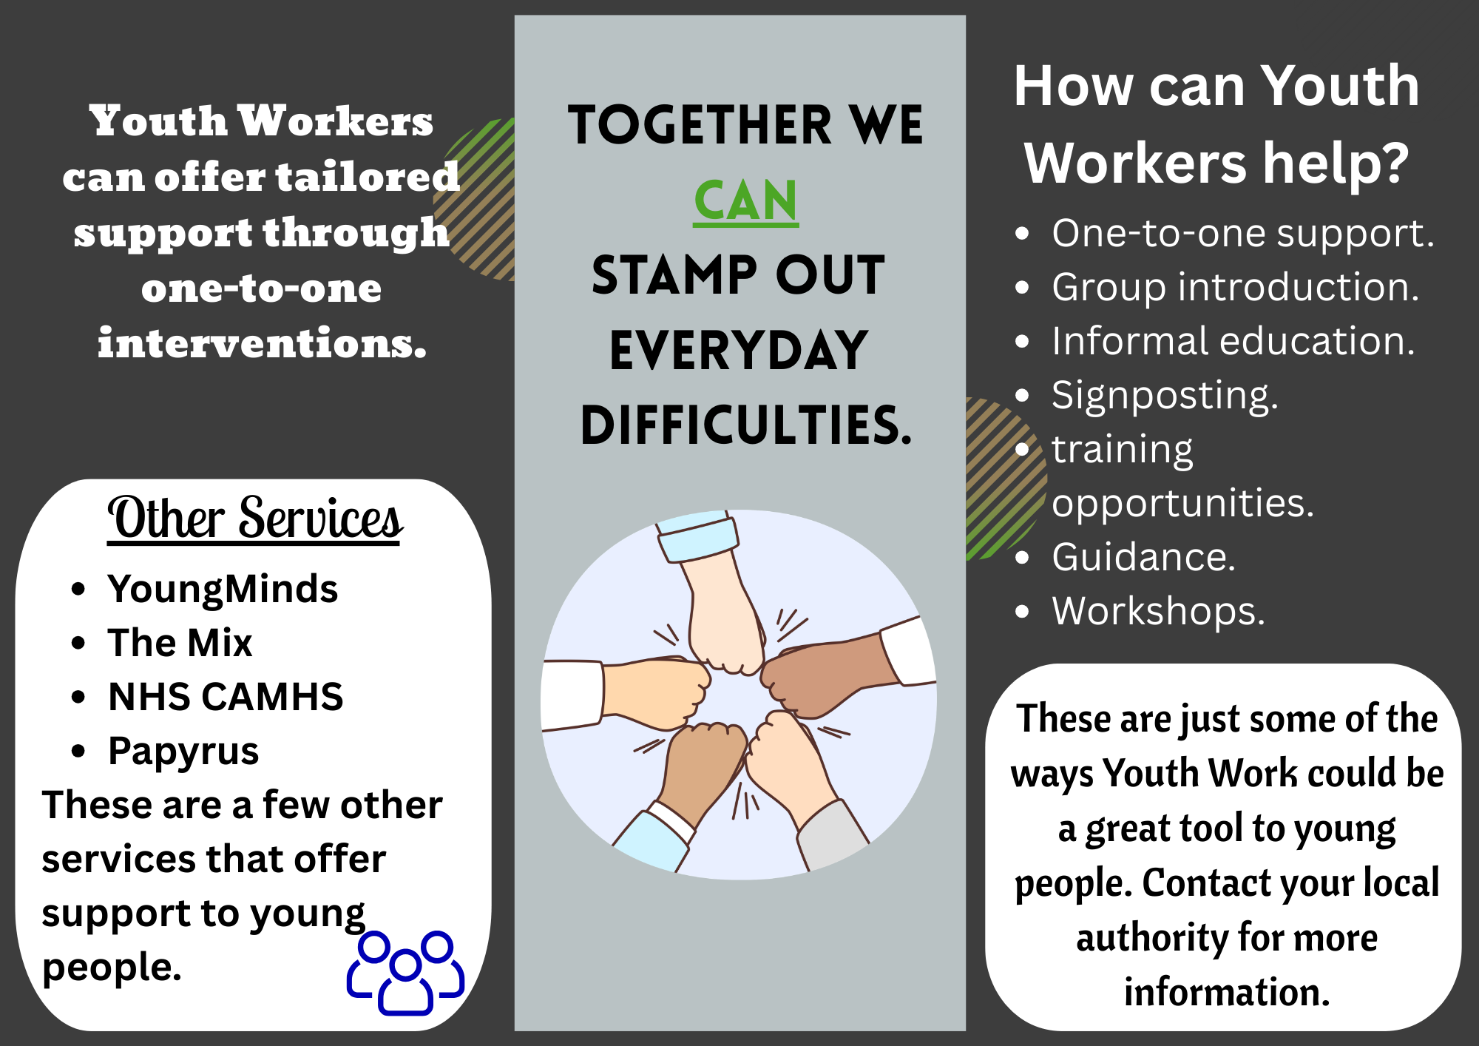
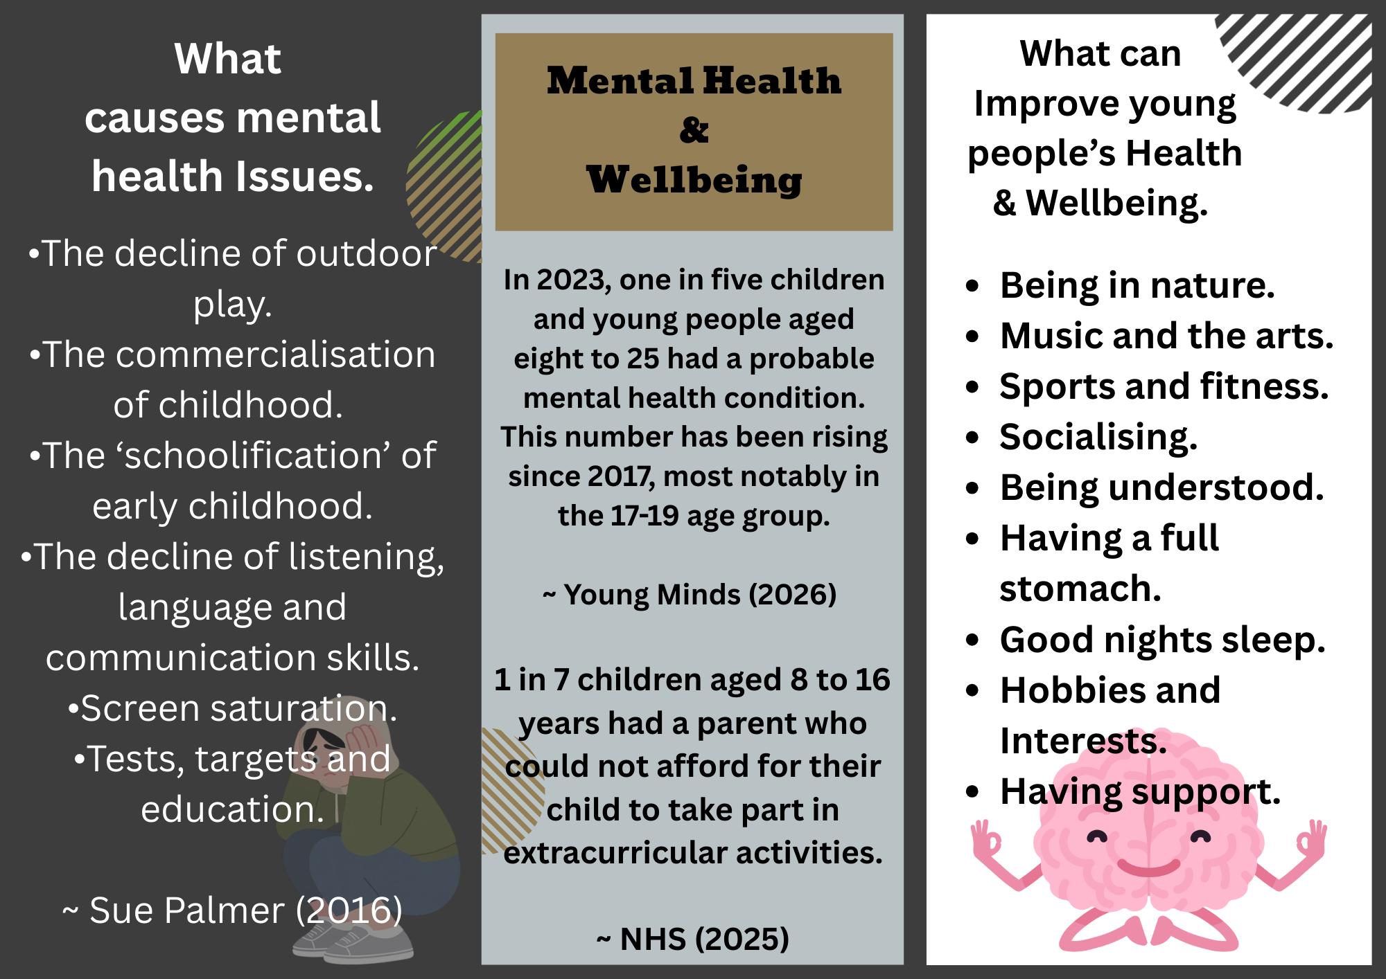
The Leaflet

Slide 4
Leaflet In More Contexts

Slide 5
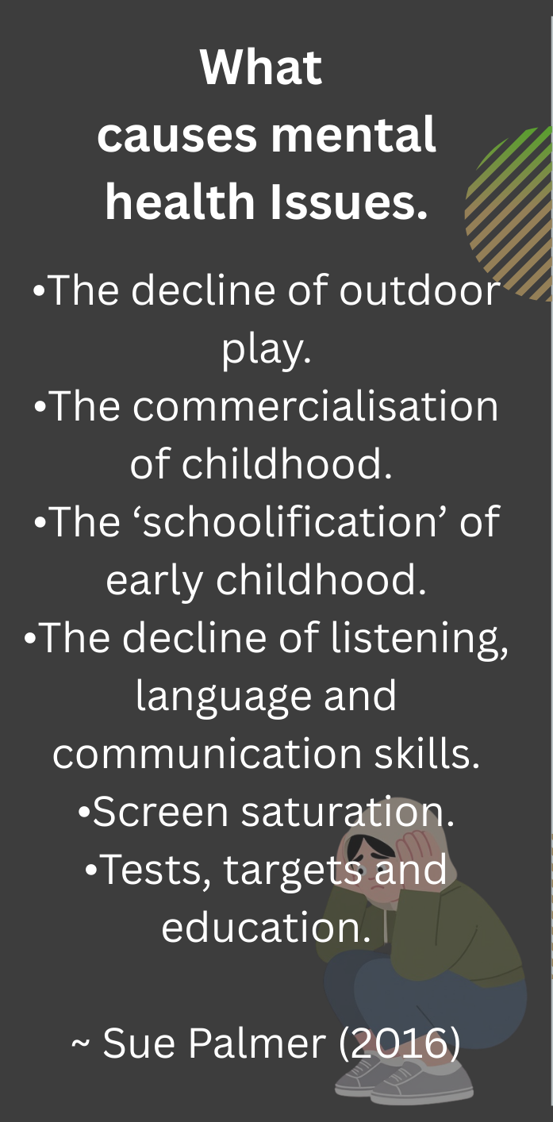
Toxic Childhood
Palmer (2007) states: these are the six social changes.
These changes can have a profound impact on young people’s mental health and well-being.

Slide 6
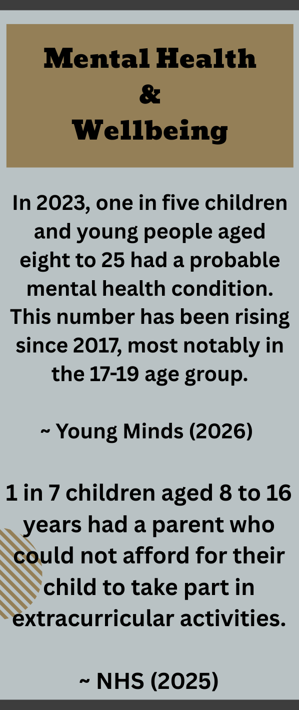
The Point
Statistics on young people’s mental health and the affordability of extracurricular activities.
Stated by NHS (2023) and Young Minds (2026)

Slide 7
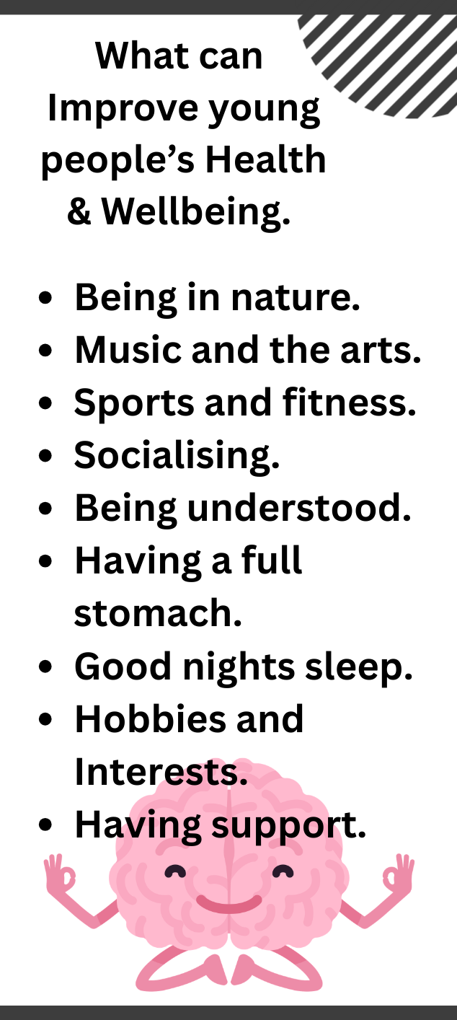
How To Improve
These are just some of the many ways young people can improve their mental health.
As we know food and rest are two of the basic needs mentioned in Maslow’s Hierarchy of Needs theory (1943, cited in McLeod, 2026).
Mind (2021) states that spending time in green space or bringing nature into your everyday life can benefit both your mental and physical wellbeing.

Slide 8
Leaflet In More Contexts

Slide 9
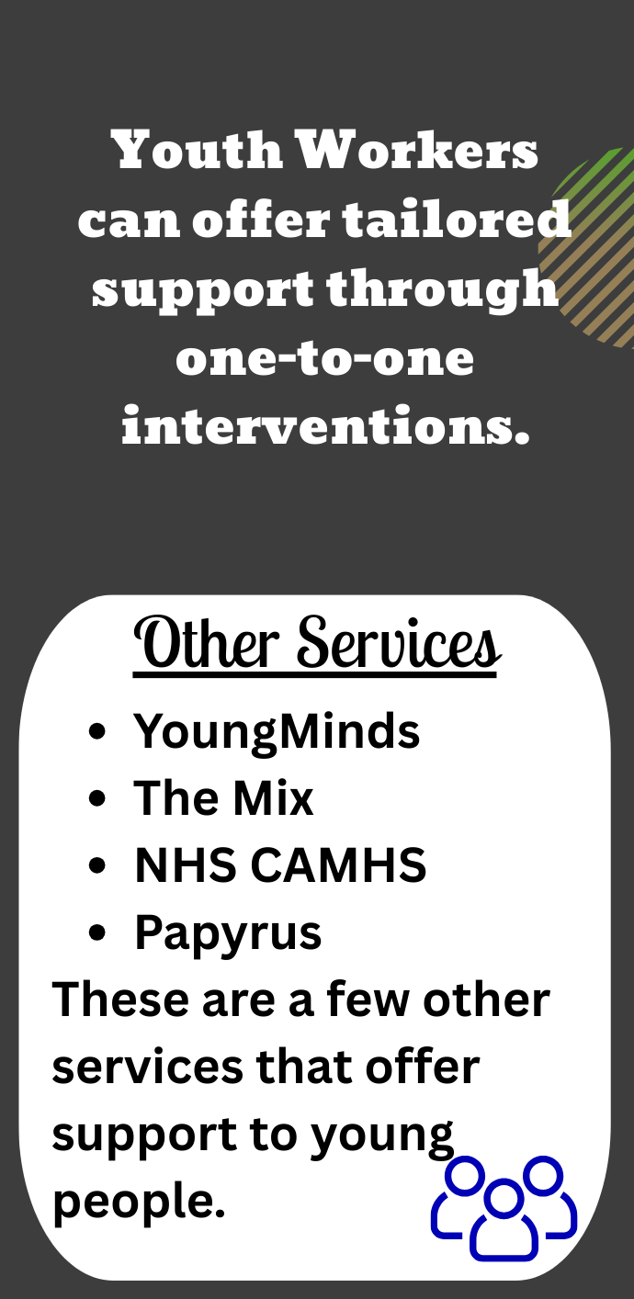
Other Services
These are just a few other services where young people can access support and guidance from other trained professionals.
“Remember that when your child is struggling, it doesn’t mean you’ve ‘failed’. You’re showing how much you love and support them by being there to listen.” (Young Minds,2026)
“We are very keen to get the message out to parents and caregivers that you are not alone. We are here for you.” (Papyrus, 2026)

Slide 10

Make Our Mark
Working in partnership with other services and professions would be a greater benefit to young people.
“Multi-sector interactions increase practitioners’ access to different support mechanisms and activities, thereby broadening the offer available for young people. This helps practitioners make more appropriate referrals and increases the likelihood that a young person will be supported by the right services and by the right professionals with the right skills and knowledge.”
(GOV.UK, 2025)

Slide 11
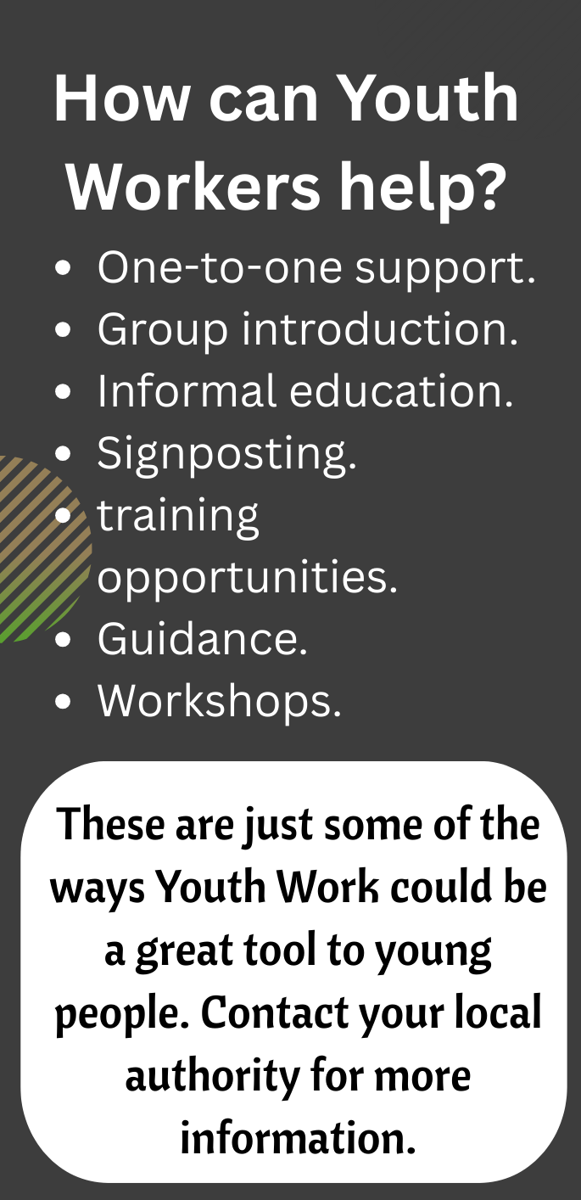
What Can We Do
Stated in The National Youth Work Strategy For Wales (Welsh Government, 2025) document, “Strategically we recognise the importance and value of good-quality open access youth work provision and the role this can play in engaging and supporting young people.”
As seen in the leaflet, the ways in which youth workers can help can be found in the Youth Work in Wales: Principles and Purpose document (Youth Work in Wales Review Group, 2022).

Slide 12
Maslow’s Hierarchy of Needs (1943), Bronfenbrenner’s Ecological System (1979) and The Five Ways to Wellbeing (2008). This gives us the knowledge to educate parents on the needs of young people.
Perspective From The
Youth Worker
The leaflet can be used in the Youth Work setting to help support and signpost Parents. It can also be used to inform others of what Youth Workers do as a profession.

Slide 13
The Bigger Picture
Young People face challenging times in today society, so we as Youth Workers must be equipped with the knowledge and tools to help support them in challenging times.
“The Code of Ethics is our commitment as youth workers to young people. It’s about making sure we always act in the best interests of the young people we support, keeping them safe and treating them with respect.”
(National Youth Agency, 2025)

Slide 14
Conclusion
In conclusion, there are many ways in which Youth Workers can help both Young People and Parents when navigating society. The evidence and information we know can be vital and it is our duty to give the best standard of support.

Slide 15
Reference List
GOV.UK (2025) Interactions with Other Sectors: Better understanding multi=agency working to support young people. Available at: Youth Worker Interactions with Other Sectors: Better understanding multi-agency working to support young people - GOV.UK (Accessed: 5 March 2026).
Guy-Evans, O. (2025) Bronfenbrenner’s Ecological Systems Theory. Available at: Bronfenbrenner's Ecological Systems Theory (Accessed: 5 March 2026).
McLeod, S. (2026) Maslow’s Hierarchy of Needs. Available at: Maslow's Hierarchy of Needs (Accessed: 3 March 2026).
McLeod, S. (2026) Maslow’s Hierarchy of Needs. Available at: Maslow's Hierarchy of Needs (Accessed: 3 March 2026).
Mind (2021) Nature and mental health. Available at: How nature benefits mental health – Mind (Accessed: 2 March 2026).
Mind (2026) 5 Ways to Wellbeing. Available at: 5 Ways to Wellbeing | Mind (Accessed: 5 March 2026).
National Youth Agency (2025) The Youth Work Code of Ethics. Available at: Youth Work Code of Ethics - National Youth Agency (Accessed: 4 March 2026).

Slide 16
Reference List
NHS (2025) National Study of Health and Wellbeing: Children and Young People. Available at: National Study of Health and Wellbeing: Children and Young People - NHS England Digital (Accessed: 3 March 2026).
Palmer, S. (2007) Toxic childhood: How the modern world is damaging our children and what we can do about it. (New ed.). London: Orion.
Papyrus (2026) New Guide for Parents. Available at: PAPYRUS Launch New Guide For Parents | Papyrus (Accessed: 5 March 2026).
Welsh Government (2025) National Youth Strategy for Wales. Cardiff: Welsh Local Government Association.
Young Minds (2026) How to talk to your Child about Mental Health. Available at: How to Talk to Your Child about Mental Health | YoungMinds (Accessed: 3 March 2026).
Young Minds (2026) Mental Health Statistics. Available at: Mental Health Statistics UK | Young People | YoungMinds (Accessed: 3 March 2026).
Youth Work in Wales Review Group (2022) Youth Work in Wales: Principles and Purposes. Wales: CWVYS.

