Slide 1

Skills for Life Employability and Future Pathways
Melanie Rowland 1602402

Slide 2
Role: Pastoral Coordinator (Safeguarding, Attendance and Family Liaison)
Purpose:
To ensure the school has a robust safeguarding culture that we confidently convey to ensure staff, students, parent/carers, governors and other agencies involved with the school are assured that safeguarding is our priority and focus at all times and in all aspects of school life.
Task: Prepare and present an individual presentation (10 minutes) on how the skills and understanding developed through the module could be applied to a career opportunity your choice

Slide 3
Skills: Ability to work with a range of people, some of whom may have special educational needs, with the aim of ensuring the safety and welfare of children.
Effective communication
Problem solving
Respect
Adaptability
Effective listening
(West, 2012)

Slide 4
Skills: Effective communicator (to staff, parents/carers, governors and pupils).
Connecting
Turn taking
Mutual influencing
Cocreating outcomes
Egan, 2002 pp65

Slide 5
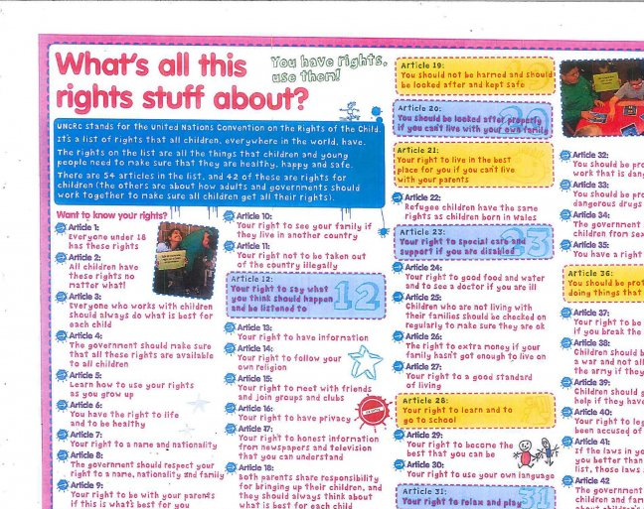
Skills: Excellent record keeping skills and attention to detail, in order to produce
reports, take minutes of meetings, and document safeguarding concerns.

Slide 6
Qualities: Emotional intelligence.
Self Awareness
Self management
Social Awareness
Relationship management
Serra 2016

Slide 7
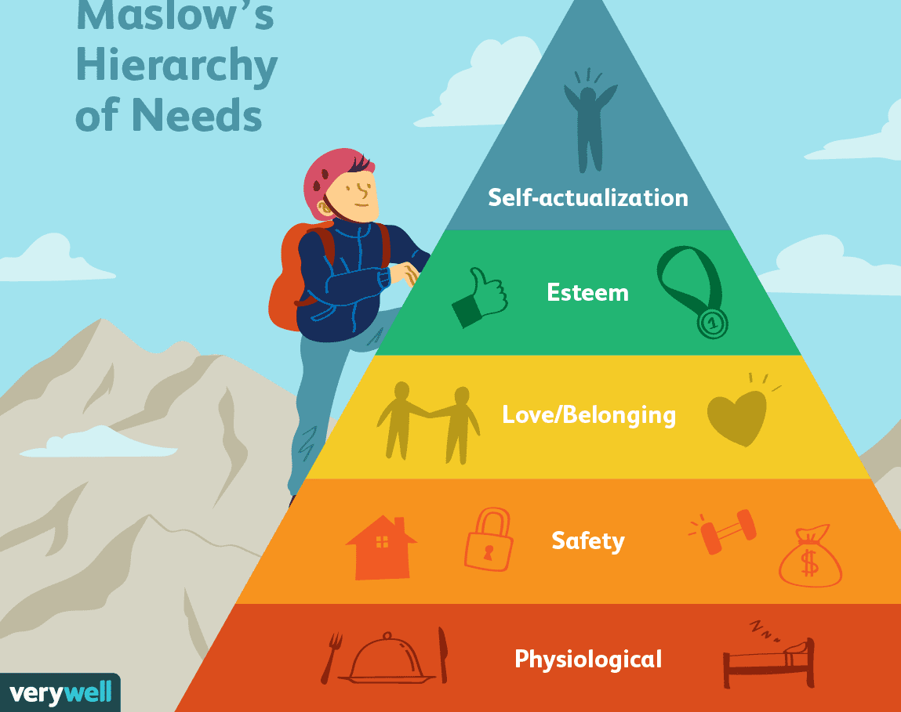
Qualities : A commitment to ensuring the health and wellbeing of all pupils and staff.
Feeling valued
Having a say
Positive feedback
Using skills
(Lupton 2019)
(Verywellmind 2019)

Slide 8

Any questions?

Slide 9
References
Cotrell, S., (2013) The Study Skills Handbook 4th edition China:Palgrave Macmillan
Egan, G. (2002) The Skilled Helper Ohio: Brookes Cole
Serra, M.C., (2016) The 4 Pillars of Emotional Intelligence [online] available at http://p4s.pt/en/the-4-pillars-of-emotional-intelligence-and-why-they-matter/ Accessed 03.05.2020
Thines talks (no date) UNCRC! What is it? Why is it so important? [online] available at https://www.thines-talks.co.uk/blog/uncrc-what-is-it-why-is-it-so-important Accessed 02.05.,2020
Osagie, G., (2017) The Importance of Record Keeping in Primary Schools. [online] available at http://thearenaweekly.myschoolarena.com/2017/11/03/the-importance-of-recordsrecord-keeeping-in-primary-schools/ Accessed 03.05.2020
West, M. A., (2012) Effective Teamwork India: BPS Blackwell
Verywellmind (2019) Maslow's hierarchy of needs [online] available at https://www.verywellmind.com/what-is-maslows-hierarchy-of-needs-4136760 Accessed 02.05.2020

