Slide 1

Cert HE Social Enterprise Management
Module: Distinctiveness & Regeneration
Module code: BMSP4016D
Student name: Catalina Andreea Pitica
Student ID number: 2517982

Slide 2
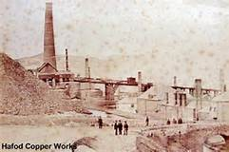
The Industrial Development of the Lower Swansea Valley
The Case of Swansea “Copperopolis
Notes:
Hello everyone my name is Catalina and today we are going to talk about The Industrial Development of the Lower Swansea Valley, The Case of Swansea “Copperopolis

Slide 3
Table of Contents
Slide 3: Introduction.
Slide 4: Why Swansea? Natural Advantages.
Slide 5: The Copper Smelting Industry Comes into Focus.
Slide 6: Industrial Processes and Technology.
Slide 7: Workforce and Migration.
Slide 8: Social and Living Conditions.
Slide 9: Environmental & Economic Impact.
Slide 10: Conclusion
Slide 11: References.
Notes:
This is what we are going to cover today

Slide 4
Introduction
This presentation will be about the Industrial Revolution which made Swansea, particularly the Lower Swansea Valley, the leading global copper smelting center.
I will cover various topics like the natural resources, the trade links, the key industrial families, the workforce, the social and environmental changes plus their impact on Wales and the economy at large.

Slide 5
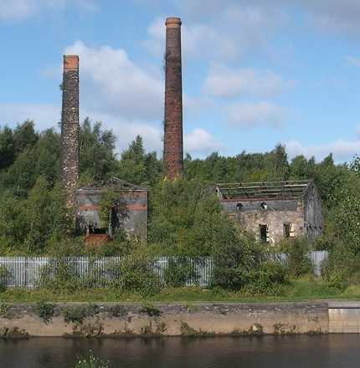
Why Swansea? Natural Advantages
Swansea was a perfect spot for the industry. It was next to the coalfields that were necessary for the high-temperature furnaces used in copper smelting Matthew’s House. (2025).
The port was also a good economic point allowing worldwide shipping of copper ores to be imported and finished metal goods to be exported (Swansea Museum, 2025).

Slide 6
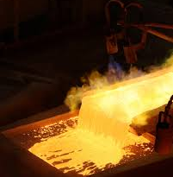
The Copper Smelting Industry Comes into Focus
Swansea started copper smelting and entered the market at the end of the 1700s, but it did not take long for other regions to follow suit as the industry was built upon the coal supply, and the valley was also the housing of many smelting works.
Before long, Swansea was the world’s leading producer of copper (Hughes and Reynolds, 1988).
The first copper works came into being in the late 18th century.
Lower Swansea Valley is the place where smelting and refining works developed faster than anywhere else.
The origin of Copperopolis is in Swansea.

Slide 7

Industrial Processes and Technology
Reverberatory furnaces for copper smelting
Coal used for smelting brought about a reduction in production costs as compared to charcoal.
The resources of big companies to produce goods were getting larger.
The technological side was very important. With the coming of the reverberatory furnace, it became possible to use coal instead of the more expensive and less productive charcoal. The coal supply of Swansea was a huge advantage for its competition (Hughes and Reynolds, 1988).

Slide 8
Workforce and Migration
The biggest smelting works required a huge number of workers.
People came from all over Wales and even Ireland.
The workplace was very hard and risky.
The copper industry was a large employer of people. Many of them came from the rural areas of Wales or Ireland searching for better living conditions (eclecs, 2017).
The work was very rough besides, it was done in long shifts and characterized by the inhalation of poisonous fumes.

Slide 9

Social and Living Conditions
Overcrowded housing was a result of fast urban growth.
Health problems and poor sanitation were the other consequences.
The working-class communities were the result of such social changes.
There was no way the housing industry could cope with the rapidly increasing population. Workers mainly lived in very congested areas close to the copper works (Newell and Watts, 1996). The main causes of the illnesses were pollution and bad sanitation. Meanwhile, very strong working-class communities and cultures were formed (Wales Online, 2013).

Slide 10
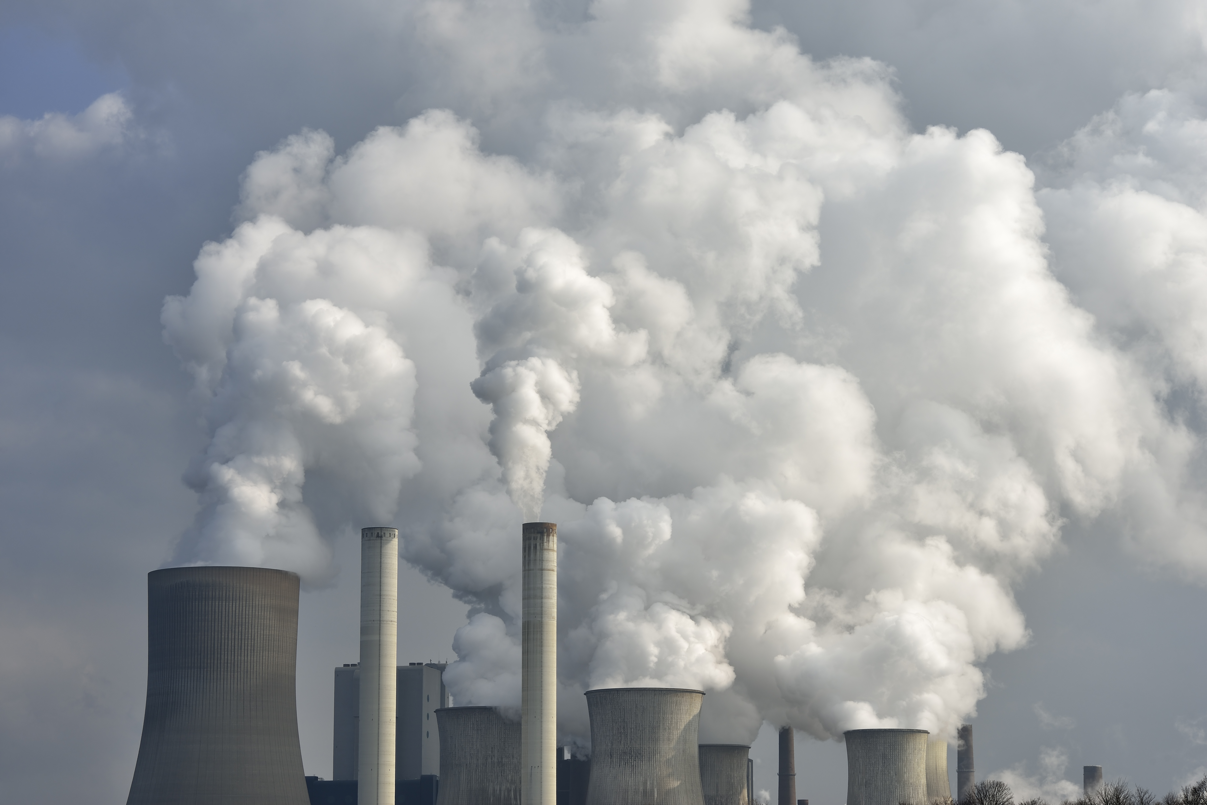
Environmental & Economic Impact
The whole geographical landscape of the Lower Swansea Valley was drastically changed by the industrial smelting process.
In addition to the pollution mentioned above, air, river, and soil pollution was produced by copper smoke and industrial waste (Hughes and Reynolds, 1988).
Swansea's copper was a factor in the shipbuilding and world manufacturing.
Britain's industrial and trade power was strengthened (MineralsUK, 2024).

Slide 11
Conclusion
Swansea got the nickname "Copperopolis" because of the presence of coal, the latest technology, and great trade connections with the world. The Vivians and Grenfell's were two family names that were leading the way in the growth of the copper industry (Biography.wales, 2020).
The industry made a big impact on the economy as well as on jobs, living conditions, and the environment. Although the production of copper has been stopped, the past and the identity of copper are still there in Swansea.

Slide 12
References
Cadw. (2019). Hafod and the Lower Swansea Valley: Understanding Urban Character. Available at: https://cadw.gov.wales (Accessed 24 Oct. 2025).
Eclecs (2017). Cymdeithas Hanes Resolfen History Society: The origins of copper working in Swansea. [online] Blogspot.com. Available at: https://eclecs.blogspot.com/2017/10/the-origins-of-copper-working-in-swansea.html. (Accessed 2 Nov. 2025).
Hughes, S. & Reynolds, P.R. (1988) Industrial Archaeology of the Swansea Region. Association for Industrial Archaeology. Available at: https://industrial-archaeology.org/wp-content/uploads/2017/05/1988-Industiral-Archaeology-of-the-Swansea-Region.pdf (Accessed 25 Oct. 2025).
Matthew’s House. (2025) Sir John Morris & Copperopolis – Trail Point 5. Available at: https://www.matthewshouse.org.uk/greenhillgardens/trail5/deep-dive-sir-john/ (Accessed 25 Oct. 2025).
MineralsUK. (2024). World Mineral Statistics. Available at: https://www.bgs.ac.uk/mineralsuk/statistics/world-mineral-statistics/ (Accessed 2 Nov. 2025).
Newell, E. & Watts, S. (1996) “Copper Smoke” and the Llanelli Copper Co. Available at: https://www.environmentandsociety.org/sites/default/files/key_docs/newell-watts-2-3.pdf (Accessed 1 Nov. 2025).
Swansea Museum. (2025). The Beginning of the Copper Industry. Available at: http://www.swanseamuseum.co.uk (Accessed 8 Nov. 2025).
Wales Online. (2013). Welsh History Month: Why I’m in Ore of the Copper Barque. Available at: https://www.walesonline.co.uk (Accessed 1 Nov. 2025).

