Slide 1


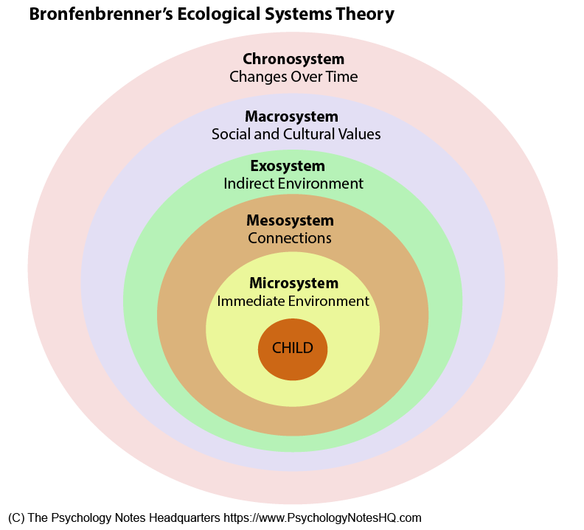

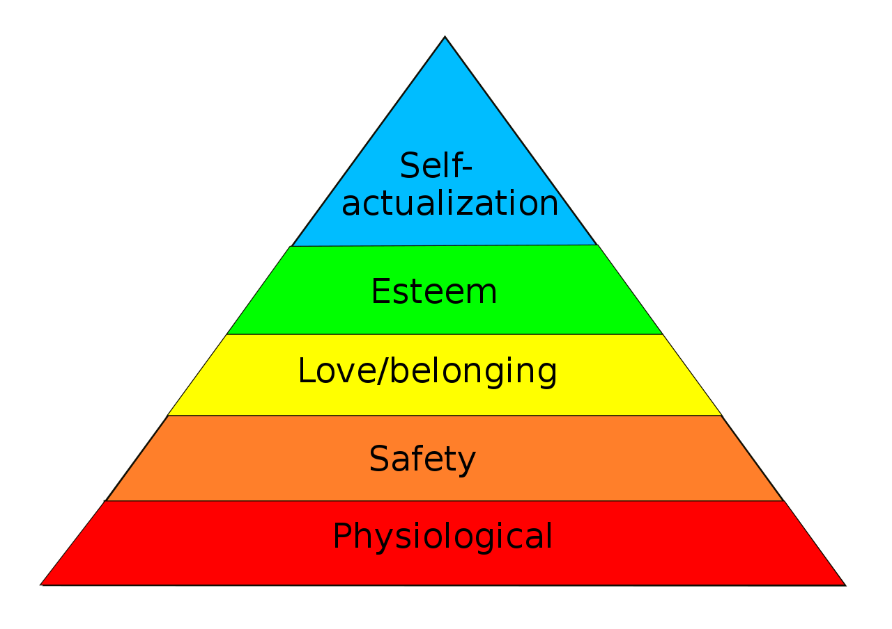




Education Infographic
Pupil Development Grant
Theorists
The Pupil development grant was launched in 2012. The Welsh Assembly Government state that the aim of the grant is to improve outcomes for learners eligible for free school meals and looked after children, the intention is to help children from disadvantaged backgrounds overcome any additional barriers that may prevent them from achieving their full potential.
(Pupil Development Grant, 2020)
Bronfenbrenner believed that a person's development was affected by everything in their surrounding environment. He divided the person's environment into five different levels: the microsystem, the mesosystem, the ecosystems, the macrosystem, and the chronosystem
(Bronfenbrenner, 2005)
1 in 5
Ruth Levitas
MASLOW
Defining Social Exclusion
Social exclusion is a complex and multi-dimensional process. It involves the lack or denial of resources, rights, goods and services and the inability to participate in the normal relationships and activities, available to the majority of people in a society whether in economic, social, cultural or political arenas. It effects both the quality of life of the individuals and equity and cohesion of society as a whole .
(Levitas, R. 2005)
Currently around one in five primary school pupils are eligible for free school meals (FSM).
From reception to
Year 6 Children who are LAC and who are on FSM are allocated £1.320.
(Maslow's hierarchy of needs, 2020)
ESTYN
Every Child Matters,(2003)
Equality Act, (2010)
ESTYNS effective practice in tackling poverty in disadvantaged in schools discusses what works best when using the grant
A whole school approach
Improving Literacy and learning skills.
Using data to track the progress of pupils
.
Breakfast club
Ducking's
After school club
(Estyn, 2020)
At the end of Key Stage 2 less than 70% of these will achieve expected levels, compared to 88% of children from better off families. By age 16, children from better off families are more than twice as likely to achieve five good GCSEs, as those from disadvantaged homes
(Pupil Development Grant, 2020)
Pro’s & Cons/ Conclusion,
In relation to free school meals, schools are placed into one of five bands according to the three-year trend in the proportion of pupils eligible for free school meals in the school. The school’s performance is then placed into quartiles (from the top 25% to the bottom 25%) in relation to how well it is doing compared with other schools in the same free school meal band.
(Pupil Development Grant, 2020)
School uniform grant
£125.
All schools must publish online their PDG allocation and an outline of their plans to use the funding to improve outcomes for deprived children.
(Estyn, 2020)

Slide 2
Reference List
Allan, S. and Gordon, P. (2011) How Children Learn 4 Thinking on special educational needs and inclusion. London; Practical Pre-School Books.
Upload.wikimedia.org. 2020. Available at: <https://upload.wikimedia.org/wikipedia/commons/thumb/3/33/MaslowsHierarchyOfNeeds.svg/1280px-MaslowsHierarchyOfNeeds.svg.png> [Accessed 19 August 2020].
Bates, B. (2019) Learning Theories Simplified. 2nd Ed. London; Sage Publication Ltd.\
Bronfenbrenner, U., 2005. Making Human Beings Human. Thousand Oaks: Sage Publications.
Donaldson, G., 2020. Gov.Wales. Available at: https://gov.wales/successful-futures-review-curriculum-and-assessment-arrangements [Accessed 6 April 2020].
Estyn.gov.wales. 2020. Estyn. Available at: <https://www.estyn.gov.wales/> [Accessed 19 August 2020].
Goodwin, P. (2010) The Literate Classroom. London: David Fulton.
Gross, J. (2013) Time to Talk: Implementing outstanding practice in speech, language and communication. Oxon: Routledge.
Gov.wales. 2020. Pupil Development Grant.Available at: <https://gov.wales/sites/default/files/publications/2018-11/what-really
-works.pdf> [Accessed 19 August 2020].
GOV.UK. 2003. Every Child Matters. Available at: <https://www.gov.uk/government/publications/every-child-matters> [Accessed 19 August 2020].
GOV.UK. 2020. Equality Act 2010: Guidance. Available at: <https://www.gov.uk/guidance/equality-act-2010-guidance> [Accessed 19 August 2020].
Hwb.gov.wales. 2020. Curriculum for Wales 2008 - Hwb. Available at https://hwb.gov.wales/curricul https://hwb.gov.wales/curriculum-for-wales-2008/ um-for-wales-2008 [Accessed 6 April 2020].
Killick, S. (2006) Emotional Literacy. London: Paul Chapman Publishing.
Knowles, G. (2006) Supporting Inclusive Practice. Oxon; David Fulton Publishers.
Lavitas, R. and Fahmy, E., 2020. [online] Poverty.ac.uk. Available at: <https://www.poverty.ac.uk/sites/default/files/attachments/Levitas,%20Social%20Exclusion%20in%20the%20UK.pdf> [Accessed 19 August 2020].
Levitas, R. (2005) The Inclusive Society? Social Exclusion and New Labour. Hampshire; Palgrave Macmillan.
Lewis, M, and Ellis, S. (2006) Phonics: Practice, Research and Policy. Paul Chapman Publishing.
Macleod-Brudenell, I. and Kay, J. (2008) Advanced Early Years. Oxford; Heinemann.
National Literacy and Numeracy Framework: To support schools in introducing the National
Literacy and Numeracy Framework available at: https://hwb.gov.wales/curriculum-for-wales-2008/national-literacy-and-numeracy-framework-curriculum-for-wales-2008-version [Accessed 6 April 2020]
Palmer, S. and Corbett, P. (2004) Literacy, What Works? Cheltenham: Nelson Thornes.
Pierson, J. (2010) Tackling Social Exclusion. 2nd Ed, Oxon; Routledge.
Pugh, K. and McCardle, P. (2009) How Children Learn to Read. New York: Psychology Press.
Rogers, B. (2002) Classroom Behaviour. London; Paul Chapman Publishing.
Thompson, N. (2018) Promoting Equality, 4th Ed, London; Palgrave.
Walton, A. and Goddard, G. (2012) Supporting Every Child. (2nd Edn) Exeter: Learning Matters Ltd.
Wearmouth, J., Soler, J. and Ried, G. (2002) Addressing Difficulties in Literacy Development. London; Routledge Falmer.

