Slide 1
International Business Communications
~LCBB6001~
“
Presented by Ana Maria Dragoi ( 2027456 )
”

Slide 2
Agenda
3
4-5
6
7
Introduction
Introduce the
Chinese culture
Success and failure factors of joint ventures
Cultural sensitivity in China / The differences from the UK
8-9
Hofstede cultural Dimensions:
UK and China
10
Recommendations
11
Conclusion
12
References List
2

Slide 3
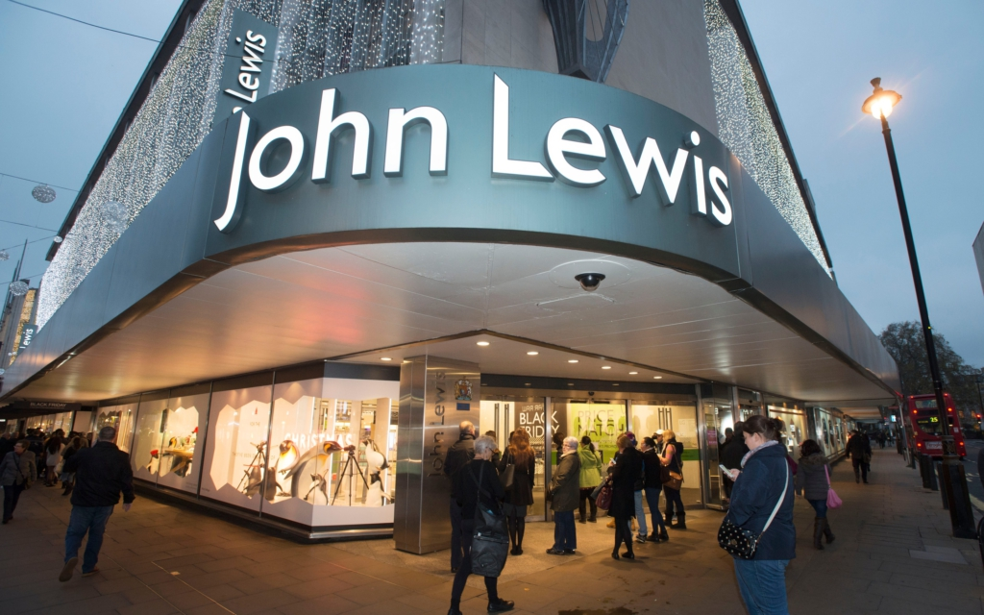
Introduction
The main focus of the presentation will be to present John Lewis that is thinking of a joint venture agreement with a foreign company that is based in China.
The success, as well as failure aspects of joint ventures, will be analysed by using examples regarding the Chinese context.
The cultural dimensions of Hofstede based on the UK and China will be discussed.

Slide 4
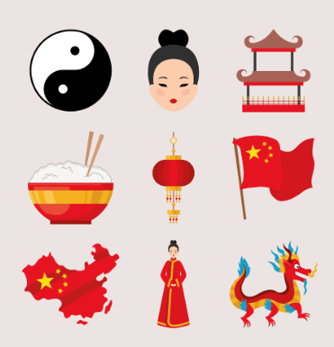
Introduce the Chinese culture
(Zhang et al., 2017)
The cultures of China and the UK are differen:
geographical locations
historical backgrounds
values of society
Communication style
in the UK is generally straightforward, direct, and formal
in China tends to be context-dependent and
indirect.
(Zhang et al., 2017)
4

Slide 5

Introduce the Chinese culture
Trust is built through credibility, professionalism, and reliable delivery of services and products in the UK. On the contrary, interpersonal relationships play a crucial role in China to success in their business.
The business culture of China gives importance to the hierarchy. On the contrary, the UK has a comparably flatter hierarchy.
(Bickers, 2017)
5

Slide 6

Success and failure factors of joint ventures
The
knowledge and network of local parteners
Unequal contribution and commitment
Legal and regulatory complexities
Complementary technology and resources
(Jiang et al., 2018)

Slide 7


Cultural sensitivity in China / The differences from the UK
While marketing in China individuals need to be very cautious about the meaning of numbers and colours which have hell and heaven differences from the UK.
China is not just a vast and complex market it is also very different from the Western market in terms of cultural factors and sensitivity.
,
Older people in China love luxury and prefer traditional advertising
President
Chief Executive Officer
Chief Operations Officer
VP Marketing
(Johnson et al., 2022)

Slide 8
Hofstede cultural Dimensions:
UK and China
Power Distance
Individualism
Masculinity
Uncertainty Avoidance
Long-term orientation
Indulgence
(Large et al., 2019)

Slide 9
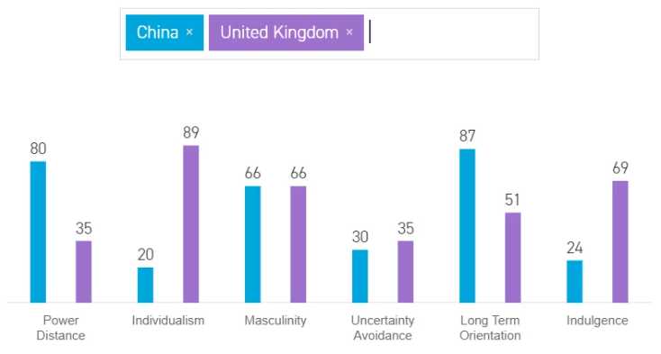
Hofstede cultural Dimensions:
UK and China
Source: Hofstede-insights.com
9

Slide 10

Recomandation
Trends in China are different from the trend in the UK therefore, John Lewis needs to deeply research the market trend before making any decision to open a business.
It is important to conduct thorough market research beforehand to understand the audience and their preferences if John Lewis considering expanding the business to China.
The success of the John Lewis will depend upon the communication between the leaders.

Slide 11
Conclusion
This report has ilustrated the culture of China to study their business market.
The report has discussed the culturally sensitive points of the Chinese market.
This report has described the Hofstede cultural Dimensions between the UK and China.
(Bickers, 2017)
11

Slide 12
References List
Bickers, R., (2017). Britain in China: community, culture and colonialism 1900-1949. In Britain in China. Manchester University Press.
Jiang, K., Keller, W., Qiu, L.D. and Ridley, W., (2018). International joint ventures and internal vs. external technology transfer: Evidence from China (No. w24455). National Bureau of Economic Research.
Johnson, D., Nathan, A.J. and Rawski, E.S. eds., 2022. Popular culture in late imperial China (Vol. 4). Univ of California Press.
Large, D.R., Burnett, G., Crandall, E., Lawson, G., Skrypchuk, L. and Mouzakitis, A., (2019). Evaluating secondary input devices to support an automotive touchscreen HMI: A cross-cultural simulator study conducted in the UK and China. Applied ergonomics, 78, pp.184-196.
Zhang, Y., Wang, J., Hu, F. and Wang, Y., (2017). Comparison of evaluation standards for green building in China, Britain, United States. Renewable and sustainable energy reviews, 68, pp.262-271.

Slide 13

13

