Slide 1

History of Counselling
Psychological Interventions in The 20th Century
Ember Teal, Sarah Howell and Lou Labbett.

Slide 2

Psychological Intervention
What is a Psychological Intervention
A strategy
To change a behaviour, emotion or a person's cognitive functioning
Unknown. (2020, 11 30). Interventions may have lasting benifits . Retrieved from Aps- association for psychological science : https://psychologicalscience.org/observer/interventionseffects
Igi. (2023, 1 3). what is a psychological intervention. Retrieved from igi-global.com: https//.igi-global.com/dictionary/psychological-intervention/24009
Scull, A. (2016). Madness in civilization . London: Thames & Hudson .

Slide 3
Psychological Interventions
Where did psychological interventions take place?
Who was in receipt of a psychological intervention?
Scull, A, (1993). The Most Solitary of Afflictions, Madness and Society in Britain, 1700-1900. Yale University Press New Haven and London.
(2018, June 13). A Victorian Mental Asylum. Science Museum. Retrieved January 12, 2023, from https://www.sciencemuseum.org.uk/objects-and-stories/medicine/victorian-mental-asylum

Slide 4


Psychological Interventions leading up to the
20th century
Changes in the way people with mental health issues were seen and treated – Previously thought of as degenerates and deviants
Treatments used previous the 20th century may be considered torturous to the modern era
Changes included people's mindsets and the recognition that the mad needed support and moral treatments
Silvestri, M. (2022, 8 17). Batman and Joker in the ultimate team up. Retrieved from DC: https://www.dc.com/blog/2022/08/17/batman-and-the-joker-in-the-ultimate-team-up-by-marc-silvestri
Scull, A. (2016). Madness in civilization . London: Thames & Hudson .

Slide 5
Psychoanalysis and Sigmund Freud
Somatic symptoms related to a person's experience to traumatic experiences
Talking Therapy/ free word association
Critiqued due to lack of evidence, the work being subjective and claims of healed patients being false
Scull, A. (2016). Madness in civilization . London: Thames & Hudson .
Tyson, P. J., Davies , S. K., & Torn, A. (2020). Madness History, concepts and controversies . New York: Routeledge .

Slide 6
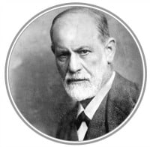
Sigmund Freud
Victorians were not keen on Freuds theories and ideas around sex
Making the unconscious conscious, bringing repressed memories to the surface so what's hidden can be understood and healed
All that is spoken by a client is relevant and may hold symbolism with deeper meaning
Many years of work with a therapist to be able to heal and restore good health
Scull, A. (2016). Madness in civilization . London: Thames & Hudson .
Tyson, P. J., Davies , S. K., & Torn, A. (2020). Madness History, concepts and controversies . New York: Routeledge .
tutor, C. (2020, 11 10). Counselling tutor. Retrieved from Psychoanalytical school of psychology: https://counsellingtutor.com/psychoanalytical-scool-of-psychology/

Slide 7
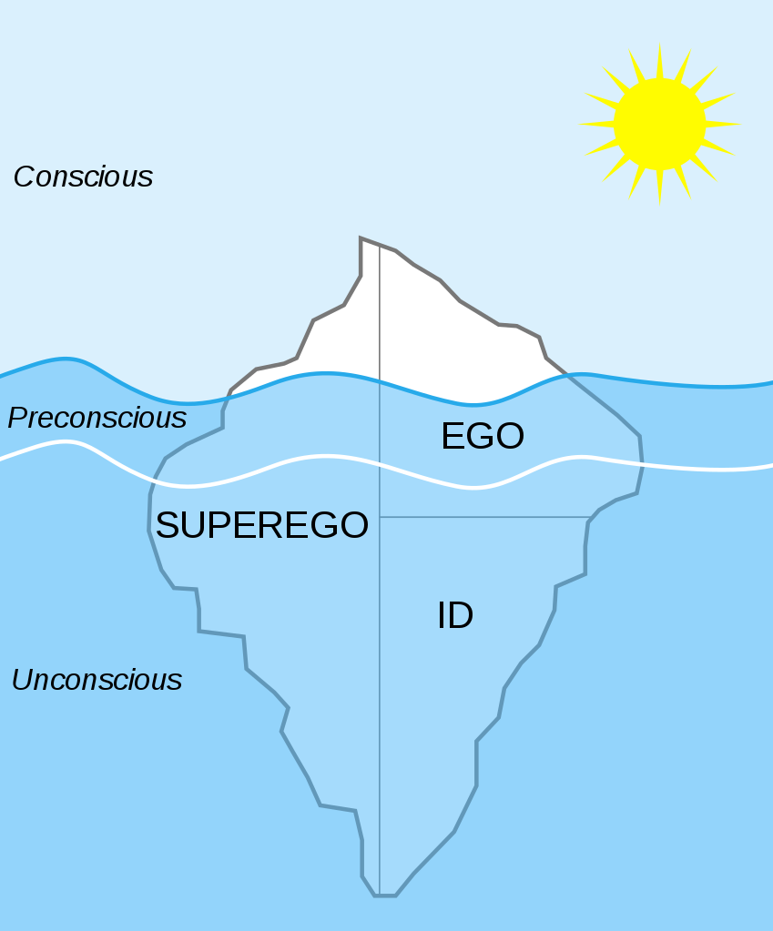
THE ID AND THE EGOS
The ID & THE EGOS
Historicar. (2006, 12 16). Structural-Iceberg.svg. Retrieved from wikimedia: https//:commons:wikimedia.org/wiki/File:structural-iceberg.svg
Scull, A. (2016). Madness in civilization . London: Thames & Hudson .
Tyson, P. J., Davies , S. K., & Torn, A. (2020). Madness History, concepts and controversies . New York: Routeledge .

Slide 8
The Therapies
Transference
Free association
Dream analysis

Slide 9
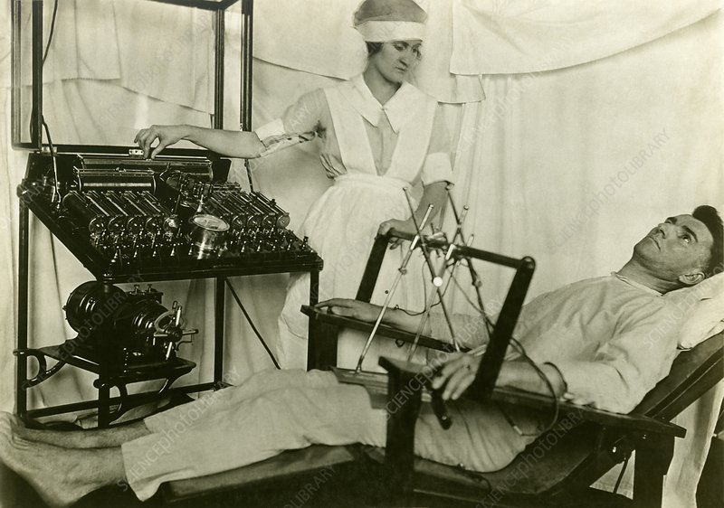
Shell shock and WW1
Scull, A. (2015). Madness in civilization . London: Thames & Hudson.
Retrieved January 15th, 2023, from https://sciencephoto.com/media/c0211927/view

Slide 10
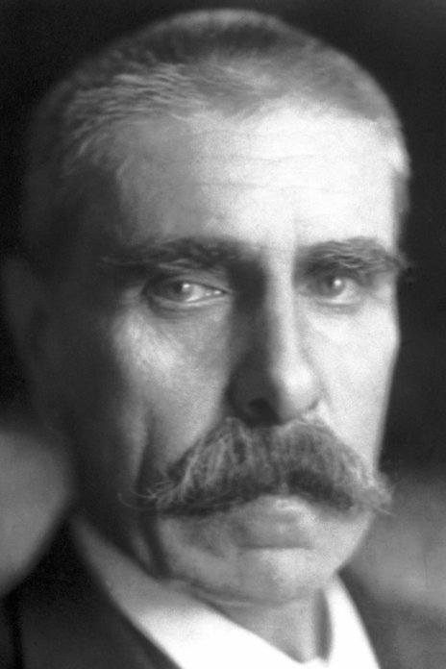
Malarial Therapy
Julius Wagner-Jauregg
The first Psychiatrist to win The Nobel Prize for Malarial Therapy
He tried to cure insanity by raising the temperature of the body
Scull, A. (2015). Madness in civilization . London: Thames & Hudson.
Retrieved January 15th, 2023, from https://nobelprize.org/prizes/medicine/1927/wagner-jauregg/facts/

Slide 11
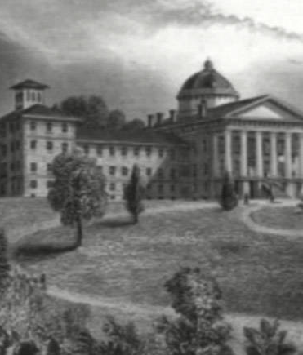
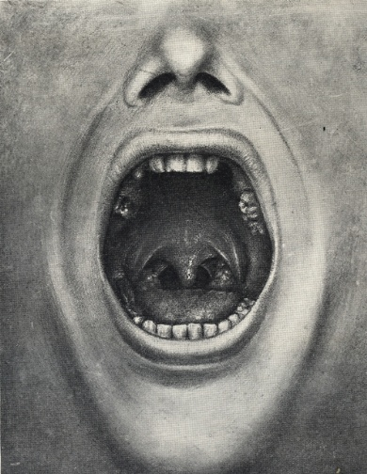
Was the brain being poisoned by toxins?
Scull, A. (2016). Madness in civilization . London: Thames & Hudson.
Tyson, P. J., Davies , S. K., & Torn, A. (2020). Madness History, concepts and controversies. New York: Routeledge.
Retrieved January 15th, 2023, from http://www.allthatsinteresting.com/Henry-Cotton
Retrieved January 15th, 2023, from https://kingscollections.org/exhibitions/specialcollections/mind-matters/from-alienism-to-psychiatry/henry-cotton

Slide 12
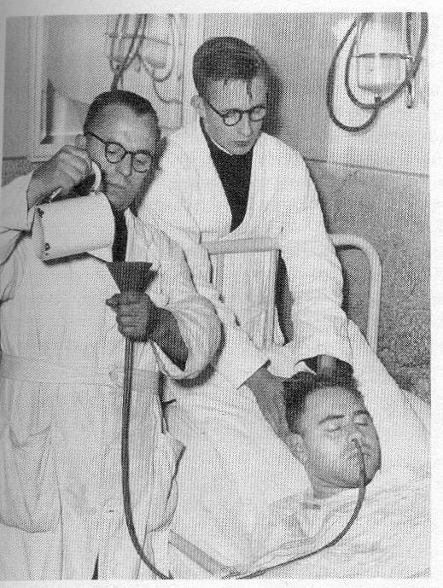
The Introduction of Shock Therapy
Manfred Sakel – Insulin Shock Therapy
Ladislas Joseph Meduna – Pentathylenetetrazol (Metrazol)
Scull, A. (2015). Madness in civilization . London: Thames & Hudson.
Tyson, P. J., Davies , S. K., & Torn, A. (2020). Madness History, concepts and controversies. New York: Routeledge.
Retrieved January 15th, 2023, from https://www.priory.com/homol/insulin.htm

Slide 13
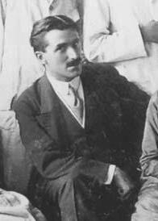
E.C.T.
Electroconvulsive Therapy
Ugo Cerletti and Lucio Bini, Italian physicians
Scull, A. (2015). Madness in civilization . London: Thames & Hudson.
Tyson, P. J., Davies , S. K., & Torn, A. (2020). Madness History, concepts and controversies. New York: Routeledge.
Retrieved 15th January, 2023, from https://en.wikipedia.org/wiki/Ugo_Cerletti#/media/File:Ugo_Cerletti.jpg

Slide 14
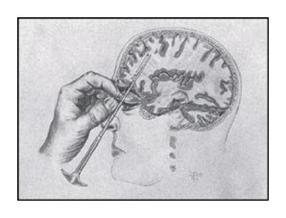

Surgical Interventions
Lobotomy
Neurosurgery
(2019, April 17). The Psychologist. Inside Lobotomies. The British Psychological Society. Retrieved January 12, 2023, from https://www.bps.org.uk/psychologist/inside-lobotomies
Pritchard, C. (2006). Mental Health Social Work. Evidence Based Practice. Routledge Taylor & Francis Group.
(2018, June 13). A Victorian Mental Asylum. Science Museum. Retrieved January 12, 2023, from https://www.sciencemuseum.org.uk/objects-and-stories/medicine/victorian-mental-asylum

Slide 15
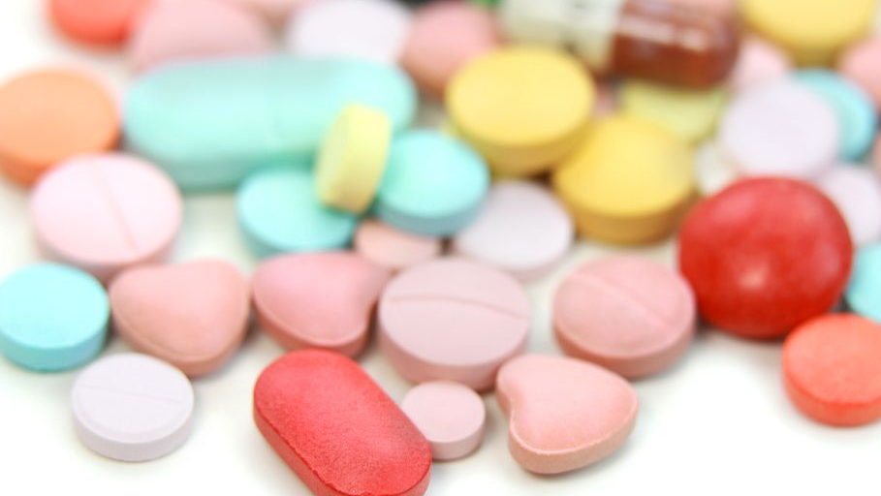
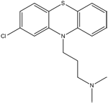
A Psychopharmaceutical Revolution
Antihistamines
Antipsychotics
Antidepressants
Marston, H. (2018, April 13). A Brief History of Psychiatric Drug Development. British Association for Psychopharmacology. Retrieved January 13, 2023, from https://www.bap.org.uk/articles/a-brief-history-of-psychiatric-drug-development/
(2013, July 16). The History of Lithium Therapy. National Library of Medicine. Retrieved January 13, 2023, from https://www.ncbi.nlm.nih.gov/pmc/articles/PMC3712976/ https://www.nimh.nih.gov/health/topics/mental-health-medications).
(2022, June 15). Mental Health Medications. National Institute of Mental Health. Retrieved January 14, 2023, from https://www.nimh.nih.gov/health/topics/mental-health-medications

Slide 16
The National Health Service and Community Care Act 1990
Community care
Mental health support
Drop in services
(1990, June 29). Nation Health Service and Community Care Act 1990. Legislation.gov.uk. Retrieved January 14, 2023, from https://www.legislation.gov.uk/ukpga/1990/19
(2018, October 10). Mind. Information and support. Mind.org.uk. Retrieved January 14, 2023, from https://www.mind.org.uk/information-support/guides-to-support-and-services/crisis-services/day-services/
(n.d.). We are rethink mental illness. Rethink.org. Retrieved January 14, 2023, from https://www.rethink.org/

Slide 17
References
(2018, June 13). A Victorian Mental Asylum. Science Museum. Retrieved January 12, 2023, from https://www.sciencemuseum.org.uk/objects-and-stories/medicine/victorian-mental-asylum
Historicar. (2006, 12 16). Structural-Iceberg.svg. Retrieved from wikimedia: https//:commons:wikimedia.org/wiki/File:structural-iceberg.svg
Igi. (2023, 1 3). what is a psychological intervention. Retrieved from igi-global.com: https//.igi-global.com/dictionary/psychological-intervention/24009
Marston, H. (2018, April 13). A Brief History of Psychiatric Drug Development. British Association for Psychopharmacology. Retrieved January 13, 2023, from https://www.bap.org.uk/articles/a-brief-history-of-psychiatric-drug-development/
(2022, June 15). Mental Health Medications. National Institute of Mental Health. Retrieved January 14, 2023, from https://www.nimh.nih.gov/health/topics/mental-health-medications
(2018, October 10). Mind. Information and support. Mind.org.uk. Retrieved January 14, 2023, from https://www.mind.org.uk/information-support/guides-to-support-and-services/crisis-services/day-services/
(1990, June 29). Nation Health Service and Community Care Act 1990. Legislation.gov.uk. Retrieved January 14, 2023, from https://www.legislation.gov.uk/ukpga/1990/19
Pritchard, C. (2006). Mental Health Social Work. Evidence Based Practice. Routledge Taylor & Francis Group.

Slide 18
References
Scull, A. (2020). Madness in Civilization. Thames & Hudson.​
Scull, A, (1993). The Most Solitary of Afflictions, Madness and Society in Britain, 1700-1900. Yale University Press New Haven and London.​
Silvestri, M. (2022, 8 17). Batman and Joker in the ultimate team up. Retrieved from DC: https://www.dc.com/blog/2022/08/17/batman-and-the-joker-in-the-ultimate-team-up-by-marc-silvestri​
(2013, July 16). The History of Lithium Therapy. National Library of Medicine. Retrieved January 13, 2023, from https://www.ncbi.nlm.nih.gov/pmc/articles/PMC3712976/ https://www.nimh.nih.gov/health/topics/mental-health-medications).
(2019, April 17). The Psychologist. Inside Lobotomies. The British Psychological Society. Retrieved January 12, 2023, from https://www.bps.org.uk/psychologist/inside-lobotomies
Tutor, C. (2020, 11 10). Counselling tutor. Retrieved from Psychoanalytical school of psychology: https://counsellingtutor.com/psychoanalytical-scool-of-psychology/​
Tyson, P. J., Davies , S. K., & Torn, A. (2020). Madness History, concepts and controversies . New York: Routeledge .​
Unknown. (2020, 11 30). Interventions may have lasting benefits . Retrieved from Aps- association for psychological science : https://psychologicalscience.org/observer/interventionseffects​
(n.d.). We are rethink mental illness. Rethink.org. Retrieved January 14, 2023, from https://www.rethink.org/​

Slide 19
References
Electrotherapy at Horton (County of London), War hospital, Epsom, in WW1. Retrieved on 15th January, 2023 from Epsom and Ewell history explorer. https://eehe.org.uk
Photo from The Nobel Foundation archive. Retrieved on 15th January, 2023 from The Nobel Prize.org. https://nobelprize.org/prizes/medicine/1927/wagner-jauregg/facts/
Trenton psychiatric hospital. Retrieved on 15th January,2023 from all that's interesting. http://www.allthatsinteresting.com/Henry-Cotton
Henry Cotton. Princton: Princton University Press; London: Oxford University Press, (1921). Retrieved on 15th January, 2023 from https://kingscollections.org/exhibitions/specialcollections/mind-matters/from-alienism-to-psychiatry/henry-cotton
The insulin treatment of schizophrenia. Retrieved January 15th, 2023, from https://www.priory.com/homol/insulin.htm
Ugo Corletti. Retrieved 15th January, 2023, from https://en.wikipedia.org/wiki/Ugo_Cerletti#/media/File:Ugo Cerletti.jpg

