Slide 1

Reflective Practice
Ethics and Values

Slide 2
Aims
To become familiar with the terms Ethics and Values, we'll break these down a little so that you have a good understanding of the two concepts
Introduction to a Values-based critical reflection model
Support your development of anti-discriminatory practice
Explore power within the therapeutic relationship

Slide 3

Questioning the difference between ethics and values
As psychotherapists we will be hearing a range of stories and experiences that explore a client's culture and experiences. Clearly, we need to be critically reflective and explore our own assumptions in order to be able to engage in the narrative of others.
Knowles and Lander (2012) discuss values and ethics and highlight that values are things that are important to us. In addition, our values are very much tied up in our understanding and beliefs about the world. Furthermore, ethics are the rules that allow us to behave appropriately in accordance with our values.

Slide 4

Personal and Professional Ethics
Values can be professional and personal. Our personal values will stem from things that we learnt to give importance to from an early age. It can often include honesty, time-keeping, hard-work. Personal values are always culturally based and are framed within the social context that we are living within.
Professional values are connected to the ethics and values that the profession believes is important to maintain the integrity of the importance. They are often embedded within codes of practice.
We have covered BACP ethics in a previous session, but it's worth looking back over these and exploring the ethics and values of the Counselling organisations.

Slide 5
Challenge of Ethics and Values –
Activity Two
Identifying and exploring our own ethics and values is always going to be challenging. It can also engage us in very large discussions and allows a range of different viewpoints to be heard.
Ethical dilemmas are challenging and often have no correct answer. On Moodle I have put an ethical dilemma that has been in the BACP Therapy Today Journal. Take a look at this and see how you might respond to the questions that are set below the case.

Slide 6
Your values – Activity Three
Following the previous activity, start to think about your own personal values and make a list of these. Consider this list and reflect on how many relate to your work.
Do you feel that there are any personal values that you hold, which directly conflict with your professional code of ethics?
Which areas of Counselling might you find challenging and consider how these are influenced by your values.

Slide 7
Me, More, My, Most Model
I have provided you with the direct link to the journal for this model. This section of the work is adding a little further detail to the model, but essentially you have the information for this if you are considering it for your assignment.
Wareing's (2017) model is essentially a model based on values. This model encourages us to consider who we are and how our values impact on our experiences. We consider our values, before we think about the experiences. This means that the values are in the front of our mind before we start to critically engage in reflecting on an event.
Notes:
Bassot, Barbara. The Reflective Journal (p. 89). Macmillan Education UK. Kindle Edition.

Slide 8
Me, My, More, Must.
The model asks questions of us, in order to reflect on our experiences:
Me – Who am I? Which of my values are most important to me in my work? What helps me to work, what holds me back? What helps me to work at my best, what hinders my work?
My – What is my emotional experience in relation to the event? What do I think about myself and others in relation to the experience? What impact do my values have on this? Who can assist in helping me to make sense of the event?
More – What questions do I now need to think about? What puzzled me, what makes me feel I need more infrmation? What do I now need to find out?
Must – What do I need to do now, what are my new learning goals? Who do I need to talk to to develop my understanding, what are my training needs? What valudes do I now need to explore?

Slide 9

Critical Awareness
Exploring our own values can be difficult. This model encourages us to really think deeply about our own processes and beliefs. The question 'Who am I?' Encourages us to dig deep and consider our own experiences and how they impact on our current behaviours.
In addition, it’s not enough to just reflect. We also need to think about what's next? What is our action plan? What are our learning goals. For reflective practice to be effective we need to think about what we've learnt and what we need to do next. This can also be challenging, particularly if our values are being questioned.

Slide 10
Issues of Power – Looking at Anti-Discriminatory Practice
Being reflective involves exploring the issues of power in a relationship.
This is a key area of Counselling practice and an area that is significant particularly in Humanistic Counselling (e.g. Person-centred Counselling).
Thompson (2016) explores discrimimation and inequality in his PCS model:
Personal
Cultural
Structural

Slide 11

Personal
This again is connected to our values. It's also our thoughts and feelings and behaviours that come from them.
It's how we see things and people.
In addition it's all about our stereotypical assumptions and prejudices.
It is shaped by our personal experiences, our childhood experiences and our community values.

Slide 12

Cultural
This relates to values that are shared by communities and people. It includes shared understandings, shared society morals.
It is about what is deemed socially acceptable and what is deemed unacceptable.
Very often we take these without question, it is just "what is done".

Slide 13
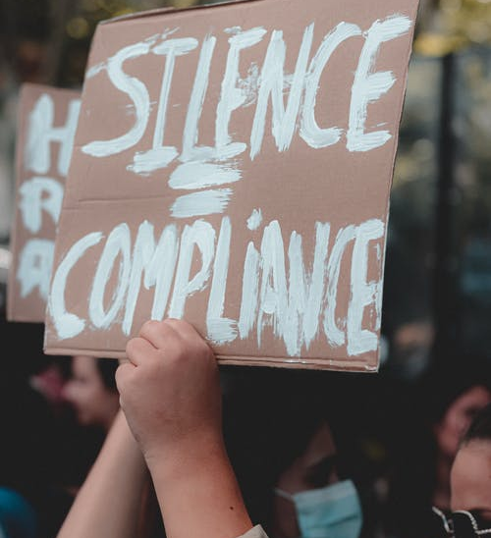
Structural
Thompson suggests that this is all about the way in which society operates. It is linked very much with who is in power and who is not.
It is linked to oppression.
Thompson suggests that this is about oppression and discrimination and how they become embedded or "sewn in" to the fabric of society' (p.36)

Slide 14
Discrimination
Thompson suggests that discrimination happens at every level and each level is connected, thus stereotypes, oppression and discrimination are linked in at each level of the model.
Being engaged in critical reflective practice enables Counsellors to aim to explore their own prejudices and allow ourselves to be challenged. In addition, it also encourages us to think about the culture of Counselling and the structures within Counselling and how they might be oppressive for people in need.
This is particularly true within the UK and the Western World..
Is Counselling a Western Ideal and does it help people from non-western cultures? What are the issues of power within Counselling structures and cultures and again, are they questioned or assumed to be right?
Questions to consider as you develop your understanding within the Counselling profession.

Slide 15
Power and Professional Relationships
In Counselling it is important to look at the relationship and question 'who holds the power?'
In certain professions it is clear who holds the power, and it is a necessary part of the role e.g. teachers and maintaining boundaries in the classroom and enabling a positive environment for learning. Social Workers also need to maintain elements of power in order to protect the vulnerable groups of society.
But are there aspects of Patriarchal power within certain professions and does this mean that some workers are not able to achieve their potential because of the limitations set by the profession?
In Humanistic Counselling we aim towards a more equal relationship. The ethos is always that the 'Client is the Expert in their own lives'. However it is always important to question whether even with this understanding, does the Counsellor still hold the Power within the relationship?

Slide 16
Summary and Final Activity
Ethics, Values and Prejuedices are always going to be large subjects.
The points covered in this lesson are just the tip of the iceberg and I encourage you to explore some of these ideas in greater depth.
Activity:
Look at the BACP website or the NCS website and explore their ethics and values and see if you can critique their frameworks. Don't take anything at face value and assume it's just the "done thing".
Look at the framework and really try to dig deep and explore whether the values are also your values.
In addition, consider whether they are aimed to support a dominant culture or whether they can apply or be relevant for minority groups also.

Slide 17
References
Knowles, G. and Lander, V. (2012) Thinking Through Ethics and Values in Primary Education, London: Learning Matters.
Thompson, N. (2016) Anti-discriminatory Practice, 6th edn, London: Red Globe Press.

