Slide 1
M5X01878: Contract Practice and Procedures:
Types of contract (pt1)
Lara Hopkinson
Senior Lecturer

Slide 2
Outline
Introduce the types of contracts used within the industry
Specific focus:
  JCT Standard Building Contract
  Other forms available in the JCT family

Slide 3
Standard form of building contract
Earliest reference – 19th Century
1903 – first standard form (RIBA, IOB, NFBTE), amended 1909
1931 – JCT formed by RIBA, 1st standard form issued
1937 – Local authority version published
1952 – ICE involvement
1963 – range extended to four
1967 – JCT forms
1994 – Latham report; standard forms under review
Many major revisions, last in 2016

Slide 4
JCT Forms of Contract
Minor Works Building Contract
Intermediate Building Contract
Standard Building Contract
Major Project Construction Contract
Design & Build Contract
Management Building Contract
Construction Management Contract
MW with Contractors Design
IC with Contractors Design
SBC with Quantities
MP Sub-contract
D&B Sub-contract
Management Works Contractor Employer Agreements
CM Appointment
SBC without Quantities
CM Trade Contract
IC Sub-contract
MW Sub-contract with Contractors Design
IC Sub-contract with Contractors Design
SBC with Approx. Quantities
Intermediate Named Sub-contract
SB Sub-contract
Intermediate Named Sub-contract Tender
SB Sub with Contractors Design
Amended from JCT SBC 2016

Slide 5
JCT Standard Building Contract family
Standard Building Contract with Quantities (SBC/Q)
Standard Building Contract without Quantities (SBC/XQ)
Standard Building Contract with Approximate Quantities (SBC/AQ)
Standard Building Contract Sub-contracts (SBC ONLY)
  Standard Building Sub-contract Agreement (SBCSub/A)
  Standard Building Sub-contract Conditions (SBCSub/C)
  Standard Building Sub-contract with sub-contractors design Agreement (SBCSub/D/A)
  Standard Building Sub-contract with sub-contractors design Conditions (SBCSub/D/C)
Other sub-contract forms available

Slide 6
JCT Intermediate Building Contract family
Intermediate Building Contract (IC)
Intermediate Building Contract with Contractors Design (ICD)
Intermediate sub-contracts:
  Intermediate Sub-Contract Agreement (ICSub/A)
  Intermediate Sub-Contract with subcontractors design Agreement (ICSub/D/A)
  Intermediate Sub-contract Conditions (ICSub/C)
  Intermediate Sub-Contract with subcontractors design Conditions (ICSub/D/C)
  Intermediate Named Sub-Contract Tender and Agreement (ICSub/NAM)
  Intermediate Named Sub-Contract Conditions (ICSub/NAM/C)

Slide 7
Other JCT Contract families
JCT Minor Works Building Contract family
  Minor Works Building Contract (MW)
  Minor Works Building Contract with subcontractors design (MWD)
  Minor Works Sub-Contract with subcontractors design (MWSub/D)
  Minor Works Building Contract (MW) Tracked Change Document
  Minor Works Building Contract with contractors design (MWD) Tracked Changes Document
JCT Major Project Construction Contract family
  Major Project Construction Contract (MP)
  Major Project Sub-Contract (MPSub)

Slide 8
Other JCT Contract families (contd)
JCT Design & Build Contract family
  Design & Build Contract (DB)
  Bespoke sub-contracts are used
  Design & Build Sub-Contract Agreement (DBSub/A)
  Design & Build Sub-Contract Conditions (DBSub/C)
JCT Management Building Contract family
  Management Building Contract (MC)
  Management Works Contract Agreement (MCWC/A)
  Management Works Contract Conditions (MCWC/C)
  Management Works Contractor/Employer Agreement (MCWC/E)

Slide 9
Other JCT Contract families (contd)
JCT Construction Management family
  Construction Management Appointment (CM/A)
  Construction Management Trade Contract (CM/TC)
JCT Constructing Excellence Contract family
  JCT – Constructing Excellence Contract (CE)
  JCT – Constructing Excellence Contract Project Team Agreement (CE/P)
JCT Measured Term Contract (MTC)
JCT Prime Cost Building Contract (PCC)

Slide 10
Other JCT Contract families (contd)
JCT’s Repair and Maintenance Contract (RM)
JCT’s home owner contracts
  Building Contract for a Home owner/Occupier who has not appointed a consultant to oversee the work (HO/B)
  Building Contract and Consultancy Agreement for a Home Owner/Occupier (HO/C and CO/CA)

Slide 11
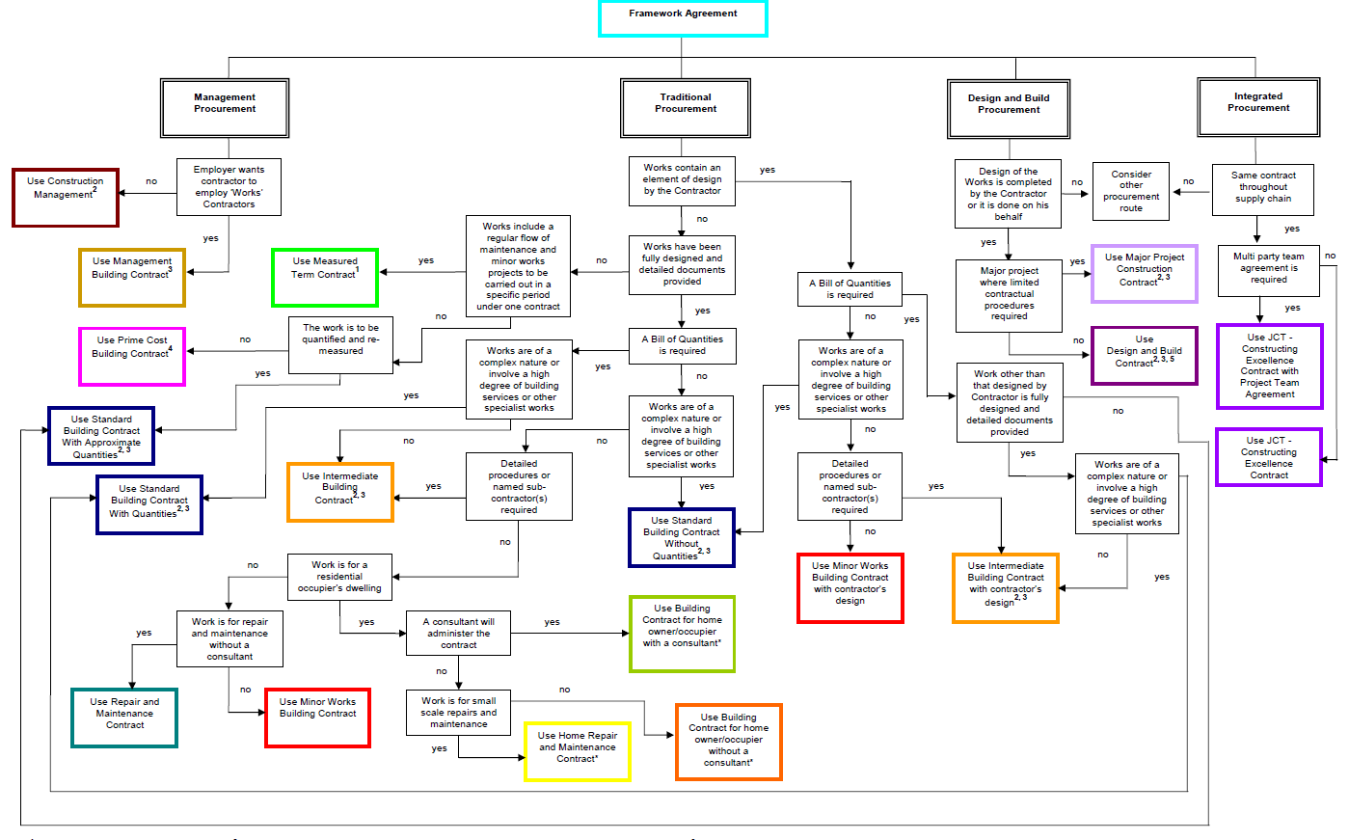
Source: Practice Note: Deciding on the appropriate JCT contract 2011

Slide 12
Useful information
Joint Contract Tribunal – history (www.corporate.jctltd.co.uk)
Ashworth A & Perera S (2018) Contractual Procedures in the Construction Industry. 7th Ed. Abdingdon, Oxon: Routledge. Chapter 6: Forms of Contract
JCT (2011) Practice Note: Deciding on the appropriate JCT contract. London: Sweet and Maxwell

