Slide 1
How effective were papal and secular methods in removing heresy during the medieval period
Joe Neal
1701080
JH Archaeology and Medieval Studies

Slide 2
Research questions
How and why were certain heretical groups persecuted?
Did any groups survive persecution, and if so what happened to them?
Did these methods prevent the spread of heresy?

Slide 3
Focusing my research
There have been many heresies all over Europe, I had to narrow my research to three main groups, these are:
The Cathars
The Waldensains
The Lollards

Slide 4

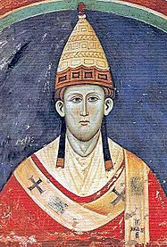
Structure
Four Chapters, these will be;
How effective were inquisitors in removing heresy
How effective was legislation created by rulers and the church
How effective was violent methods
How revolutionary was Pope Innocent III in his approach to dealing with heresy

Slide 5
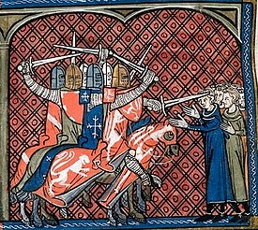
Catharism
A dualtistic belief system
Possibly originated from the Orthodox heretical group the Bogomils
Spread to south-west Europe, mainly in southern France and northern Italy in the 11th century
The abligensian crusade 1209-1229

Slide 6
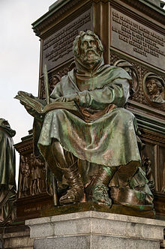
Waldensians
Originated in Lyon in the 1170s
Started by Valdes (1140-1205)
Preached apostolic poverty as a means to obtain perfection
Was proclaimed as a heresy in 1215
Was also affected by the Alibgensian crusade
The Waldensian belief is still around today, and can be found in places like Argentina, United States, and northern Italy

Slide 7
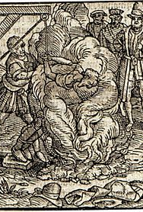
Lollards
An English heresy
Created by John Wycliffe (1328-1384)
Their beliefs were made on the Twelve Conclusions of the Lollards, which was inspired by the works of Wycliffe
Pre-Protestant movement
Oldcastle revolt 1414

Slide 8
Sources
Papal letters by Pope Innocent III
Various ecumenical councils, such as;
The first Lateran council 1122
The second Lateran council 1139
The third Lateran council 1179
The fourth Lateran council 1215

Slide 9
Conclusion
My research is showing that the use of persecution against heretical groups can be effective in quickly eradicating a large number of people, but it is not a guarantee in removing the heresy.

