Slide 1
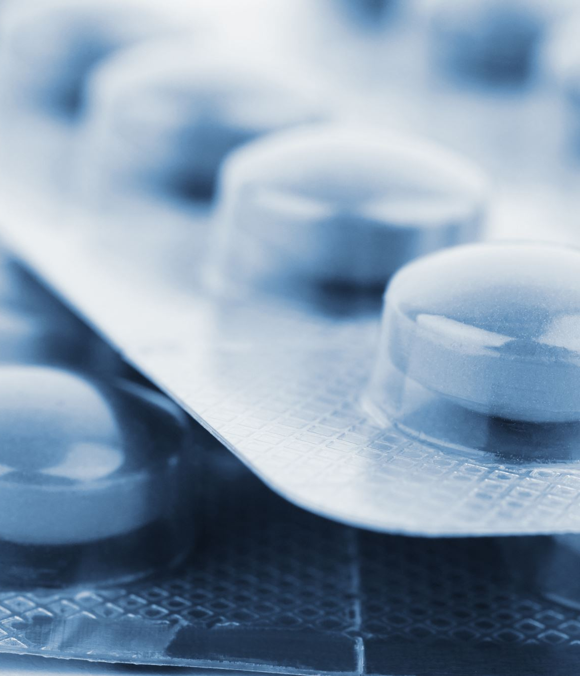
Addiction
Lecturer: Dushika. S (BSc, MSc)

Slide 2
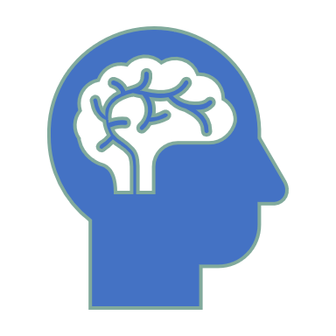
Addiction
Addiction is a psychological condition, in which an individual feels an intense need to engage in a particular in order to overcome an unpleasant sensation.
  Substance based addiction (F10-F19 Mental and behavioural disorders due to psychoactive substance use )
  Non-substance Addiction

Slide 3
Substance Addiction is where the addiction is based on a particular drug.
  A drug may be any product that has the capacity to alter one’s brain and body.
  A substance may include but is not limited to Alcohol, Tobacco, Caffeine, Marijuana, etc.
Non-Substance Addiction is where the addiction is based on a particular activity.
  A non-substance addiction may include activities such as Gambling, sex, internet usage, gaming, etc
  It is common for individuals to experience withdrawal symptoms upon trying to stop engaging in the addictive behavior

Slide 4
Substance Related Addiction
A substance related addiction has the capacity to alter an individual’s cognitive as well as behavioral functioning.
It is not uncommon for individuals to experience substance intoxication.
  Individuals, who are intoxicated may indicate a change in mood, poor coordination, irritability, lack of judgement and a slurred speech.
Certain substance such as LSD may have the tendency to evoke symptoms that are related to psychosis. This could be observed in the form of hallucinations as well as Delusions.
Both legal as well as illegal drugs may be abused by individuals.

Slide 5
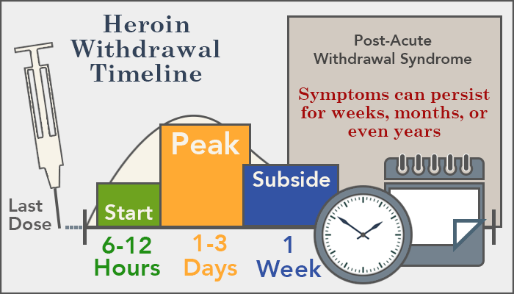

Slide 6
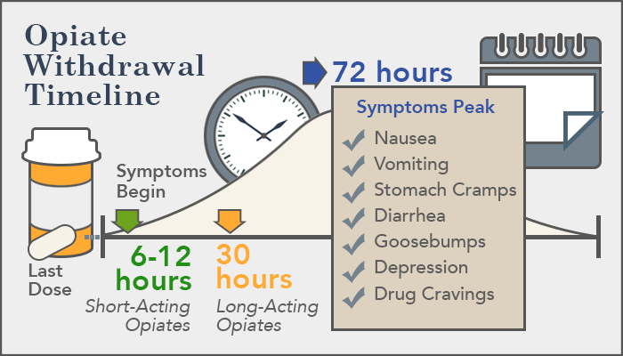

Slide 7
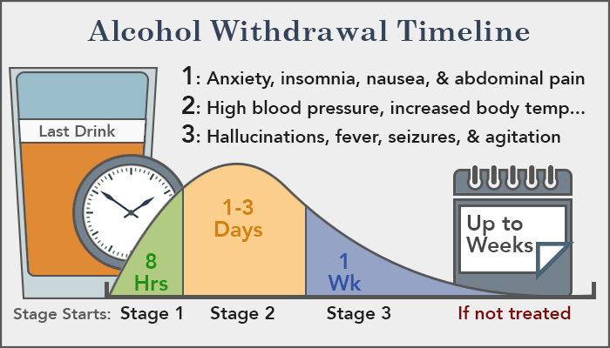

Slide 8
Addiction’s Influence on Individual and Society
Addiction may adversely influence an individual’s relationship with their family and friends.
Addiction may affect an affect an individual’s work as well as their financial stability
An individual’s quality of lift could be disrupted due to their addiction
Addiction leads to a huge economic burden. This is mainly because addiction leads to health/medical conditions. Such conditions may affect the productivity in the organization they are employed at.
In addition, health care expense due to substance misuse would negatively impact the NHS.
The government would have to allocate cost for treatments and rehabilitation programs.
Individuals may engage in criminal activities

Slide 9
Non-Substance related Addiction
Individuals may develop an addiction towards activities such as gambling, internet, pornography, and gaming
Similar, to substance addiction, non-substance can negatively impact an individual’s personal relationships, work life and overall quality of life.
Although substance addiction such as alcohol addiction has been frequently acknowledged in the past as a harmful behavior.
It is only recently that the addiction definition has been altered to take into account behavioral addiction such internet addiction and addiction to gaming.

Slide 10
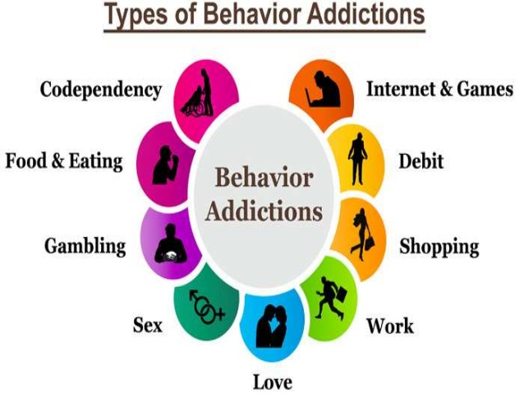

Slide 11
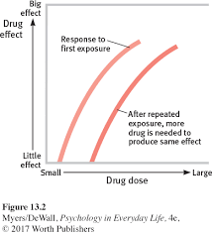

Slide 12
Biological Perspective of Addiction
Genetic
There may be a genetic component to addiction
Dorit Carmelli et al (1992) identified that when one monozygotic individual was addicted to substance such as smoking, there was a higher tendency for other monozygotic twin to engage in similar behaviors in comparison to dizygotic twins.
Donald Goodwin (1973) identified that adoptive children, whose at least one parent was addicted to alcohol, indicated signs of alcohol addiction themselves in the future
It was identified that the DDR2 gene was associated with addiction.
The gene plays a role in which an individual’s brain reacts to pleasurable sensations. Individuals with an addiction was found to have fewer D2 receptors hence they felt the need to engage in an behavior more frequently to experience the pleasurable sensation

Slide 13
Biochemical:
Dopamine is released upon experiencing pleasurable sensations.
Hence, continuing the addictive behavior would be perceived to be rewarding
However, upon repetitively engaging in the same behavior the dopamine released is usually reduced.
A reduction in dopamine will maintain the compulsion and addiction – reward deficiency syndrome
According to Vroon et al when participants consumed a dopamine agonist, impulsive behaviors and reaction times increased while decision conflicts decreased when compared to the control group.

Slide 14
Biological Explanation – Development of Tolerance
Pharmacological Explanation: Drug tolerance takes place due to a change in the physiological mechanism of the individual. Eg: metabolism alters, creating an increase in drug intake
Solomon and Corbit Theory: The b-process in an individual becomes strengthen with repeated drug use thereby creating a tolerance for the particular drug.
According to biological explanation, upon repeated drug use an individual’s body is altered in the way in which is responds to the drug

Slide 15
Behavioral Explanation of Addiction
Operant Conditioning:
  The drug usage may lead to a positive sensation (Reward)
  When the behavior is rewarded, it is reinforced to continue in the future as well.
  There is a tendency where when the rewarding sensation is strong it may encourage an individual to administer a higher dose of the drug
Classical Conditioning:
  Positive sensation that are associated with the drug usage
  Shepard Siegal – 1975, 2005
  CS- Following the drug administration
  CS includes contextual stimuli (environment), the stimuli associated with the drug administration (needle), bodily sensation that occurs before the drug administration.
  CS elicits a compensatory response

Slide 16
Cognitive Explanation of Addiction
Miller (2010): Feeling State Theory - Intense desires that are associated with the activity/behavior (State dependent Memories) may produce desirable sensations, which are recalled better.

Slide 17
Social Explanation of Addiction
  One may begin using addictive substances as they perceive the consequences of it to be positive while observing their role models
  Advantages outweigh cost
  Social Reinforcement – Peer pressure

Slide 18
Research evidence highlights that approximately 20% of the heroine addict’s have at least one or more family member who is an addict.
In addition, a similar pattern has been observed among alcohol addicts, where college students who abused alcohol had a family history with alcoholism.
Individuals, who had a close relationship with their parents imitated their parent’s drug use but individuals, who had a poor relationship with their parents did not in most cases.
Similarly, drug and alcohol use among peers may not be due to hereditary reasons as the members within the peer groups were unrelated.

