Slide 1

Attachment

Slide 2
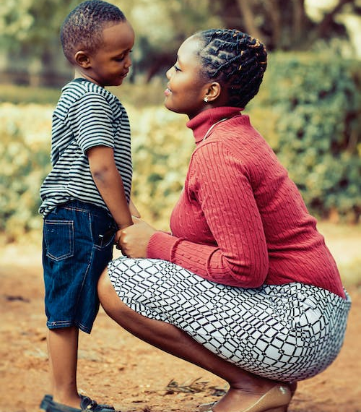
Aims
To understand attachment
Explore why it is important
To look at and understand attachment behaviours.

Slide 3

Why attachment matters
Introduction: why attachment matters on Vimeo

Slide 4
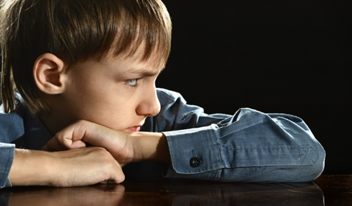
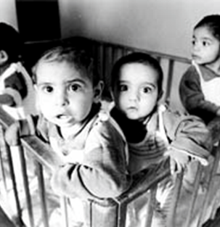
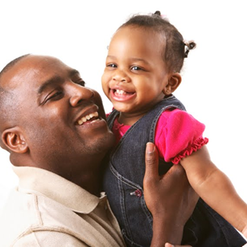
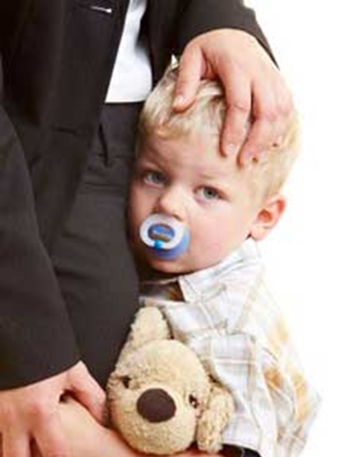
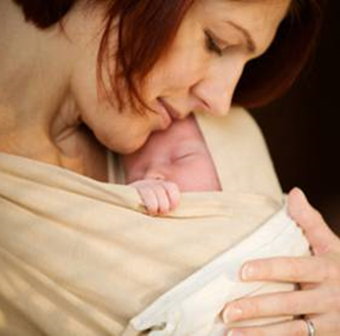
Attachment in children

Slide 5
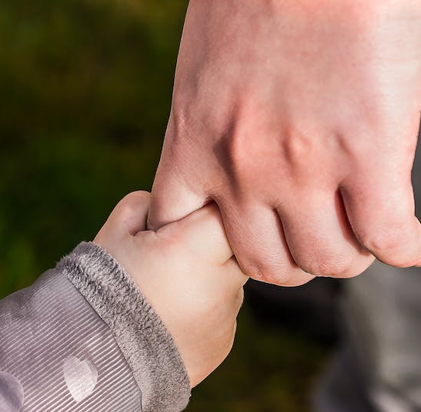
What is attachment?
The ability to allow a child to feel safe through their relationship with their main caregiver.
What does attachment mean to you? Can you produce a definition?

Slide 6
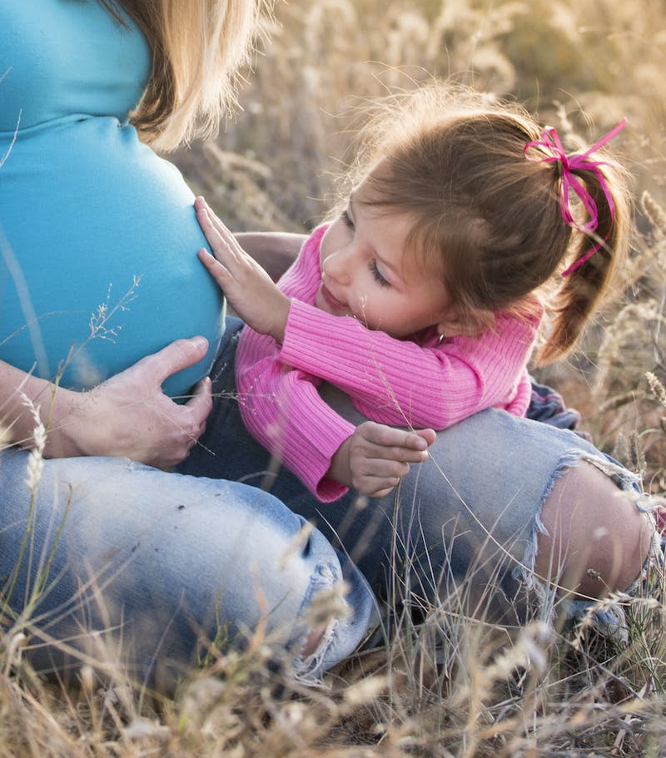
How does attachment begin or develop?
Attachment begins even before the birth of the baby. The mother will respond to the baby's movement and interacts through gentle caresses and speaking gently to the baby as it is in the womb.
Sounds and touch are particularly important for nurturing and demonstrating love.
After the baby is born, attachment is the response that provides safety, security. It helps to regulate emotions, through the nurturing response towards the newborn.
As the child grows older it becomes the safe and secure base from which to discover the world around them.

Slide 7
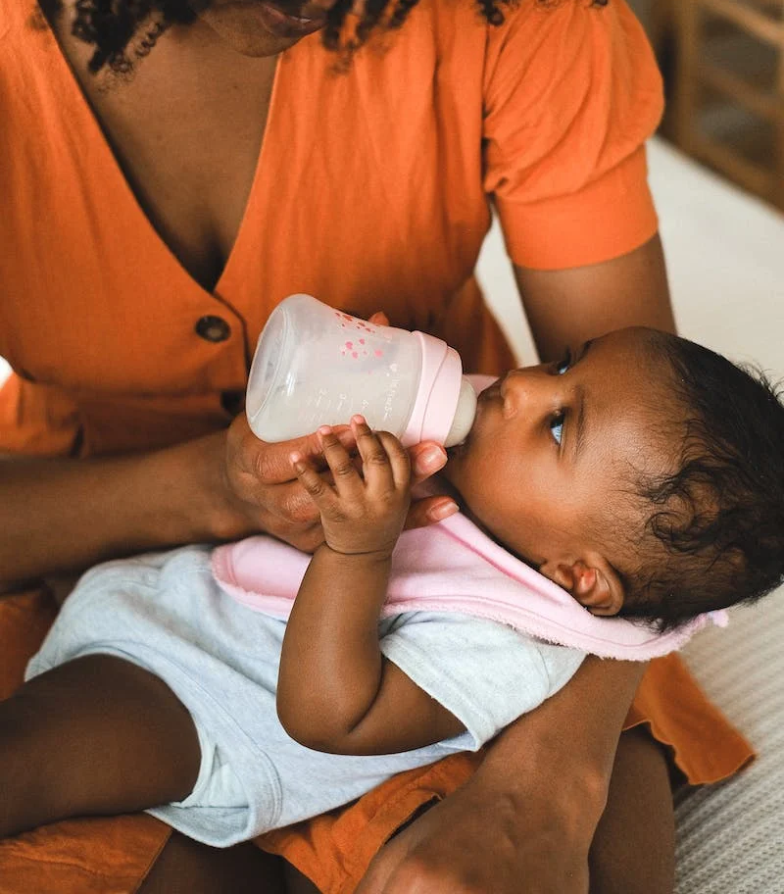
Why is it important?
Brain development
Stress Hormones
Emotional and Social Development

Slide 8
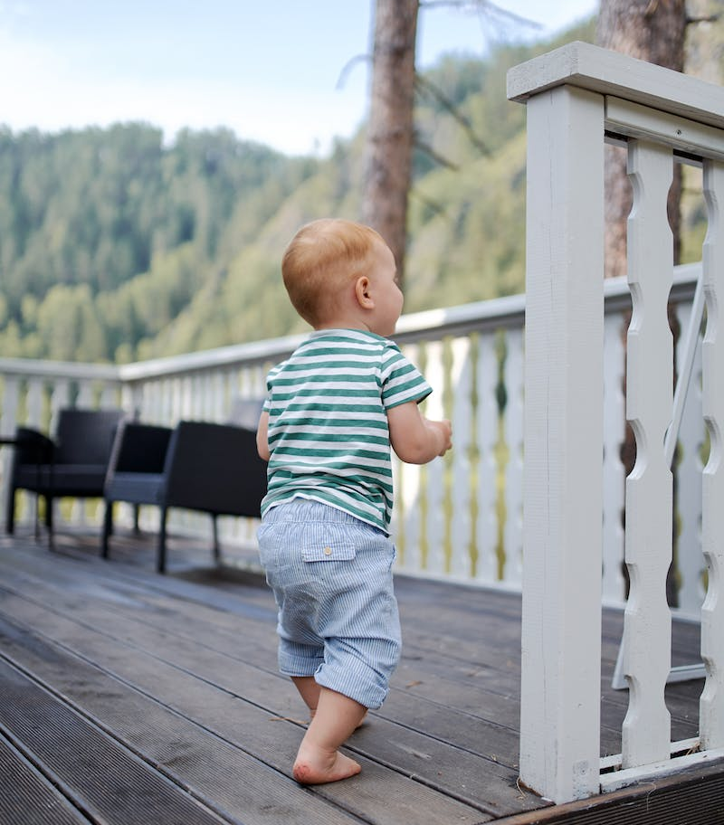
Where did it all start?
John Bowlby
Mary Ainsworth

Slide 9

John Bowlby
Psychodynamic Influences
Object-Relations theory
Tavistock Clinic
Drew from different sciences
Ground-breaking trilogy -
Volume 1: Attachment (1969), Volume 2: Separation: Anxiety and Anger (1972), and Volume 3: Loss: Sadness and Depression (1980). The series is considered revolutionary in psychology and psychoanalysis, establishing attachment as a fundamental, evolutionary drive for protection.

Slide 10
Mary Ainsworth
The Strange Situation.
Worked with John Bowlby for a number of Years
Developed the ideas further:
The four types of attachment styles are secure, anxious, avoidant, and disorganized. Each style describes how individuals form and maintain relationships, with secure attachment being the most balanced, while the others are considered insecure, often stemming from inconsistent or unstable early caregiving.

Slide 11

The Strange Situation
The Strange Situation - Mary Ainsworth

Slide 12
Attachment styles:
Secure attachment: People with this style tend to have healthy, balanced relationships. They are comfortable with closeness and independence and can express their needs and feelings openly.
Anxious attachment: Those with an anxious style may worry about relationships and fear abandonment. They are often highly sensitive to their partner's actions and moods and may seek constant reassurance.
Avoidant attachment: This style is characterized by a preference for emotional distance and independence. Individuals may seem aloof and avoid discussing deep feelings.
Disorganized attachment: This style often develops in individuals who have experienced trauma or instability in childhood. It results in mixed and unpredictable behaviours in relationships, such as sometimes seeking closeness and other times pulling away.

Slide 13
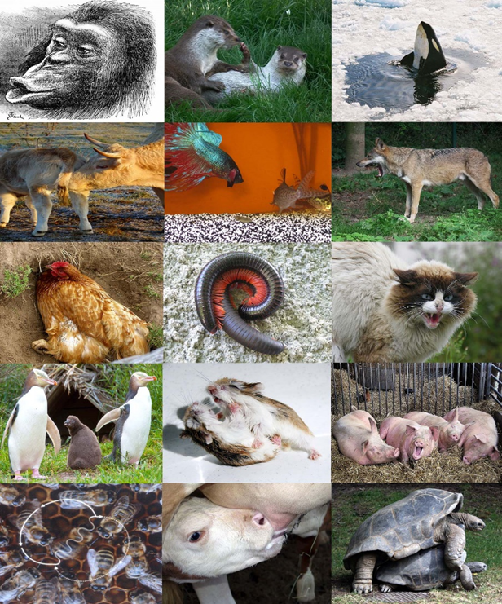
Ethology – the scientific study of non-human animal behaviour
Animals can learn from experience
Develop a range of strategies to cope with situations
Behaviours that do not achieve their goal are not as likely to be repeated.
This is an important element of child attachment and how children react to their caregiving environment.
Think Konrad Lorenz and imprinting.

Slide 14
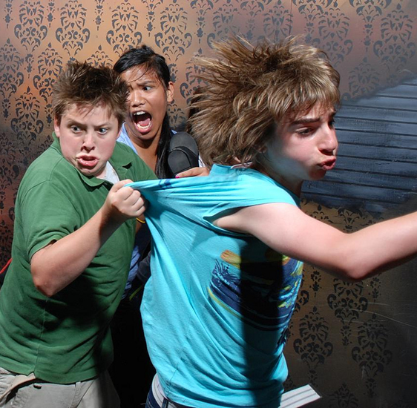
Fear System
Fundamental System
Alerts us to danger
Fear and Attachment come hand-in-hand
Remember the flight/fight response and the underlying mechanisms ( Selye`s GAD: General Adaptation System).
Stress as an adaptive response, short term, but if long term may have serious consequences.

Slide 15

Attachment System and the Fear System
Activation of the attachment system
Attachment behaviours
Proximity to someone safe
What are the implications of this?

Slide 16

Attachment Behaviour and Young Children
Young children will regularly look for two phenomena:
1. Is danger or stress present?
2. Where, or how easy will it be to reach my caregiver?

Slide 17
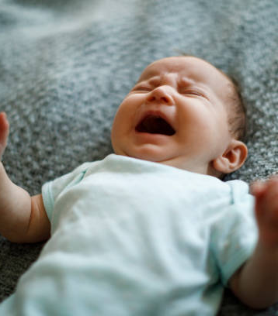
Attachment and young children
•Availability of the parent/primary caregiver
•Fight responses and signalling behaviours – crying, grasping, clinging, babbling, looking, following.

Slide 18
Attachment: development
Pre-attachment (birth to 6 weeks):
Infants do not show a specific attachment to a particular caregiver. They use behaviours like crying, smiling, and eye contact to get a response from any adult.
Attachment-in-the-making (6 weeks to 6–8 months):
Infants begin to show a preference for their primary caregiver. They start to develop a sense of trust based on the caregiver's consistent availability and responsiveness. They are better at distinguishing between familiar and unfamiliar faces.
Clear-cut attachment (6–8 months to 18–24 months):
A strong attachment to one or two specific caregivers is established. The child may show "separation anxiety," when the caregiver leaves. They use the caregiver as a "secure base" to explore the world.
Formation of a reciprocal relationship (18 months onwards):
The child begins to understand the caregiver's plans and can form more complex relationships. They can understand that a caregiver leaving is temporary. They can form strong bonds with multiple caregivers and begin to form reciprocal relationships.

Slide 19
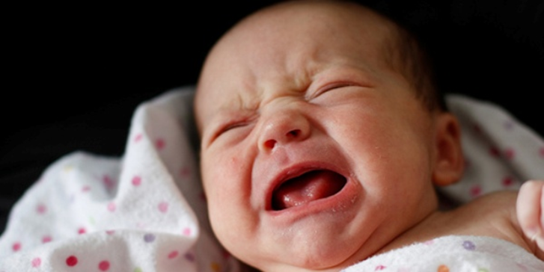

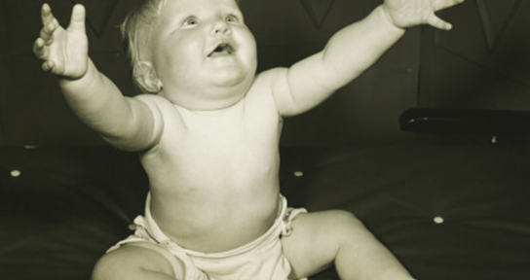
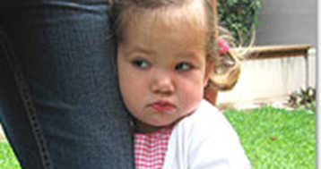
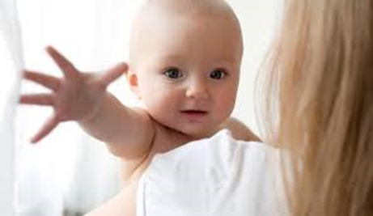
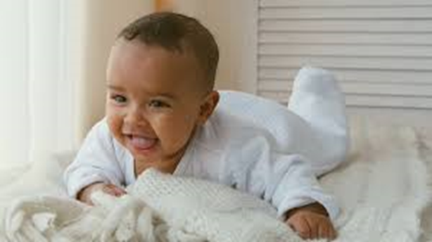
Attachment behaviours

Slide 20
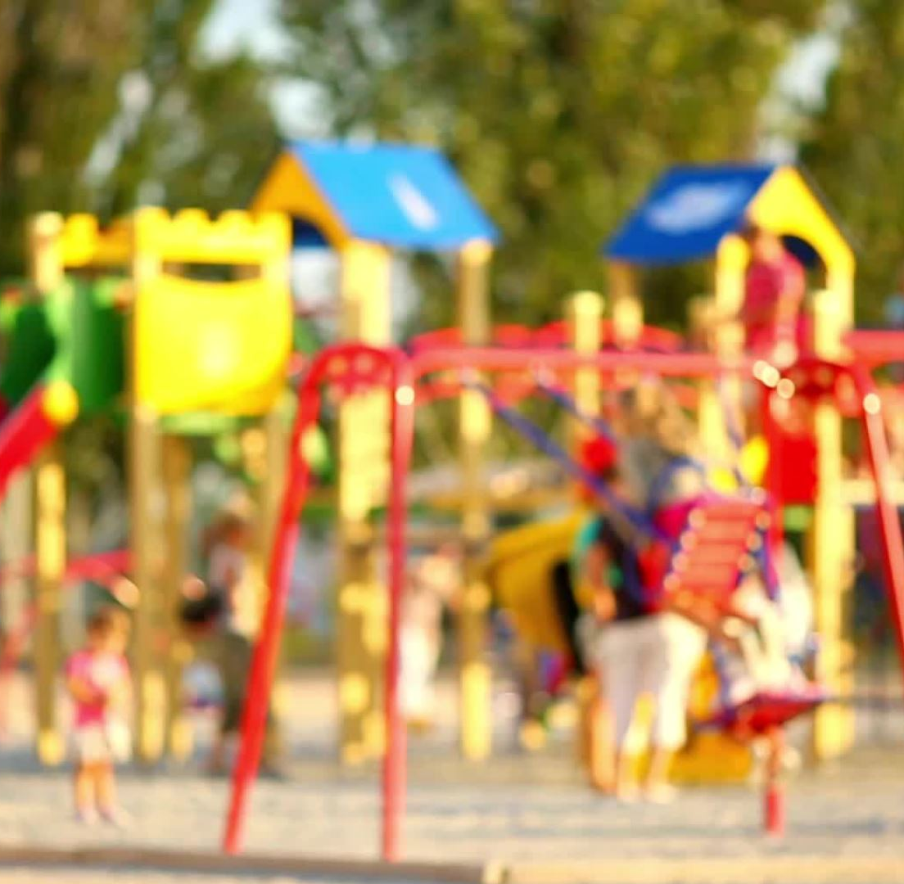
The older infant
As the young child develops, learns to walk etc, they will be able to run towards their primary caregiver.
They can make sense of relationships and social situations
All children (with only extreme exceptions) will attach to their carers.

Slide 21
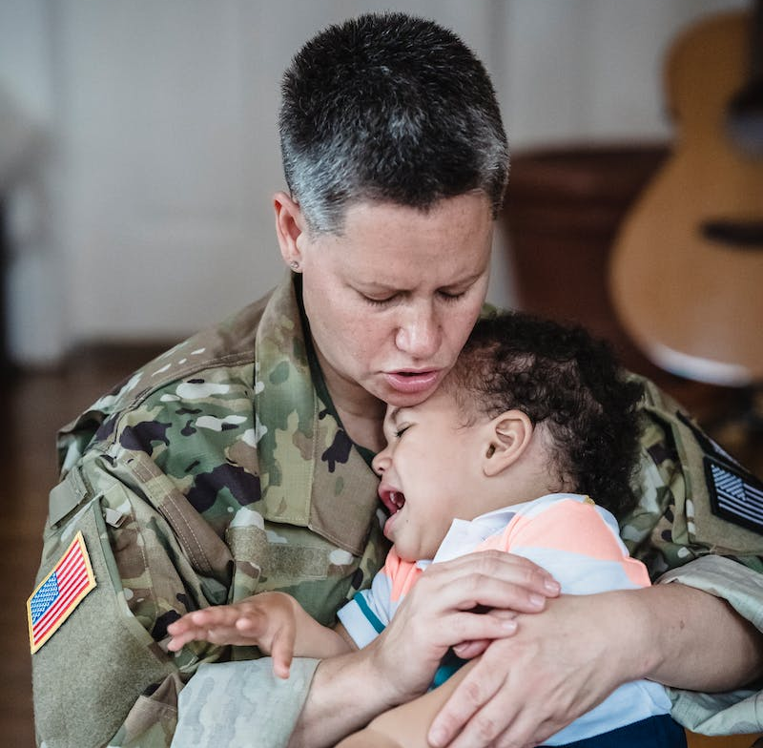
Attachment Figures
Primary Caregivers and attachment figures
Guarded and cautious around unfamiliar adults
Stranger anxiety is the distress an infant shows when approached by an unfamiliar person, and it typically begins after they have formed a specific attachment to a primary caregiver.
Multiple attachments are secondary attachments that form with other people, like family members, after the primary attachment is established.

Slide 22

Maintenance of Attachment System
If attachment behaviours fail to achieve their goal, the system will remain activated – along with this will go the arousal and distress that accompanies the activated system.
Protest
Despair – period of grief and mourning
Detachment

Slide 23
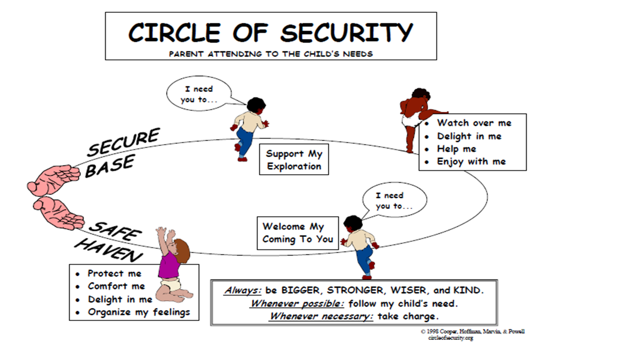
Circle of Security

Slide 24
Safe-haven and Secure base
Attachment figures and the safe-haven
Lack of a secure base can have significant development consequences.

Slide 25
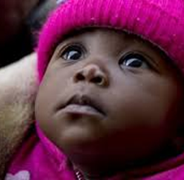
Emotion Regulation
Young babies cannot regulate their emotions, they do not know how. Therefore, they need adults around to help them to cope with the arousal.
Interaction between caregivers and babies is a dual process. Parent and child respond to each other, each can respond and predict the other’s reactions and behaviours as well as their own during interactions with each other.

Slide 26
Emotion Regulation
• Regulation and co-regulation
• Neuroscience
Reading:
How Your Attachment Style Influences Your Fears | AP
Notes:
.

Slide 27
Emotion Regulation
The neuroscience of emotional regulation involves a network of brain regions, primarily the prefrontal cortex (PFC) and the amygdala. The PFC evaluates situations and sends signals to the amygdala to modulate the intensity of emotional responses, a process that improves with age as the PFC develops.
Common strategies like cognitive reappraisal involve using the PFC to reframe the meaning of a situation, which in turn can decrease the amygdala's activity and the resulting emotional experience.
Key brain regions are: PFC, Amygdala and Hippocampus.
Notes:
.

Slide 28
Neuroscience of emotional regulation
evaluates emotional significance, considers outcomes, and initiates regulation. It is crucial for conscious, effortful strategies
PFC
Amygdala
Hippocampus
helps provide context and reasoning to the amygdala. It plays a role in memory, and its function can be impaired by chronic stress, leading to a more reactive emotional state.
the brain's threat detection and emotional response center. It responds to aversive experiences, and the PFC's role is to send signals back to the amygdala to moderate its response

Slide 29
Cognitive reappraisal
When faced with a negative situation, you can consciously think about it differently (cognitive reappraisal).
This mental effort activates the PFC, which uses its high-level cognitive functions to re-evaluate the situation.
The PFC sends signals to the amygdala, telling it to "cool down"
This decreases the strength of the emotional response, even though the initial trigger is still present.

Slide 30
Biological
Stress Systems
Stress hormone – Cortisol
What are the effects of the stress hormone cortisol?
1887_16225-Chapter 2 (1).pdf
Triggers the "fight-or-flight" response:
Increases energy availability:
Enhances brain function:
After the immediate adrenaline rush, cortisol helps maintain the body's high alert state.
It causes the liver to release glucose into the bloodstream for a quick energy source
Cortisol boosts the brain's use of glucose, improving its function during a stressful event.
Modulates the immune response:
It inhibits the immune system and reduces inflammation- beneficial in the ST but can cause problems if stress is chronic.
Supports cardiovascular function:
It helps maintain BP and supports cardiovascular function by increasing heart rate and cardiac output.

Slide 31
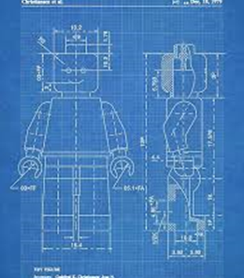
The Internal Working Model
Mental Representation (internal working model)
of their own worthiness
The Self
Other People
The Relationship between self and others.
The quality of the close relationships developed as a young child, has a significant impact on how the self, others and social relationships are viewed, not just in childhood, but also into adulthood.

Slide 32
Cont'd...
Internal Working Models contain expectations and beliefs
Expectations about the self: This involves an individual's sense of self-worth and whether they are worthy of love and support
Beliefs about others: This includes beliefs about whether others are trustworthy, responsive, and available when needed
Relationship templates: These expectations and beliefs form the template for future relationships, influencing how individuals seek proximity, respond to separation, and manage emotional distress

Slide 33
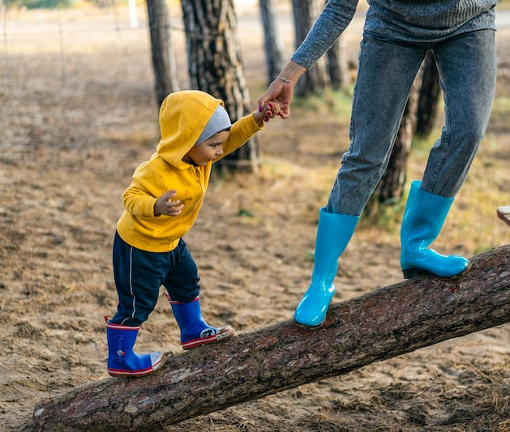
Patterns of attachment
Whatever the quality of the parent-child relationship, the goal of any attachment behaviour is to bring the child to a place of safety. To find the attachment figure where safety and protection can be found.
If the child cannot get to that protection or security, the child will develop psychological strategies that will help them to cope, to defend against the anxieties.

Slide 34
Patterns of attachment
Each pattern of attachment represents a strategy to produce and receive care and protection.
Four combinations of the way the self and others are experienced and mentally modelled within the parent-child relationship:
Secure
Avoidant
Ambivalent
Disorganised

Slide 35
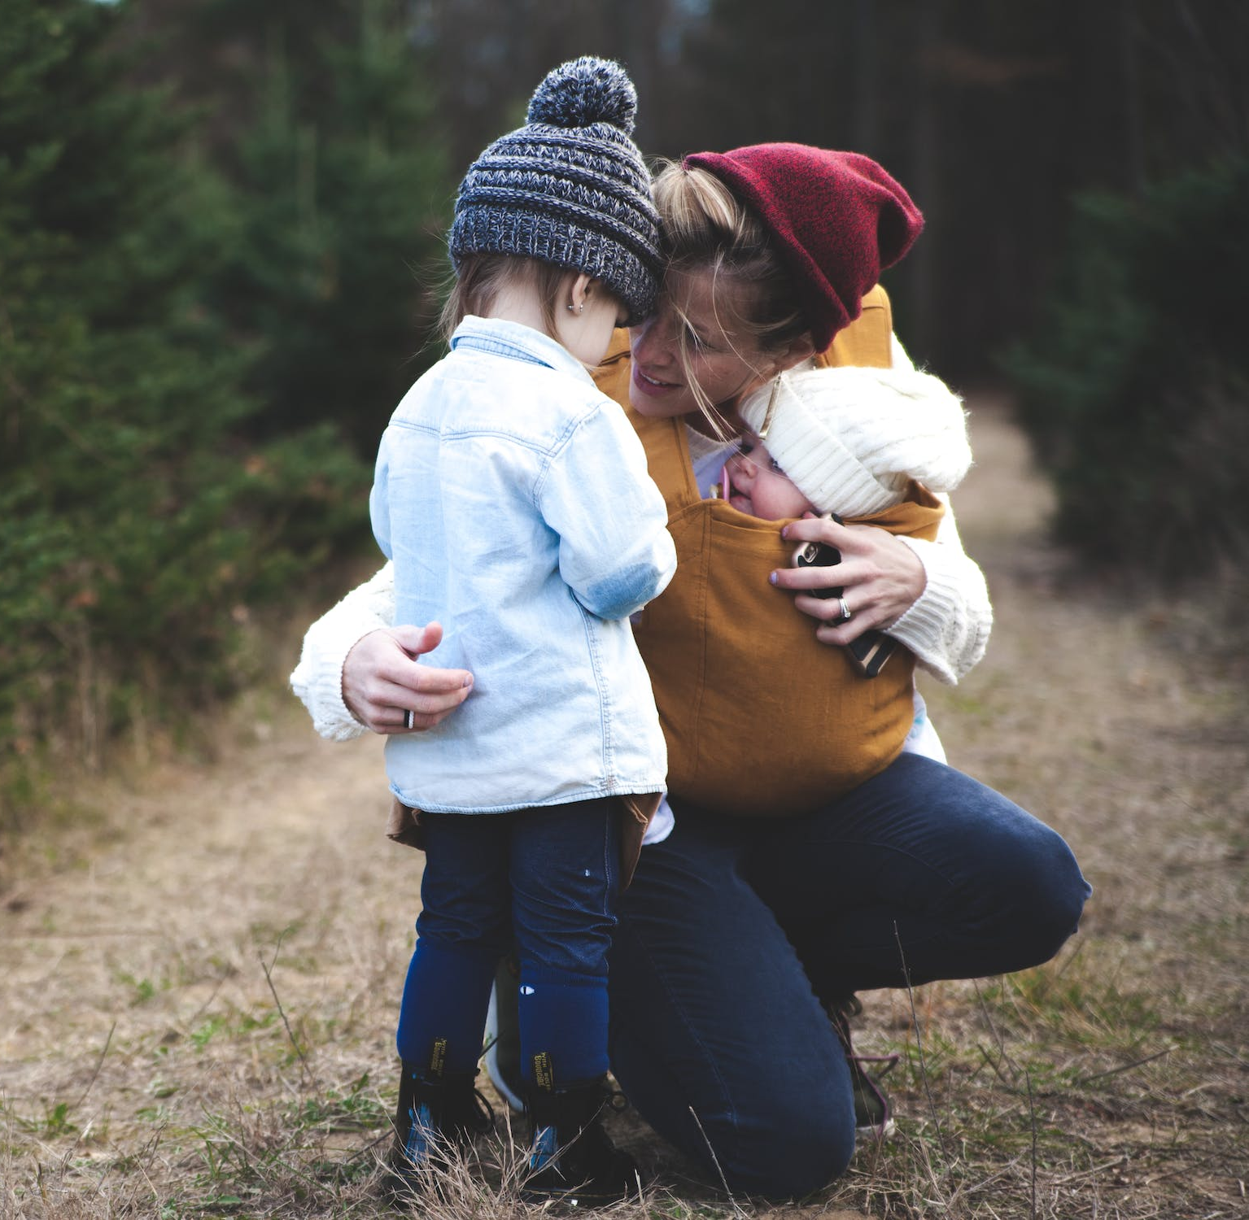
Secure Attachment
They will approach their caregiver directly and positively
A sense of trust in others
They have an internal working model of the self that feels loved, lovable and loving

Slide 36
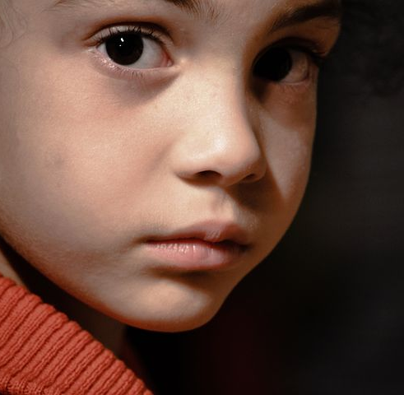
Insecure-Avoidant
When caregivers reject expressions of need and support children are likely to develop avoidant attachment strategies.
The child begins to learn that to get close to the caregiver, they stop showing signs of need and attachment.
Children learn to control their feelings, their affect is over-regulated.

Slide 37
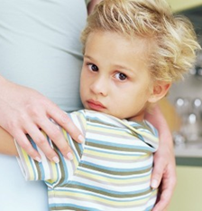
Insecure- ambivalent
Usually display clingy behaviour and can be difficult to settle.
Carers who are insensitive, or where love and affection are inconsistently given, will have children who develop ambivalent strategies:
In ambivalent relationships, there is no safety. Love and acceptance one day do not guarantee love and acceptance the next day, even under identical circumstances.

Slide 38
Disorganised attachment behaviour
Perhaps the most complex and has caused a lot of discussion in the field.
It arose as a result of watching children who behaved in an unsual manner, when traditionally they should have been running to their caregiver. It’s a complex attachment style and can arise if the child is frightened of or frightened for their caregiver.
Relationship with caregivers is stressful. The attachment figures is often the cause of the stress, fear.
Parents who are abusive, psychotic, depressed, emotionally unavailable, who neglect to offer protection, who frighten the children.

Slide 39

Positive outlook
All of these attachment behaviours can be reversed if there is a consistent positive, nurturing relationship, or through therapy that can change the neural pathways. Having a different understanding of relationships can change behaviour.

Slide 40

Homework
Look for literature that engages in critical discussion of attachment styles, particularly disordered attachment.

