Slide 1
INTRODUCTION TO PUBLIC HEALTH
Infectious disease prevention
LCHS 4008
Week 5

Slide 2
Learning outcomes
Upon successful completion of this module, you should be able to:
Understand different approaches and strategies used to measure, monitor and control the incidence of disease in communities
Investigate the implications of illness and disease in communities for the provision of health and social care services
Understand the factors influencing the health and wellbeing of individuals in health or social care settings.

Slide 3
Module Summary
The module aims overall to raise learners’ awareness and critical evaluation of factors influencing public health and the different approaches taken to reduce incidence of disease and illness in communities.

Slide 4
Lesson objectives
Today we will go on to consider and understand
How infectious diseases spread
The chain of infection
How infectious diseases can be prevented?

Slide 5

How do infectious diseases spread?
Notes:
Infectious Diseases: Types, Causes, Symptoms And Preventions (byjus.com)

Slide 6
Spread of infectious diseases
Infectious diseases can spread through so many ways depending on the type.
Pathogens can enter the body through the common places like the mouth, nose and cuts on the skin.

Slide 7
Spread of infectious diseases
Diseases can spread through several means which include
From person to person when you cough or sneeze. In some cases, droplets from coughing or sneezing can stay in the air.
From close contact with another person, like kissing or oral, anal or vaginal sex.
By sharing utensils or cups with other people.
On surfaces like doorknobs, phones and countertops.

Slide 8
Spread of infectious diseases
Infectious diseases can spread through so many ways depending on the type.
Pathogens can enter the body through the common places like the mouth, nose and cuts on the skin.

Slide 9
Spread of infectious diseases
Through contact with faeces from a person or animal with an infectious disease.
Through bug (mosquito or tick) or animal bites.
From contaminated or improperly prepared food or water.
From working with contaminated soil or sand (like gardening).
From a pregnant person to their unborn baby.
From blood transfusions, organ/tissue transplants or other medical procedures.

Slide 10
Activity
Working in a groups, research the following terms associated with disease causation
Host
Agent
Environment
Vector
Carrier – active
Incubatory
Feedback your findings to the whole class
Notes:
Agent originally referred to an infectious microorganism or pathogen: a virus, bacterium, parasite, or other microbe. Generally, the agent must be present for disease to occur; however, presence of that agent alone is not always sufficient to cause disease. A variety of factors influence whether exposure to an organism will result in disease, including the organism’s pathogenicity (ability to cause disease) and dose.
Host refers to the human who can get the disease. A variety of factors intrinsic to the host, sometimes called risk factors, can influence an individual’s exposure, susceptibility, or response to a causative agent.
Environment refers to extrinsic factors that affect the agent and the opportunity for exposure. Environmental factors include physical factors such as geology and climate, biologic factors such as insects that transmit the agent, and socioeconomic factors such as crowding, sanitation, and the availability of health services.

Slide 11
Class Activity
Epidemiologists use a model for studying infectious disease and its spread that involves the microbe that causes the disease, the organism that harbors the disease, and the external factors that cause or allow disease transmission. This is also known as
host, vector, and transmission.
transmission, host, and environment.
host, agent, and environment.
organism, transmission, and environment.
Notes:
C

Slide 12
Activity
Watch the video below then discuss and
https://www.youtube.com/watch?v=2JWku3Kjpq0
Feedback your findings to the whole class
Notes:
Infectious Diseases - How do we control them? – YouTube

Slide 13
In summary: Activity
Watch the video below then discuss and
https://www.youtube.com/watch?v=9axOFtPqS0c
https://www.youtube.com/watch?v=Wmrlpa1XyMI
Feedback your findings to the whole class
Notes:
Infectious Diseases - An Introduction – YouTube
Infectious Diseases Overview, Animation - YouTube

Slide 14
Transmission of infectious diseases
Environmental factors determine if a host will become exposed to one of these agents, and subsequent interactions between the agent and host will determine the exposure outcome.
Agent and host interactions occur in a cascade of stages that include infection, disease, and recovery or death.
In this model, disease results from the interaction between the agent and the susceptible host in an environment that supports transmission of the agent from a source to that host.
(van Seventer and Hochberg, 2017)

Slide 15
Reservoir of infection
Reservoir of infection: Any person, animal, plant, soil or substance in which an infectious agent normally lives and multiplies.
The reservoir typically harbours the infectious agent without injury to itself and serves as a source from which other individuals can be infected.

Slide 16
Portal of entry
A portal of entry is the site through which micro-organisms enter the susceptible host and cause disease/infection. Infectious agents enter the body through various portals, including the mucous membranes, the skin, the respiratory and the gastrointestinal tracts.

Slide 17
Portal of exit
Portal of exit is the way the infectious agent leaves the reservoir (through open wounds, aerosols, and splatter of body fluids including coughing, sneezing, and saliva)
Mode of transmission is the way the infectious agent can be passed on (through direct or indirect contact, ingestion, or inhalation)

Slide 18
Susceptible host
This is the organism (e.g., You or your resident) that will feel the effects of the infectious disease that has travelled through the chain of infection.

Slide 19
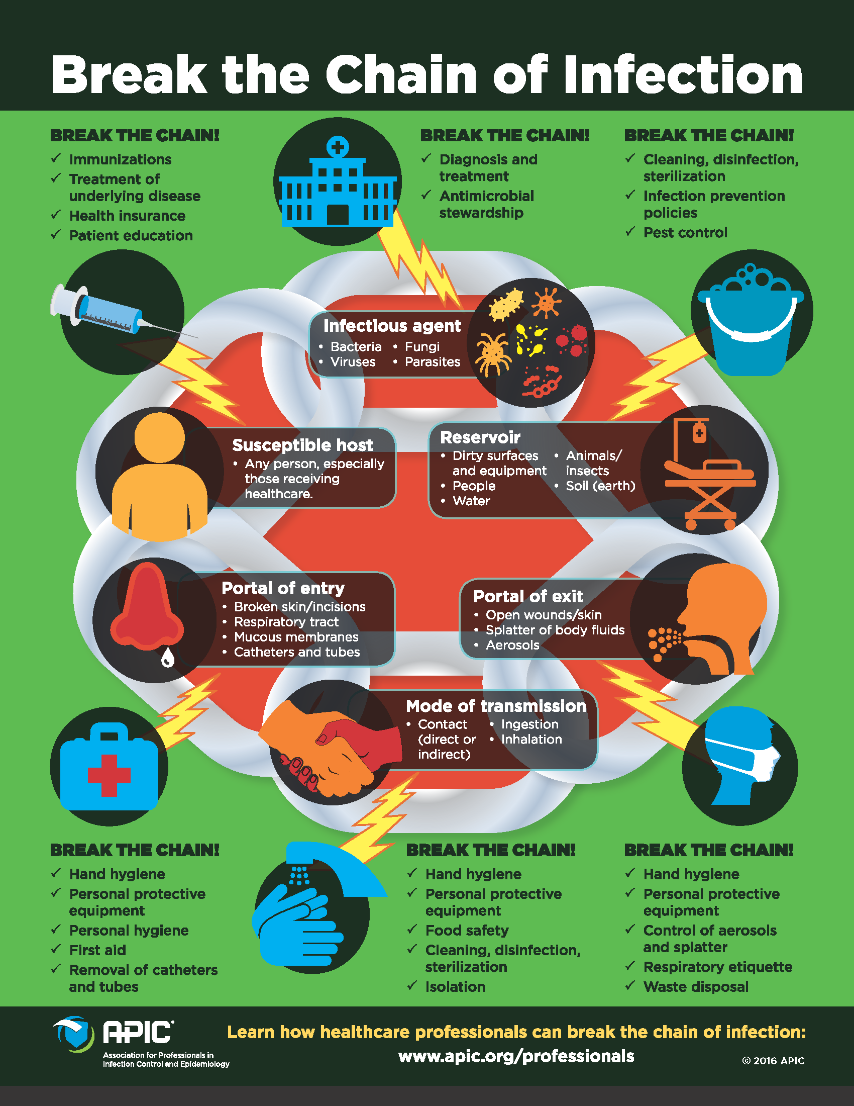

Slide 20
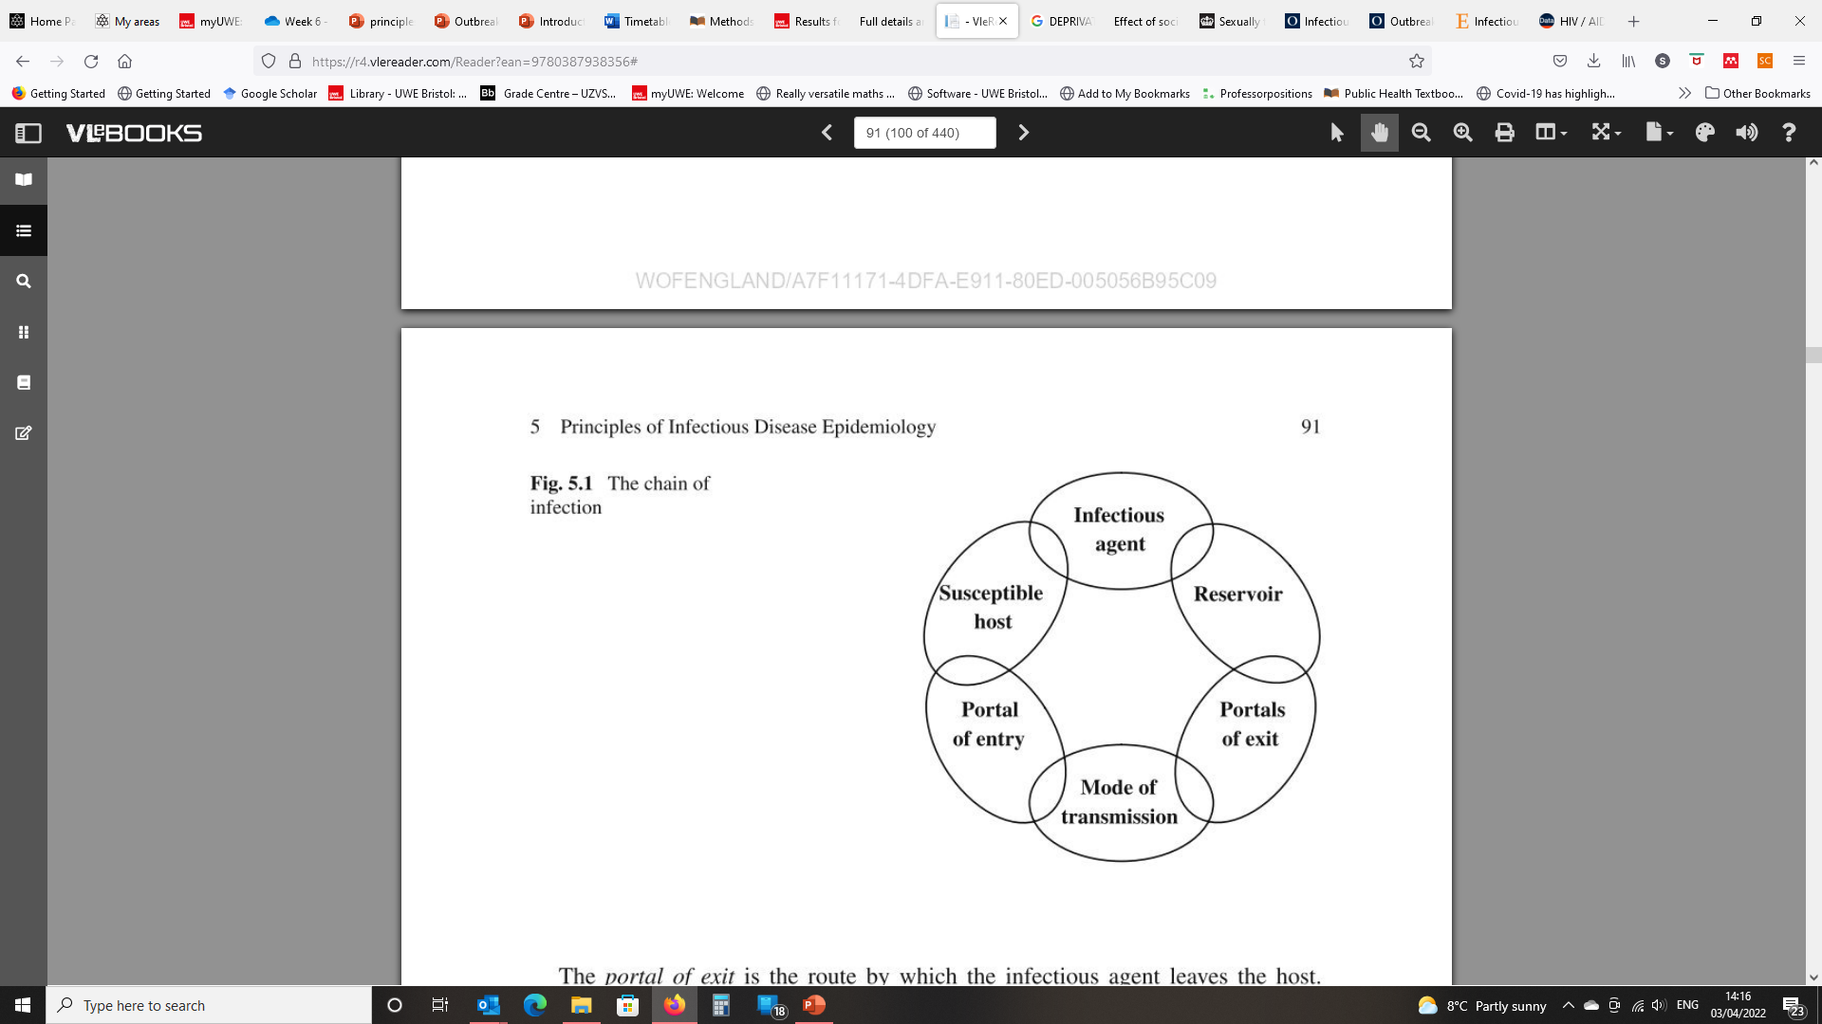
The chain of infection
Page RM, Cole GE, and Timmreck TC (1995) Basic Epidemiological Methods and Biostatistics. A Practical Guidebook. Boston London Singapore: Jones and Bartlett Publishers

Slide 21
How can infectious diseases be prevented?

Slide 22
Prevention of infectious diseases
Vaccination
Use of antibiotics.
Maintaining proper hygiene.
Avoid travelling or going to work when you fall ill.
Avoid sharing used personal belongings such as a razor, glass, toothbrush, comb, etc.
Keeping your kitchen clean by washing all the used utensils, cooking area before and after preparing each food.
Extra care needs to be taken while going to hospitals such as wearing a mask, using sanitizer, etc.

Slide 23
Activity
Working in groups research the ways by which infectious diseases can be prevented
Feedback your findings to the whole class

Slide 24
Who is most at risk for getting infectious diseases?

Slide 25
People Most at Higher Risk of ID
Anybody can get an infectious disease,
But one may be at a higher risk if the immune system is weakened or
If the person travel to areas with certain highly transmissible diseases.

Slide 26
People Most at Higher Risk of ID
People at higher risk of getting infectious disease include:
Those with suppressed or compromised immune systems, such as those receiving cancer treatments, living with HIV or on certain medicines.
Young children, pregnant people and adults over 60.
Those who are unvaccinated against common infectious diseases.
Healthcare workers.
People traveling to areas where they may be exposed to mosquitoes that carry pathogens such as malaria, dengue virus and Zika viruses.

Slide 27


BREAK

Slide 28
Assignment 1
This Assignment is a group work activity and will take place in Week 6.
A member of the course delivery team will complete your assessment.

Slide 29
Assignment 1
Student name: |  | Student ID number:
Programme: | Certificate of Higher Education Skills for the Workplace (Health and Social Care)
Module: | Introduction to Public Health
Module code: | LCHS4008 | Contribution to Overall Module Assessment (%): | 50%
Lecturer: | Gillian Weaver | Internal Verifier: | Dr Besty Jose
Assignment Title: | Component 1 Event discussion (Group) | Word count (or equivalent): | 5 minutes per student
LEVEL 4 ASSESSMENT SPECIFICATION

Slide 30
Notes:
As this is a discussion, you will be awarded a mark based on the knowledge, understanding, and skills that you demonstrate during your talk and discussion.
You may be asked questions to clarify any points you make as part of this.
Your work must be underpinned by researched facts and data that show your research skills and understanding of the key points that you have included.

Slide 31
Workshop
Use the resources provided, and your own research, practice your group discussion skills in preparation for next week.
Your lecturer will observe and give you feedback.

