Slide 1
HPFY3005
Academic Writing
Academic (dis)honesty/ Referencing
Dr Joanna Holmes
j.holmes@uwtsd.ac.uk

Slide 2
plan
Why…
When…
How….
…do we use references?

Slide 3
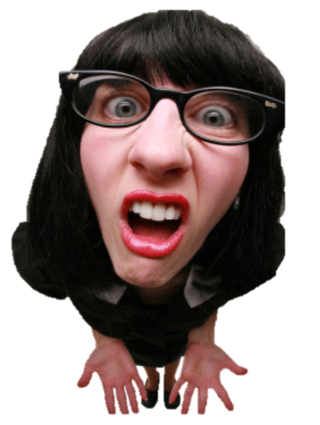
What is referencing?
No, really…what is this all about?

Slide 4

Referencing
Citing your sources –
  showing the reader which book (or source) you got your info out of, who said it and when
Acknowledging the source of the info is expected scholarly practice
This is usually done twice in each essay.
  Once in the text (in brief)
  Again in the final list (in full)

Slide 5
Referencing in summary is…
A clear acknowledgement of where you have got any information, ideas, opinions, viewpoints etc.
Essentially, every piece of information, every opinion, every viewpoint, every picture and sketch needs to be referenced.

Slide 6
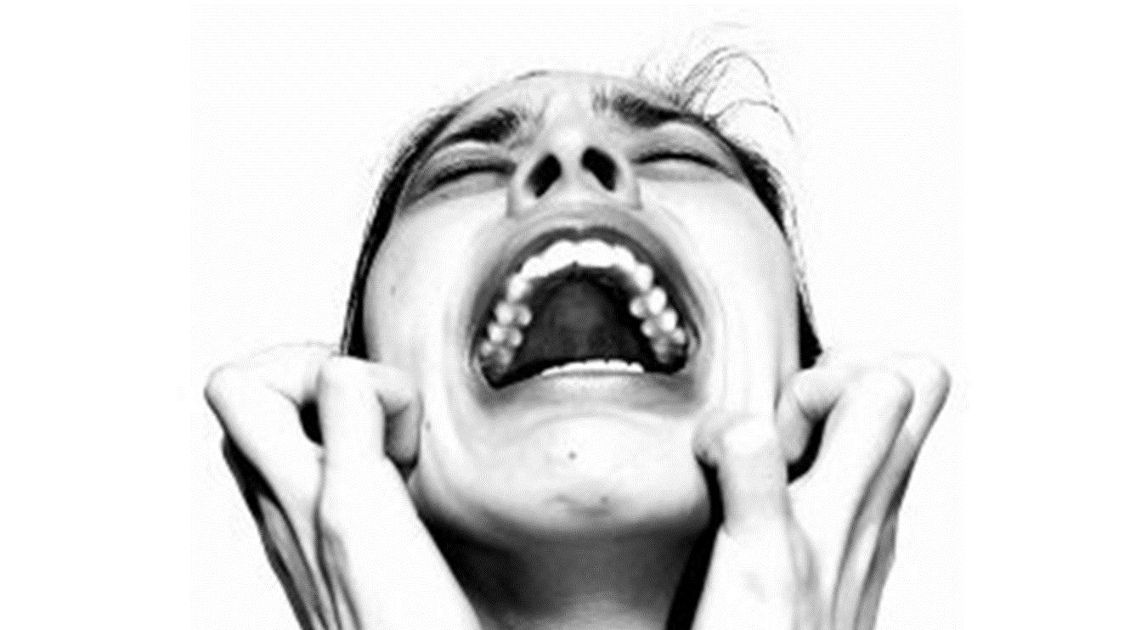
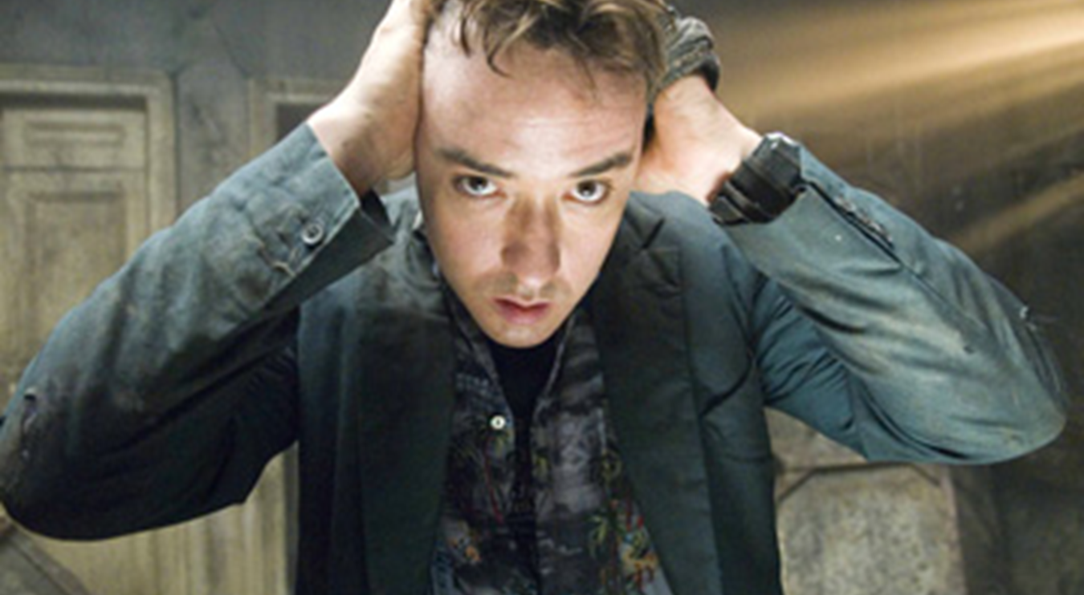
Every department, discipline, journal has a different style
We will look in more detail at HOW to reference later in this session

Slide 7
The rationale: Why

Slide 8
Good reasons
Signals you have joined the academic community
Gives credibility to your work
Shows your lecturer you have been reading
Develops your discussion
Supports your claims
Adds authority to your writing
Brings in other ideas which augments and deepens your work
Demonstrates awareness of ideas
Creates a ‘sharing trail

Slide 9
The sources you refer to should
Always be relevant (!)
Be from reliable sources – not Wiki or the Daily Mail (?!? But…)
Support your claims
Be accurate and complete

Slide 10
And finally….
You need to avoid Plagiarism

Slide 11
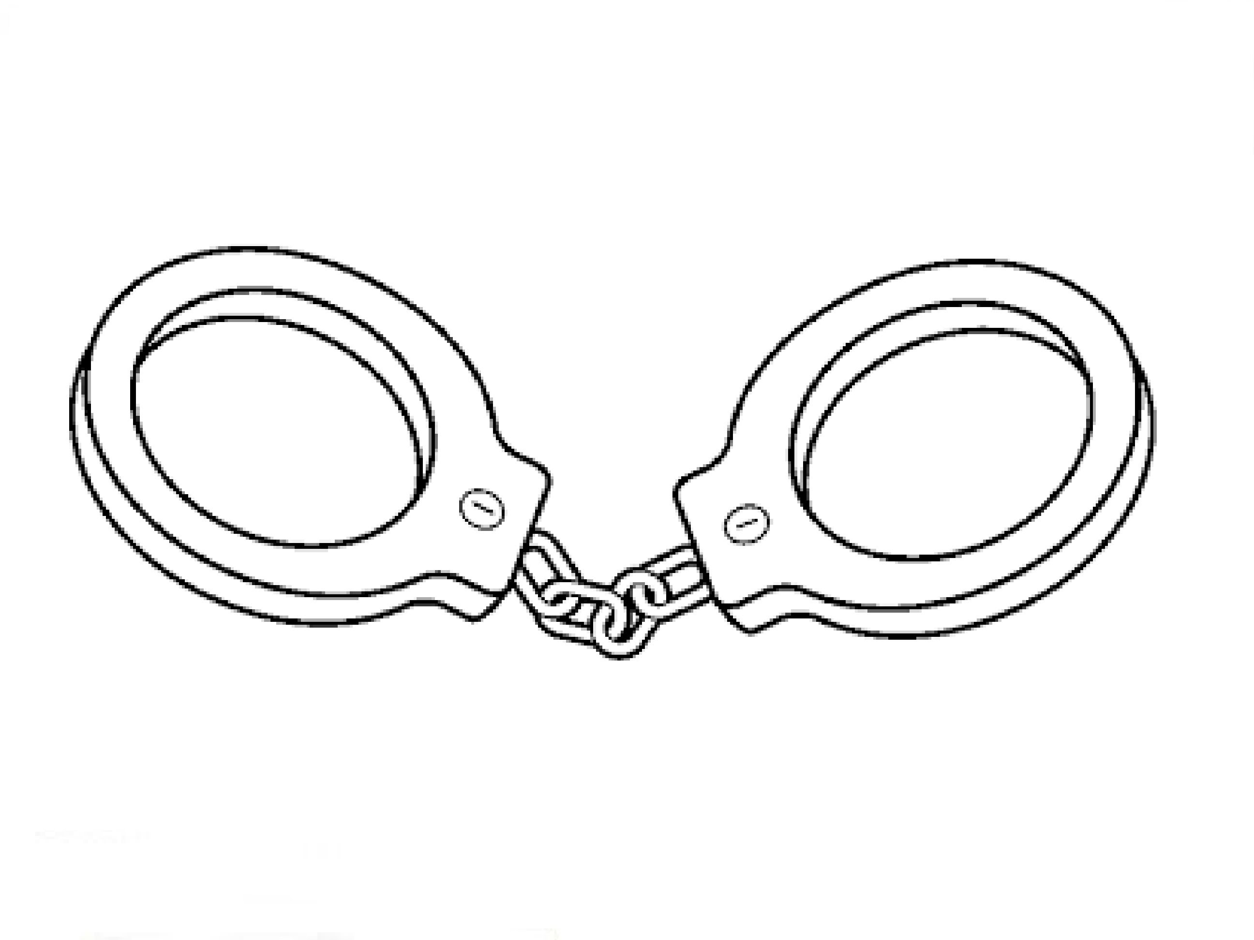

Plagiarism is…
Presenting the words, ideas, views and arguments of others as your own.
This is an academic crime and can cost you your degree.

Slide 12
Types of unfair practice

Slide 13
Types of Unfair Practice in academic work
Intentional Plagiarism
Inadvertent Plagiarism
Self-Plagiarism
Collusion

Slide 14
Intentional Plagiarism
This occurs if you simply copy chunks out of a textbook or from a website and pass them off as your own composition. There is nothing to be gained from this; it will always, if detected, count against you.

Slide 15
Inadvertent Plagiarism
This may occur if, in the course of note-taking, you copy substantial passages from a book or article into your own notes. After a lapse of some days, you may have forgotten that the notes were taken verbatim from another writer, and may use them in the composition of an essay. From the point of view of the tutor reading the essay, this is still plagiarism, even if unintentional.

Slide 16
Self-Plagiarism
Besides ensuring that all essays you submit are your own work, you must also avoid self-plagiarism. This means that you must not submit the same piece, or part of a piece, of work (with or without merely stylistic variation) in order to gain credit more than once. The same criteria apply to self-plagiarism as to other forms of plagiarism, and it is liable to incur the same penalty.

Slide 17
Penalties
The higher your level of study, the harsher the penalties for Academic Misconduct.
A second offence is treated more harshly than a first offence.
In determining the penalty, intention does not matter. So if you did it without realising it, that does not count AT ALL as a defence.
The penalties and regulations are available in the Academic Quality Handbook (you can see this on HWB under Academic Office).

Slide 18
How to Avoid Plagiarism:
The GOLDEN RULE
ALWAYS ACKNOWLEDGE YOUR SOURCES!

Slide 19
Recognising and avoiding the dreaded P!

Slide 20
Let’s try this out…Task 1
You should have one page with part of an academic article and a “mock” essay paragraph.
Read through both and decide what is plagiarism and what is not.

Slide 21
Unfair Practice?
Excavations in 1964 uncovered a building that is tentatively identified with the “Persian Stoa”.
YES
NO

Slide 22

Unfair Practice?
Excavations in 1964 uncovered a building that is tentatively identified with the “Persian Stoa”.
YES

Slide 23
Plagiarism?
The excavation uncovered a very important Roman statue made of bronze (Pikoula 2001:425).
YES
NO

Slide 24
Plagiarism?
The excavation uncovered a very important Roman statue made of bronze (Pikoula 2001:425).
NO
Why?
Has reference and there is no quotation.

Slide 25
Plagiarism?
Pikoula (2001:425) considers the appearance of the statue “odd”.
YES
NO

Slide 26
Plagiarism?
Pikoula (2001:425) considers the appearance of the statue “odd”.
NO
Why?
Has reference and the quotation is marked.

Slide 27
Plagiarism?
According to Pikoula (2001:425) the individual features of the statue are discernible: thinly arched brows, big eyes with heavy upper eyelids, small fleshy mouth.
YES
NO

Slide 28
Plagiarism?
According to Pikoula (2001:425) the individual features of the statue are discernible: thinly arched brows, big eyes with heavy upper eyelids, small fleshy mouth.
YES
Why?
Has reference But NO quotation marks.

Slide 29
Plagiarism?
Further the hair is rendered by incision and is parted in the centre.
YES
NO

Slide 30
Plagiarism?
Further the hair is rendered by incision and is parted in the centre.
YES
Why?
No reference and no quotation marks

Slide 31
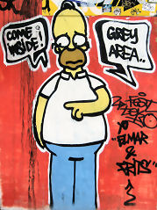
Grey areas
  Common knowledge (not expert) or generally accepted facts
    Info found unreferenced in respectable sources
Examples:
  Dolphins are mammals
  Car emissions contribute to atmospheric co2
Historical events (not documents) –
Example:
  Battle of Hastings 1066

Slide 32
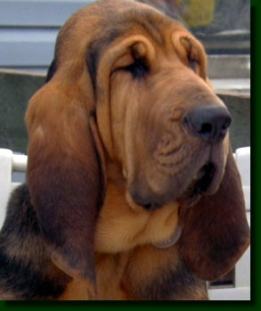
Detection
Detection software is linked to all electronic submissions (TIN)
Even without software staff are plagiarism bloodhounds

Slide 33
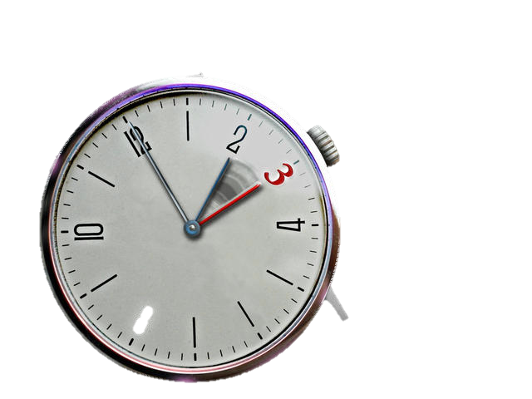
Reasons given
You ran out of time
You thought no one would notice
You thought no one would realise
You thought no one would care
You couldn’t do the work yourself
You didn’t know the rules!

Slide 34

What don’t you need to reference?
Your own information, observation, ideas, experiences, conclusions.
If you are writing up your findings from field data or experiments
If you use your own images
Common knowledge…

Slide 35
If in doubt – cite.

Slide 36
P2
Q&A
P2: Primary sources: Identify one primary source for your essay, and summarise the relevant information for your specific topic in 250 words. Remember to provide references throughout: Wednesday 8th November

