Slide 1
BuSINESS, MARKETING
& SELF PROMOTION
Neil Dyer

Slide 2
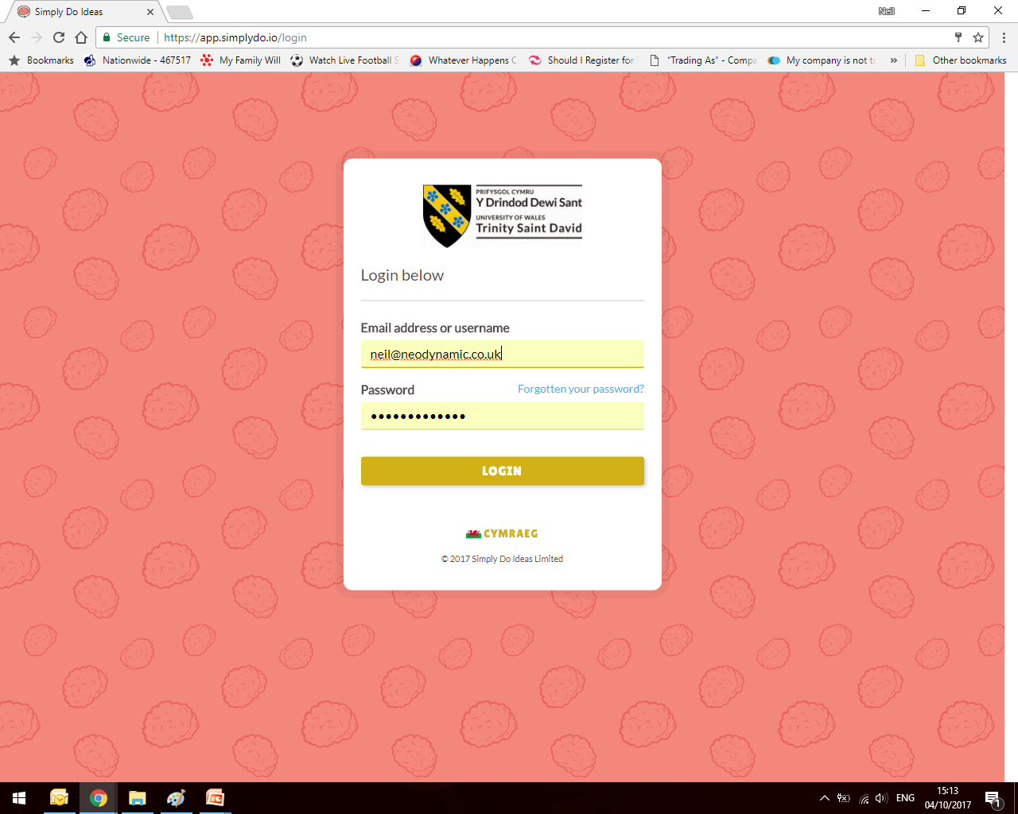
Simply Do Ideas
http://app.simplydo.io/new/uwtsd
(make sure you click and add yourself to our group:
‘Neil Dyer – Business, Marketing & Self-Promotion’

Slide 3
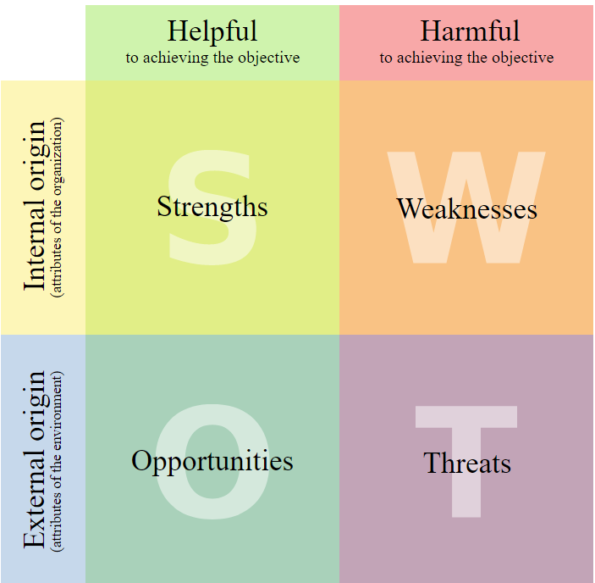
SWOT
IN
OUT

Slide 4
WEEK | Date: | TOPIC
Wk 1: | 2nd Oct | Introduction & Assignment
Wk 2: | 9th Oct | Self-Evaluation (CV, Application & Interviews)
Wk 3: | 16th Oct | Researching the Market & Scanning the Environment (Taking a Snapshot) Business Planning – The Formal Stuff (Structure, Legal) Introduction to Simply Do Ideas Portal (Canvas and Sign-up) STEP 1. Concept (including SWOT Analysis of idea, value proposition, features, benefits)
Wk 4: | 23rd Oct | STEP 2. Customer (market research, demographics, profiling) STEP 3. Competitors (competitor analysis with 5 Forces)
Wk 5: | 30th Oct | Insight into Marketing (how to Get, Keep, Grow customers – marketing, self-promotion, elevator pitch, relationship marketing, networking, pricing strategy)
Wk 6: | 6th Nov | FEEDBACK TUTORIAL WEEK
Wk 7: | 13th Nov | STEP 4. Compatibility (going back to self-evaluation, roles and responsibilities, human resource, skills) Insight into Networks (the importance of networks, alliances, partnerships – support, advice and suppliers/customers) STEP 5. Contents (distribution, assets, resources, equipment, training)
Wk 8: | 20th Nov | STEP 6. Cash (key costs and income, funding) Insight into Financial Planning and Projections (Income, expenditure and profit) Insight into Funding (Crowdfunding, loans, grants)
Wk 9: | 27th Nov | Recap and Troubleshooting Session
Wk 10: | 4th Dec | Self-study and assignment preparation
Wk 11: | 11th Dec | 1-2-1 Assignment Support Slots Assessment Submission Deadline Week
Wk 12: | 8th Jan | Feedback to students and module evaluation
Course Outline

Slide 5
Assessment
1. The Simply Do Ideas Tool: This online system works on 6 ‘business’ elements or steps. The student is asked to analyse and complete necessary sections under each of these elements. These are then automatically compiled and presented in an online or presentation format as seen in this example here: https://app.simplydo.io/idea/aDzkr9rC4SonrGawi/pitch
Student requirements:
Submission of completed online portfolio. [50%]
Supporting attachments to include: [40%]
  SWOT Analysis of their idea/business
  Five Forces Competitor Analysis
  Pricing Proposal and Financial Projection
  Marketing Plan
2. A completed and professional CV (10%)

Slide 6
Customers & competitors
Neil Dyer

Slide 7
Customers
Neil Dyer

Slide 8
Your Ideas...
Tell me your idea again!
Who are your customers going to be?
Who will be your competitors?

Slide 9
TODAY WE START ON MARKETING
Basic Business Principles
Customer have to want what you’re offering (MARKET RESEARCH:Remember - Meet a need/desire, solve a problem)
You need to say how you meet that demand
(MARKETING: value proposition, marketing mix, communication)
You need to keep appealing to that demand
(MARKETING: ‘get, keep, grow’, relationship marketing)
You have to continuously compete to survive
(COMPETITIVE STRATEGY: adapt or die, innovation)

Slide 10
TODAY’S SESSION
Assignment:
STEP 2: Customers
-Overview (target customers and market size)
-Customer Profiles (3 key targets)
-Market you idea (key marketing mediums)
STEP 3: Competitors
Competitor profiles (3 key competitors – good & bad)
What you do better (marketing mix)
ATTACHMENTS: Five Forces Analysis and Marketing Plan

Slide 11
TODAY’S SESSION
Assignment Relevance:
STEP 2: Customers
-Overview (target customers and market size)
-Customer Profiles (3 key targets)
-Market you idea (key marketing mediums)
STEP 3: Competitors
Competitor profiles (3 key competitors – good & bad)
What you do better (marketing mix)
ATTACHMENTS: Porter’s Analysis and Marketing Plan
What we’re going to do is complete a marketing plan/strategy that covers all these areas!
(You can extract the detail from this to put into the portal)

Slide 12
YOUR MARKET
MARKET RESEACH
What is the overall market like?
General description
Size (population, financial value, places)
Environment Trends (PESTEL analysis)
b. Customer research and profiling.

Slide 13
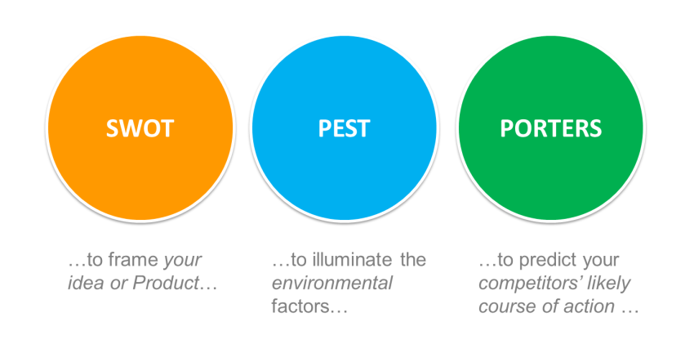
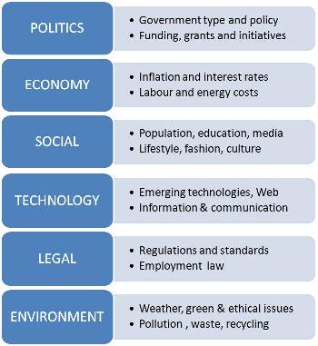
YOUR MARKET
PESTEL Analysis
... PEST is fine!

Slide 14
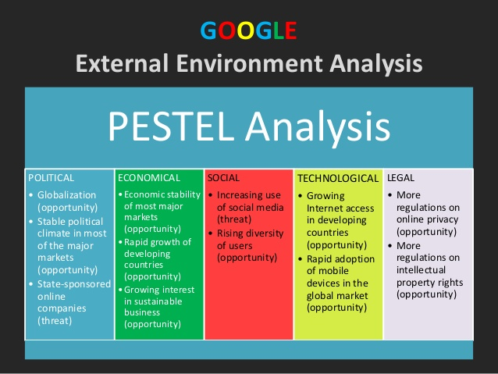
A MARKETING PLAN

Slide 15
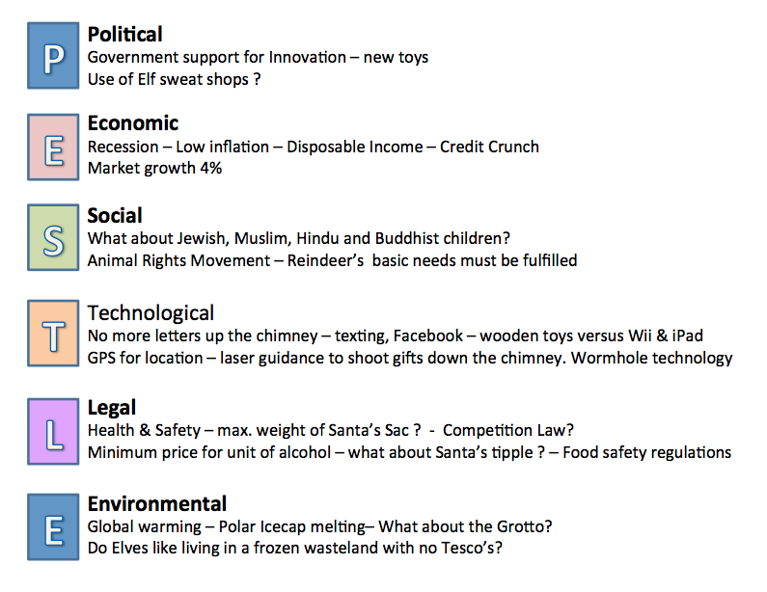
Santa’s Grotto - PESTLE

Slide 16
YOUR MARKET
MARKET RESEACH
What is the overall market like?
Customer research and profiling
Segmenting your market
Defining your customer

Slide 17
YOUR MARKET
Segmentation
This is the marketing process that recognises that not all customers have the same motivations for buying. Therefore marketers split their markets into smaller sub-markets called segments. They will attempt to understand why these customers buy and will develop profiles of typical customers to anticipate and satisfy their needs and wants, this is the cornerstone of all good marketing.

Slide 18
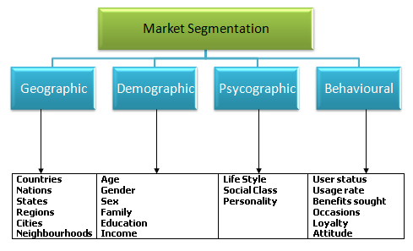
YOUR MARKET
Bases of Segmentation

Slide 19
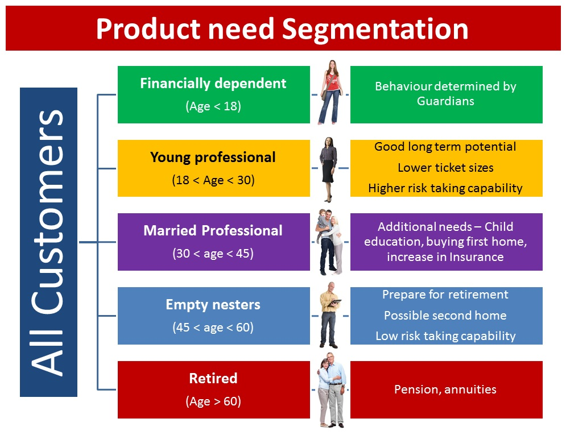
FINANCIAL SERVICES

Slide 20
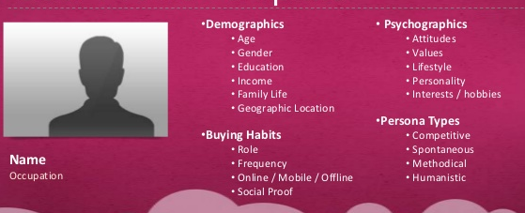
YOUR MARKET
Customer Profiling
...a way to create an unique identity for your customers to help you make marketing decisions concerning your product/service. Your customers are broken down into groups of customers sharing similar goals and characteristics and each group is given a representative with a photo, a name, and a description.

Slide 21
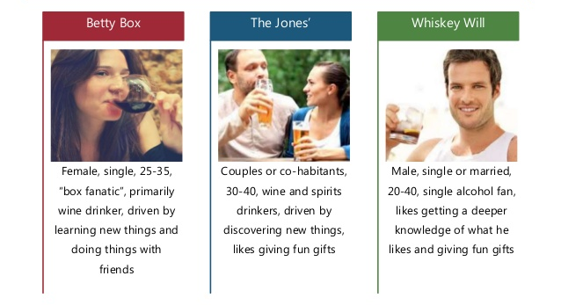
YOUR MARKET
Customer Profiling

Slide 22
YOUR MARKET
MARKET RESEACH
What is the overall market like?
Customer research and profiling
HOW DO YOU DO IT THOuGH?

Slide 23
YOUR MARKET
MARKET RESEACH
$$$ Use a market research company $$$
Or...
Desk Research: Use the internet to find out about market activities, news, case studies, completed research. Check out competitor websites.
Published Market Research: Visit the library and ask what databases are available. Look at reports, market trends and statistics. Check out journals in your industry.
Field Research: Qualitative (focus groups, interviews) and quantitative research (surveys). Ask people questions!

Slide 24
Your Ideas...
EXERCISE
Who are your customers going to be?
Can you identify three distinct segments?
How would you profile them?
(Use Worksheet 3a)

Slide 25
competitors
Neil Dyer

Slide 26
COMPETITORS
COMPETITIVE STRATEGY
- Who are your major competitors?
What are they good and bad at?
What can you do better?
Therefore, what are your competitive advantages?
- Is all competition bad?
Consider the benefits of competition: increased market awareness, opportunity for outsourced work, knowledge/insight.

Slide 27
Your Ideas...
Who are your competitors going to be? [Discuss]

Slide 28
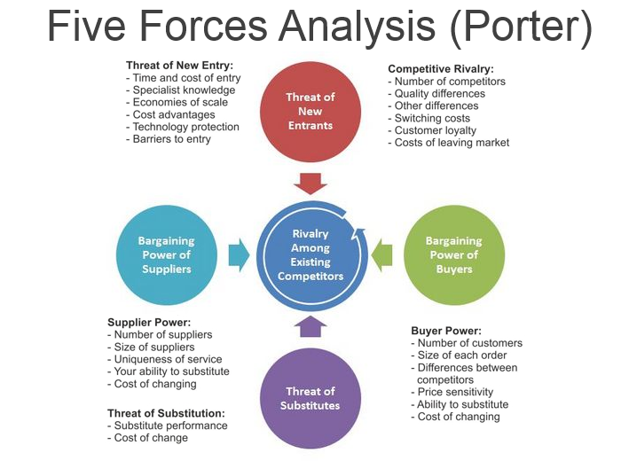
A MARKETING PLAN
(Porter, 1979)

Slide 29
Porter’s Five Forces
...helps to look at the ‘balance of power’ in a market between different types of organisations, and to analyse the attractiveness and potential profitability of an industry sector.
It’s a strategic tool designed to give a snapshot overview, rather than a detailed business analysis technique. It helps review the strengths of a market position, based on five key forces.
Helps show you how competitive you’re going to be or can be!

Slide 30
Porter’s Five Forces
1. Competitive Rivalry
This looks at the number and strength of your competitors.
How many rivals do you have?
Who are they, and how does the quality of their products and services compare with yours?
Where rivalry is intense, companies can attract customers with aggressive price cuts and high-impact marketing campaigns. Also, in markets with lots of rivals, your suppliers and buyers can go elsewhere if they feel that they're not getting a good deal from you.
On the other hand, where competitive rivalry is minimal, and no one else is doing what you do, then you'll likely have tremendous strength and healthy profits.

Slide 31
Porter’s Five Forces
2. Buyer Power
Where there are fewer buyers, they often control the market.
Questions here include:
How powerful are the buyers?
How many are there?
Can the buyers get costs down?
Do they have the power to dictate terms?
An example is the grocery sector since supermarkets tend to retain power over suppliers due to volume and price of contracts. They dictate terms, set prices and can possibly end agreements at any time.

Slide 32
Porter’s Five Forces
3. Supplier Power
Markets where there are few suppliers means the suppliers retain the power.
Examine how many suppliers are in the market?
Are there a few who control prices?
Or many so prices are lower?
Do your suppliers hold the power?
How easy is it to switch, what’s the cost?
Some sectors have monopolistic (one) or oligopolistic (few) suppliers, such as utility companies. Sometimes customers have little choice i.e. where to buy domestic water suppliers though this is changing.
In the jewellery sector, diamond suppliers often hold the power and can set prices, withhold supply and restrict sales.

Slide 33
Porter’s Five Forces
4. Threat of New Entry
If a new businesses can be easily started up in your sector without substantial investment - then this is a threat.
The Internet has made this a reality in many sectors, especially publishing!
So ask yourself the questions:
What’s the threat of new businesses starting in this sector?
How easy is it to start up in this business?
What are the rules and regulations?
What finance would be needed to start-up?
Are there barriers to entry which give you greater power?
An example is web design, as there are independents in every location. This is an easy market to enter with few requirements, other than skills, initiative and relevant hardware and software. This does mean there are many new entrants!

Slide 34
Porter’s Five Forces
5. Threat of Substitution
If there are available alternatives then the threat of substitution increases.
How easy is it to find an alternative to this product or service?
Can it be outsourced? Or automated?
The substitute to all services is DIY. For example hairdressing or writing a will. Focus is on expertise, customer service or added value.
THIS DOES NOT MEAN OTHER DIRECT COMPETITORS. Substitution refers to where customers can fulfil the same need or desire through an alternative way – i.e. A threat to the vitamin market would be fresh produce or ‘boost’ drinks.

Slide 35
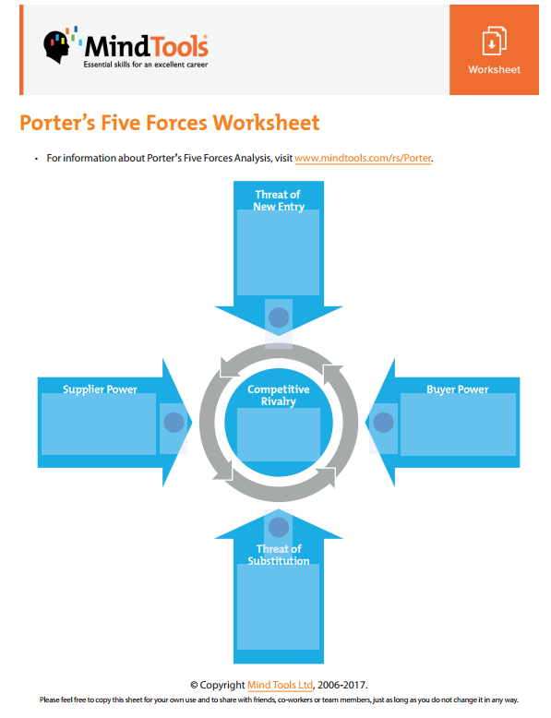
Porter’s Five Forces
http://www.mindtools.com/rs/Porter

Slide 36
Your Ideas...
Who are your competitors going to be?
Can you identify three distinct competitors (think substitutes, new entrants, direct, suppliers)?

Slide 37
Competitive Advantage
How do you get a competitive advantage?
(What influences your decision when choosing a product/service?)

Slide 38
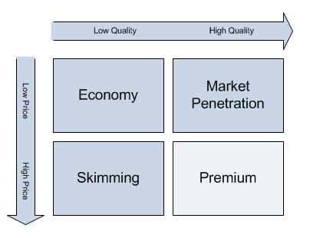
Competitive Advantage
Differentiation by Price
‘Price is the first thing businesses look at to compete!’

Slide 39
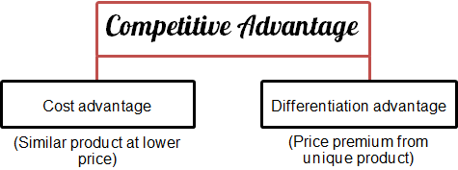
Competitive Advantage
Differentiation ‘not by price’:
Differentiation by:
Quality
Product design/features
Marketing/Branding
Customer service
Reliability/reputation
Product diversity

Slide 40
Pricing
The three ‘real-life’ principles:
Profit = Price – cost
What price will get the work?
What am I worth? What do I want to earn?

Slide 41
COMPETITORS
COMPETITIVE STRATEGY
-Porter’s Five Forces, and most models, are snapshots.
-You need to constantly review to be able to react.
-Adapt or die principle.
-Creativity and innovation are key.

Slide 42
Your Ideas...
Who are your competitors going to be?
Can you identify three distinct segments (think substitutes, new entrants, direct, suppliers)?
How are you going to compete with those different groups?
(what do they do well/bad, what can you do better or differently?)

Slide 43
Customers & competitors
Neil Dyer

Slide 44
Home tasks for next Monday:
NOTE: Will be emailed out to you.
Log into Simply Do Ideas portal (and join group).
Complete SWOT Analysis and Step 1 on portal.
Complete your CV.
Complete the Overview and 3x Customer Profiles ONLY in Step 2.
Have a go at a Porter’s Five Forces Analysis using the link provided in the slides.
Complete the 3x Competitor Profiles ONLY in Step 2.

Slide 45

THE WELSH BUSINESS SHOW
Exhibition: 10am – 3pm
This Thursday
at the Liberty Stadium
FREE VISITOR – REGISTER HERE:
http://www.twbs.wales/the-shows/swansea-2017/exhibitors-swansea-2017/

Slide 46
In addition:
Weekly Homework is:
  to contextualise topics discussed – ‘relate it to your industry’ and feedback
  Work on and complete CV
  Complete the ‘Simply Do Ideas’ platform and attachments

Slide 47

ANY QUESTIONS?
Neil Dyer
neil@neodynamic.co.uk
Check Moodle and
your emails
Ask anything, any time!

