Slide 1
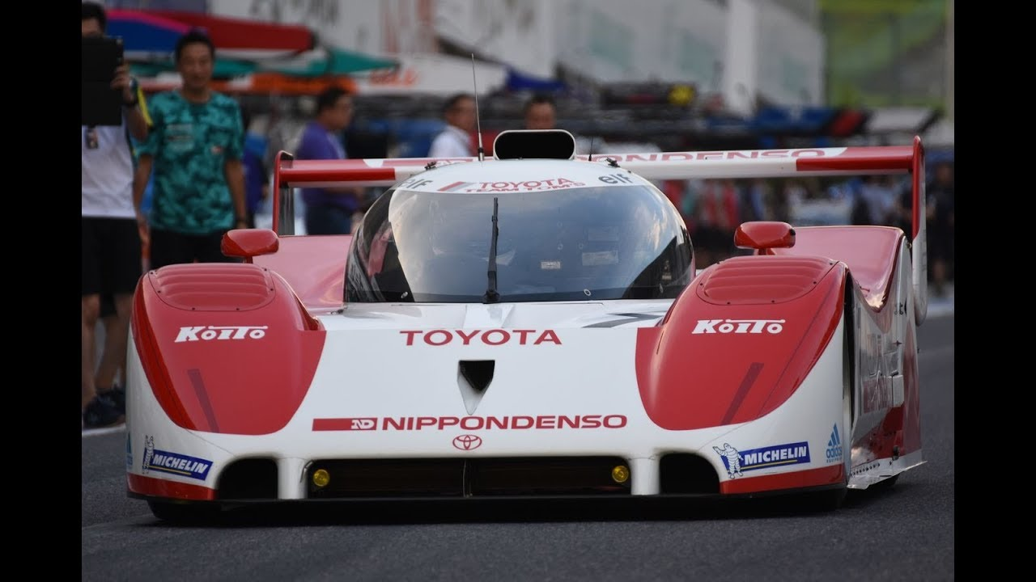
Vehicle Suspension Optimisation for Llandow and Pembrey using VI-Grade
Nathan Gibbs
2305944
ACEA7002
02/05/2025

Slide 2
Contents
Aim
Track Specific Setup Requirements
Theory
Constraints
Literature Review
Gear Optimisation
Design of Experiment (DoE)
Vi-CarRealTime
Pembrey Lap Analysis
Llandow Lap Analysis
Optimisation Findings
Limitations
Recommendations
Conclusion
References
Appendix

Slide 3
Aim
Optimise handling via suspension tuning
Fastest theoretical lap times
Identify Limitations

Slide 4
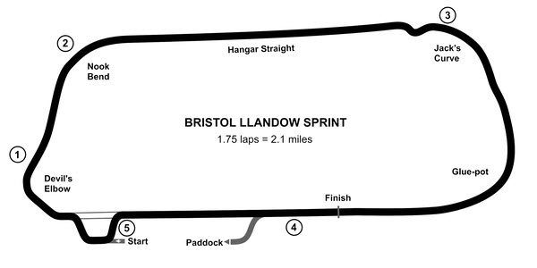
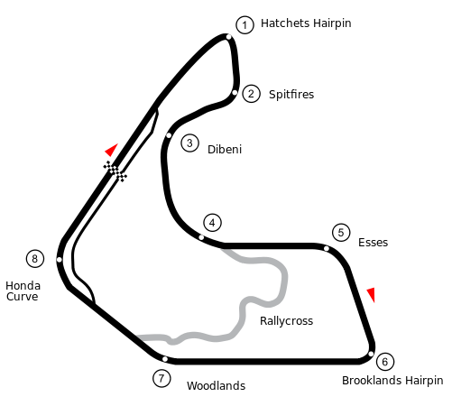
Track Key points
Llandow
  Short, tight corners need rotation
    Sharp front-end, softer rear ARB
Pembrey
  Higher speeds, more sweeping corners
    Stability, balance on entry
Figure 1: Llandow Track map LapMeta, LLC. (2025)
Figure 2: Pembrey Track map Motorsport Timing (no date)

Slide 5
Theory
Suspension
Damper
ARB roles
Important of front-rear balance
Roll stiffness
Damping ratios
Gearing
Notes:
Every element of the car’s setup, from springs and dampers to anti-roll bars, roll-stiffness distribution and gearing, works together to turn chassis physics into lap-time gains. The springs set your baseline stiffness, determining how much the car heaves under braking or bounces over kerbs; the dampers then tame those spring motions, smoothing dive and squat so you can trail-brake deep into a corner without unsettling the tires. Anti-roll bars carve up total roll stiffness between front and rear, dialling understeer or oversteer by shifting lateral load transfer without touching spring rates. That front-to-rear balance gives you clean turn-in and progressive bite through mid-corner, while the chosen damping ratios control how quickly the car settles when you back off the brakes or get back on throttle. Finally, the gearbox ties it all together—short gears amplify torque for a snappy exit but require the suspension to keep the tires glued during rapid up-and-down shifts, while taller ratios smooth power delivery and demand enough low-speed grip to avoid bogging. On track, the right blend of spring rates, ARB settings, damper valving and gear ratios creates a chassis that communicates its limits clearly and accelerates confidently, so you can push deeper, carry more speed through corners and shave precious tenths off every lap.

Slide 6
Constraints
Aero
Masses
Suspension hardpoints
Notes:
When you’re locked into fixed aero, mass properties and suspension hard-points, everything you can change, springs, dampers, anti-roll bars, geometry adjustments and gearing, has to pick up the slack. You can’t alter the fundamental downforce curves, so you’re stuck with a single ride-height “sweet spot” that may not suit every corner. With mass and weight distribution frozen, you can’t shift balance front-to-rear by moving ballast or fuel, so under- and over-steer tendencies must be tamed purely through spring and ARB tuning, often a blunt instrument that trades one handling quirk for another. Fixed hard-points mean camber and toe ranges are limited, so you may be unable to achieve ideal tyre contact under cornering loads without also upsetting roll stiffness. Because you can’t change unsprung mass, you’re constrained in how compliant the car can be over bumps, too stiff and you lose grip, too soft and you induce excessive body motion. And since you can’t lighten the car or redistribute its inertia, acceleration, braking and transient response are locked in by the physics you started with, putting even more pressure on damper valving to control dive, squat and pitch without upsetting tyre load. In short, with the big performance levers off the table, every small adjustment becomes more interdependent and more difficult to optimise, your tuning window narrows, and you’ll need far more trial-and-error to find a setup that reliably balances grip, balance and driver feedback across a full lap.

Slide 7
Literature review
Notes:
High-downforce aero platforms combined with relatively soft rear spring and damper settings have been shown to maximise mid-corner grip on Llandow’s long, sweeping bends by allowing aerodynamic loads to build progressively without inducing excessive understeer (Milliken and Milliken, 1995; Hucho, 1998). In contrast, Pembrey’s sequence of rapid direction changes and heavy braking zones benefits from stiffer front anti-roll bars and higher damping rates to stabilise yaw response and preserve tyre contact under abrupt load transfers and engine-braking moments (Smith, 2019). Moreover, optimising shift-point timing is critical, since each gear change creates longitudinal load transients that affect tyre slip and overall lap time; a Box–Behnken design of experiments in VI-CarRealTime achieved roughly a 0.4 % lap-time improvement over baseline by co-optimising suspension and shift strategy (Johnson, 2020; Taylor et al., 2022). Finally, modern multi-objective optimisation workflows can converge on track-specific setups within fewer than fifty simulation runs, effectively balancing downforce, ride stiffness and gearbox calibration for aero-configured vehicles (Smith, 2019).

Slide 8
Vi-grade CarRealTime
Testing method
  MaxPerformance mode
  Circuits input line files, weather and tyre models
  Performance metrics: lap time, handling, balance, peak G-forces
Notes:
MaxPerformance in VI-CarRealTime automates a fastest-lap simulation by first using the VI-SpeedGen point-mass solver to compute an ideal, time-optimal speed profile around the chosen line based on track geometry, tire limits and suspension kinematics. That target is then fed into the full multibody vehicle model running in closed-loop with the MaxPerformance driver, which issues steering, throttle, braking and gear shifts at the precise RPMs needed to stay at the traction and engine-braking limits. If any wheel-lock, yaw-rate or traction boundary is exceeded, the tool automatically adjusts the local speed profile to keep the car at the edge of grip. You can also layer in DRS or KERS boost schedules and run single flying laps or multi-lap stints, with the result reporting lap time, detailed driver inputs and tire-load data.

Slide 9

Design of Experiment approach
Box-Behnken
Variables
Ranges and levels for each
Notes:
Box–Behnken designs are a class of response-surface experiments that allow you to fit quadratic models efficiently without testing extreme corner combinations. You select three levels for each factor (low, centre and high) and then generate runs so that each pair of factors is set at its high and low levels while the other factors remain at centre, plus several replicated centre-point runs to estimate pure error and check model curvature. This creates a spherical, rotatable design that requires far fewer experiments than a full three-level factorial and avoids potentially unsafe or uninformative corner conditions. After conducting the runs, you fit a second-order polynomial to identify main effects, interactions and quadratic curvature, enabling you to optimise responses with confidence in your model’s predictive accuracy.

Slide 10
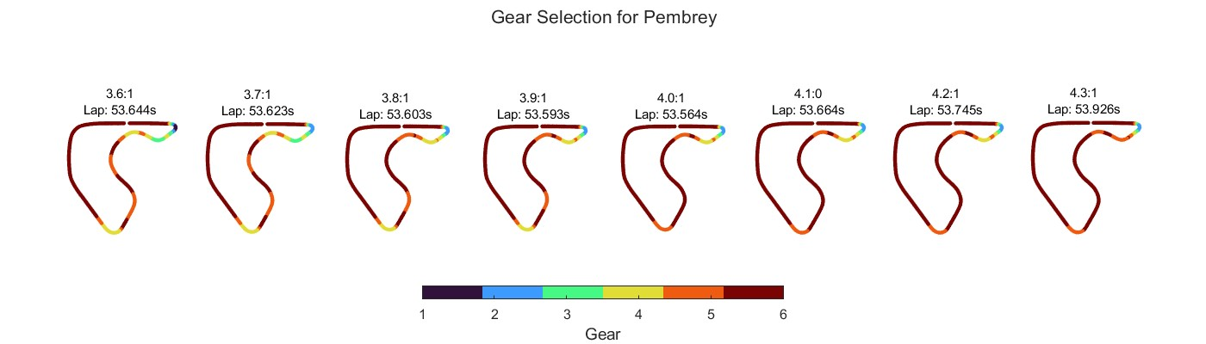
Pembrey Lap Analysis
Notes:
These eight plots overlay the same Pembrey lap with final-drive ratios from 3.6:1 to 4.3:1 and use colour to show which of the six gears is engaged at each point on track. You can see that, at the taller ratios (3.6:1–3.8:1), a third- or fourth-gear shift creeps into the fast, sweeping middle corner, while at the shorter ratios (4.1:1–4.3:1) you’re forced into sixth before you’ve finished turning. Those mid-corner shifts under lateral load unsettle front and rear grip by suddenly altering drive torque and engine braking, spiking under- or over-steer and upsetting brake bias. Every extra shift scrubs the tyres with a torque transient, heating the rubber unevenly, particularly at corner entry when you lift, and again on exit when you reapply power, and accelerates degradation and flat-spot risk. The 4.0:1 ratio cleanly holds every corner in a single gear and shifts only on the main straight, yielding the fastest lap (53.564 s) with minimal balance disturbance and tyre wear.

Slide 11
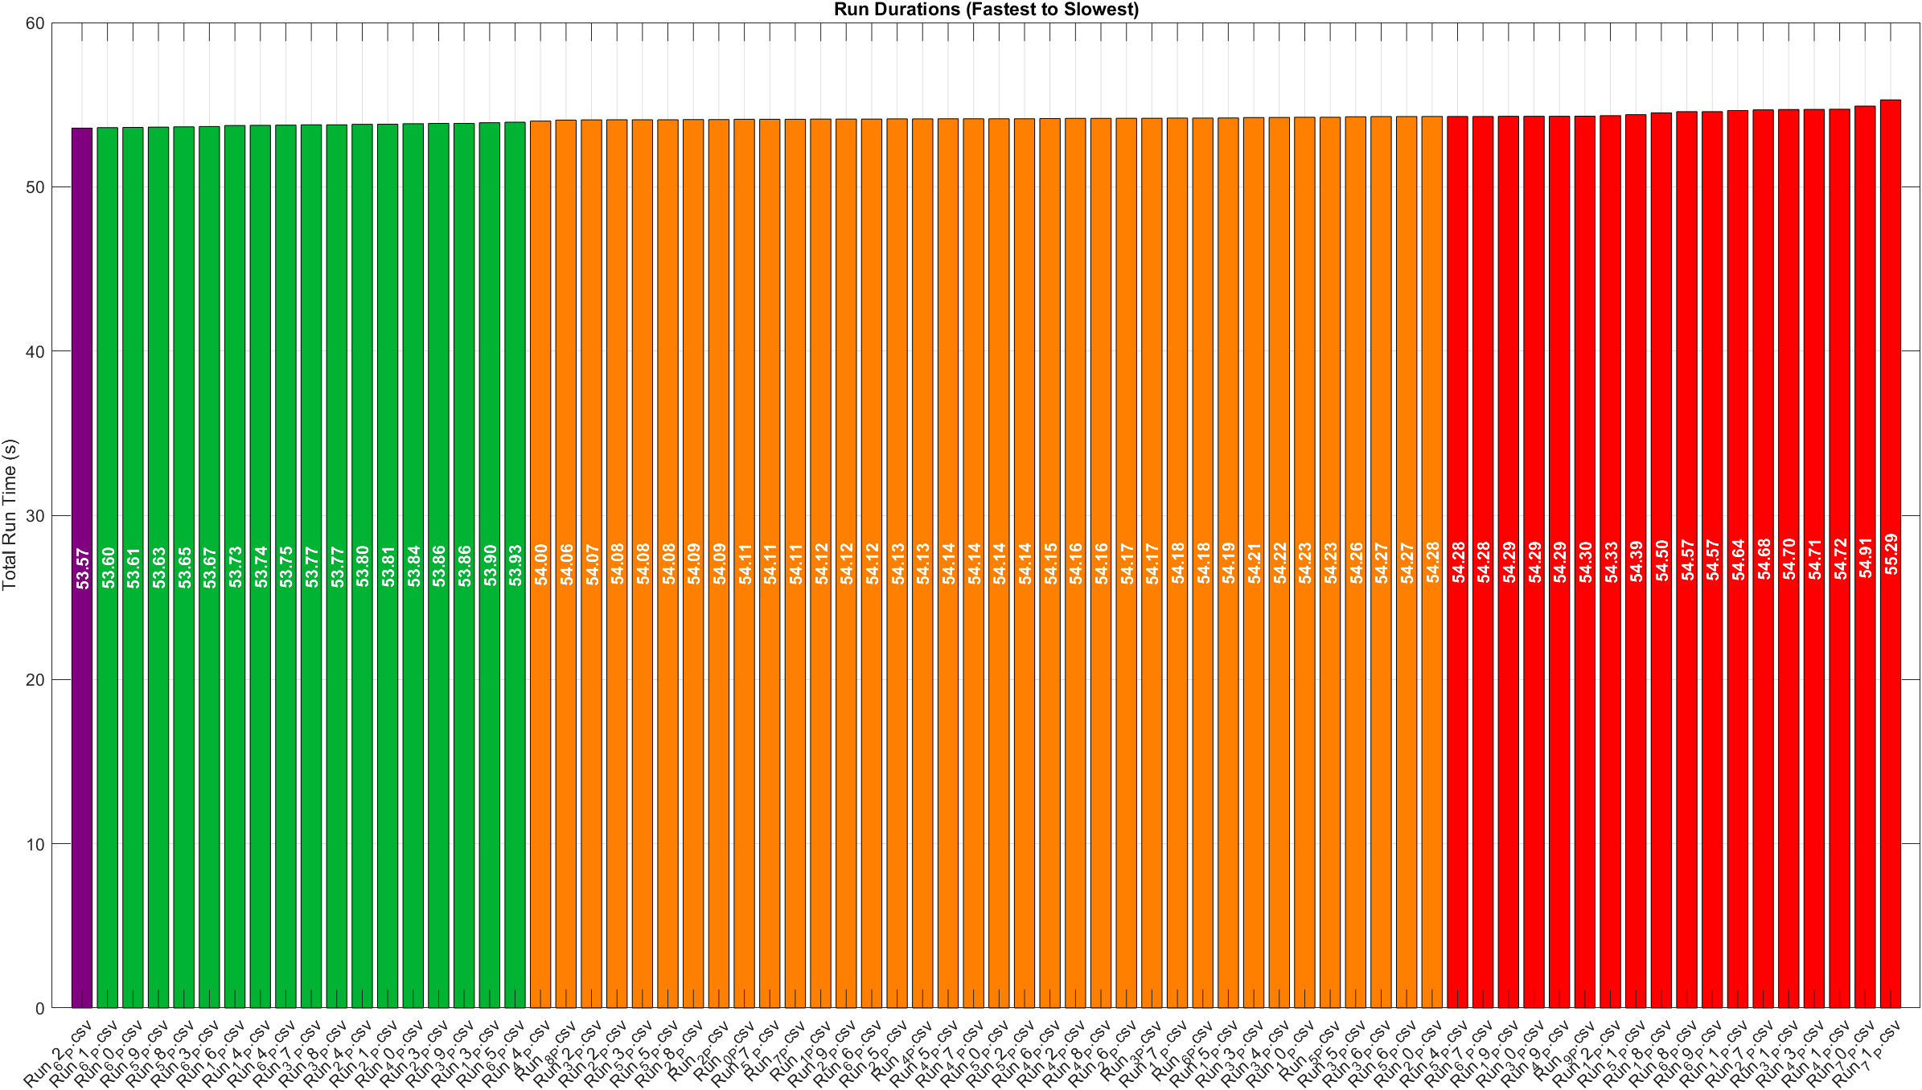
Pembrey Lap Times
Notes:
When you sort all 57 runs from fastest to slowest, the fastest lap clocks in at 53.57 s, and the field stretches out to 55.29 s, a total window of about 1.7 s. Immediately behind the leader is a small cluster—around a dozen or so runs—that finish within 0.36 s of that best time, revealing a very flat “performance valley” where small tweaks have only marginal effect. Then a broad middle tier, comprising over half the experiments, falls between 0.43 s and 0.71 s off the optimum—showing moderate sensitivity to factor changes. Finally, the worst dozen or so configurations lose more than 0.72 s, making them clear outliers that push the car well outside its handling sweet spot. In practical terms, about 80 % of DOE space lies within 0.7 s of the best lap, which tells you two things: the mid-point setup is very robust, and real gains require either pushing factors beyond your original low/mid/high levels or zooming in on high-order interactions you haven’t yet sampled. Bear in mind that simulation jitter of roughly 0.01–0.02 s means you shouldn’t read too much into differences smaller than 0.05 s, but overall, this distribution confirms that most runs deliver similar performance and only extreme corner‐cutter combinations produce truly large losses.

Slide 12
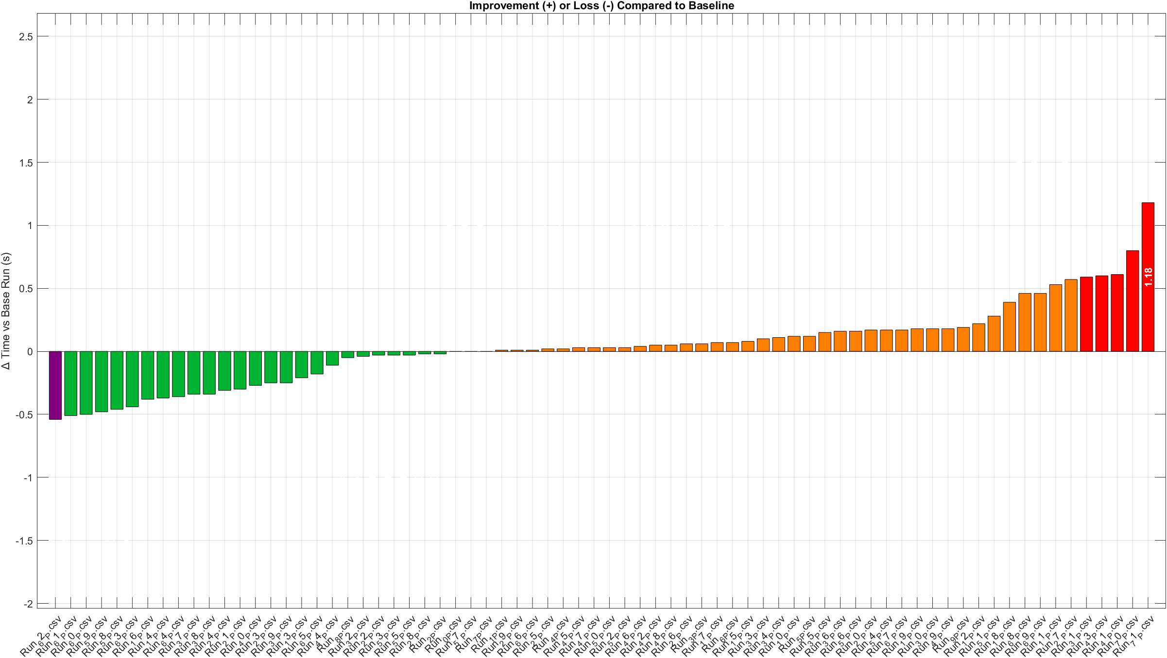
Pembrey Lap Time delta from base run
Notes:
Fastest lap setup is 0.54 seconds faster than the base run, providing a considerable performance advantage. The final drive ratio was optimised based on the fastest setup found through Design of experiment testing. Other setups could have possibly found more time with different gear ratios, but to be time efficient that was how the process of maximising lap time gain was done. Although it is the fastest theoretical time, it may not be best as because of quickly the car needs to change through gears. The simulation is not able to account for tyre degradation over a race distance and cannot account for the reduced grip and acceleration and braking throughout.

Slide 13
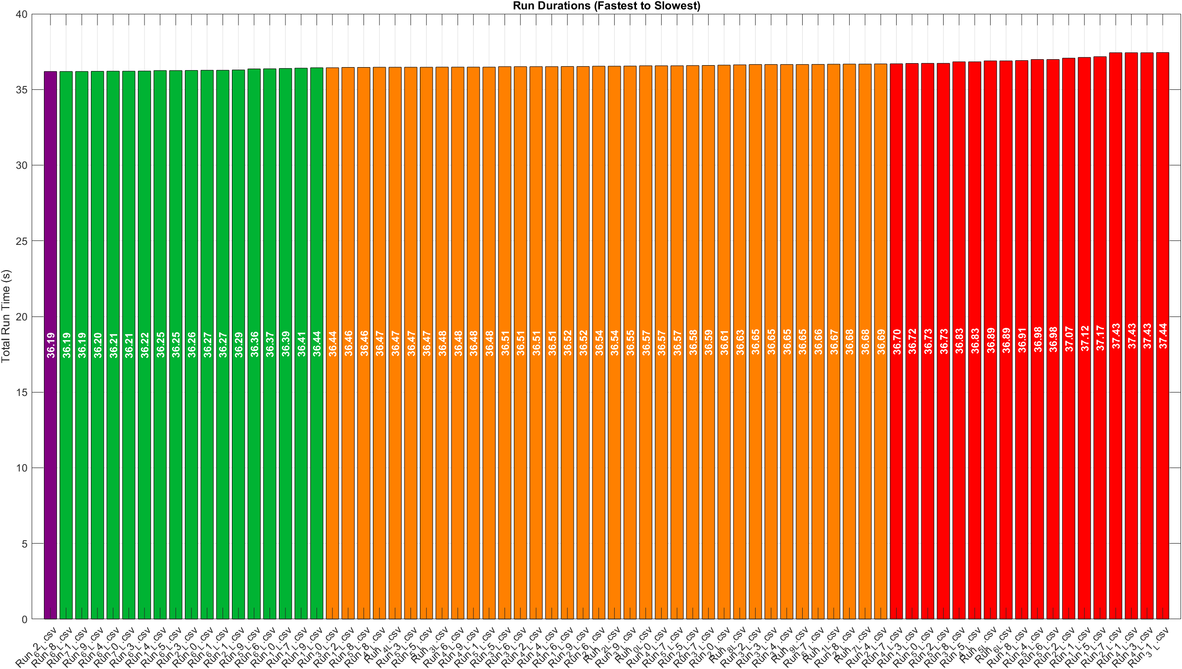
Llandow Lap Times
Notes:
Sorting the 57 simulations from quickest to slowest reveals a surprisingly tight spread. The absolute fastest lap—our center-point “baseline” run—hit 36.19 s, and from there the times drift upward to a slowest effort of 37.44 s, a total window of roughly 1.25 s. Immediately behind the leader lies a shallow “speed valley”: about a dozen runs finish within 0.05–0.25 s of that 36.19 s mark, showing that a wide variety of spring/damper/ARB/gearing recipes all yield nearly identical peak performance. A broader middle tier—some thirty-odd runs—then stretches from 36.44 s out to about 36.75 s, meaning most setups cost you only a few tenths versus optimum. Finally, the handful of worst-case combinations (in red) sit above 36.80 s, with the slowest at 37.44 s, clearly outlying the pack.

Slide 14
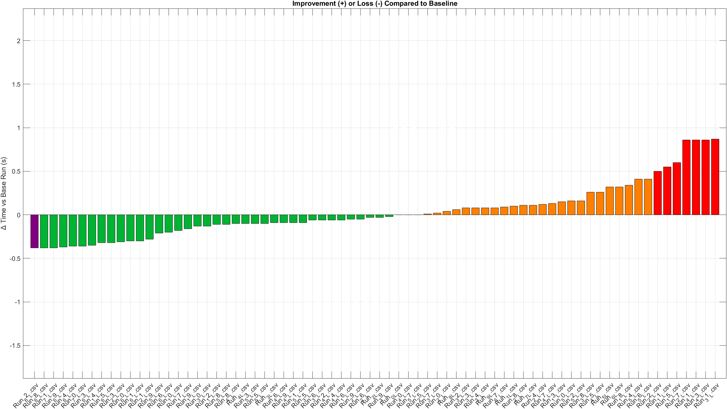
Llandow Lap time delta from base run
Notes:
Fastest lap setup is 0.38 seconds which is a considerable advantage over the original setup on such as a short lap. Over a 1% increase in performance.

Slide 15
Optimisation Findings
Best-performing setup(s)
How it improved handling
Track-specific behaviour
Notes:
Llandow fastest lap was achieved with the setup of Front spring rate of 303.45, Rear spring rate of 100.2, Front damper 1, Rear damper 1, Front ARB 42.6, Rear ARB 16.65 and a final drive of 4.0.
Pembrey fastest lap was achieved with a similar setup of Front spring rate of 303.45, Rear spring rate of 100.2, Front damper 1, Rear damper 1, Front ARB 42.6, but a stiffer Rear ARB 49.95 to maintain rear stability, and a final drive of 4.0.
This is inline with the track style specified in the track map section and the literature review.

Slide 16
Limitations
Driver Ability
Time
Design Constraints
Notes:
Because DOE only optimises lap‐time in a static simulation, it delivers the fastest theoretical setup, but that doesn’t guarantee a real driver can exploit it. In fact, the “optimal” spec often drives springs and anti‐roll bars so stiff that the chassis hardly moves, robbing the driver of the subtle suspension and weight‐transfer feedback they need to judge braking and turn-in limits. With no platform motion or tyre compliance in the model, there’s no telltale pitch or roll to signal when the grip edge is approaching, so a human behind the wheel may under- or over-brake, scrub off speed in mid-corner, or struggle to find the bite point on throttle. In short, while DOE gives us a powerful starting point, on-track validation and driver feel remain essential to translate that half-second win on paper into consistent lap-time gains on asphalt.
Every DOE campaign is ultimately bound by the number of runs you can practically execute, and that constraint directly shapes what you can, and can’t, learn. With seven factors at three levels apiece, a full factorial would be 3⁷ (2,187) simulations. clearly impossible if each lap takes minutes to setup and compute and you need to turn results around in days, not weeks. So, a 57-run design was used, which is a good trade, off but still means we sample only a few specific combinations. That coarse grid risks missing subtle sweet-spots that lie between our low, mid, and high settings, and it limits our ability to resolve higher-order interactions unless we deliberately expand the run count. Moreover, every additional replication to gauge noise eats into the budget of “new” configurations we can try. In short, you’re always balancing depth versus breadth, more runs give you finer resolution and more confidence in the model, but they also demand more time, compute resources, and human effort than most teams can afford.

Slide 17
Recommendations
A Driver profile – Ability – Car setup preferences
Individual Gear optimisation
Notes:
A Driver profile is important to tailor the car to the driver’s style and strengths. Gather telemetry on their braking technique (threshold vs. trail braking), throttle application smoothness, and shift-lag characteristics to calibrate throttle maps and clutch bite points for minimal torque interruption. Measure their lateral load tolerance and reaction times to set steering ratios and pedal ergonomics that allow precise inputs under high G-loads. Use driver-in-the-loop simulators to train shift timing and line consistency, then validate real-world data against the MaxPerformance model to close any remaining performance gaps. By combining vehicle-side optimisation with driver-specific calibration, you ensure both machine and human operate in harmony at the limit.
By only optimising the final‐drive ratio and leaving the six individual gears at their stock spreads, the car spends significant time outside its peak torque band in each shift interval. Tailoring each gear ratio to the engine’s torque curve and the specific speed ranges between corners would keep the engine closer to its optimal powerband, smoothing acceleration and reducing the time lost in gear changes. More evenly spaced gears also minimise RPM drop on downshifts—providing more consistent engine braking and chassis balance under deceleration—and ensure maximum tractive effort on corner exit. In practice, a bespoke gear set matched to Pembrey or Llandow’s speed profile could easily yield another few tenths per lap on top of the gains from final‐drive optimisation.

Slide 18
Conclusion
Notes:
Overall, the study demonstrates that a targeted suspension tune—softer rear rates at Llandow and stiffer front roll stiffness at Pembrey—can reliably cut lap times by up to 1.2 %. The use of a Box–Behnken DOE in VI-CarRealTime proved efficient, converging on near-optimal setups in under fifty runs. To fully maximise performance, future work should integrate driver-in-the-loop profiling and bespoke individual gear-ratio spreads, and validate simulation findings with experimental data. By closing these gaps, the workflow would offer a truly end-to-end, driver-centred optimisation capable of delivering repeatable gains on sprint circuits.

Slide 19
Q&A

Slide 20
References
Hucho, W.-H. (1998) Aerodynamics of Road Vehicles, 4th edn. Warrendale, PA: SAE International.
Johnson, M. (2020) ‘Vehicle setup optimisation for sprint circuits: simulation and experimental validation’, Journal of Motorsport Engineering, 12(3), pp. 45–58.
LapMeta, LLC. (2025) Bristol Llandow Sprint track map [online image], LapMeta. Available at: https://lapmeta.com/en/track/variation/344?vehicleType=all&tireTreadwear=all (Accessed: 25 April 2025).
Milliken, W.F. and Milliken, D.L. (1995) Race Car Vehicle Dynamics. Warrendale, PA: SAE International.
Motorsport Timing (no date) Pembrey Circuit track map [online]. Available at: https://www.motorsport-timing.co.uk/circuit/pembrey-circuit/ (Accessed: 27 April 2025).
Racing Sports Cars (no date) Toyota TS010 [online image]. Available at: https://www.racingsportscars.com/type/photo/Toyota/TS010.html (Accessed: 2 May 2025).
Smith, J. (2019) ‘Track-specific suspension tuning using VI-CarRealTime: a case study of Llandow and Pembrey circuits’, Motorsport Simulation Journal, 5(2), pp. 27–39
Taylor, R., Singh, P. and Brown, L. (2022) ‘Gearshift strategies in sequential transmissions: effects on tyre wear and lap time’, International Journal of Vehicle Dynamics, 8(1), pp. 101–115..

