Slide 1
Name – Sophie Scott
Student ID – 2416712
Course Lecturer – Antoinette Milne
Assignment - Placement: developing restaurant management Bmgm5004
Assignment type – presentation – 1500 - word assignment – minimum 10 references
Submission date – 20th April - 2026 – 11:59pm
Placement: developing restaurant management Bmgm5004
I confirm that I have not used any AI tools in the research and creation of this assignment. I confirm that I have not presented any AI generated materials as my own work. I confirm I have copies of my drafts, notes, and other resources I used, which I may be asked to provide in evidence

Slide 2

Millefoglie Italian Coffee Shop And Bakery

Slide 3

Presentation Overview
This presentation examines the development of restaurant management skills during placement at millefoglie Italian coffee shop and bakery. the presentation focuses on key areas including:
communication
leadership
problem solving
and the use of operational systems
The aim is to reflect on performances within a professional hospitality environment and demonstrate the application of initiative in real workplace situation. Three core elements explored throughout this presentation include:
Communication and teamwork
Troubleshooting and problem solving
And the use of systems and data analysis
This presentation highlights how these skills contribute to effective management and improved business performances.

Slide 4

Introduction
The purpose of this presentation is to evaluate professional development during placement at Millefoglie Italian coffee shop and bakery. Working within a semi fast-paced environment required adaptability, responsibility, and effective task management (Huffman, 2025).
The role involves front of house duties, customer service, and supporting team coordination. smith, (2025) states that these responsibilities contributed to the development of essential management skills, including:
Communication
Leadership
problem solving
The experience also provides an insight into the importance of operational systems in supporting business performance. This presentation demonstrates how these skills were applied in practice and how they contributed to both individual development as well as organisational effectiveness.

Slide 5

About The Business
Millefoglie an Italian coffee shop and bakery, is a hospitality establishment, which specialises in:
Italian pastries
Coffee
Brunches
Lite bite lunches
The establishment prioritises the products quality and efficient service, particularly during high-demand periods such as breakfast and lunch for example (Arlow, 2021).
The role undertaken involved front of house responsibilities, including taking orders, serving customers, as well as maintaining the cleanliness within the workplace (Prince, 2025). Millefoglie requires:
strong teamwork
and effective use of communication to ensure a smooth-running operation
This setting provided valuable exposure to real-world hospitality management and allowed for the development of key professional and operational skills.

Slide 6

Communications In Operations
Effective communication is a fundamental aspect of successful hospitality operations (Petty, 2023). Within the placement, clear and consistent communication is essential, this is to ensure coordination between front of house and the chef. This includes:
accurately relaying customers' orders
providing updates on delays
and supporting the team during peak operating hours.
Communication with customers included delivering s positive experience, managing customers' needs to fulfill expectations (Zambito, 2022). These practices contributed to reduce errors, improve efficiency, and a more organised workflow.
Throughout the experience had proven the importance of communication as a core management skill within a fast-paced service environment.

Slide 7

Co-ordinating Service
During peak service periods, effective coordination was required to support efficiency. For example, some responsibilities included
Supporting the organisation of tasks
Ensuring that team members understood their roles
Assisting where demand was highest
Awareness of the overall operation enables prioritisation of tasks and effective management of customer flow (Heroshe Mihindukulasuriya and Creately, 2024). This approach contributed to a more structured service, reducing waiting times and improving customer satisfaction.
The ability to take initiative in coordination service demonstrates developing leadership skills and an understanding of operational management within a management context (Cabinet Office, 2024).

Slide 8

Supporting Team Members
Support for team members was an important aspect of maintaining efficiency operations. Guidance was provided to less experienced staff through explaining procedures and demonstrating tasks. This support contributed to an increased level of confidence and had improved performance within the team.
A positive and cooperative approach also helped to maintain morale during busy periods. By taking initiatives in assisting colleagues, overall service quality was enhanced and many errors had been reduced (National Institute for Health and Care Excellence, 2018). This highlights the importance of leadership In fostering teamwork and ensuring consistent service delivery in a hospitality environment

Slide 9

Impact On The Business
Effective communication and teamwork had directly impacted the businesses performance. Improved coordination contributed to smoother operations and a more efficient workflow, this resulted in faster service and an enhanced customer experience, which is essential for customer retention (Ewim et al., 2024).
Additionally, a supportive team environment reduce pressure during peak periods and improved overall productivity (Gillian , 2024). These outcomes demonstrates how effective communication and leadership skills can positively influence both operational efficiency and customer satisfaction. the experience highlights the role of management skills in achieving business success.

Slide 10
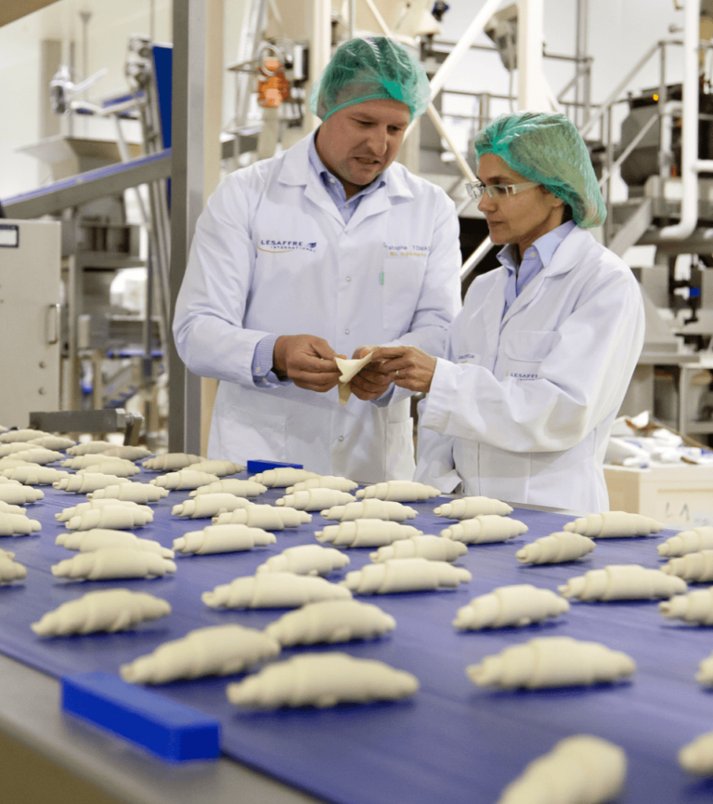
The Importance Of Trouble Shooting
Trouble shooting is a critical component of hospitality management due it its unpredictable nature of service environment (Kim and So, 2023). The ability to respond quickly and effectively to challenges is essential in maintaining operational standards. This requires:
remaining calm under pressure
Making informed decisions
Adapting to changing situations
Proactive awareness of potential issues can also help to prevent disruptions (Corbin, 2022). The development of troubleshooting skills during the placement demonstrates the importance of initiative and adaptability in ensuring continuous and efficient service within the business.

Slide 11

Service Issue
An example of trouble shooting involves managing delays in order preparation during busy service periods (Spacey, 2024). Effective communication with the barista/front of house staff ensured that urgent orders were priorities and workflow was improved.
Although, at the same time, clear communication with customers helped manage expectations and reduce dissatisfaction. This approach allowed the issue to be resolved without significantly impacting the overall customer experience. The situation highlights the importance of:
Quick decision making
Communication
And Coordination in resolving operational challenges within the hospitality setting.

Slide 12

Staff Challenge
Challenges arose during a period of reduced staffing levels. In response responsibilities were adapted to cover multiple areas within millefoglie, ensuing that essential tasks were completed efficiently.
Prioritisations of duties and collaboration with the front of house staff helped maintain high service standards despite increased pressure. This situation required:
Flexibility
Initiative
Effective time management
The ability to adapt to staffing challenges demonstrates key management competence as well as highlighting the importance of maintaining operational continuity in demanding situations (Thompson, 2023).

Slide 13

Reflection On Problem Solving
Reflecting on these experiences highlights the development of confidence in regard to managing challenging situations. The ability to remain calm, thinking on a more critical level, as well as acting efficiently contributed to effective problem resolution.
Communication was shown as a key factor in preventing any issues from escalating. However, further development is required in anticipating potential problems and implementing preventative strategies.
Further developing these skills will support more effective management in future roles. Overall, the experience has strengthened problem solving capabilities and offered a valuable insight into managing operational challenges.

Slide 14
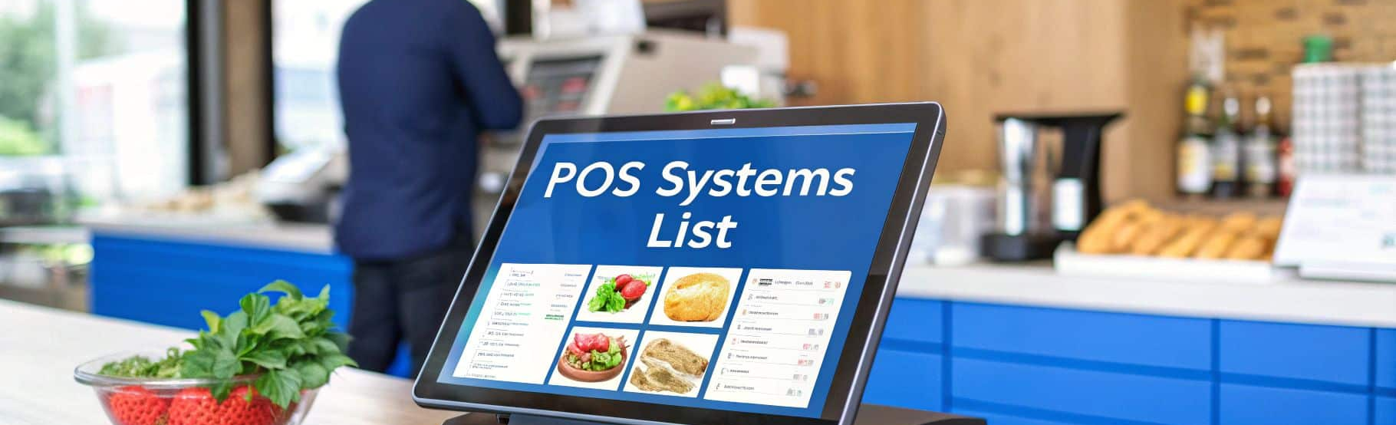
Systems Used
During placement experience was gained in the use of key operation systems within the business. The point-of-sale system was used to process customer orders and payments efficiently, ensuring accuracy and reducing errors (Team, 2025).
Stock management processes were also observed, including:
monitoring inventory
supporting ordering decisions
In addition, daily operational procedures contributed to maintaining organisation's within the business. Understanding these systems is essential for effective, accuracy and overall operational control within a hospitality environment (Deutch, 2025).

Slide 15

Data And Reporting
Data and reporting plays a significant role in supporting business decisions. End of day reconciliation processes ensured that financial transactions were accurately recorded and balanced (Farr, 2024). Sales reports provide insights into daily performances, including:
Revenue
Product popularity
Analysis of this data allowed for the identification of trends, such as peak trading times and high-demand items (Djellouli, 2023). This information is valuable for:
improving staffing decisions
Stock management
Overall efficiency
The experienced gained in millefoglie demonstrated the importance of data driven decision making in regards to hospitality management.

Slide 16

Analysis And Improvements
The analysis of operational data provides opportunities for improving business performance. Identifying popular products allows for better stock control and reduces the risks of shortages.
Understanding peak periods supports effective staff scheduling, ensuring adequate coverage during busy times (Shyft, 2024). Observations during placement highlighted how these insights could enhance efficiency and reduce waste.
Additional improvements could include promoting high-demand items or adjusting service processes (SafetyCulture, 2025). This demonstrates how the effective use of data can support strategic decision making and contribute to long term success for the business.

Slide 17

Conclusion
To conclude this presentation, placement at Millefoglie coffee shop and bakery provided a valuable experience in regard to developing key management skills.
Communication and leadership abilities were enhanced through teamwork and operational coordination.
Problem solving skills were strengthened through handling challenges and adapting to more difficult situations.
The experience gained through operational systems and data analysis contributed to a deeper understanding of business processes.
These skills are essential for effective hospitality management. Overall, time spent in placement has supported professional development and prepared for future roles within the industry.

Slide 18

Thank you for listening! Any questions?

Slide 19
Reference List
Arlow, C. (2021). Lifelong friends open café together. Wales Online. Available at: https://www.walesonline.co.uk/whats-on/food-drink-news/millefoglie-italian-cafe-swansea-food-21187448. Accessed 11.04.26
Cabinet Office (2024). Success Profiles: Civil Service Behaviours. gov.uk. Available at: https://www.gov.uk/government/publications/success-profiles/success-profiles-civil-service-behaviours. Accessed 11.04.26
Corbin, M. (2022). Proactive Problem Management: Examples, Benefits & How to Implement. Official Teamly Blog - Official Teamly Blog - Your Project Management Resource. Available at: https://www.teamly.com/blog/proactive-problem-management/. Accessed 11.04.26
Deutch, K. (2025). What Is a POS System and How Does It Work? | Square. The Bottom Line by Square. Available at: https://squareup.com/gb/en/the-bottom-line/operating-your-business/what-pos-system?msockid=3bed063b20a366651b62111321c96734 Accessed 11.04.26
Djellouli, A. (2023). Seasonality and Trends. [online] Adamdjellouli.com. Available at: https://adamdjellouli.com/articles/statistics_notes/time_series_analysis/seasonality_and_trends. Accessed 10.04.26
Ewim, N.C.P.-M., Godwin, N., Adams, N., Okeke, C. and Mokogwu, N.C. (2024). Developing a cross-functional team coordination framework: A model for optimizing business operations. International Journal of Frontline Research in Multidisciplinary Studies, 4(1), pp.015–034. doi: https://doi.org/10.56355/ijfrms.2024.4.1.0030. Accessed 10.04.26
Farr, C. (2024). What is Business Reporting and Why is it Important for Data Driven Decision Making? Sontai. Available at: https://www.sontai.com/post/what-is-business-reporting-and-why-is-it-important-for-data-driven-decision-making. Accessed 10.04.26
Gillian (2024). How to Lead Teams in High-Pressure Situations – London School of International Business. Lsib.co.uk. Available at: https://blog.lsib.co.uk/2024/10/16/how-to-lead-teams-in-high-pressure-situations/. Accessed 09.04.26
Heroshe Mihindukulasuriya and Creately (2024). Operational Decisions: The Key to Business Success. Creately. Available at: https://creately.com/guides/operational-decisions/. Accessed 11.04.26
Huffman, G. (2025). Is Working at a Coffee Shop Hard? Uncovering the Challenges and Rewards - CoffeePlusThree. CoffeePlusThree. Available at: https://coffeeplusthree.com/is-working-at-a-coffee-shop-hard/. accessed 09.04.26
Kim, H. and So, K.K.F. (2023). The evolution of service failure and recovery research in hospitality and tourism: An integrative review and future research directions. International Journal of Hospitality Management, 111(103457), p.103457. doi: https://doi.org/10.1016/j.ijhm.2023.103457. Accessed 09.04.26

Slide 20
Reference list
National Institute for Health and Care Excellence (2018). Practical Steps to Improving the Quality of Care and Services Using NICE Guidance. https://www.nice.org.uk/Media/Default/About/what-we-do/Into-practice/Practical-steps-improving-quality-of-care-and-services-using-NICE-guidance.pdf. NICE. Available at: https://www.nice.org.uk/Media/Default/About/what-we-do/Into-practice/Practical-steps-improving-quality-of-care-and-services-using-NICE-guidance.pdf. Accessed 11.04.26
Petty, L. (2023). What is the importance of effective communication in the hospitality industry? The Hub | High Speed Training. Available at: https://www.highspeedtraining.co.uk/hub/communication-in-the-hospitality-industry/. Accessed 10.04.26
Prince, E. (2025). Understanding the Role of FOH Staff in the Hospitality Industry - KitchenSterling. KitchenSterling. Available at: https://kitchensterling.com/what-is-foh-staff/ Accessed 11.04.26
SafetyCulture (2025). Mastering the Inventory Replenishment Process | SafetyCulture. SafetyCulture. Available at: https://safetyculture.com/topics/retail-inventory-management/inventory-replenishment. Accessed 10.04.26
Shyft (2024). Shyft. Myshyft.com. Available at: https://www.myshyft.com/blog/peak-time-scheduling-optimization/. Accessed 11.04.26
smith, C. (2025). Enhancing Leadership Through Communication Skills and Leadership Qualities. Join The Collective. Available at: https://www.jointhecollective.com/article/enhancing-leadership-through-communication-skills-and-leadership-qualities Accessed 10.04.26
Spacey, J. (2024). 13 Examples of Problem Management. Simplicable. Available at: https://simplicable.com/en/problem-management Accessed 09.04.26
Team, M. (2025). What is a Point-of-Sale System? Costs and Features Explained | Understanding POS Systems. Moneris.com. Available at: https://www.moneris.com/en/blog/posts/product-education/what-is-a-point-of-sale-system. Accessed 10.04.26
Thompson, J. (2023). The Benefits of Being Adaptable - business.com. business.com. Available at: https://www.business.com/articles/how-well-do-you-handle-change-the-benefits-of-being-adaptable/. Accessed 11.04.26
Zambito, V. (2022). The Role Of Communications In The Customer Experience Process. Forbes. 5 Oct. Available at: https://www.forbes.com/councils/forbescommunicationscouncil/2022/10/05/the-role-of-communications-in-the-customer-experience-process/. Accessed 09.04.26

