Slide 1

The Management of Change
Lecture 2

Slide 2

Objectives of the session
At the end of the session you should be able to:
  Identify the triggers for change
  Describe the factors that can cause resistance to change
  Compare two main approaches to dealing with change
  Identify ways of creating a culture for change

Slide 3

Organisational change
Change refers to the movement of an organisation away from its present state toward some desired future state to increase its effectiveness
  Question: What forces might act as triggers for organisational change?
Notes:
Triggered by need to respond to new challenges or Opportunities
Need to cope with existing or potential problems

Slide 4

The most successful organisations are those that are most agile and adaptable
In today’s world, organisations must respond effectively to change or risk jeopardising the organisations performance, productivity and survivability.

Slide 5
Organisations that make changes FASTER, BETTER, EASIER AND CHEAPER will have the competitive advantage
21st century organisations face multiple challenges. Therefore, flexibility and adaptability are key
No company today is in a particularly stable environment, including Microsoft, Apple, Tesco
Innovation and positive response to change are Key! But why?

Slide 6

Competition - you need to be ahead of or at the very least at the same level as the competition
Lack of innovation - failure to keep up with or move ahead of your competitors, customers may also tire of your products/service
Failure to update systems - new technological systems come about daily – old systems can slow down productivity, affect an organisations ability to compete
Resistance to change - this can be both from an organisationl perspective and the perspective of the employees.
30% of profits come from young products and services (less than 4 years) Organisations cannot rest on their Laurels.
Organisations must be innovative ALWAYS!

Slide 7
There are numerous forces that bring about change
Internal and external forces act as major drivers for change
It is important that organisations have the capability to adapt and respond

Slide 8
Change: Sequence of Events
Environmental Forces
Monitor external environment, customers, competitors, etc.
Need for Change
Initiate Change
Implement Change
Internal Forces
Consider plans, goals, organisational strengths, weaknesses, and needs

Slide 9

Forces that stimulate change
Nature of the workforce
More cultural diversity
Aging population
Many new entrants with inadequate skills – computer, literacy, numerical

Slide 10

Forces that Stimulate change
Technology
  Faster, cheaper and more mobile computers/tablets – sophisticated IT
  What is the office/organization of the future going to look like?

Slide 11
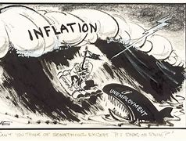
Forces that Stimulate Change
Economic Shocks
Volatility of stock markets
Low interest rates / high inflation
Immigration in high-and-low-skill jobs
Skyrocketing energy costs

Slide 12

Forces that Stimulate Change
Competition
Global competitors
Entrepreneurs
Mergers and consolidations
Short product lifespan
Growth of e-commerce

Slide 13

Forces that Stimulate Change
Social Trends
Internet chat rooms
Retirement of baby boomers
Rise in discount and ‘big box’ retailers
Generation X
Piercing/tattoos

Slide 14

Forces that Stimulate Change
World Politics
Wars
Terrorism
Rise in Power of China
Break up of the Soviet Union
911 (New York)
9/11 Berlin Wall (fall of communism)
India commerce rise
Brexit

Slide 15

How work has changed - The production line
The production line originated at the Ford Motor Company and resulted in the development of workers and the increase in their skills set. Since then, the production has evolved
An uttana.com Video: Henry Ford and His Mass Production Line - YouTube
How work has changed – the production line
https://www.youtube.com/watch?v=NkQ58I53mjk
The human – AI collaboration
https://www.youtube.com/watch?v=Fo6pWIi-Ixo

Slide 16
Types of change
Top-down
Bottom-up
Implemented by managers at a high level in organization
Result of radical restructuring & re-engineering
More resistance
Implemented by employees at low levels and rises over time
All levels involved in change process
Less resistance

Slide 17
Approaches to Change
Planned Change - Lewin (1958) Movement from one fixed state (equilibrium) to another - Series of planned steps
Kotter’s 8 stage model – Kotter (1995)
Eight sequential steps to overcome typical problems that arise when introducing change

Slide 18
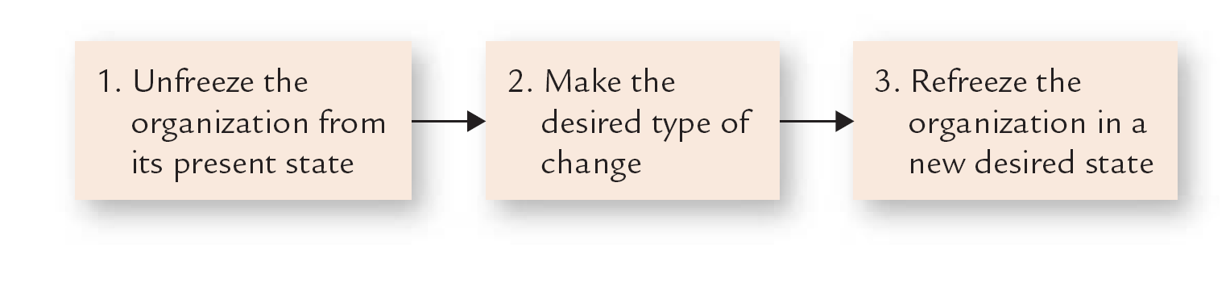
Lewin three step change process

Slide 19
Kotter’s model
Establish a sense of urgency – creating a compelling reason for change
Form a coalition to lead the change
Create a new vision
Communicate the vision
Empower others to act
Plan for and create short term wins
Evaluate changes and make adjustments as appropriate
Reinforce the new changes – consolidate the new behaviours etc.

Slide 20
Force-Field Theory (Lewin, 1951)
Forces Resisting Change / Maintaining the Status Quo
_____________________________________________________________________
Forces for Change

Slide 21
Applying Force-Field Analysis
Forces Resisting Change / Maintaining the Status Quo
Staff contentment with current system of work
Trade Union suspicions that changes will be used to enforce redundancies and/or reduce pay levels
Middle management anxieties concerning implementation of the changes
Individual fears about job security
___________________________________________________________________
Senior management’s desire to achieve cost competitiveness and survival of business by enhancing technology and broadening staff skills / responsibilities
Existence of competitors ready and willing to take over the company’s customers / business
Prospects of multi-skilling attractive to many staff
Concern of all staff regarding survival of the business / their jobs
Forces for Change

Slide 22
Resistance to change is an inbuilt mechanism
Organisations and their members resist change
Resistance can be positive and negative

Slide 23
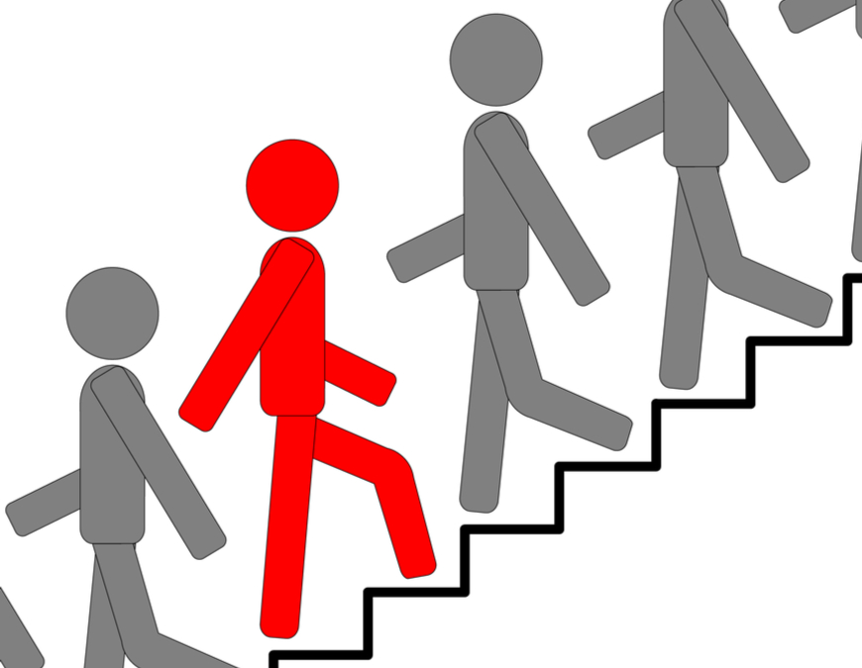
Resistance to Change (Hannigan, 2008)
Security – ‘we don’t know where we stand’
Competence – ‘we don’t know what to do’
Relationships – ‘we don’t know who the boss is’
Territory – ‘ we don’t know where we will be working or with whom’
Direction – ‘why is this happening?’

Slide 24
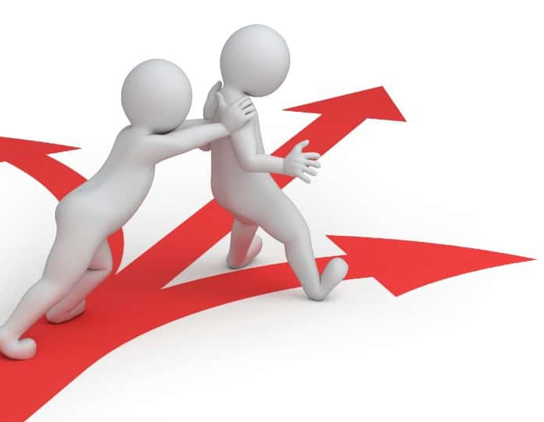
Resistance to change
Question: What factors might cause you to resist change?

Slide 25
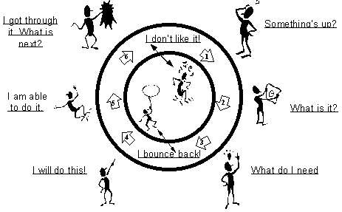
Coping Cycle (Kubler Ross, 1969)
Denial
Anger
Bargaining
Depression
Acceptance

Slide 26
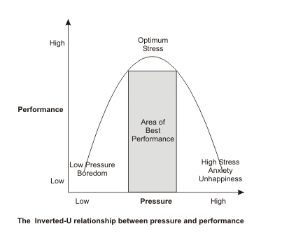
Performance and Stress (Yerkes-Dodson law, 1908)

Slide 27
Unfreezing can be achieved by:
Increase driving forces that direct behaviour away from the status quo
Decrease restraining forces that hinder movement from the existing equilibrium
Combine the two above approaches

Slide 28
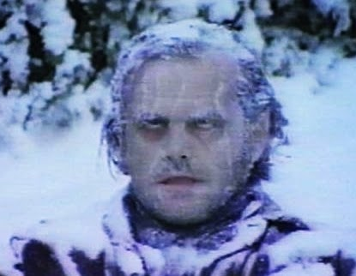
Considerations
Talking about the future is seldom enough to move people
Significant effort is needed to ‘unfreeze’ people and get them moving
Push methods to shift them, Pull methods to keep them moving
‘Change ready’ is a term used to describe people who are already ‘unfrozen’ and ready to move
Some are always ready to move, whilst others take a long time to let go of their comfortable current realities

Slide 29

Some ways to make it happen
Burning platform: Expose a crisis (melting iceberg)
Challenge: Inspire them to achieve remarkable things
Command: Just tell them to move!
Evidence: Cold, hard facts are difficult to ignore
Destabilising: Shaking people out of their comfort zone
Education: Teach them to change
MBO: Tell people what to do, but not how
Restructuring: Redesign the organisation to force behavioural change
Rites of passage: Hold a wake to help let go of the past
Setting goals: Give them a formal objective
Envisioning: Done well, visions work to create change

Slide 30
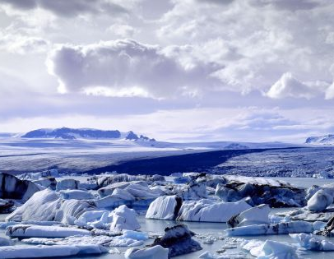
Refreeze
Burning bridges: Ensure there is no way back
Evidence stream: Show them time and again that the change is real
Golden handcuffs: Put rewards in their middle-term future
Institutionalisation: Build change into the formal systems and structures
New challenge: Get them looking to the future
Reward alignment: Align rewards with desired behaviours
Rites of passage: Use formal rituals to confirm change
Socialising: Build into the social fabric

Slide 31
A Desired Journey

Slide 32
A Real Journey

Slide 33


