Slide 1

ASSESSMENT COMPONENT 1
PRESENTATION
Student name: Maryan Mohamed
Student ID: 2029256
Module name: Community Care and Development.
Module code: (BMHP6022_LON)
Lecturer name: Jolly Nwankwo

Slide 2

Community Development cost of living in Tower Hamlets
Assignment 1
Maryan Mohamed ( 2029256)

Slide 3

INTRODUCTION
Community development – this is a process of engaging collective action on issues that are important to the community. This can be carried out with or without the support of an organization in community development (SHA, 2024).
Community- This is a social group of people who reside in the same place who have certain things in common (Merriam-Webster, 2024).

Slide 4

AIM OF THE PROJECT
The interventions of improving the cost of living in Tower Hamlets UK.
cost of living in Tower Hamlet in the UK
The increase of the cost of living is the main issue in tower hamlets currently.
Tower Hamlets has the most people under 40, with half being from ethnic minorities
The cost of living in the key concern for residents (Tower Hamlets Council,2023).

Slide 5
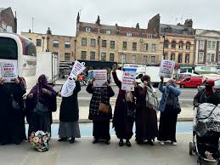
ISSUES IN TOWER HAMLETS
Financial insecurities
Cost of living
Racism
The housing crisis
Crime and antisocial behavior.
Health inequalities.

Slide 6
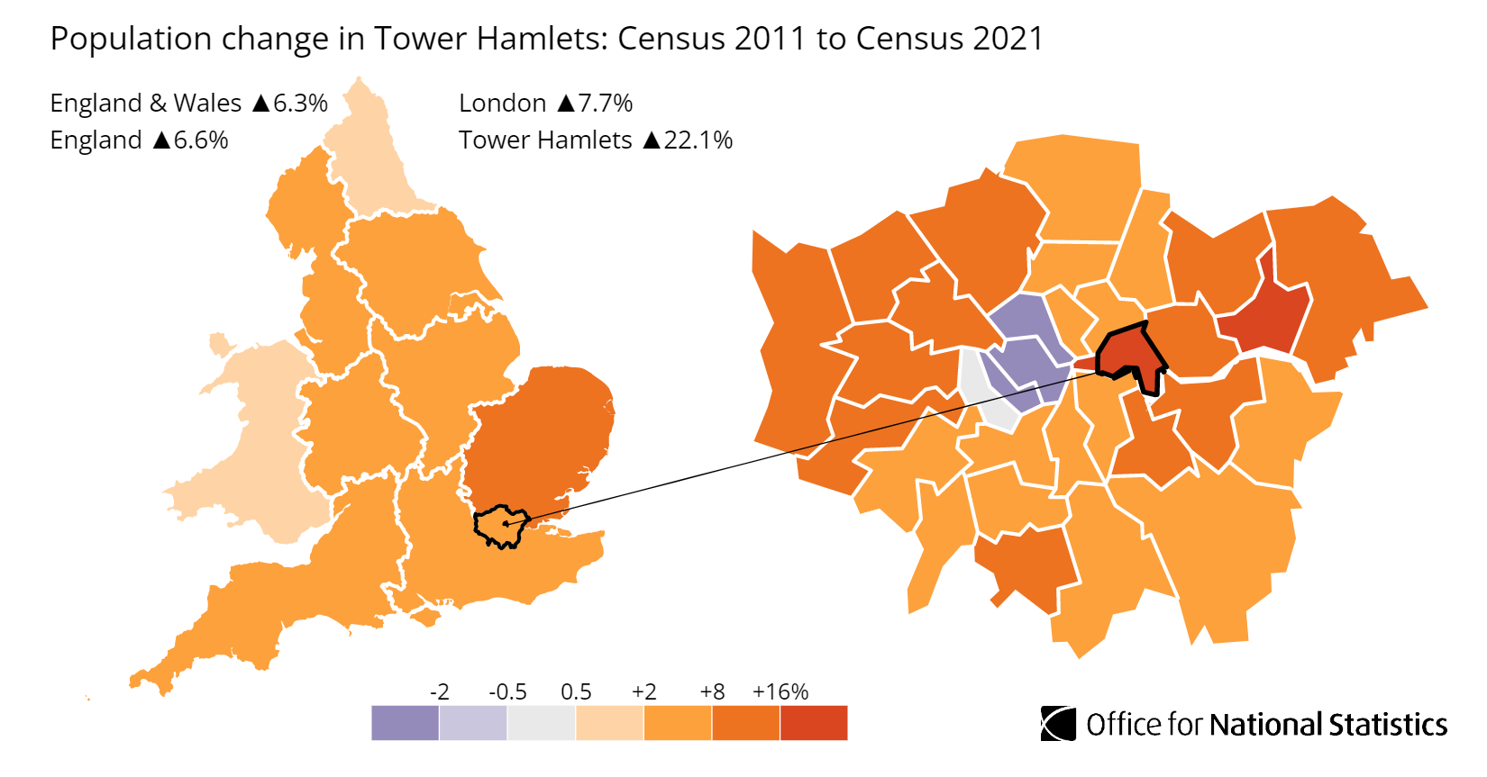
DEMOGRAPHICS
The Demographics of Tower Hamlets are;
The ethnic groups 55% are from BME (Black and Minority Ethnic group)
14% of the people living in Tower Hamlets are from the White Minority Group.
The Tower Hamlets borough’s 3 main largest groups of people are from Bangladesh, White British, and ‘Other White’ populations.
(Tower Hamlet Council, 2024).

Slide 7
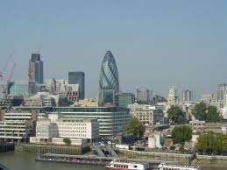
KEY FACTS OF TOWER HAMLETS
The borough is heavily populated with over 200,00 people living in Tower Hamlets
It is known as the heart of the East End of London.
There is no shortage of energy and culture in the area.
Tower Hamlets is known for its parks and open spaces. E.g. Mile End park and Victoria Park.
the local people are known for having mutual respect towards each other and everyone (Tower Hamlet Council, 2024).

Slide 8
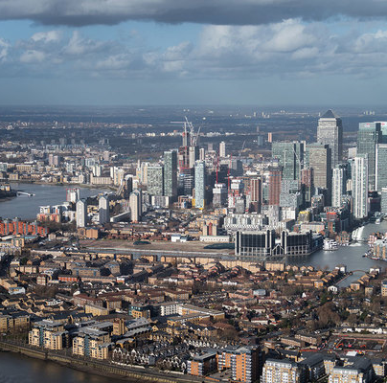
STAKEHOLDERS INVOLVED IN THE PROGRAM
The Tower Hamlets Council.
Businesses, local institutions, residents, and members who work together to make Tower Hamlet a better place to live for everyone.
The residents’ support scheme.
The Government- universal free school meals for children (16-year-olds)
Council Team- holiday activities for children coming from low-income families is available for the people who live in Tower Hamlets ( Tower Hamlets Council, 2024).

Slide 9
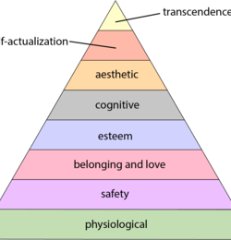
THEORIES
Maslow’s Hierarchy of needs focuses on the five important needs. One of the two needs that applies to Tower Hamlets are.
Physiological needs – the price of the cost of living is increasing rapidly which affects the people’s basic needs to affordable housing, and food (simply Psychology 2024).
Safety- the cost of living affects the safety of the people living in Tower Hamlets which results to overcrowding. This is one of the most urgent housing problem ( Local Government Association, 2024).

Slide 10

PRINCIPLES WHICH SUPPORT COMMUNITY DEVELOPMENT
Principles which support community development in tower hamlets are.
Equality
Work flexibility
Teamwork/ among leaders too.
Respect and value (Tower Hamlets, n.d).

Slide 11

DIGITAL MEDIA AND TECHNOLOGIES FOR COMMUNITY DEVELOPMENT
Some of the digital media technologies that can be used to raise awareness are.
Instagram
Twitter
Facebook
YouTube
TikTok
This helps improve communication, build relationships (Ukomadu,2018)
#️⃣reduce overcrowding.
#️⃣cost of living.

Slide 12
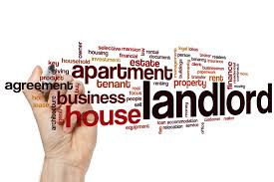
LEGISLATION AND POLICY IMPACT THE SUPPORT AND GROWTH OF A COMMUNITY
Housing and planning Act
household support fund
Council tax cost of living relief fund (Tower Hamlets Council, 2020).
Equality Act 2010
Human rights Act 1998.

Slide 13

BARRIERS
The cost of living is a barrier to health. Especially for people with low-income support.
Cost barriers. Which consist of course fees. Including, transport.
Lack of communication.
Renters and young people are affected the most the cost of living (The independent, 2023).

Slide 14

RECOMMENDATIONS
The government should help with the housing costs and for the homeless people (GOV.UK, 2023).
Turning off the lights during day times to avoid the increase of electricity.
Chopping off food spend.
Tracking spending budget.

Slide 15
CONCLUSION
In conclusion, the government should change start cutting tax, absorb VAT costs so that this could help the public afford living costs(the trussell trust, 2023).
The Tower Hamlets council should produce a new Tower Hamlets plan to overcome the cost of living in the borough.
Avoiding high costs as this may affect the cost of living.
The tower hamlets can offer supports for the people who cannot afford paying rents.

Slide 16
REFERENCES
Future Generation University (2022) principles of community Development. Available at: https://www.future.edu/ accessed on 7th July 2024
GOV.Uk (2021). Household Support Fund: guidance for local councils. Available at: https://www.gov.uk/ accessed on 7th July 2024.
Healthwatch (2023). Cost of living. A barrier to healthcare for the most vulnerable. Available at: https://www.healthwatch.co.uk/ accessed on 7th July 2024.
Independent (2023) renters and young people are hit hardest by cost of living. Available at: https://www.independent.co.uk/ accessed on 7th July 2024.
Merriam-Webster (2024) Community. Available at: https://www.merriam-webster.com/ accessed on 7th July 2024.
Office for National Statistics (2022). How the population changed in Tower Hamlets: census 2021. available at: https://www.ons.gov.uk/ accessed on 7th July 2024.
SHA (2024) Community Development. Available at: https://sochealth.co.uk/ accessed on 7th July 2024.
Tower Hamlets Council ( 2022). Housing and Planning Act. Available at: https://www.towerhamlets.gov.uk/Home.aspx accessed on 7th July 2024.
Tower Hamlets Together ( n.d) The challenge. Available at: https://www.towerhamletstogether.com/ Accessed on 7th July 2024.
Tower Hamlets Council ( 2023) Cost of Living is a key concern for residents. Available at: https://www.towerhamlets.gov.uk/Home.aspx accessed on 7th July 2024.
Tower Hamlets (2023) About the Borough. Available at: https://www.towerhamlets.gov.uk/Home.aspx accessed on 7th July 2024.
Tower Hamlets (2023). Household support Fund. Available at: https://www.towerhamlets.gov.uk/Home.aspx accessed on 7th July 2024.
The trussell trust (2023). The cost-of-living crisis getting worse. What should the government do next? Available at: https://www.trusselltrust.org/ accessed on 7th July 2024.
Local government Association (2024) Cost of living. Available at: https://www.local.gov.uk/ accessed on 7th July 2024.
EastLondonLines, (2023) Significant issues Found in Tower Hamlets Community Housing. Available at: https://www.eastlondonlines.co.uk/ Accessed on 7th July 2024.
Simply Psychology ( 2024). Maslow’s Hierarchy of Needs. Available at: https://www.simplypsychology.org/ accessed on 7th July 2024.

