Slide 1
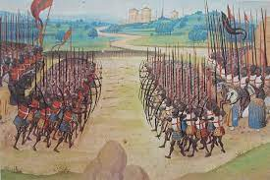
What was deciding Factor in the Battle of Agincourt?
By John Gallacher

Slide 2
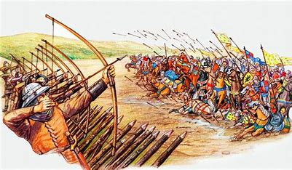
Contents
Introduction
Aim
Background
Background (2)
Personality
Resources
French Strategy
English Strategy
Longbow and Bodkin arrow
Mindset
The Battle of Agincourt
Decisive Factors
Questions

Slide 3

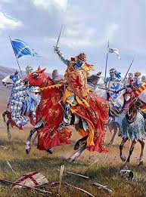
Introduction
John Gallacher
Year 3 Ordnance Munitions
Explosives (OME) Degree Apprenticeship
Based at Clyde

Slide 4
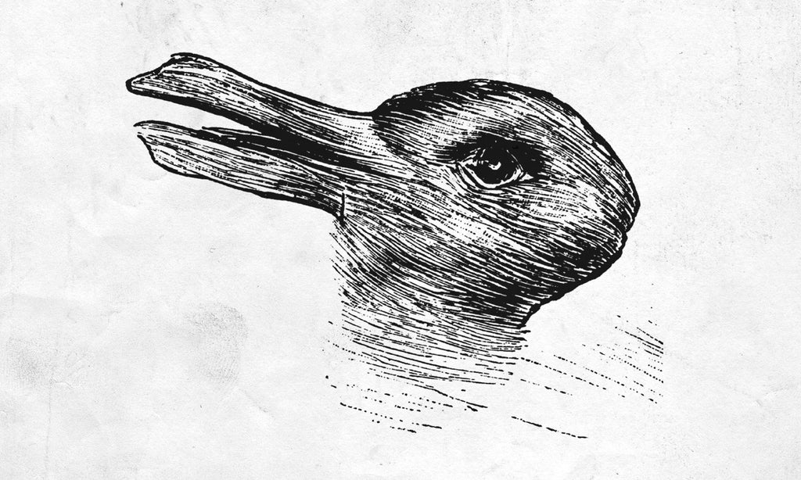
Aim
Paint a picture
Use assumptions and evidence based on research
Conclusion
Notes:
Give background information, personal opinions and research to develop a picture
The battle being decades ago, not all information will be accurate. I will use my own assumptions, use specialised information from books and reports which are reliable,
to give my idea (everyone will have different opinions- this is a very subjective argument due to it not being recorded)
Give a conclusion on what my opinions are on the key factors that impacted the outcome in the battle of Agincourt.

Slide 5
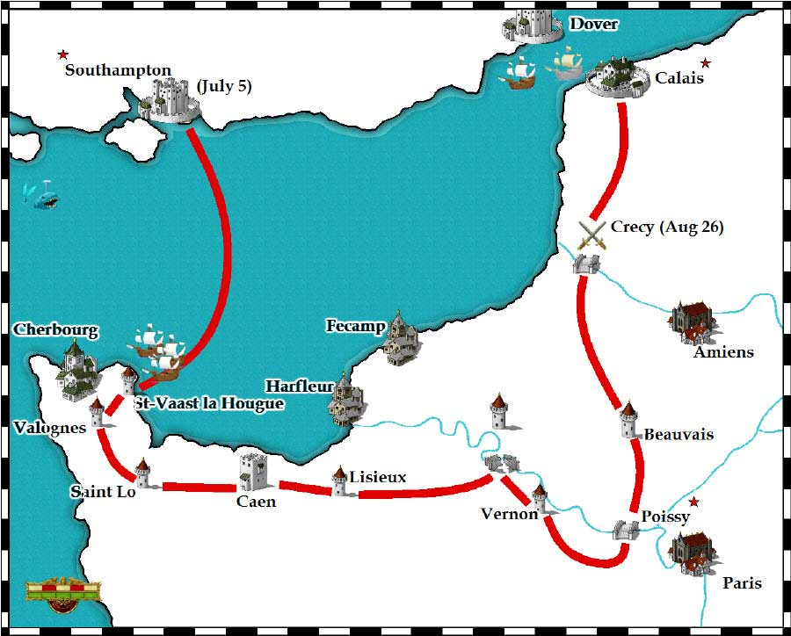
Background
100-year war (1337-1453)
King Edward III x King Philip VI
English Victory
Notes:
A paradox statement- More accurately known as the 116-year war due to the dates it occurred
Based on differences between French and England for the rights of the French throne
In 1337, King Philip VI of France confiscated the duchy of Aquitaine, a territory in south-west France, from Edward III, king of England
+Battle of Crécy (1346) and the Battle of Poitiers (1356)
A good reference explaining the history can be found- Did the Hundred Years War against France strengthen a sense of English national identity? | Faculty of History (ox.ac.uk)

Slide 6
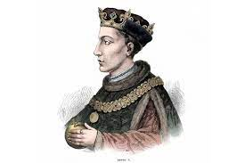
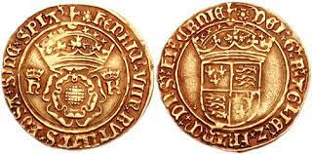
Background (2)
French restored land
Civil War
Demands
King Henry V x King Charles VI
Notes:
The black death, lack of initiative and many returning back to their hometown in England significantly reduced the presence of English personnel on previously known French soil,
Therefore, it began to be reinstated by French population
A French civil war began in which made France a target and vulnerable
King henry the 5th was announced in 21st March 1413, he had little respect across Europe and saw this as a great opportunity to state his claim. He demanded the treaty of bretigny to be reinstated giving England the ownership of Normandy, Brittany etc. A ransom for John II that was outstanding from Edward III days.
The hand in marriage with Charles IV daughter and 2 million crowns (£450 million in today's money). In exchange Charles would renounce the French throne.
An insulting offer was returned with Charles being furious at the amount Henry had enquired. Henry also furious had now set out to reclaim the land that in his mind was righly claimed by his ancestors (Edward III)
They arrived in 1415 via ships through the channel into France for battle…

Slide 7
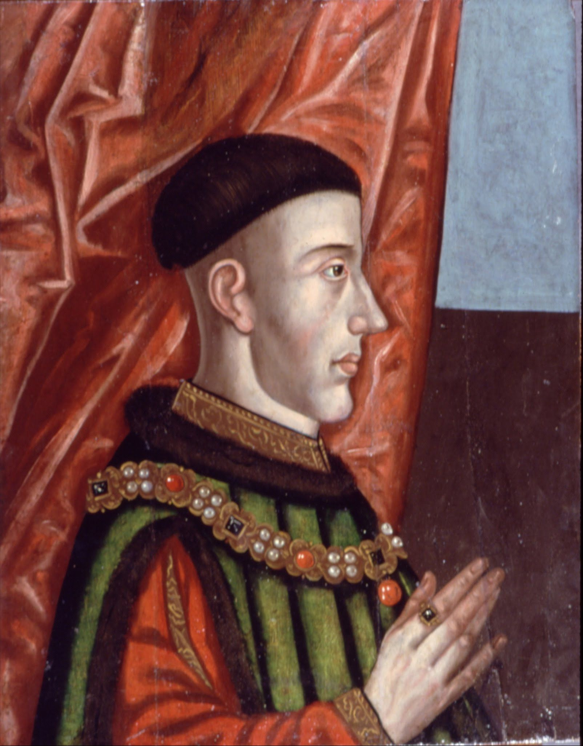
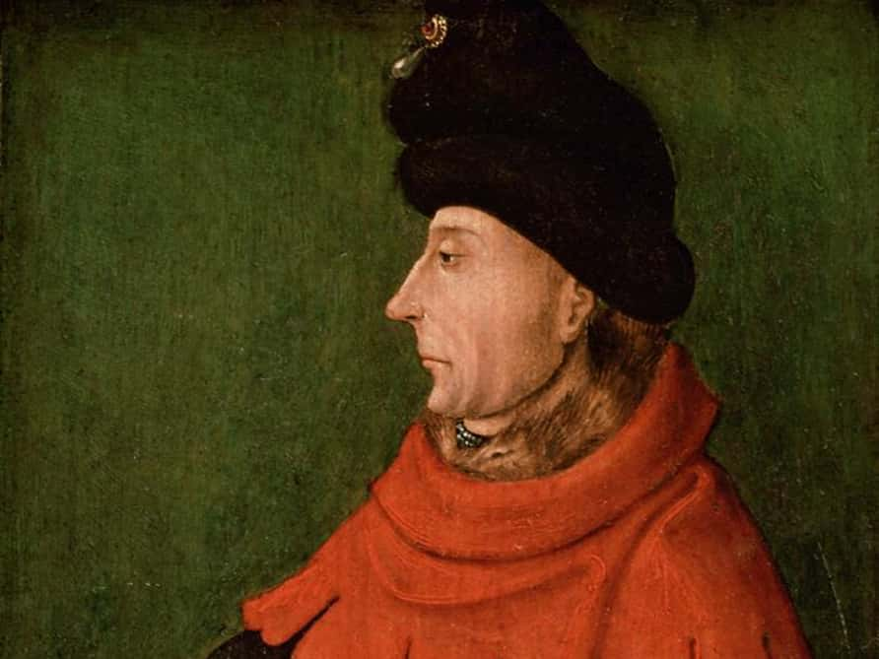
Personality
Ruthless but effective
Hungry to make an impression
Admired by French writers
Under immense pressure
A figurehead
Labelled Insane and incapable
People Turned against him
Under Immense pressure
Notes:
King Henry V- Took the reins at 25 years old, he was a stern individual, but an effective and impressive leader. He was hungry to make an impact on Europe, as they considered him and England to be a small, weak country. Lack of respect.
Despite his lack of comforting individuals has had a knack of motivating his people
The French considered him brave, loyal, respectable man and an honourable fighter
he found a nation weak and drifting and after nine years left it a powerhouse in Europe.
Charles VI- A figurehead, at becoming the King at just 11 years old Charles was rightfully a figurehead in his king position holding no power
Believed he was made of glass and dressed in a way he wouldn’t be touched,
People turned against him- his hungry deceiving uncles spent the fortune King Charles V had generated. In return uncles (dukes) raised taxes in which the people revolted and
Disputed against
Again under immense pressure- he not only had to deal with the civil warm in his own state but also the looming battle of King Henry V and his men.

Slide 8
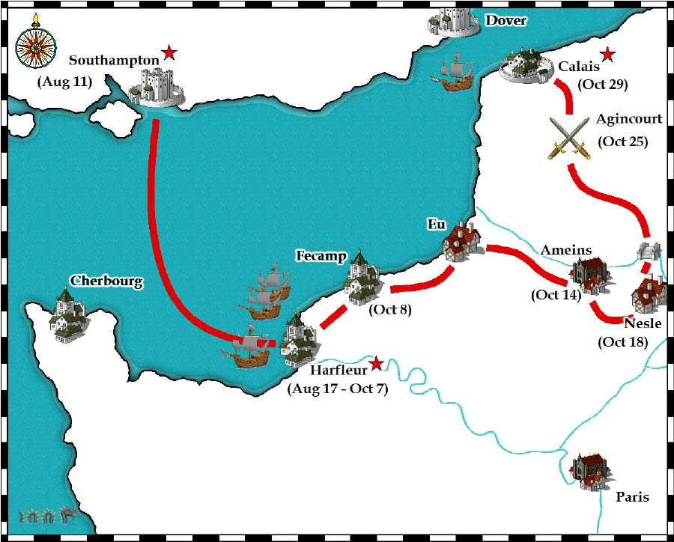
Resources
Harfleur effects
French numerical Advantage (6,000<12,000-60,000?)
6:1 Men at Arms
5:1 Bowmen to men at Arms.
Notes:
Harfleur- This battle occurred 2 months before the battle of Agincourt in claiming the land they had sailed in to (Southampton to Harfleur)King Henry V men were significantly weakened using heavy resources to defeat the village and claim it, there was men killed, ill and sent back to England.
English are heavily ill with dysentery and hungry
Dysentery definition- Dysentery is a gastrointestinal disease. Its causes include bacterial or parasitic infections. Symptoms include diarrhea, fever, nausea, vomiting, weight loss and stomach cramps.
French numerical advantage- the English numbers were significantly reduced from the previous battle, some sources mention upto 60,000 Frenchman fought that day however Anne curry a recognised historian at the University of Southampton managed to claim credible evidence in the financial records that 6,000 men at arms were recruited and 3,000 bowman on top of 3,000 additional men ready for battle.

Slide 9
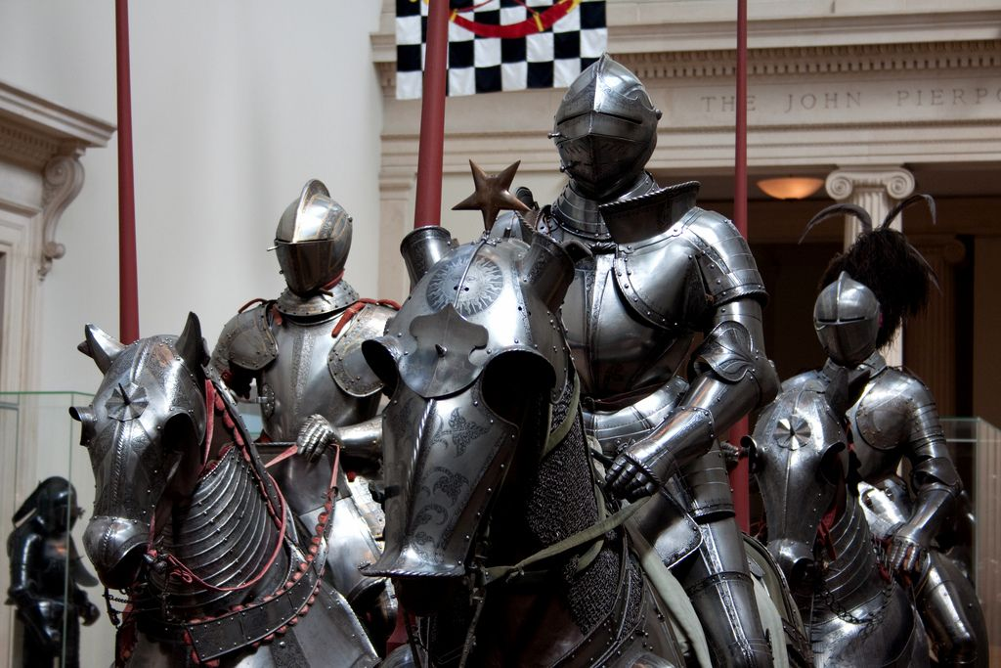
French Strategy
Notes:
Use numerical advantage with waves of attack
Steel armour- 25-50kg 2-4mm thick steel plate, other armours such as chain mill and animal fat etc.
Relied on horse armour which was far more advanced than the English horse armour (some sources say that no horse armour was purchased in the English arsenal)

Slide 10
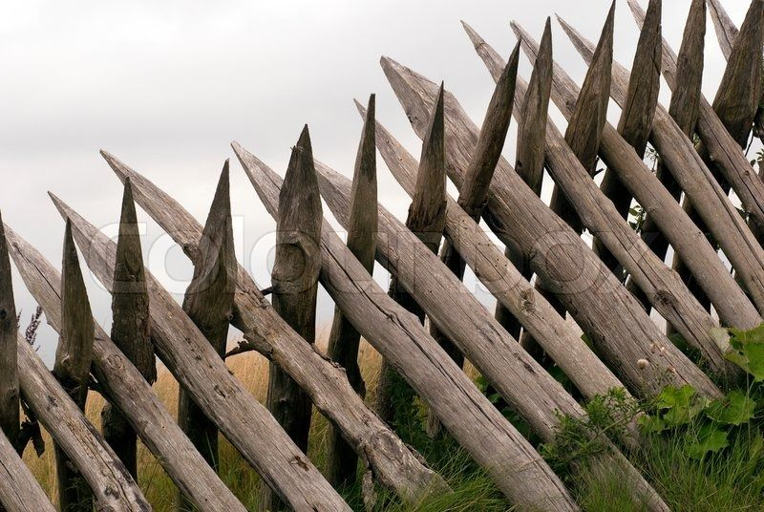
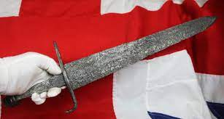
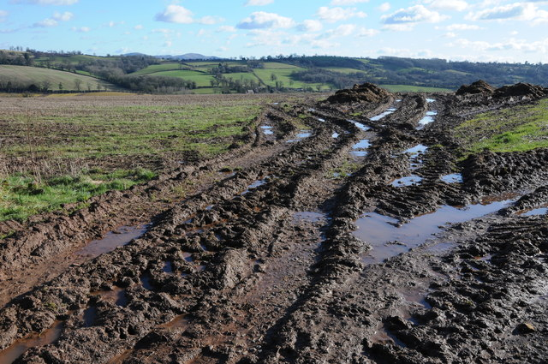
English Strategy
Notes:
Spikes to avoid French rushing bowman and manipulated entry lanes.
Topography- Damp autumn day allowed the mud to effect the French soldiers who were heavily armoured
Swords, knifes, tool to eliminate the French who were trapped in mud lane.Bowmen were knife specialists as well not just bowmen.

Slide 11
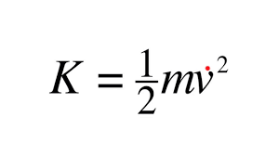
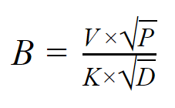
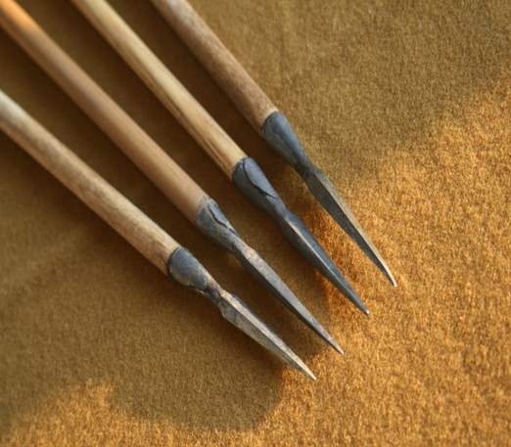

Longbow and the Bodkin Arrow
Theory
Penetrate, Injure and Kill
Horses
Most effective weapons used
Notes:
Longbow- 6 ft (1.8 m) long, used for hunting and in battle, bodkin arrow 11.11mm.
My calculations suggested that it would depend on the quality and thickness of the armour, anything over 3mm would depend on the velocities of the horse and bodkin arrow on impact of the knights wearing steel armour,
Major impact on the French horses which lead to friendly fire
Around 53.34m/s and generates around 165J, contradicting papers. It’s hard to determine as there’s not credible evidence of the weapons used and how effective they are,
There’s no one training from a kid to undertake the tests and the equipment used cannot be properly descripted.
Not uncommon to penetrate and injure, unlikely to through steel plated armour which was used by the French however could penetrate chain mill and cause serious damage (potentially fatal)- to exposed chain mill areas such as the groin, shoulders etc.
I believe it was the most effective weapon used as it caught the French off guard and forced them into an area (trapped them in a mudbath) susceptible to a flank and disrupted there movement due to the heavy armour
Jacob de Marre
Krupp
Where B is the thickness of armour penetrated in decimeters, V is the velocity of the shell on impact, P is the mass of the projectile, and D is the projectile caliber. K is a resistance constant, which represents the quality of the armour and the capacity of the shell to penetrate it.

Slide 12
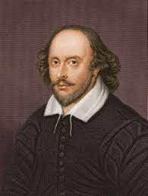
Mindset
‘The French boasted’
“We few, we happy few, we band of brothers;
For he to-day that sheds his blood with me
Shall be my brother; be he ne’er so vile..”
Nothing to lose - Couldn’t lose (complacent)
Notes:
The French boasted (24th) and were eager to defeat King Henry V men- they sent a small quadrant to send shots and begin the battle late! Lack of personnel showed the French respect to the limited rmy
St Crispins day speech-
‘be he ne’er so vile, / This day shall gentle his condition’, he means that every man, no matter how small (‘vile’ was used to refer to someone of minor social standing, e.g. a member of the ‘great unwashed’, as well as denoting someone mean or evil), will become a ‘gentleman’, or be raised up in the eyes of society, through his heroic conduct in battle.- quoted from shakespeares King V

Slide 13
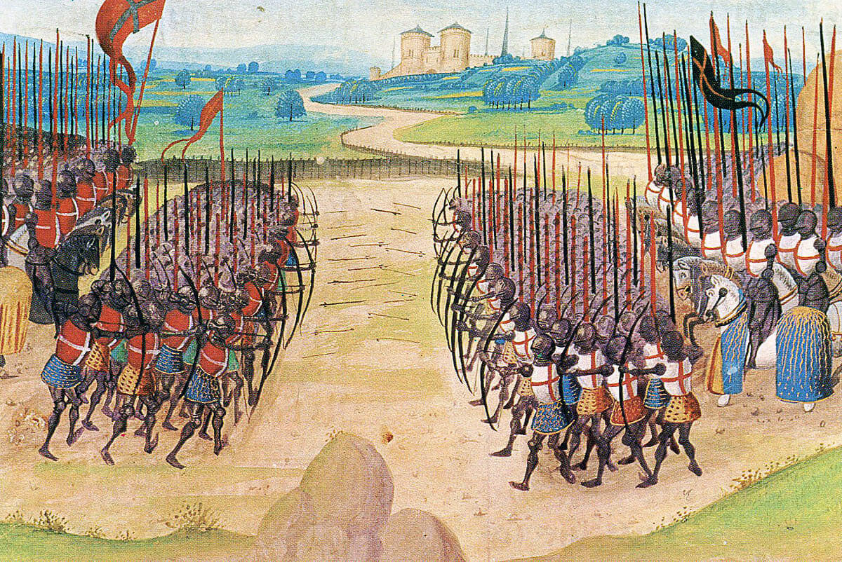
The Battle of Agincourt
Notes:
25th October 1415- battle commenced
English were heavily outnumbered, hungry and tired. They initiated war due to starvation taking place. They sent bowen in the woods to initiate battle, which caused the French charge,
This is when the English used there V tactic- Explain in drawing.
No Charles VI due to illness, constable Charles d,Albert
English 6,000- 600 casualties
French- 12,000 approx- 5,000 casualties

Slide 14

Decisive factors
Leadership – King Henry
Strategy- Charge manipulation, Longbow Influence
Complacency- French
Notes:
French relied to heavily on their numbers and Gucci armour on display. Not the environment or strategic approach to the battle.
Some other factors revolve around luck, the weather being damp causing mud pile ups.
King Charles being unwell and unable to attend,

Slide 15


Questions?
References:
Arms from Age of Agincourt (medieval.eu)
Henry V - Military Leader, Diplomat, Reformer | Britannica
Mathematical modelling of a mediaeval battle: the Battle of Agincourt, 1415 – ScienceDirect
Henry V’s Military Strategy in 1415 in: The Hundred Years War (brill.com)
The truth about Agincourt | University of Southampton

