Slide 1
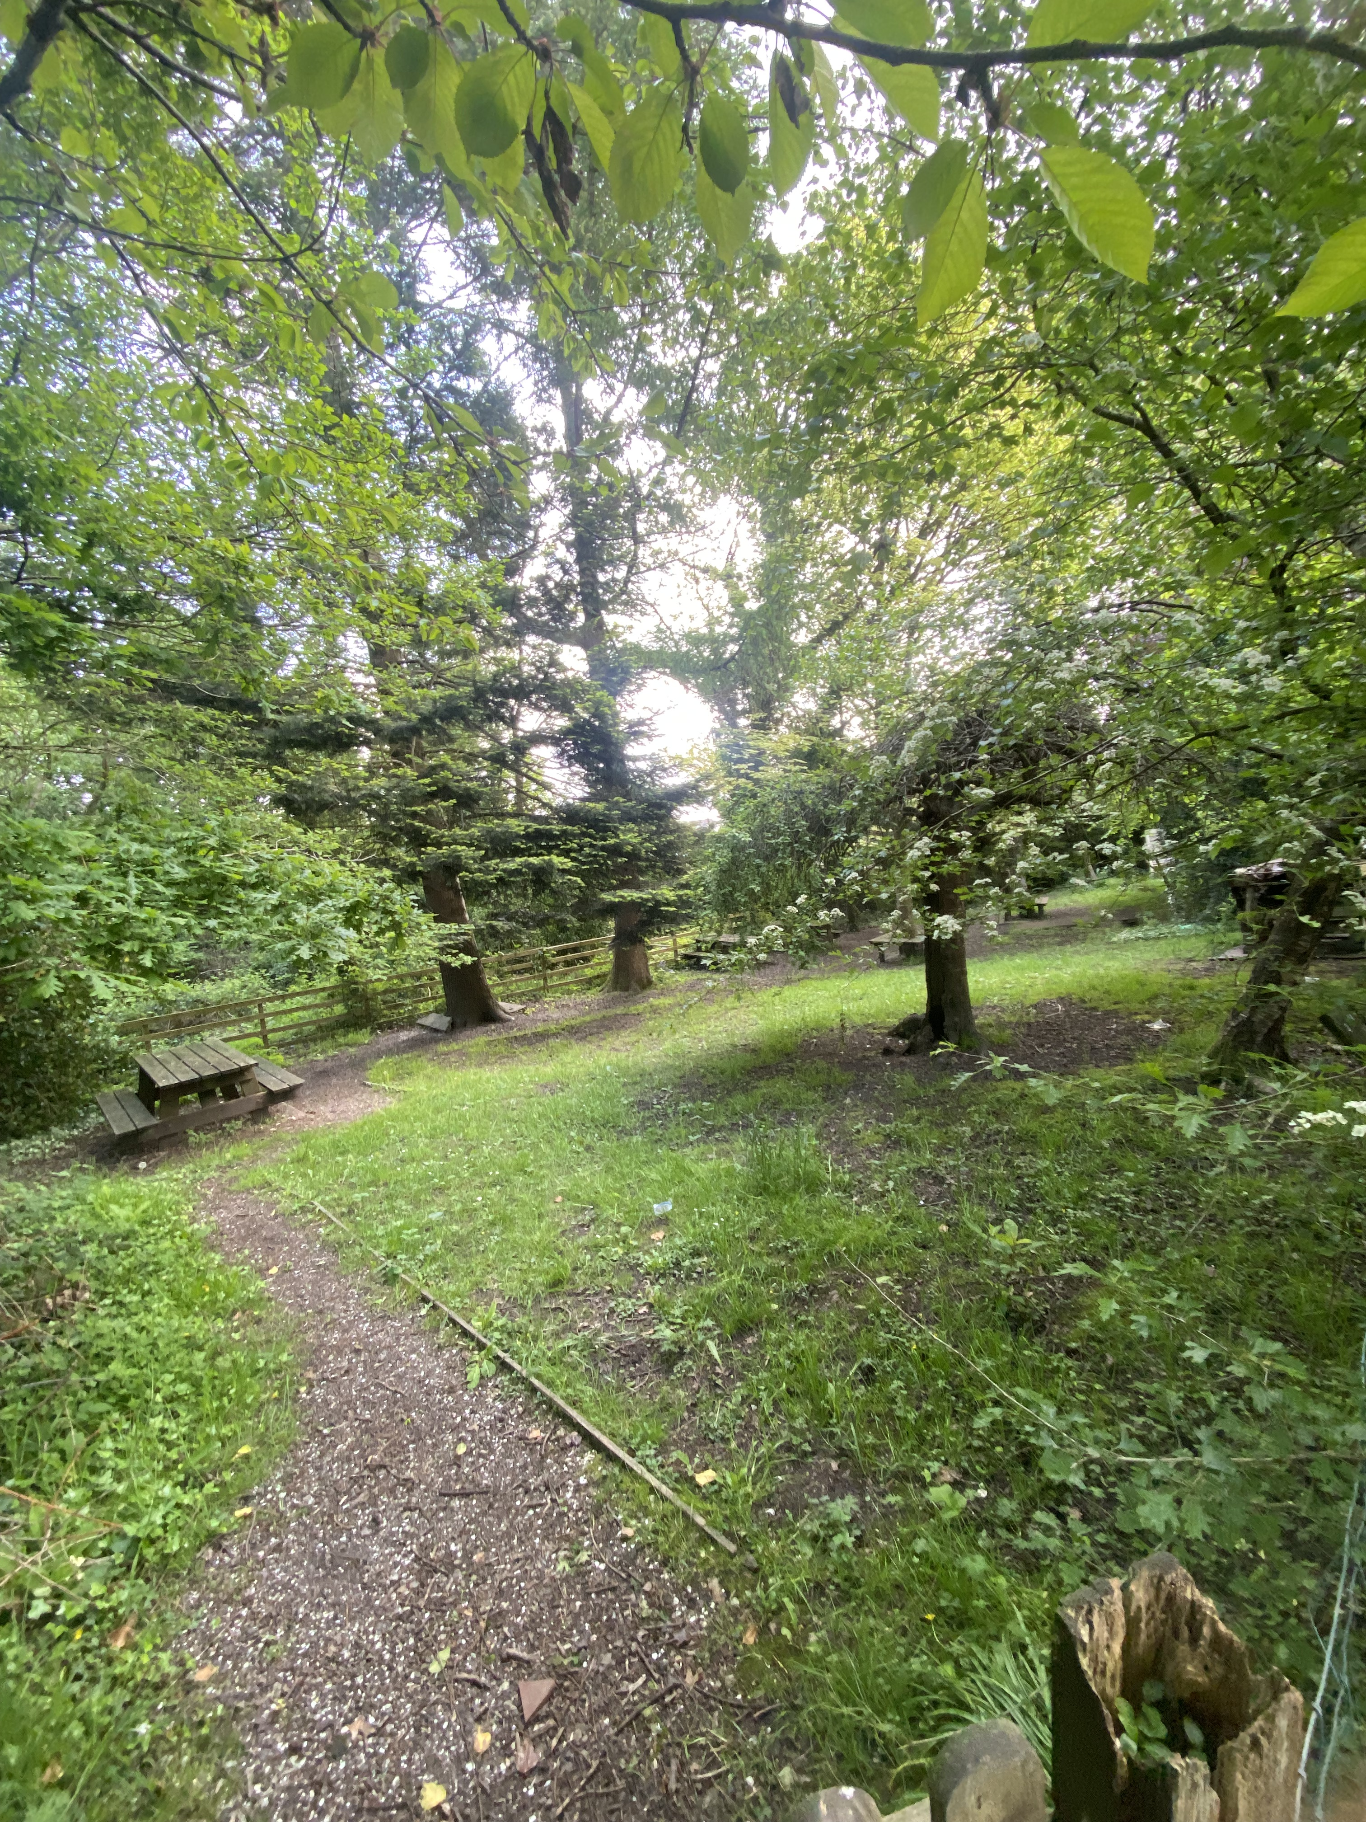
Our School Woodland
My John Muir experience

Slide 2
What is the John Muir award?
The John Muir Award inspires people from all walks of life to appreciate, interact with, and protect natural places.
The John Muir Award is a programme of the Trust that recognises environmental achievement in wild areas. It is accessible, inclusive, and non-competitive, yet each participant should be challenged. The Award promotes environmental knowledge and stewardship through a planned yet flexible programme, all while fostering a joyful, adventurous, and exploratory mindset.
Each participant who wants to receive a John Muir Award must:
Comply with the four challenges.
Fulfil the necessary time commitment
Be enthused and dedicated to your involvement.
Have an awareness of John Muir
They should be aware of the John Muir Award and its significance.

Slide 3
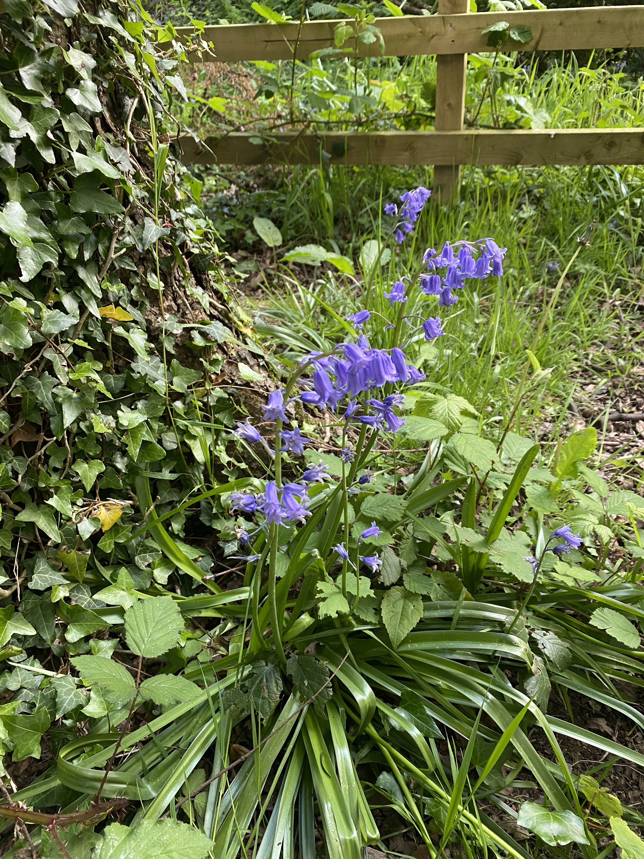
Discover..
Growing up in Swansea as a child. My primary school had a woodland, which was wonderful. My exposure to the woods at a young age helped me develop an interest in nature and small animals. As a teaching assistant in my previous primary school, it is my mission to convey to the students the importance of small animals to human survival. The same woods experience and interests that I had as a child would be ideal for our children. I've been able to educate the children about the value of the woodland and what lives and thrives their courtesy to the John Muir Award.

Slide 4
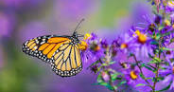
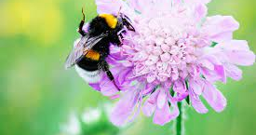
Identifying the area..
We have wildlife and trees all around Swansea. The woodlands are awash with colour during the John Muir Award season thanks to the wildflowers and the deep green trees. Brightly painted butterflies and bees are fluttering around, and you can hear chirping birds and insects whirring.

Slide 5
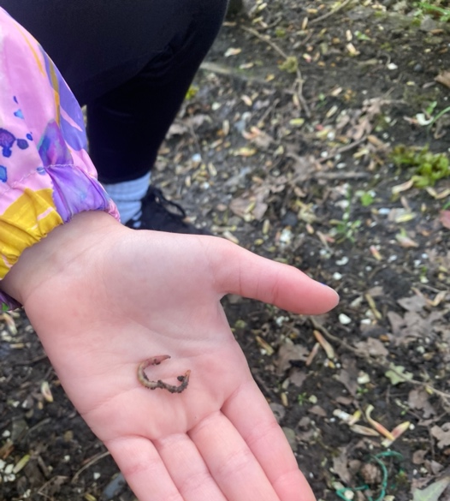
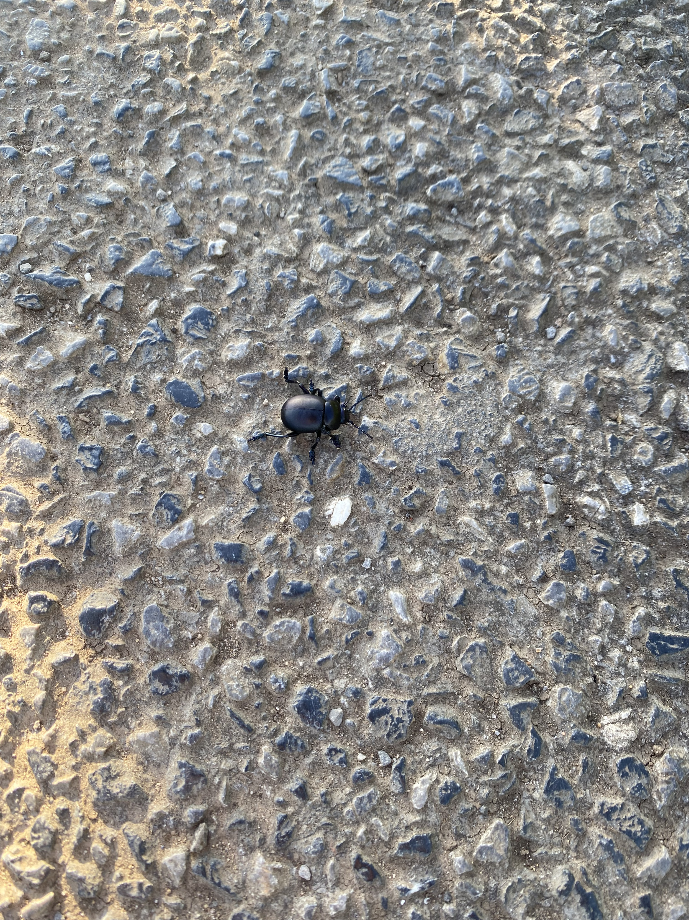
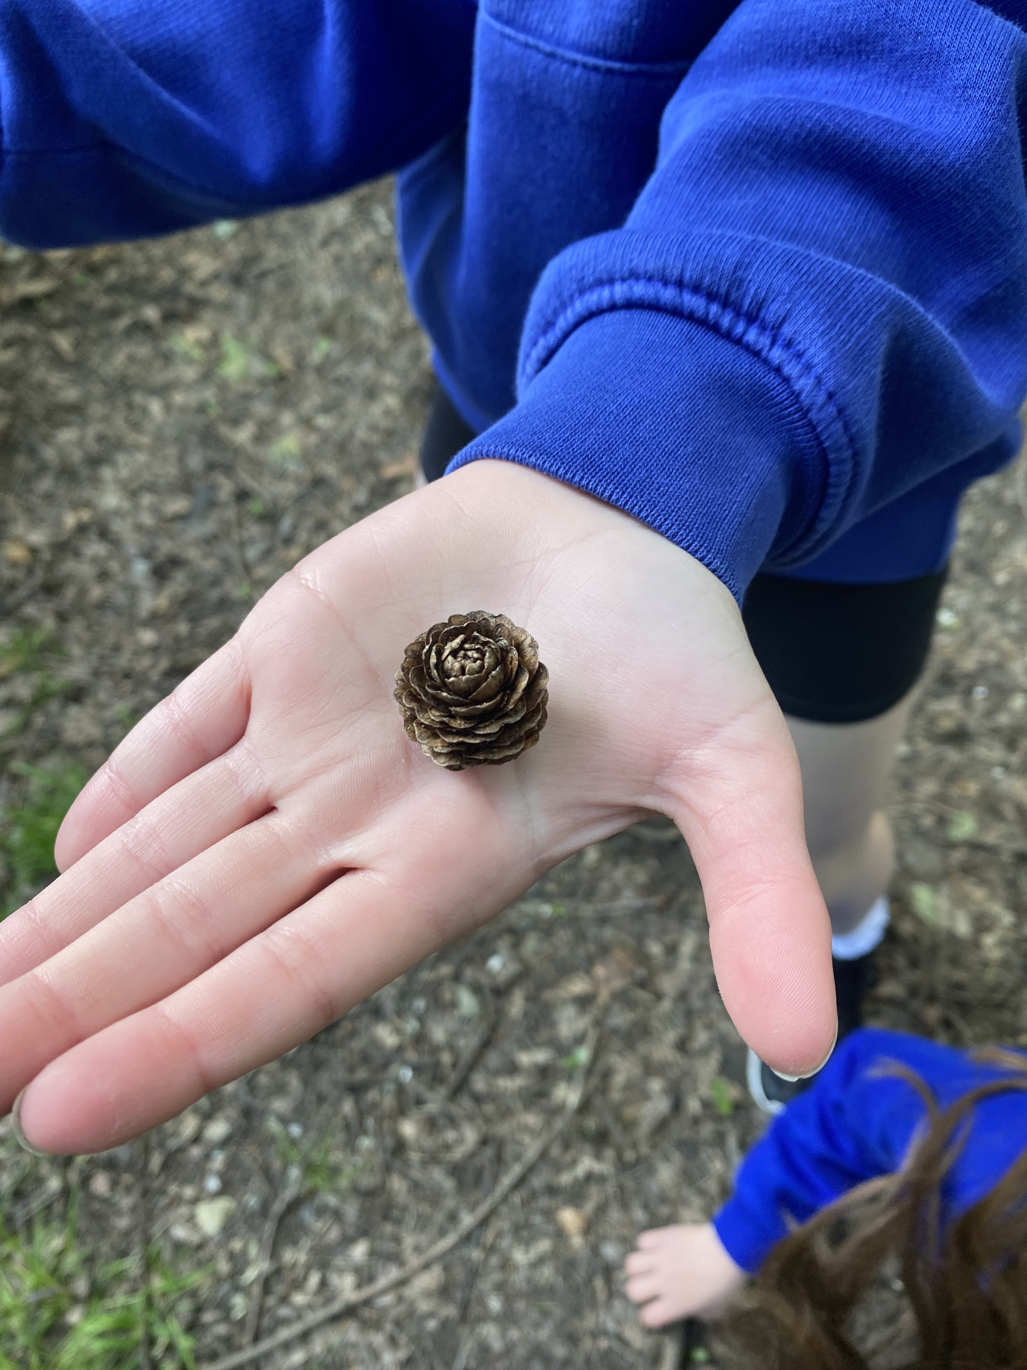
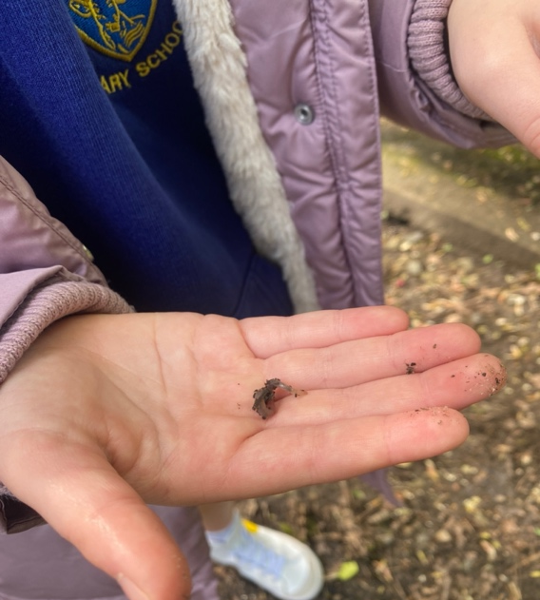
There are many different species of creatures in the woodland. Finding out where the various creatures reside in the woodland is interesting. The children and I went looking for insects and plants living in the woodland area to see what we could discover. What we discovered in the school woodland is seen in the photographs.

Slide 6
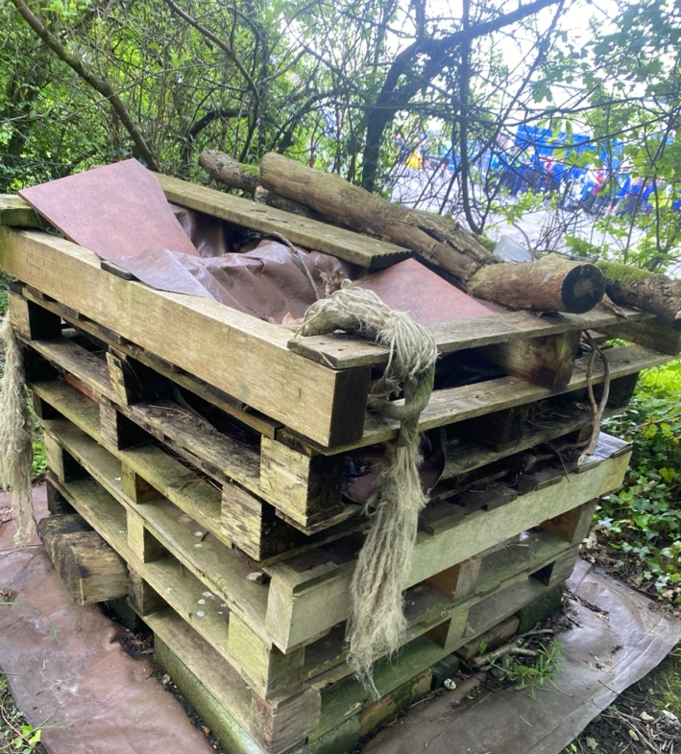
Explore:
The children and I discovered that the school woodland was a child-friendly place while exploring it. However, it had few supplies for small animals and wildlife. Due to the woodland being a frequented by children, there were few plants for the bees and butterflies, making it unsafe for the insects to deposit their eggs and grow their young. To promote and keep the insects safe inside the school woodland, I made the decision to create a plan and build a bug home. The children were eager to participate in the initiative and increase their comprehension.

Slide 7
Why will the bug house benefit the woodland?
The bug home provided insects with a secure environment in which to breed and live, as well as a source of food. By including twigs and logs in the bug house, it was intended that they would eventually rot and attract insects that would consume the nutrients included in the decaying wood. Insects would feel safe and secure in the bug house because it would be a calm location where they wouldn't be disturbed. The bug house would draw other creatures including birds, hedgehogs, fox's badgers, and owls to the woodland because it is a habitat for numerous insects.

