Slide 1
Athens and Rome: Life and Culture in Classical Antiquity
Lecture 23 – Roman Myth and Religion
CLCS4007

Slide 2
Roman Pantheon
“Let this one god be Jupiter in the aither, Juno in the air, Neptune in the sea… Pluto on earth… Vesta on the domestic hearth, Vulcan in the metal-worker’s forge…” – Augustine The City of God 4.11.
“…to the goddess Cloacina (the Purifier; a cloaca is a drain), or to Volupia (whose name has the same root as ‘voluptuous’) or to Lubentina (a name derived from libido), or to Vaticanus (who presides over the wails – vagitus – of infants)… But how can I give a list, in one passage of this book, of all the names of their gods and goddesses? The Romans had difficulty in getting them into the massive volumes in which they assigned particular functions and special responsibilities to the various divine powers.” – (4.8).
Varro Human and Divine Antiquities – (flamines minors – 2 of the 12 gods forgotten.

Slide 3
State Cults

Slide 4
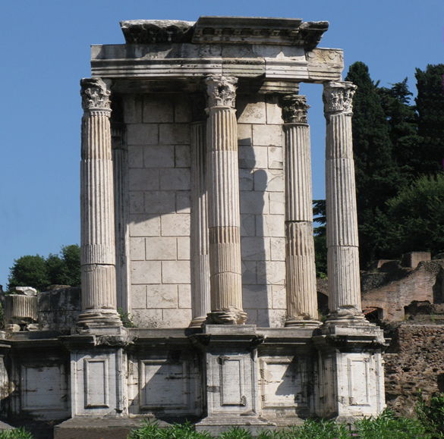
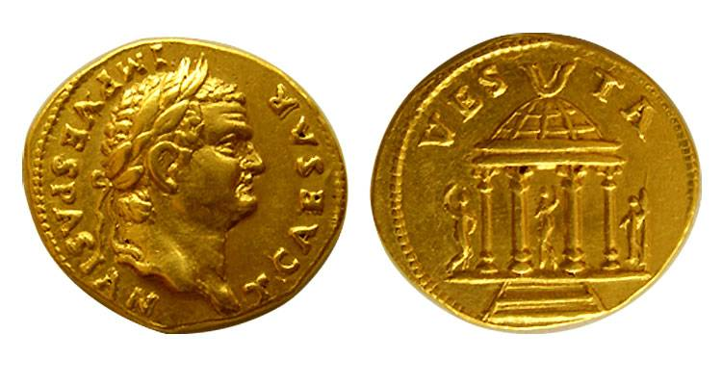
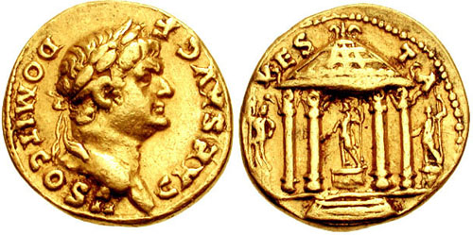
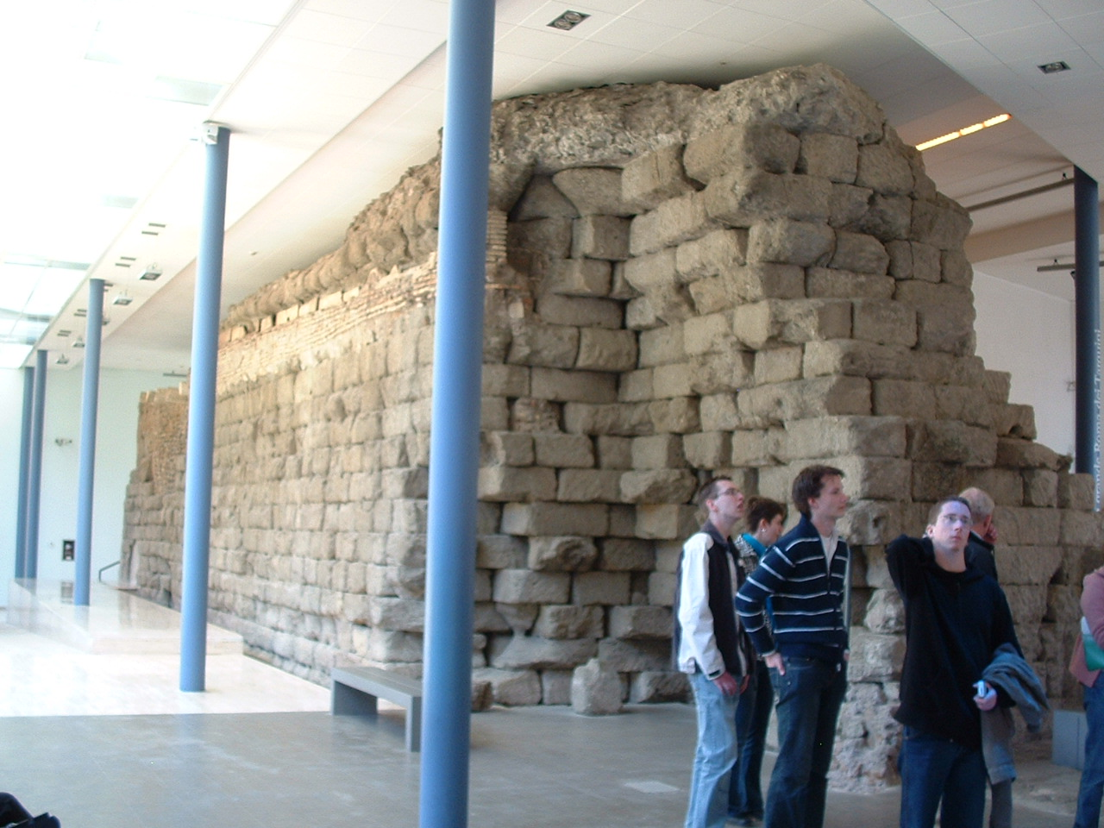
The Capitoline Temple and Temple of Vesta
Located on the Capitoline Hill - dedicated to Jupiter Optimus Maximus (‘The Best and Greatest’) along with the goddesses Juno and Minerva.
The ‘Capitoline triad’ – here from Praeneste - begun in “Regal period” rebuilt several times over the centuries
Titus, as Caesar, AV Aureus. 74 AD.
Domitian, as Caesar, AV Aureus. 73 AD.
“[After the Capuans had started a fire in the Forum (210 BC), it was said that the enemy] were attempting to destroy the temple of Vesta, with its eternal flame and divine guarantee of Roman rule hidden in its inner shrine.” – Livy 26.27.14.
Reconstruction & remains in Capitoline Museum

Slide 5
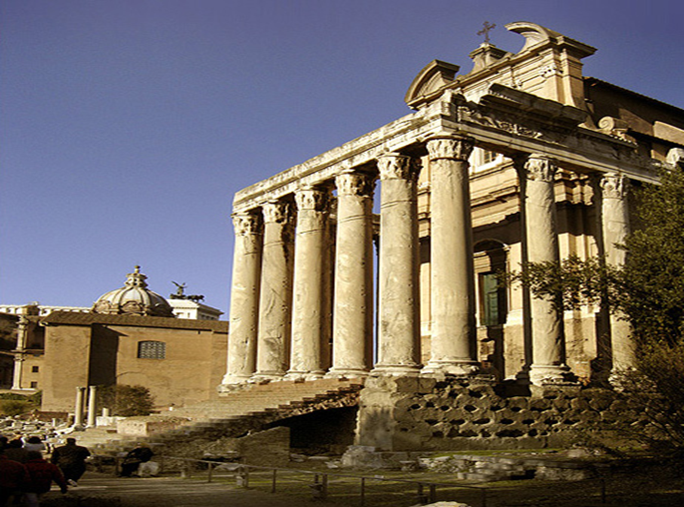
The Imperial Cult
“This practice began with Octavian [=Augustus] and it has been carried on under other emperors, not only with regard to the Hellenic peoples, but to all others in so far as they acknowledge Roman rule. In Rome itself and in Italy generally, no emperor, however greatly venerated he may have been, has so far ventured to do this. However, even there other divine honours are conferred after their death upon those emperors who have ruled virtuously, and in fact shrines are built in their honour.” – Dio Cassius 51.20.6-8.
“He was deified by the senate, while all men vied with one another to give him honour, and all extolled his devoutness… He well deserved the flamen and games and temple and the Antonine priesthood.” - SHA Antoninus Pius 13.3.
“Much was said against him [Hadrian] after his death, and by many persons. The senate wished to annul his acts, and would have refrained from naming him "the Deified" had not Antoninus requested it. Antoninus, moreover, finally built a temple for him at Puteoli to take the place of a tomb, and he also established a quinquennial contest and flamens and sodales and many other institutions which appertain to the honour of one regarded as a god.” - SHA Hadrian 27.

Slide 6
Priesthoods and Rituals

Slide 7
Four principal colleges of priests,
- Pontifices,
- Augures,
- quindecemiviri sacris faciundis (15 to attend to sacred matters),
- septemviri epulonum (7 masters of the feasts).
“All these Salii are sorts of dancers and singers of hymns in praise of the gods of war. Their festival falls about the time of the Panathenaea, in the month which they call March…” – Dionysius 2.70.
“…he [Tullus Hostilius, Rome’s fourth king] might himself give out a ceremonial of war, and that wars might not only be waged but also declared with some sort of formality, he copied from the ancient tribe of the Aequicoli the law, which the fetiales now have, by which redress is demanded. When the envoy has arrived at the frontiers of the people from whom satisfaction is sought, he covers his head with a bonnet – the covering is of wool – and says: ‘Hear, Jupiter; hear, ye boundaries of’ – naming whatever nation they belong to; – ‘let righteousness hear! I am the public herald of the Roman People; I come duly and religiously commissioned; let my words be credited.’ Then he recites his demands…” - Livy 1.32.
  “… after the death of the man who had taken the opportunity of civil disturbance to seize it for himself, I received the priesthood, in the consulship of Publius Sulpicius and Gaius Valgius, and such a concourse poured in from the whole of Italy to my election as has never been recorded at Rome before that time” – Res Gestae 10.2.

Slide 8
The Flamen Dialis
“Many ritual duties are imposed on the flamen Dialis, and likewise a variety of taboos… there is a rule against the flamen Dialis riding a horse; likewise there is a rule against him seeing ‘the levy arrayed’ outside the pomerium, that is the army equipped for battle. Likewise it is never lawful for the Dialis to take an oath; nor is it lawful for him to wear a ring, unless it is perforated and quite plain…if a man in chains enters his house, he must be freed and the chains taken up through the impluvium [strictly speaking the compluvium] onto the roof and let down into the street outside… He never enters a place where there is a tomb, he never touches a dead body; he is not, however, prohibited from attending a funeral.” - Aulus Gellius Attic Nights 15.1-25.

Slide 9
Rituals, Procedure and Politics
“…it is a general belief that without a certain form of prayer it would be useless to immolate a victim, and that, with such an informality, the gods would be consulted to little purpose. And then besides, there are different forms of address to the deities, one form for entreating, another form for averting their ire, and another for commendation… it is the duty of one person to precede the dignitary by reading the formula before him from a written ritual, of another, to keep watch upon every word, and of a third to see that silence is not ominously broken; while a musician, in the meantime, is performing on the flute to prevent any other words being heard.” – Pliny NH 28.10-11.
Caesar and competition of the office of Pontifex Maximus - Plutarch Julius Caesar 7.1-4.
“He [Caesar] brought forward an agrarian law too, and when his colleague announced adverse omens, he resorted to arms and drove him from the Forum; and when next day Bibulus made complaint in the senate and no one could be found who ventured to make a motion… until the end of his term he [Bibulus] did not leave his house, but merely issued proclamations announcing adverse omens.” – Suetonius Divus Julius 20.1.

Slide 10
Incorporating
New Cults

Slide 11
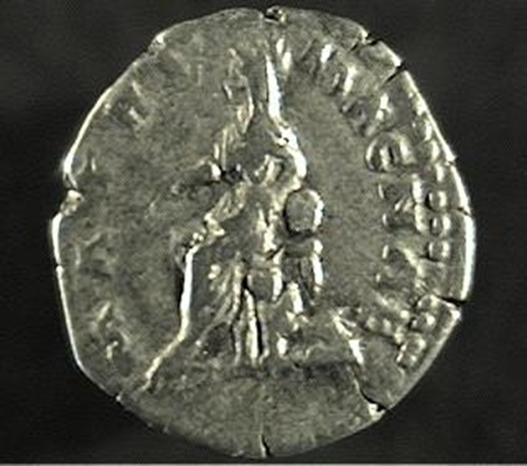
Evocatio: ritual requesting the native gods of a place to abandon the population and come over to the Romans – see Macrobius for the formula used:
    “With these words victims are to be sacrificed, and the import of the entrails examined to see if they indicate a fulfilment of the above.” - Macrobius Sat. 3.9.7-9 .
Incorporating new cults – usually after consultation of the Sibylline books
In 204 BC – raining stones (seen as bad omen) – Sibylline books consulted.
Black stone of Magna Mater brought from Pergamum – meet at Ostia by Scipio Nasica I and a procession of Roman Matrons – games begun in 194 BC.
“They brought the goddess into the temple of Victory… Crowds of people brought gifts for the goddess to the Palatine, and there was a lectisternium, and games which were called the Megalesia.” – Livy 29.14.
Faustina the Younger Denarius – (reverse) - MATRI MAGNAE, Cybele seated left, lion at her feet – RIC 706.
“…rites from abroad, she [Rome] celebrates them in accordance with her own traditions, after banishing all fabulous clap-trap. The rites of the Idaean goddess [Magna Mater] are a case in point… the priest and priestess of the goddess are Phrygians, and it is they who carry her image in procession through the city… no native Roman walks in procession through the city arrayed in a multi-coloured robe, begging alms or escorted by flute-players, or worships the god with the Phrygian ceremonies...” – Dionysius of Halicarnassus 2.19.

Slide 12
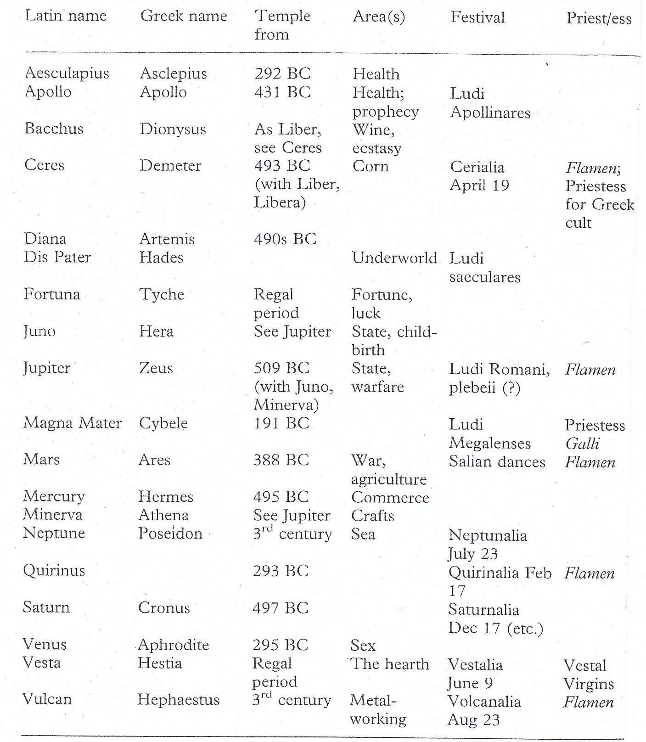

Slide 13
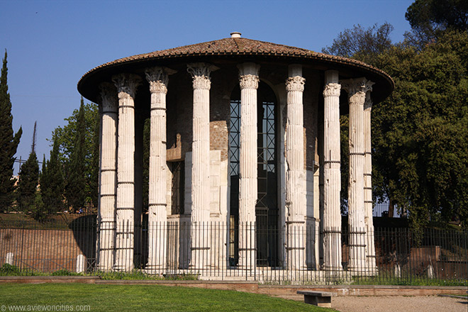
Conservatism?
Temples built in second century BC appear less foreign or exotic in origin.
Temples of Latin deities established in early second century BC – Vediovis (healing deity), Faunus (Pan), Fortuna Primigenia; Juno Sospita (saviour).
Increased use of Greek artists and artisans.
Temple Hercules Victor (c. late 2nd century BC – Forum Boarium.

Slide 14
Suppressing Foreign Cults

Slide 15
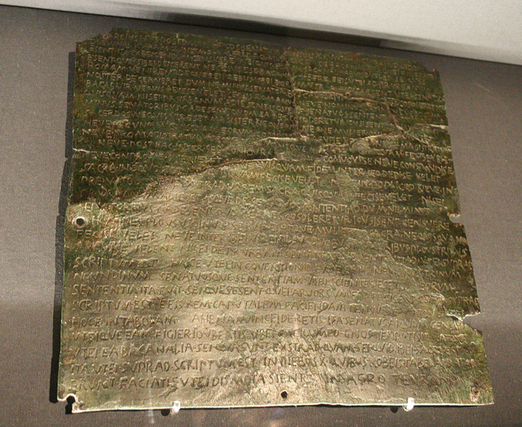
Suppression of rites of Bacchus in 186 BC – Livy 39.8-18.
“Low-born” Greek from Etruria introduces the cult (described as magician).
Tales of debauchery, orgies, corruption, poisoning and murder - P. Aebutius, under care of step-father T. Sempronius Rutilus and mother Duronia; 7,000 implicated in “conspiracy” – destruction of Bacchanalian shrines throughout Italy.
Influence of drama, reworking and embellishment by Livy?
Senatus consultum de bacchanalibus
Vienna Kunsthistorisches Museum - ILS 18 = ILLRP511
Restrictions on large gatherings
Creation of communal funds
Hierarchy
Needs to consult urban praetor
Interference in local Italian affairs?

Slide 16
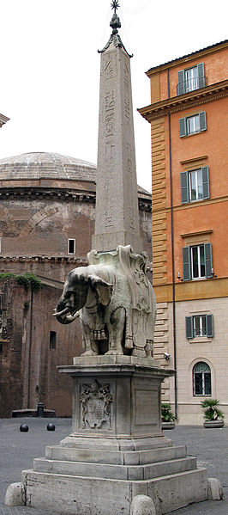
Cult of Isis
“But it seems to me that that decree passed the previous year [53 BC], near its close, with regard to Serapis and Isis, was a portent equal to any; for the senate had decided to tear down their temples, which some individuals had built on their own account. Indeed, for a long time they did not believe in these gods, and even when the rendering of public worship to them gained the day, they settled them outside the pomerium.” – Dio Cassius 40.47.
Obelisk set up by Dioceltian.

Slide 17
Superstitio and Magic

Slide 18
Religio – positive quality – often denotes traditional honours paid to the gods by the state – following the customs of the community.
Superstitio – often a slur – irregular practices - excessive devotion, often with desire for inappropriate knowledge.
“religio honours the gods, superstitio wrongs them.” – Seneca De Clementia 2.5.1.
Magic a mixture of medicine, religion and astrology, often seen as being eastern in origin – used to meet human desires, control the gods and obtain knowledge of the future.
Chaldaeans - often generic term for astrologers
“In the consulships of Faustus Sulla and Salvius Otho [AD 52], Furius Scribonianus was sent into exile on the grounds that he had consulted and looked into the death of the emperor... The expulsion of the astrologers from Italy was ordered by a drastic and impotent decree of the senate. ” - Tacitus Annals 12.52.

Slide 19
Anxieties in Roman literary sources about the power of magic – Lex Cornelia de sicariis and veneficis (81 BC).
Thessalian witch Erichtho – undid the laws of nature, feed on corpses, foretold future through necromancy – “he knew about the mysteries of cruel magicians which the gods above abominate…” – Lucan Pharsalia 6.430.
“After he finally had assumed the office of pontifex maximus on the death of Lepidus… he collected whatever prophetic writings of Greek or Latin origin were in circulation anonymously or under the names of authors of little repute, and burned more than two thousand of them, retaining only the Sibylline books and making a choice even among those; and he deposited them in two gilded cases under the pedestal of the Palatine Apollo.” – Suetonius Divus Augustus 31.1.

Slide 20
Nefarious Magic
“When I had rounded off the case for the defence on behalf of Cotta’s Titinia in a very important private suit, he [Curio] was speaking against me on behalf of Servius Naevius. All of a sudden he forgot his entire case and said that this had been caused by Titinia’s spells/poisons [veneficia] and incantations.” – Cicero Brutus 217.
“The cruel virulence of the disease was intensified by the patient's belief that Piso had given him poison; and it is a fact that explorations in the floor and walls brought to light the remains of human bodies, spells, curses, leaden tablets engraved with the name Germanicus, charred and blood-smeared ashes, and others of the implements of witchcraft by which it is believed the living soul can be devoted to the powers of the grave.” – Tacitus Annals 2.69.

Slide 21
Bibliography
Beard, M., North, J., and Price, S. 1998: Religions of Rome, 2 volumes. Cambridge: Cambridge University Press.
Dowden, K. 2007: Religion and the Romans. London: Bristol Classical Press.
North, J. 1986: ‘Religion and politics, from Republic to Empire’, Journal of Roman Studies 76: 251-258.

