Slide 1


Rangemaster plc
Ratio Analysis
BA International Hotel Management
Financial Management For Hotel Industry
M5XD1922
Lecturer: Dr. David Jenkins
Created by: Stilyana Mincheva
1816276

Slide 2

Company Overview
Rangemaster plc is a manufacturing company producing and supplying catering machines to hotels, restaurants, and public houses in the United Kingdom (UK).
All its sales and trade purchases are on a credit basis.

Slide 3
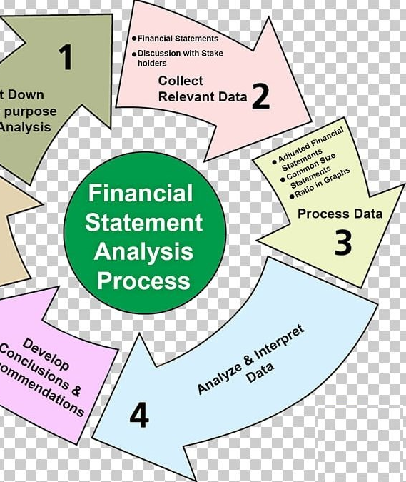
Financial Analysis
Assessment of the company past, present, and the future financial condition
Done to find the company's strengths and weaknesses
Primary method:
Ratio Analysis of financial statements for 2019 and 2018 years

Slide 4
Liquidity Ratio
In 2018 the Rangemaster plc ability to cover its current liabilities with its current assets was 1.83%. In 2019, the ratio goes up to 1.89 %, which means that the company has the ability to pay its liabilities. This tells that Rangemaster plc improves its liquidity and efficiency because its current ratio is improving. This can be a good sign for investors and even better for creditors, because they want to know that they will be paid on time.
At the same time, the Quick ratio shows that in 2018, the firm has a ratio is 1.12. Then in 2019, we observe a slight improvement to 1.23.
So we can figure out that the company can pay its debts without using its inventory.

Slide 5
Profitability Ratio
According to the definition, the ratio must be high, because of the higher the ratio, the higher the company's ability to produce low-cost goods with higher sales.
In 2018, the Gross Profit Margin of Rangemaster plc was 26.81% and in 2019 it is 26.80%, a decrease of 0.05%. This may mean that the company has reduced its profit margin in 2019.
At the same time, the Net Operating Profit Margin also decreased in 2019 to 7.60% from 2018-8.79%, decreasing by 13.55%.
All of this can be due to an increase in company costs as well as a drop in commodity prices in order to achieve higher turnover to cover the higher costs.
This may be due to the company's decision to invest part of the profits in the purchase of new assets or in investing in another business.

Slide 6
Profitability Ratio
The ratio should be higher. Here in 2018 ratio is 15.21 and goes down in 2019 to 13.92%. This decrease in return on capital employed is not a good sign and indicates that the company is not using during this specific year effectively capital employed.
At the same time, Asset Turnover is increased to 1.83p in 2019 compared to 2018-1.73p. This shows that the revenue earned per £1 of capital employed is increased that is a good sign for company performance.

Slide 7
Efficiency Ratio
In 2019 inventory days were 73.80 days compared to 2018 when they were 75.63 days, indicating accelerated sales process.
This is a good indication of the policy of the company's sales in 2019.
While the turnover of fixed assets was 2.50 pence in 2018 and 2.89 pence in 2019 or 15.61%, indicating that fixed assets are increased, indicating improvement in company policy not to invest in current assets, which will lead to more profit.

Slide 8
Capital Structure
The Interest Cover Ratio indicates how far the interest paid is covered by the profits generated by the company. In 2018 company Rangemaster plc has 8.2 times and in 2019 it is increased to 12 times.
This means that the business in 2019 succeeds easily able to meet its interest obligations from its profit with 46.34% more comparing to 2018.
At the same time Gearing shows that in 2019 debt is decreased to 199.48 % compare to 2018-221.48 %, which shows that the company depends more on equity in 2019.
As so this tendency we can see from the decrease in borrowing with 3.32 %, as in 2019 it is 66.61% compared to 2018 it was 68.89%.

Slide 9
Investment Ratio
In 2018, EPS is 51p, and in 2019 was 63p, an increase of 23.53%.
The increase in EPS is a good sign that the company's performance improves because the profits paid to the owners of one share is increased.
P / E ratio for both years (2019 - 5.56 and 2018-5.39, an increase of 3.03%) gives us an indication of the confidence that investors can have in the future prosperity of the business.
The increase indicates that the future of the company is good.

Slide 10
Investment Ratio
In 2019 the amount of dividends paid to the holder of an ordinary share, was 33 000p compared with 2018 - 30 000p, it shows a 10% increase.
This means that the Rangemaster plc has good earnings and stable position on the market in 2019
At the same time the amount of the dividend paid to shareholders to profit in 2019 was 52.38% and in 2018 is 58.82% or 10.95% decrease.
This again shows good company policy in the future development of the company.

Slide 11

Rangemaster plc management should focus on:
As gearing is decreasing, management should focus on reaping the benefits.
Management should be very careful as they will not have the chance to make a mistake because of stakeholder expectations for next year.
The company must focus on long-term investments in order to establish a stable and long-term position in the market.
Management needs to take a new approach to find new sources for investment.
The company needs a fine innovative strategy for future development.

Slide 12


After applying the full ratio, we can conclude that Rangemaster plc is a profitable company. Based on a two-year analysis, we have found that the company receives a profitable return on short and long-term investments. At the same time, the company was able to pay dividends to its shareholders and to cover the debts and expenses. Rangemaster plc also focused part of the profit on investment in fixed assets, aiming to expand its market position in the long term.

Slide 13


