Slide 1

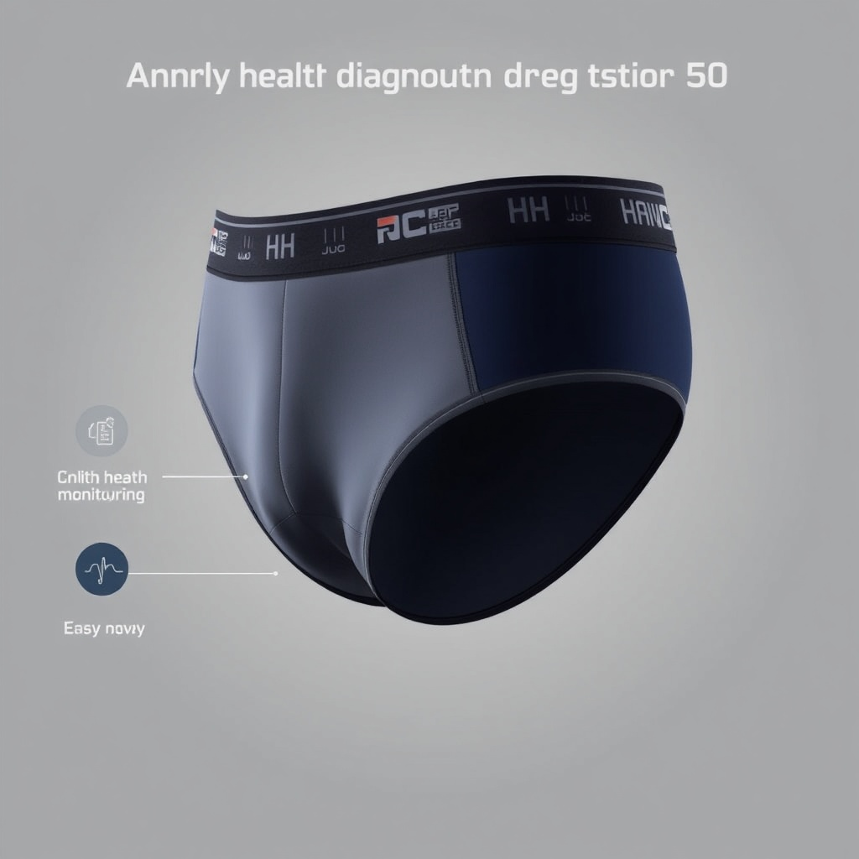
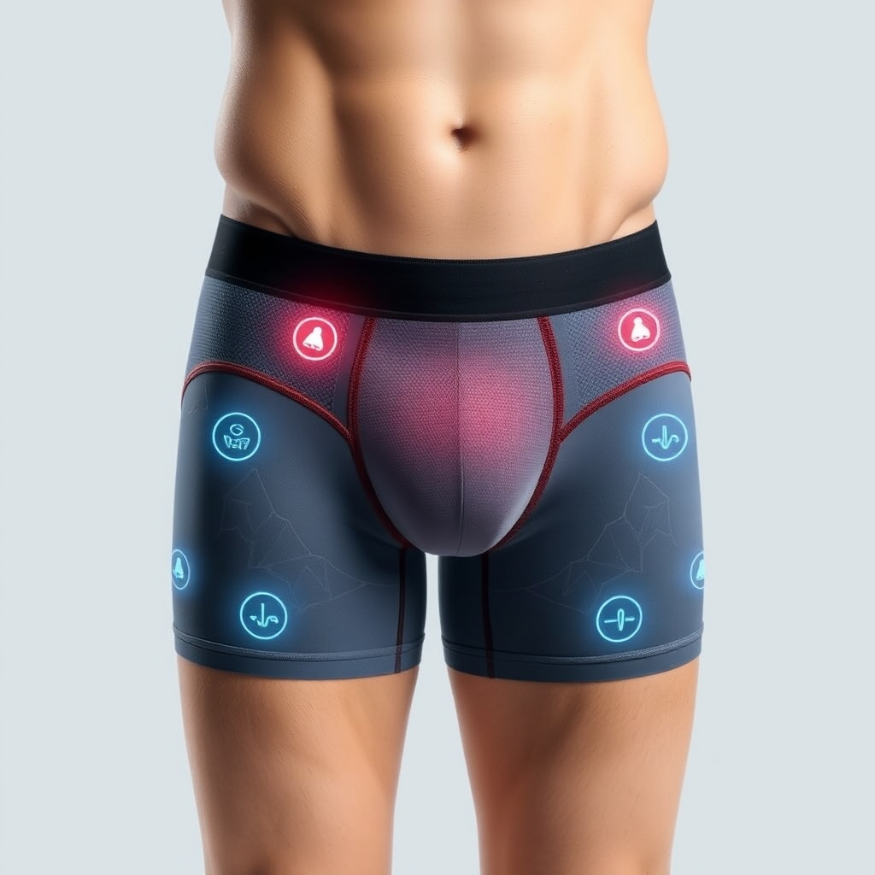
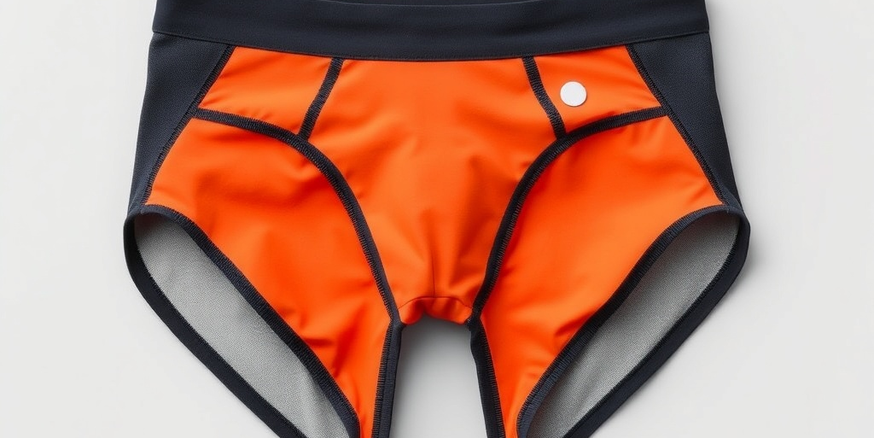
Men's Health Diagnostic Underwear
Group:50+ men
Setting: NHS
CATCH IT EARLIER
Student Names & ID Numbers
Imtiaz Begum: 2128130
Madona Igbinoba: 1815861
Adji Makangila: 2126238
Mihaela Sandu-Rizea: 2126225
Nomaathemba Amanda Socikwa: 2128581
I.M.A.M.N

Slide 2


Component 3
Group Project Presentation
Programme: MSc Public Health and Social Care in Practice
Module: Population Health and Digital Health Promotion
Module code: LCHS7009
Lecturer: Dr Besty Jose

Slide 3
Table Of Contents
Introduction ADJI
Justification IMTIAZ
Application planning model MADONNA
Barriers AMANDA
Benefits MIHAELA
Conclusion ADJI

Slide 4
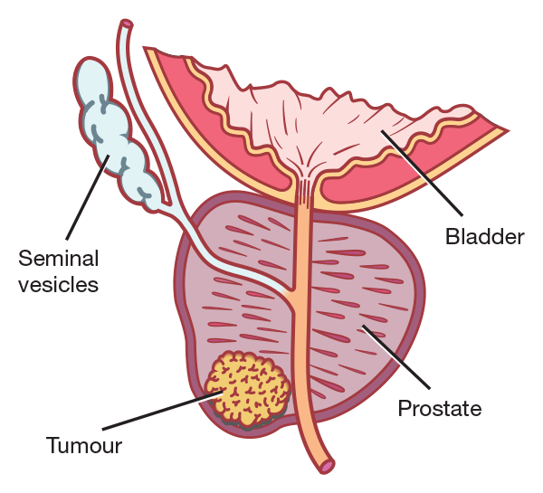
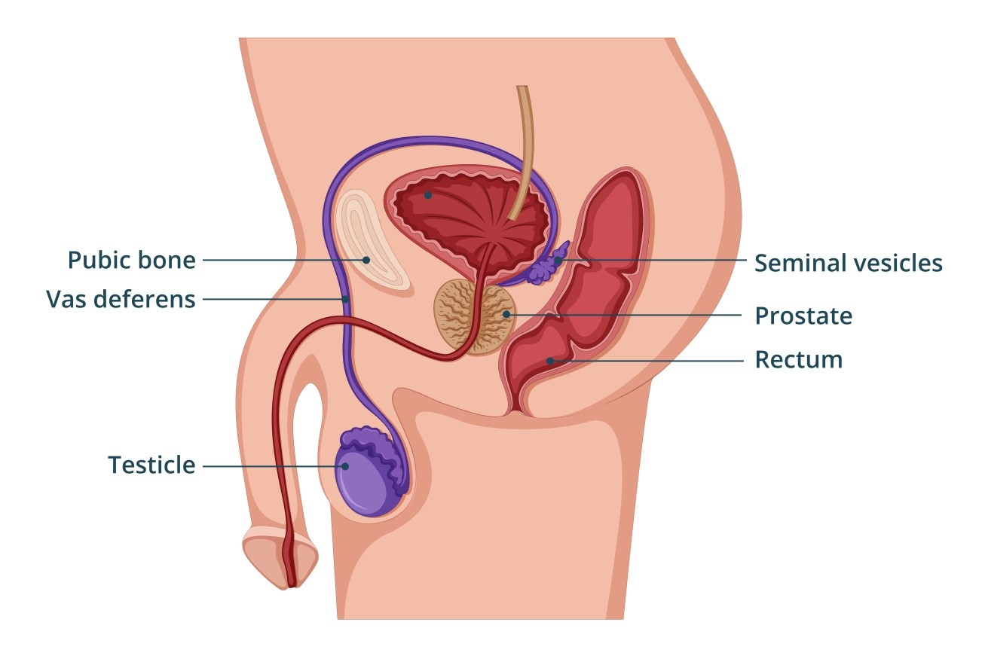
Introduction (Adji)
This group presentation is going to discuss the promotion of prostate cancer early detection by using Smart Underwear technology.
This presentation aims to raise awareness of the importance of early detection of abnormal cells and promoting early detection promoting early prevention.
The objective of this presentation is to promote the Smart Underwear among men aged 50 years and above, as well as encourage the use of this product to improve the early diagnosis and promote early treatment intervention.
The targeted group are the NHS patients with a family history of prostate cancer to take part in the program and use the product to prevent, detect, early diagnosis and initiate treatment with a professional urologist within the NHS.

Slide 5
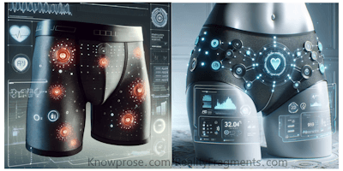
Overviews
As a group, we will be looking at the justification as prostate cancer is the most common type of cancer affecting over 52,000 men in the UK each year ( NICE, 2023).
The Ewles and Simnett planning model will be discussed in this group presentation to emphasise empowerment through tailored intervention to enable individuals to act ( Scriven and Ewles, 2017).
The barrier of the Smart Underwear will discuss how to implement it and what solution can be put in place to prevent concerns regarding privacy when looking at the product capability, data security and personal privacy that might deter users from engagement ( Brey, 2018).
Finally, the benefits of the product (IMAMN) support self-tracking using sensors and app integration allowing users to adjust behaviour, which aligns with the principle of the health belief model is included in the recommendation ( Rosenstock, 1974).
(Adji)

Slide 6

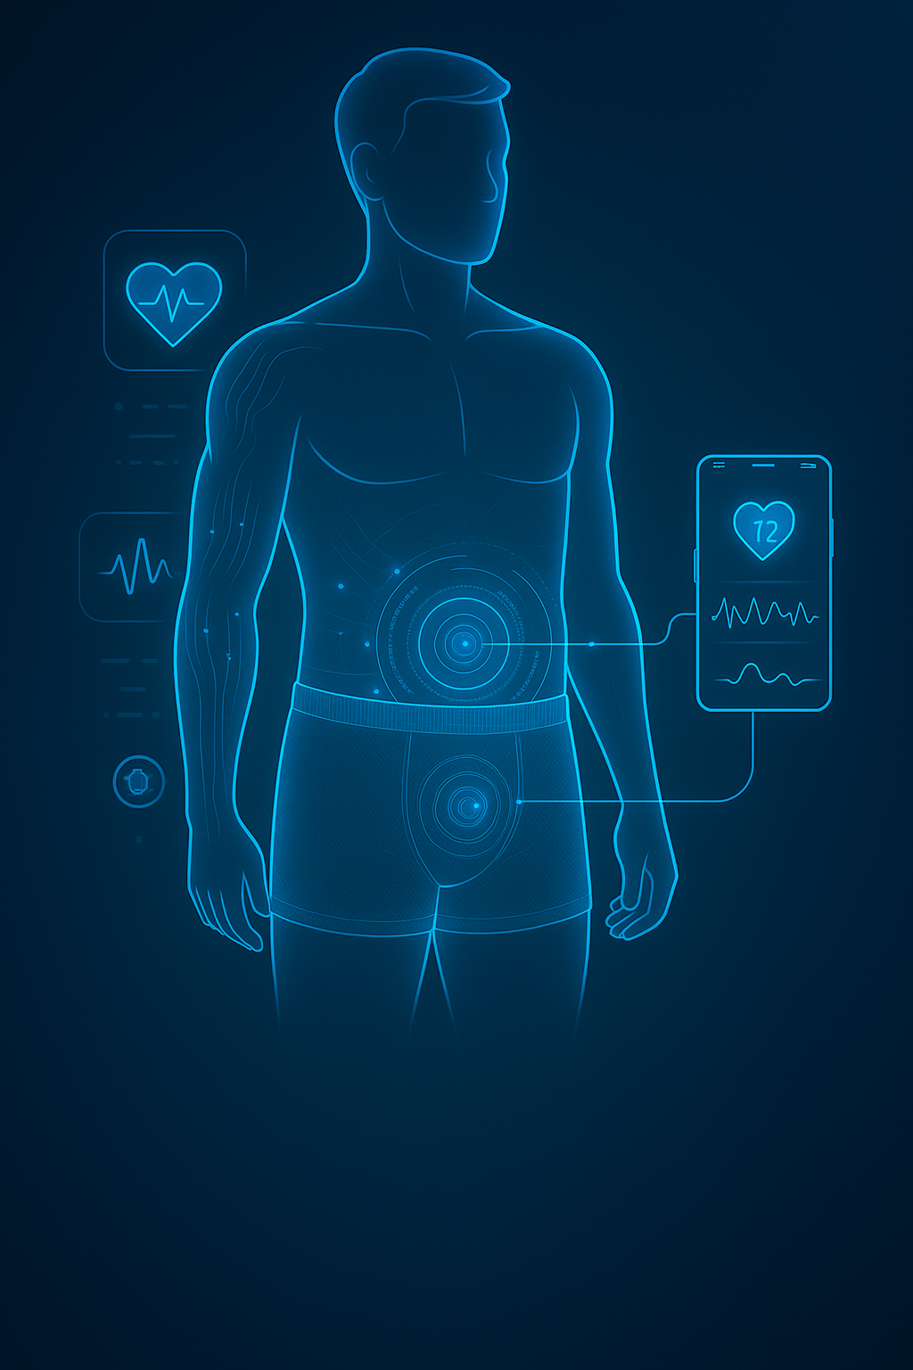
Adji Smart Underwear feature
Comfortable and weather-adjustable
Smart sensor to detect body temperature
Urinary patterns includes urine markers
ECG Reading
Detect abnormal cells
Share information with the urology team within the NHS department
Multi language
Product to be offered to the NHS to men aged 50 and above with a family history of prostate cancer

Slide 7
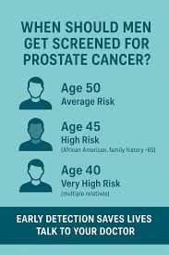
Understanding the Public Health Issue: Prostate Cancer in the UK. (First slide Imtiaz)
Justification
Prostate cancer is the most common cancer affecting men in the United Kingdom, with over 52,000 new cases diagnosed each year (NICE, 2023).
The condition often shows no early symptoms, leading to delayed diagnosis (Mayo Clinic, 2025).
Late detection increases the risk of death and reduces treatment success (DHSC,2023).
Cultural stigma, embarrassment, and perceptions of masculinity discourage men from seeking help (Public Health England, 2023).
Men’s health awareness remains limited, with low participation in screening and prevention programmes (Prostate Cancer UK, 2023).

Slide 8
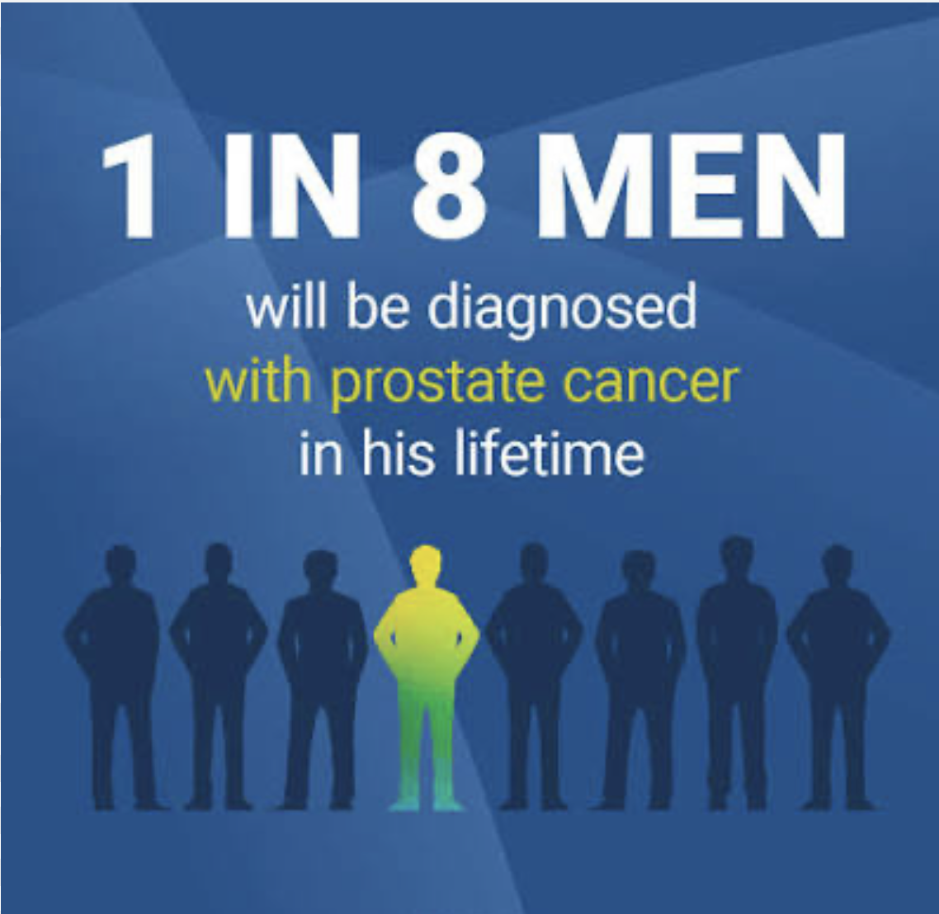
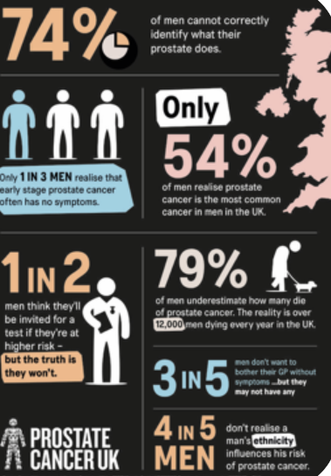
Key Statistics on Prostate Cancer in the UK. Imtiaz
Over 52,000 new prostate cancer cases are diagnosed in the UK each year, making it the most common male cancer (Cancer Research UK, 2024).
Around 12,000 men die annually from the disease, accounting for around 7 % of all male cancer deaths (Cancer Research UK, 2024).
One in eight men will receive a prostate cancer diagnosis during their lifetime (Cancer Research UK, 2024).
Black men are about twice as likely to develop prostate cancer and often present at a later stage (NHS, 2023).
When detected early, the five-year survival rate exceeds 95 %, compared with less than 50 % for advanced cases (WHO, 2023).

Slide 9


National Guidelines and. Imtiaz Public Health Context.
NHS Long Term Plan aims for 75% of cancers to be diagnosed at an early stage by 2028, reducing mortality and improving survival (NHS England, 2019).
NICE (2023) recommends early referral for men presenting with urinary or prostate-related symptoms to ensure prompt diagnosis and treatment (NICE, 2023).
Public Health England’s Men’s Health Strategy highlights the need for digital innovation and self-monitoring tools to engage men in preventive care (Public Health England, 2022).
Early diagnosis is proven to save lives and reduce NHS costs, supporting the national focus on integrated, technology-driven care (GOV UK, 2020).

Slide 10

Comparison with Other Countries. Imtiaz
UK survival rates improving but remain lower than in the USA and Canada (Cancer Research UK, 2024).
In the UK, PSA testing is available only on patient request, not through national screening (NHS, 2023).
The USA and Sweden promote proactive prostate screening and early detection (Centers for Disease Control and Prevention, 2024; WHO, 2023).
Global use of digital health tools and wearable devices for early cancer detection is rapidly expanding (WHO, 2021; Deloitte, 2024).

Slide 11


⚠️ Consequences of Not Addressing the Problem. Imtiaz
Late diagnosis → advanced cancer, lower survival, men diagnosed at later stages face limited treatment options and poorer outcomes (NICE, 2023).
Increased NHS costs and service pressure, advanced disease requires expensive treatments and prolonged care (NHS England, 2019).
Emotional, social, and family strain, late diagnosis causes anxiety, loss of independence, and emotional distress for patients and families (Brazier, 2025).
Missed early-detection targets, failure to raise awareness hinders NHS aims to detect 75 % of cancers at early stages by 2028 (NHS England, 2019).

Slide 12

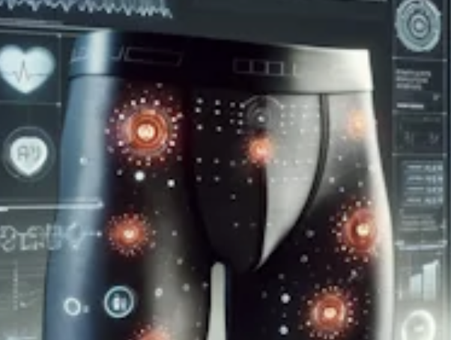

Digital Health Intervention - Smart Pants. Imtiaz
﻿Sensor-based underwear for early prostate health monitoring
﻿Detects urinary frequency, flow changes, and pelvic pressure
Detect abnormal cells
Sends real-time alerts via smartphone app
﻿Encourages screening and health-seeking behaviour
﻿Supports self-care, awareness, and early detection

Slide 13

⭐ Unique Selling Point Imtiaz
Discreet, private, and non-invasive, offering a comfortable alternative for early detection (Prostate Cancer UK, 2024).
Detects biological changes, not just symptoms, enabling earlier and more accurate diagnosis (NICE, 2023).
Real-time data is shared securely with clinicians, supporting continuity of care and early intervention (NHS England, 2019).
Empowers men through self-monitoring, aligning with Public Health England’s approach to behaviour change and self-management (Public Health England, 2023).
Supports NHS digital transformation and integration of AI-driven health technologies (NHS England, 2019).

Slide 14


Rationale for Target Group (Men 50+). Imtiaz
Men aged 50+ (and Black men 45+) at highest risk. Risk increases with age and is double for Black men (NHS, 2023).
Cultural stigma limits help-seeking – Many men avoid prostate checks due to embarrassment or fear (Prostate Cancer UK, 2024).
Addresses gender and ethnic health inequalities. Improves access for groups less likely to seek help (Public Health England, 2023).
Raises awareness and encourages early testing. Supports early detection and NHS prevention goals (MacMillan Cancer Support, 2025).

Slide 15
Existing Digital Health Solutions. Last slide: Imtiaz
Digital Intervention​
NHS Prostate
Cancer Risk
Checker
OWise Prostate Cancer App (UK)
Smart Pants (Current Intervention)
Main Features
Online tool to assess prostate cancer risk and encourage GP consultation
Provides symptom guidance, testing information, reminders, and support
Wearable underwear with biosensors detecting urinary changes and abnormal cells; securely shares data with urology teams for early review
Detects Abnormal Cells / Biomarker
❌ No
❌ No
✅ Yes
Data Shared with Healthcare Teams
❌ No
❌ No
✅ Yes – Shared with NHS clinicians and urology departments
Continuous Monitoring / Prevention
⚠️ One-off self-assessment only
⚠️ Awareness-
focused only
✅ Continuous and preventative monitoring
Source
(NHS, 2023)
(Owise, 2024).
(IMAMN, 2025)

Slide 16
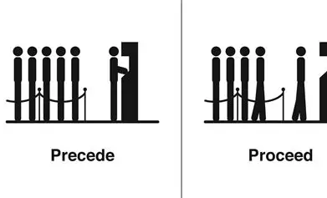

Precede-Proceed Planning Model (Madona)
The PRECEDE-PROCEED model is an extensive framework utilized for the systematic design, implementation, and evaluation of health promotion and behavioral change programs (Gielen et al. 2008; Green and Kreuter, 2005).
It was first established in the 1970’s by Green and associates (Green and Kreuter, 2004).
This model combines two components:
PRECEDE → diagnostic and assessment phase.
PROCEED → implementation and evaluation phase.
This model has shown beneficial for numerous health promotion issues and may adequately promote one-time interventions or continuous initiatives (RHIHub, nd; Crosby and Noar, 2011).

Slide 17

Justification for choosing Precede-Proceed Planning Model (Madona)
Precede-Proceed planning method assists planners in assessing community needs, identifying behaviors and environmental factors that influence health and developing targeted interventions..
Early identification of prostrate cancer necessitate behavioral modification among men aged 50 and older, who frequently underutilize screening programs (Maines et al., 2015; Wei et al., 2023; Fehlberg et al., 2025).
Precede–Proceed model aid in identifying predisposing, reinforcing, and enabling variables that affect the adoption of wearable health technology (Jeeihooni et al., 2015; Kim et al., 2022).
This model was selected as it can be used as the theoretical foundation for health promotion interventions across population groups (+50 Men), and these interventions are specifically effective with regard to knowledge enhancement (Kim et al., 2022).

Slide 18
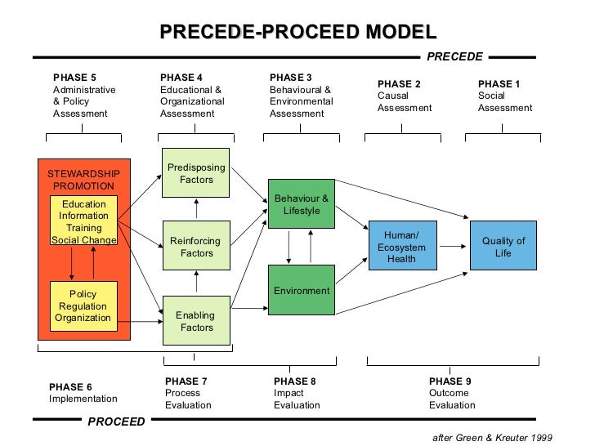
Precede-Proceed Model (Madona)
(Green and Kreuter, 2005; Green and Kreuter, 2015)

Slide 19
Applying Precede Phase 1-5 (Madona)
Phases | Application
Phase 1- Social Assessment | Men aged 50+ experience stigma, embarrassment, and hesitance to get prostate checks due to cultural and emotional barriers (Christie-de Jong et al., 2025). Smart Underwear provides discreet, home-based monitoring (Crossfly, 2025).
Phase 2- Epidemiological Assessment | 55,300 UK men are diagnosed with prostate cancer annually, and late identification increases mortality risk (Cancer Research UK, 2024).
Phase 3- Behavioral and Environmental Assessment | Men aged 50+ have low prostrate cancer screening uptake due to fear, stigma, and masculinity standard (Christie-de Jong et al., 2025; Tomas & Benyamin, 2025). While smart underwear offers discreet, home-based biosensing, urine-based tests (MPS2) are the most validated non-invasive methods for early prostate cancer detection (Vanderbilt University Medical Center, 2025).
Phase 4- Educational and Ecological Assessment | Predisposing factors like low awareness of early symptoms, fear of prostate exams, and stigma, reduces screening uptake among men aged 50+ (Mweya, 2023; Tomas & Benyamin, 2025). Enabling factors include wearable technologies and user-friendly apps provide unobtrusive home-based early detection (Karolinska Institutet, 2025; Mokni et al., 2021). Reinforcing factors include clinician feedback, NHS follow-up reminders, and family encouragement boost screening acceptability and adherence (Christie-de Jong et al., 2025).
Administrative and Policy assessment and Intervention alignment | The GDPR-compliant NHS digital transformation strategy enables remote diagnostics, data protection, and clinical service integration, enabling scalable digital health solutions for early cancer detection (NHS England, 2023; NHS Digital, 2023).

Slide 20
Applying Proceed Phase 6-9 (Madona)
Phases | Application
Phase 6- Implementation | Smart Underwear has undergone clinical evaluation in NHS-affiliated environments, indicating its potential for implementation through general practitioner practices and urology departments (Long et al., 2015).
Phase 7- Process Evaluation | Process evaluation include acceptability, daily usage frequency, application engagement, and sample size (Glanz et al., 2015).
Phase 8- Impact Evaluation | It is anticipated that the impact evaluation will result in an increase in Prostrate-specific antigen (PSA) testing and prompt referrals to urology (NICE, 2023).
Phase 9- Outcome Evaluation | The outcome evaluation aims to decrease late-stage prostate cancer incidences and enhance survival rates (Cancer Research UK, 2024; Prime, 2025).

Slide 21


Critical Evaluation of Precede-Proceed Model (Madona)
Strengths Vs Limitations
Structured and thorough: Provides a systematic framework from needs assessment to result evaluation, suitable for intricate health interventions.
Resource-intensive: The complete implementation necessitates time, financial investment, and interdisciplinary collaboration (Green & Kreuter, 2005).
Technological advancement surpasses the model: The swift progression of digital health may exceed the model's fixed stages, necessitating continual adjustments (RHIhub, nd).
Capable of integrating digital health technologies: Can assimilate wearable devices, mobile applications, and remote diagnostic tools (Glanz et al., 2015).
Facilitates stakeholder collaboration: Fosters interaction among NHS, physicians, patients, and technology developers (Kim et al., 2022).
User Dependent Outcomes: Success is significantly contingent upon consistent user behaviour (e.g., daily utilisation of smart underwear), which may differ among populations (Salem and Syed, 2022).

Slide 22
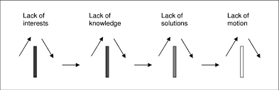
Barriers
Amanda Slides
A barrier is a visible structure or an invisible factor that obstructs, hinders, or complicates the movement, fulfilment of objectives, or communication of an individual or entity (Heffernan, 2024).

Slide 23
Identified Potential Stakeholders for IMAMN
NHS: The primary facilitator for promoting and distributing the health underwear, leveraging its extensive network to reach the target audience.
Healthcare Providers: General practitioners and urologists who can endorse the product, providing credibility and personalised communication about its benefits.
Patient Advocacy Groups: Organisations focused on men's health and prostate cancer awareness can help advocate the importance of early detection and promote the product.
Technology Partners: Companies that specialise in wearable technology and health data analytics can assist in the development and integration of the monitoring features.
Pharmaceutical Companies: Collaborations may be possible to promote the health underwear alongside traditional cancer screening methods.
Amanda

Slide 24
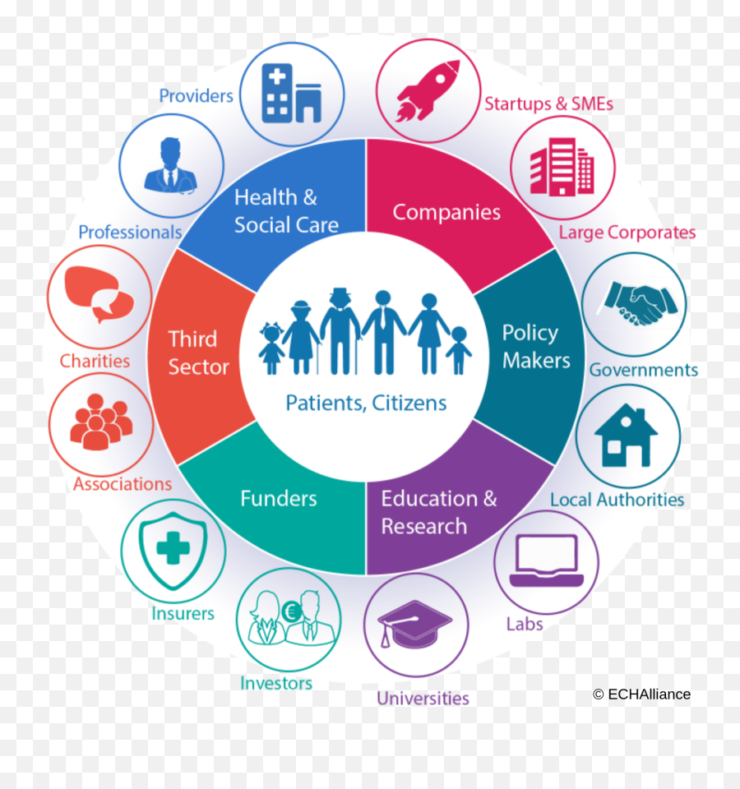
Potential Barriers to Implementation
Amanda
Resistance to Change: Older men may be hesitant to adopt new technology or modify their health behaviour due to traditional attitudes toward healthcare.
Privacy Concerns: With the underwear's health monitoring capabilities, concerns about data security and personal privacy may deter users from engagement (Brey, 2018).
Technological Literacy: Many individuals over 50 may lack the comfort or familiarity with digital health technologies, impacting their willingness to use the app associated with the underwear.
Cost and Accessibility: Ensuring the underwear remains affordable and accessible to the target demographic may present economic challenges.
Regulatory Compliance: Navigating healthcare regulations concerning wearable devices may limit implementation strategies (Loeb and Laporte, 2020).

Slide 25

Barriers and Potential Stakeholder Collaborations
1. Resistance to Change
Amanda
Barrier: Older men may show resistance to adopting new technologies or changes in health behaviour, rooted in traditional health practices and scepticism towards innovation.
Collaborating Stakeholders:
.General Practitioners (GPs): GPs can play a crucial role in educating their patients about the benefits of the health diagnostic underwear. By recommending it during consultations, they can reduce scepticism.
Patient Advocacy Groups: Organisations focused on men's health, such as Prostate Cancer UK, can facilitate awareness campaigns to educate patients about the importance of regular monitoring and the role of technology in improving health outcomes.
Solutions:
Develop educational resources, workshops, and seminars that provide information on how to use the device and the benefits of incorporating technology into health monitoring (Dean et al., 2018).
Create testimonial campaigns featuring patients who have successfully adopted similar technologies, highlighting positive experiences to build trust and acceptance.

Slide 26

2. Privacy Concerns
Amanda
Barrier: There may be significant worries about data privacy and security, with potential users concerned about how their health information will be used or shared.
Collaborating Stakeholders:
Technology Partners: Collaborations with technology companies specialising in data security can ensure robust protection of user data and compliance with regulations.
Legal Experts: Engaging legal experts to establish clear data use policies and guide compliance with GDPR and other relevant regulations.
Solutions:
Implement clear data protection strategies and communicate these effectively to potential users to build trust. Providing transparency about data usage and storage practices can mitigate concerns (Brey, 2018).
Ensure features such as anonymised data sharing and user-controlled permissions in the app are prominently showcased to reassure users about their privacy.

Slide 27

3.Technological Literacy
Barrier: Many older individuals may not be comfortable using digital health technologies, limiting their engagement with the app associated with the underwear.
Collaborating Stakeholders:
Health Education Organisations: Partnering with organisations that specialise in health literacy can help develop materials to assist users in learning how to use the technology.
Community Centres: Collaborating with local community centers or senior clubs to hold training sessions can improve technological skills among the target demographic.
Solutions:
Create user-friendly interfaces with simple navigation and provide tutorial videos and written guides to assist users in understanding how to utilise the features effectively (Hurst et al. 2020).
Offer one-on-one support sessions, either virtually or in person, to help individuals learn and gain confidence in using the product which it have different languages and translation option.
Amanda

Slide 28
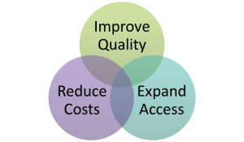
4. Cost and Accessibility
Amanda
Barrier: The price of the health diagnostic underwear may deter participation, especially among lower-income individuals.
Collaborating Stakeholders:
Local Health Departments: Collaborating with public health agencies to explore funding opportunities or subsidies for targeted demographics can enhance accessibility.
Insurance Providers: Engage with health insurance companies to consider covering part of the costs of the underwear as a preventive health measure.
Solutions:
Develop a sliding scale pricing model or provide financial assistance programs for eligible users to ensure affordability (Loeb & Laporte, 2020).

Slide 29

5. Regulatory Compliance
Amanda
Barrier: The regulatory landscape for digital health interventions can be complex and may pose challenges to the development and distribution of the product.
Collaborating Stakeholders:
Regulatory Bodies: Engage with organisations such as the Medicines and Healthcare products Regulatory Agency (MHRA) to ensure compliance and gain insights into regulatory requirements.
Healthcare Law Specialists: Collaborating with legal teams specialising in health technology can provide guidance on navigating regulatory challenges.
Solutions:
Conduct thorough pre-market assessments and trials to demonstrate the effectiveness and safety of the product, which can ease the regulatory review process (Meyer et al., 2018).

Slide 30

Legal and Ethical Issues
Amanda
Data Protection: The General Data Protection Regulation (GDPR) demands strict compliance regarding the collection, storage, and sharing of personal health data (Regulation (EU) 2016/679).
Informed Consent: Users must be fully informed of how their data will be collected, used, and shared, ensuring they understand the implications of their participation (Meyer et al., 2018).
Equity of Access: Ethical considerations must ensure that all men, regardless of socioeconomic status, have equitable access to the health diagnostic underwear to avoid disparities in health outcomes (Hurst et al., 2020).
Health Inequality: There is a risk that such interventions could exacerbate existing health inequalities if they are not designed with inclusivity in mind.

Slide 31

Data Privacy and Protection
Issue: The collection, storage, and processing of personal health data present significant privacy concerns. Users may fear how their sensitive information will be handled, leading to potential reluctance in adoption.
Strategies to Address:
Compliance with Regulations: Adhere to the General Data Protection Regulation (GDPR) guidelines, which mandate strict requirements for the handling of personal data. This includes obtaining explicit consent from users before collecting any personal information (Regulation (EU) 2016/679).
Transparency: Clearly communicate data usage policies to users, detailing what data will be collected, how it will be used, and the measures taken to protect it (Brey, 2018). Informing users about their rights, including the right to access and erase their data, fosters trust.
Robust Security Measures: Implement advanced encryption methods and secure data storage solutions to protect sensitive health information. Regular audits and risk assessments should be conducted to identify potential vulnerabilities in the system (Kelley et al., 2020).

Slide 32
Informed Consent
Informed Consent
Issue: Ensuring that users fully understand what they are consenting to when providing their data is critical. Informed consent must be obtained without coercion, and potential risks should be clearly articulated.
Strategies to Address:
Comprehensive Consent Forms: Develop user-friendly consent forms that explain the purpose of the health diagnostic underwear, the type of data collected, and how it will be utilized. These forms should be reviewed in plain language to ensure comprehension (Meyer et al., 2018).
Ongoing Consent Incorporate mechanisms for ongoing consent that allow users to review and update their preferences regarding data use over time. This approach helps maintain user agency and promotes ethical standards (López et al., 2021).

Slide 33
Equitability of Access
Issue: To ensure that the introduction of health diagnostic underwear does not exacerbate existing health inequalities, it is essential to consider how to make the product accessible to all demographic groups, particularly those with lower socio-economic status.
Strategies to Address:
Funding and Subsidies: Collaborate with public health organisations or government bodies to identify funding opportunities or grants that could subsidise costs for low-income individuals (Hurst et al., 2020).
Inclusive Design: Ensure that the product is designed with inclusivity in mind, considering various socio-economic backgrounds and technological literacy levels. Providing alternative ways to access health monitoring, such as through community health programs, can help mitigate disparities (Nguyen et al., 2020).

Slide 34
Ethical Considerations of Technology Use
Issue: The ethical implications of using technology in health monitoring, particularly concerns about dependency on technology and the potential stigmatisation of users based on their health data.
Strategies to Address:
Ethical Review Boards: Establish an ethical review board that includes diverse stakeholders to evaluate the effectiveness and ethical implications of the health diagnostic underwear before its launch (Loeb & Laporte, 2020).
User Education: Implement educational initiatives to address concerns about dependency on technology. Highlight the product as a complement to regular health check-ups rather than a replacement for traditional medical care.

Slide 35
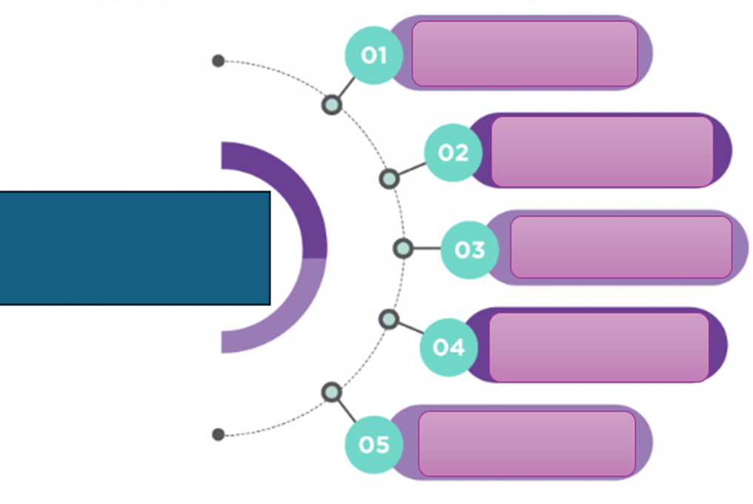
M. Sandu Rizea
The smart underwear designed with embedded smart sensors for men age group 50 and over would offer a transformative potential aligning with modern health promotion models’ goals by enhancing empowerment, enabling self-tracking, improving quality of life, and supporting early diagnosis.
EXPECTED
Monitoring health/empowerment
BENEFITS
Engaging users in self-tracking (Lupton, 2014)
HOW WOULD IT HELPS?
Quality-life improvements
FOR USERS
Provide insights into users' behaviour
Early diagnosis
(Andreu-Perez et al, 2015; Bross, Janssen, and Herder, 2020)

Slide 36
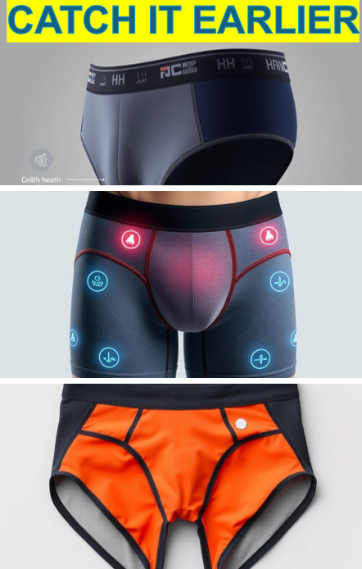
M. Sandu Rizea
1. The IMAMN is fostering self-awareness and autonomy, the users can learn more about their health feeling empowered, which reflects the principles of Ottawa Charter for health promotions, enabling the users to take control of their health (WHO, 1986). The Ewles and Simnett model, emphasise empowerment through tailored interventions (Scriven and Ewles, 2017) enabling the individual to act.
2. Digital health frameworks prioritizes user engagement and gamification to obtain long-term behaviour change (Ball et al, 2025). IMAMN supports self-tracking using sensors and app integration, and allowing users to adjust behaviour, which aligns with principles of Health Belief Model (Rosenstock, 1974).

Slide 37
M. Sandu Rizea
3. Quality-life improvements. NHS frameworks emphasize digital inclusion as a pathway to improved wellbeing, enhancing dignity, comfort, independence and patient-centred support (NHS England, 2023). The IMAMN focuses on resilience, and meaningful health experiences (Antonovsky, 1996).
4. With integrated sensors the smart underwear it is providing insights into user behaviour revealing patterns in sleep, stress, mobility, and cardiovascular health. This supports data-driven personalization, a key principle in digital health promotion (Kon et al, 2021).
5. Early Diagnosis it is enabled through continuous monitoring which support early detection of cell changes which aligns with NHS remote monitoring to reduce system burden (NHS England, 2023).
‘Empowerment is achieved when users gain control over their health data and decisions’ (WHO, 1986; NHS England, 2023).

Slide 38

M. Sandu Rizea
Potential benefits for organisation
Collecting data in real time open new opportunities for research saving valuable time and resources (Senbekov et al, 2020)
Helps the organisation to maintains high quality standards and comply with the existing regulations (CQC, 2017)
Support personalised healthcare intervention (NHS, 2025)
Long-term benefits by enabling early detection (Andreu-Perez et al, 2015)

Slide 39
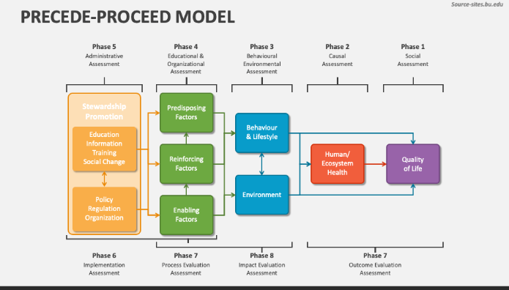
M Sandu Rizea
The model offers a structured framework to design, implement, and evaluate the smart health innovations like the sensor-embedded underwear for men aged 50+ (Green and Kreuter, 1999) with evidence to contribute to ‘significantly improved knowledge’ among users (Kim et al, 2022).
7.Process evaluation provide evidence about data collected, user engagement, evaluating the usability, comfort, and data accuracy.
8.Impact evaluation would help to assess long-term changes in self-monitoring behaviour, empowerment, and health literacy (Kim et al, 2022). Comparing with the screening program for bowel cancer, the smart underwear promotion should consider positive an 60% engagement (NHS, 2025) which was estimated to save 84,000 more lives by 2040 on the bowel screening promotion in Australia (Every Kit Counts, 2021).
7.Outcome evaluation measure the early diagnosis, increased confidence and wellbeing among users (Khortwong and Kaewkungwal, 2013).

Slide 40
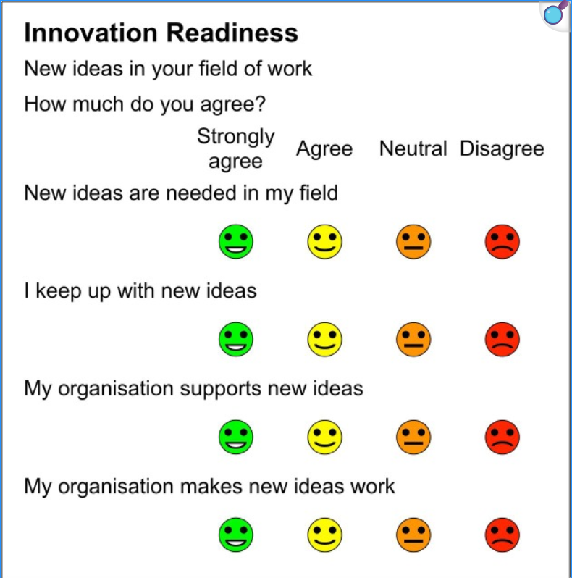
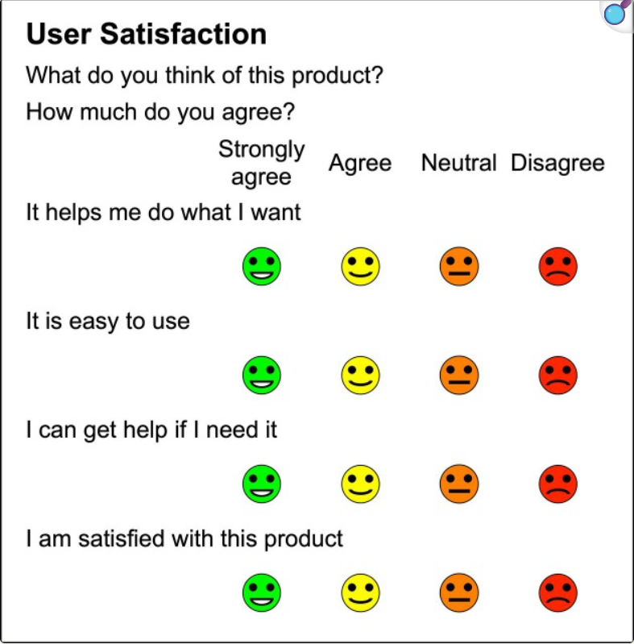
M. Sandu Rizea
Seen as a significant measurable change, the outcome can be evaluated by understanding two aspects: the innovation readiness and the user satisfaction (Benson, 2019).

Slide 41
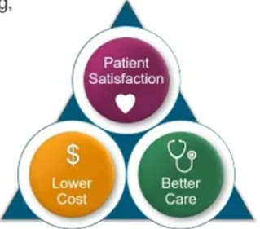
M Sandu Rizea
The outcome
Perceive empowerment, trust, satisfaction and engagement
Early detection and accuracy, reducing diagnosis time, improve survival rates
Reduce costs diagnosis and hospitalisation, long-term savings
(Bhattad and Pacifico, 2022; Gaobotse et al, 2022; NHS, 2025)

Slide 42
M Sandu Rizea
Information from patient experience surveys can be used to understand the IMAMN progress and what service users think (NHS, 2025).
The triple aim framework offers a foundation to optimise health for individuals and population by improving patients experience and reducing the costs per capita (Institute for Healthcare Improvement, 2008)
‘Early diagnosis of cancer focuses on detecting symptomatic patients as early as possible, so they have the best chance for successful treatment’ (WHO, 2025).
‘Implementing our guidance can generate cost savings and free up resources and capacity that can be used for other services’ (NICE, 2025)

Slide 43
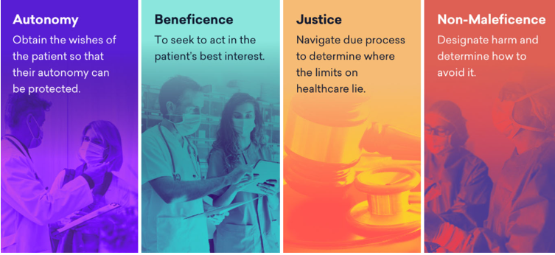
M. Sandu Rizea
Abnormal cell detection rate
Reduce percentage rate of late cancer cases
Increase quality life expectancy
Analise the psychological impact
Eliminate the harm, should not present allergy risks
Measure the satisfied user’s percentage and the understanding of the results for health
Equity and inclusion
Accessibility costs
Legal protection
(Kim et al, 2022)
(NHS England, 2025)
(Brous et al, 2020)

Slide 44
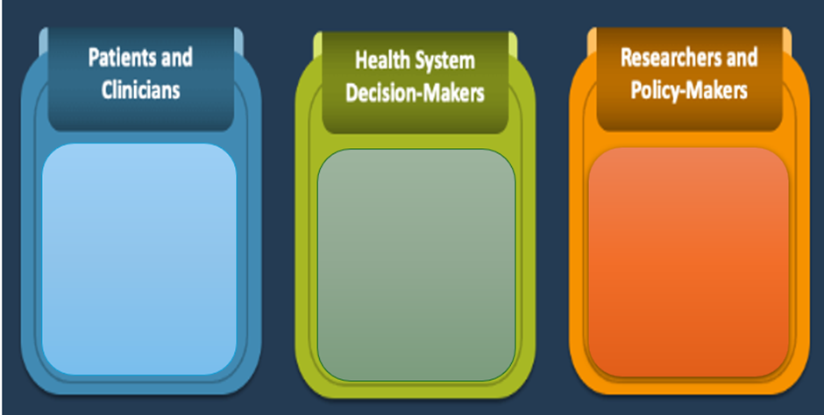
New framework should regulate the data collection, privacy, consent and the ethical implementation
Authorities should recognise the cost-saving potential of early detection
Data collection in real time open new opportunities for research on early indicators
Interdisciplinary research brings together health specialists, IT and behavioural experts
Policies should integrate smart wearable items in health programs
Educational campaigns to demystify innovative wearable tech with role in prevention
Training for professionals on interpreting the data
M Sandu Rizea
(AbouZahr and Boerma, 2005)

Slide 45

Health Information System
‘Using information systems, the providers can access the data of individuals from multiple levels of the health system. Lack of integration of these systems leads to inadequate data flow between them’ (Shahmoradi and Habibi-Koolaee, 2016).
Achieving the promise of digital Health Information system is determined by the levels of user's involvement, amount of information provided, health literacy, and how personal is the message (Kreps, 2014).
‘Databases and registries serve as valuable resources for researchers, providing insights into disease management and promoting better patient outcomes’ (Richemond and Huggins-Jordan, 2023).
IMPLICATIONS

Slide 46

Summarise
The product justification highlights understanding of the public health concerns regarding late diagnosis of prostate cancer, resulting in a high mortality rate in men and emphasises the cultural stigma concerning ethnic minorities of black men on prostate cancer, late treatment access in healthcare, low awareness of men in the UK and participation in screening and prevention programmes compare to other countries (Prostate Cancer UK, 2023; Cancer Research UK, 2024).
The consequences of not addressing prostate cancer awareness and early prevention diagnosis issues among men in the UK cost the NHS a big sum of money due to the advanced cases that require expensive treatment and prolonged care ( NHS England, 2019).
The Barrier to the Product Market highlights important issues towards the targeted group (50+) to have a clear view of their privacy when using the product and how much their information is handled to ensure safety and protection when following ethical consideration and data protection ( Hurst et al. 2020). This also involve age related issues on users and stigma of using modern technology that affect the targeted group.
The Benefits of the product emphasise the need of its use to the public health issues ragarding late diagnosis of prostate cancer in men and how reliable the product is individualised to promote quick accessibility for early detection and early treatment process that reduce stigma and mortality rate of men ( NHS England, 2023).
(ADJI)

Slide 47


Conclusion and Recommendation
The IMAMN product shows a strong stance on its feature and how much this will contribute to the health and wellbeing of individual men affected with prostate cancer in health and social care settings by demonstrating engagement in their care that breaks down barrier to the late diagnosis resulting on high mortality rate.
The product promote early detection of abnomal cells of prostate in men following with other important reading indication such as ECG and and blood pressure reading to maximise vigilance.
Failing to use the product will increase the number of men with late detection of Prostate Cancer and require the NHS to spend more money for treatment.
12,000 men die with prostate cancer each year in the UK and using IMAMN will reduce this number by ensuring early detection and early access to the healthcare service ( Cancer Research UK, 2024).
Future plan
To create an app that allow registered NHS users to download from all devices and have a direct contact with the NHS Urology department and the local GP for a rapid referral.
To make the apps multilingual so that information can be accessible for all ethnic group in UK.
To make the product cost-effective to meet the needs of those in low income, if not NHS users.
To promote the product through social media, healthcare, education and the local community and internationally to bring awareness and prevention.
To continue further research and trial of the product effectiveness through survey and patients feedback.
To maximise its productivity and make it accessible for sale in public market and To maximise its productivity and make it accessible for sale in public market and pharmacies
(ADJI)

Slide 48
IMTIAZ; REFERENCE LIST
Brazier, Y. (2025) What to know about prostate cancer. Medically reviewed by Sheel Patel, MD. Updated 15 July 2025. Available at: https://www.medicalnewstoday.com/articles/150827 (Accessed: 8 November 2025).
Cancer Research UK. (2024) Prostate cancer statistics. Available at: https://www.cancerresearchuk.org (Accessed: 20 October 2025).
Centers for Disease Control and Prevention (CDC). (2024) Prostate cancer screening and early detection: International comparisons. Atlanta, GA: U.S. Department of Health and Human Services. Available at: https://www.cdc.gov/cancer/prostate (Accessed: 25 October 2025).
Deloitte. (2024) Global healthcare outlook 2024: Digital transformation in early diagnosis. London: Deloitte Insights. Available at: https://www.deloitte.com/global-healthcare-outlook (Accessed: 30 October 2025).
GOV.UK – UK National Screening Committee UK National Screening Committee (2020) Prostate cancer. GOV.UK. Updated November 2020. Available at: https://screening-recommendations.service.gov.uk/prostate-cancerAccessed: 1 November 2025).
Macmillan Cancer Support. (2025) Prostate cancer. Available at: https://www.macmillan.org.uk/cancer-information-and-support/prostate-cancer
(Accessed: 8 November 2025).
Mayo Clinic (2025) Prostate cancer: Diagnosis and treatment. Available at: https://www.mayoclinic.org/diseases-conditions/prostate-cancer
(Accessed: 8 November 2025).
National Institute for Health and Care Excellence (NICE). (2023) Prostate cancer: Diagnosis and management [NG131]. London: NICE. Available at: https://www.nice.org.uk/guidance/ng131 (Accessed: 30 October 2025).

Slide 49
IMTIAZ: REFERENCE LIST
NHS. (2023) Prostate cancer: Overview and symptoms. Available at: https://www.nhs.uk/conditions/prostate-cancer/ (Accessed: 30 October 2025).
NHS. (2023) Prostate Cancer Risk Checker. Available at: https://www.nhs.uk/conditions/prostate-cancer/risk-checker (Accessed: 22 October 2025)
.
NHS England. (2019) Early diagnosis of cancer: NHS England and NHS Improvement strategy. London: NHS England. Available at: https://www.england.nhs.uk/publication/early-diagnosis-of-cancer/ (Accessed: 30 October 2025).
NHS England. (2019) The NHS Long Term Plan. London: NHS England. Available at: https://www.longtermplan.nhs.uk (Accessed: 30 October 2025).
OWise. (2023) OWise Prostate Cancer App (UK): Personalised support for men with prostate cancer. Available at: https://www.owise.uk/prostate-cancer(Accessed: 30 October 2025).
Prostate Cancer UK. (2023) Prostate Cancer UK App. Available at: https://prostatecanceruk.org (Accessed: 3 November 2025).
Public Health England. (2022) Men’s health and wellbeing: Supporting prevention and innovation. London: PHE. Available at: https://www.gov.uk/government/publications/mens-health-and-wellbeing-supporting-prevention-and-innovation(Accessed: 30 October 2025).
Public Health England. (2023) Men’s Health Strategy: Improving early detection. London: Department of Health and Social Care. Available at: https://www.gov.uk/government/publications/mens-health-strategy-improving-early-detection (Accessed: 30 October 2025).
World Health Organization (WHO). (2021) Global strategy on digital health 2020–2025. Geneva: World Health Organization. Available at: https://www.who.int/publications/i/item/9789240020924 (Accessed: 20 October 2025).
World Health Organization (WHO). (2023) Digital health for early cancer detection: Global perspectives and policy progress. Geneva: World Health Organization. Available at: https://www.who.int (Accessed: 30 October 2025).

Slide 50
Mihaela; REFERENCE LIST
Andreu-Perez, J., Leff, D. R., Ip, H. M., & Yang, G. Z. (2015). From wearable sensors to smart implants-–toward pervasive and personalized healthcare. IEEE Transactions on Biomedical Engineering, 62(12), 2750-2762.
Antonovsky, A. (1996) The salutogenic model as a theory to guide health promotion, Health Promotion International, Volume 11, Issue 1, Pages 11–18, https://doi.org/10.1093/heapro/11.1.11 Available at: salutogenic model as a theory to guide health promotion1 | Health Promotion International | Oxford Academic (Accessed on: 5th November 2025)
Australian Centre for the Prevention of Cervical Cancer, (2021). ‘Every Kit Counts’, Available at: Press Release: Every Kit Counts. Bowel Cancer Screening Campaign – ACPCC (Accessed: 9 June 2025).
Bhattad PB, Pacifico L. (2022) Empowering Patients: Promoting Patient Education and Health Literacy. 14(7):e27336. doi: 10.7759/cureus.27336. PMID: 36043002; PMCID: PMC9411825. Available at : Empowering Patients: Promoting Patient Education and Health Literacy - PMC (Accessed on: 6th November 2025)
Brous, P., Janssen, M. and Herder, P. (2020) ‘The dual effects of the Internet of Things (IoT): A systematic review of the benefits and risks of IoT adoption by organizations’, International Journal of Information Management, Volume 51, 101925 https://doi.org/10.1016/j.ijinfomgt.2019.05.008 Available at: The dual effects of the Internet of Things (IoT): A systematic review of the benefits and risks of IoT adoption by organizations - ScienceDirect (Accessed on: 2nd November 2025)
Benson, T. (2019) ‘Digital innovation evaluation: user perceptions of innovation readiness, digital confidence, innovation adoption, user experience and behaviour change’, BMJ Health and Care Informatics, 26(1):e000018. doi: 10.1136/bmjhci-2019-000018, Available at: Digital innovation evaluation: user perceptions of innovation readiness, digital confidence, innovation adoption, user experience and behaviour change - PMC (Accessed on: 29th October 2025)
Ball H, Eisner E, Nicholas J, Wilson P, Bucci S. (2025) How theories, models, and frameworks have been used to implement digital health interventions in services for people with severe mental health problems: a scoping review. BMC Public Health. 2025 Mar 17;25(1):1023. doi: 10.1186/s12889-025-22189-2. PMID: 40098003; PMCID: PMC11912717. Available at: How theories, models, and frameworks have been used to implement digital health interventions in services for people with severe mental health problems: a scoping review - PMC (Accessed on: 29th October 2025)
Care Quality Commission (CQC), (2017) Clarification of regulatory methodology: PMS digital healthcare providers Available at: Clarification of regulatory methodology: PMS digital healthcare providers (Accessed on: 5th November 2025)
Cancer Research UK. (2024) Prostate cancer statistics. Available at: https://www.cancerresearchuk.org (Accessed: 30 October 2025).
Centers for Disease Control and Prevention (CDC). (2024) Prostate cancer screening and early detection: International comparisons. Atlanta, GA: U.S. Department of Health and Human Services. Available at: https://www.cdc.gov/cancer/prostate (Accessed: 30 October 2025).
Deloitte. (2024) Global healthcare outlook 2024: Digital transformation in early diagnosis. London: Deloitte Insights. Available at: https://www.deloitte.com/global-healthcare-outlook (Accessed: 30 October 2025).
Green, L.W and Kreuter M.W. (1999) Health Promotion Planning: An Educational and Ecological Approach (3rd ed) Mountain View, CA: Mayfield Publishing Company, 1999; 621 pp Available at: 41997_2001_Article_BF03404986.pdf (Accessed on: 29th October 2025)
Gaobotse, G., Mbunge, E., Batani, J., & Muchemwa, B. (2022). Non-invasive smart implants in healthcare: Redefining healthcare services delivery through sensors and emerging digital health technologies. Sensors International, 3, 100156. Available at: Non-invasive smart implants in healthcare: Redefining healthcare services delivery through sensors and emerging digital health technologies - ScienceDirect (Accessed on: 5th November 2025)
Institute for Healthcare Improvement (IHI), (2008) Triple aim. Available at: The Top 7 Outcomes Measures and 3 Measurement Essentials | PPTX (Accessed on: 5th November 2025)

Slide 51
Mihaela; REFERENCE LIST
Kim, J., Jang, J., Kim, B. and HeeLee, K. (2022) ‘Effect of the PRECEDE-PROCEED model on health programs: a systematic review and meta-analysis’ National Library of Medicine, 11:213. doi: 10.1186/s13643-022-02092-2 PMCID: PMC9549687 PMID: 36210473 Available at: Effect of the PRECEDE-PROCEED model on health programs: a systematic review and meta-analysis - PMC (Accessed on: 29th October 2025)
Koh A, Swanepoel W, Ling A, Ho BL, Tan SY, Lim J. (2021) Digital health promotion: promise and peril. Health Promot; 36(Supplement_1):i70-i80. doi: 10.1093/heapro/daab134. PMID: 34897444; PMCID: PMC8667545.Available at: Digital health promotion: promise and peril - PMC (Accessed on: 5th November 2025)
Kreps, G.L. ( 2014) Achieving the promise of digital health information systems Journal of Public Health Research Available at: Achieving the Promise of Digital Health Information Systems (Accessed on: 27th October 2025)
Lupton, D. (2014) Self-tracking cultures: Towards a Sociology of Personal Informatics Available at: Lupton (2014) Self-Tracking Cultures | PDF Accessed on: 26th October 2025
Scriven, A., and Ewles, L. (2017). Ewles & Simnett’s promoting health : a practical guide (Seventh edition.). Elsevier. Available at: ProQuest Ebook Central - Reader (Accessed on: 4th November 2025)
Senbekov, M., Saliev, T., Bukeyeva, Z., Almabayeva, A., Zhanaliyeva, M., Altenova, N., Toishibekov, Y., and Fakhradiyev, I. (2020) ‘The Recent Progress and Applications of Digital Technologies in Healthcare: A Review’ International Journal of Telemedicine and Applications Available at: The Recent Progress and Applications of Digital Technologies in Healthcare: A Review - Senbekov - 2020 - International Journal of Telemedicine and Applications - Wiley Online Library (Accessed on: 27th October 2025)
AbourZahr, C. and Boerma, T., (2005) Health information systems: the foundations of public health, Bulletin of the World Health Organization | August 2005, 83 (8) Available at: Tile: Week 9- Key concepts of health information systems/ workshop C2 | Population Health and Digital Health Promotion (LCHS7009_BIRM) | Home (Accessed on: 28th October 2025)
Khortwong P, Kaewkungwal J. (2013) Thai health education program for improving TB migrant's compliance. Journal of the Medical Association of Thailand, 96(3):365-373. PMID: 23539943. Available at: Thai health education program for improving TB migrant's compliance. - Abstract - Europe PMC (Accessed on: 27th October 2025)
Murray, E., Hekler, E. B., Andersson, G., Collins, L. M., Doherty, A., Hollis, C., ... and Wyatt, J. C. (2016). Evaluating digital health interventions: key questions and approaches. American journal of preventive medicine, 51(5), 843-851.
NHS England (2023). Inclusive digital healthcare: A framework for NHS action on digital inclusion. Available at: NHS England (Accessed onn: 25th October 2025)
NHS England, (2025) Health equalities and digital inclusion Available at: NHS England » Health equalities and digital inclusion (Accessed on: 29th October 2025)
NHS England (2025) Bowel cancer screening standards data report 2023-24, GOV.UK. Available at: https://www.gov.uk/government/publications/bowel-cancer-screening-annual-report-2023-to-2024/bowel-cancer-screening-standards-data-report-2023-24 (Accessed on: 6th November 2025)
National Institute for Health and Care Excellence (NICE), (2025) Cost Saving Guidance Available at: Cost saving guidance | NICE Accessed on: 5th November 2025
World Health Organization (WHO), (2025) The 1st International Conference on Health Promotion, Ottawa, 1986. The Ottawa Charter for Health Promotions Available at: Health Promotion (Accessed on: 29Th October 2025)
Jones C.L, Jensen J.D, Scherr C.L, Brown N.R, Christy K, and Weaver J. (2016) The Health Belief Model as an explanatory framework in communication research: exploring parallel, serial, and moderated mediation. Health Commun. 2015;30(6):566-76. doi: 10.1080/10410236.2013.873363. Epub 2014 Jul 10. PMID: 25010519; PMCID: PMC4530978.
Rosenstock IM. (1974) The Health Belief Model and Preventive Health Behavior. Health Education Monographs. 1974;2(4):354-386. doi:10.1177/109019817400200405 Available at: The Health Belief Model and Preventive Health Behavior - Irwin M. Rosenstock, 1974 (Accessed on: 4th November 2025)
Richemond, D. and Huggins-Jordan, T.D, (2023) The Impact of Health Information Systems on Patient Outcomes Open Access Library Journal, Vol.10 No.8, Available at: The Impact of Health Information Systems on Patient Outcomes (Accessed on: 29th October 2025)

Slide 52
Reference Madona
Cancer Research UK (2024) Cancer Early detection, Available at: https://www.crukcentre.manchester.ac.uk/research/research-themes/cancer-early-detection/ [Accessed: 10 November 2025].
Cancer Research UK. (2024) Prostate cancer statistics. Available at: https://www.cancerresearchuk.org/health-professional/cancer-statistics/statistics-by-cancer-type/prostate-cancer#prostate_stats0 [Accessed: 10 November 2025].
Christie-de Jong, F., Oyeniyi, O. S., Nnyanzi, L. A., Ling, J., Murphy, M. K., Eberhardt, J., Jarrar, R., Kabuye, J., Kalemba, M., and Robb, K. A. (2025) Barriers and facilitators to accessing healthcare for early diagnosis of prostate cancer for black men-a qualitative exploration in North-East England and Scotland. BMC public health, 25(1), pp. 2454.
Crosby, R., and Noar, S. M. (2011) What is a planning model? An introduction to PRECEDE-PROCEED. Journal of public health dentistry, 71 (1), pp. 7–15.
Crossfly. (2025) The benefits of Crossfly underwear for those with prostate cancer. https://crossfly.com/blogs/news-1/the-benefits-of-crossfly-underwear-for-those-with-prostate-cancer [Accessed: 10 November 2025].
Fehlberg, Z., Fisher, L., Liu, C., Kugenthiran, N., Milne, R. L., Young, M. A., Willis, A., Southey, M. C., Goranitis, I., and Best, S. (2025) Using a behaviour-change approach to support uptake of population genomic screening and management options for breast or prostate cancer. European journal of human genetics : EJHG, 33(1), pp. 108–120.
Gielen, A. C., McDonald, E. M., Gary, T. L., and Bone, L. R. (2008) In K. Glanz, B. K. Rimer, & K. V. Viswanath (Eds.), Using the PRECEDE-PROCEED model to apply health behavior theories (4th ed., pp. 407–433). San Francisco: Jossey-Bass.
Glanz, K., Rimer, B. K., & Viswanath, K. "V." (Eds.). (2015) Theory, research, and practice in health behavior. In K. Glanz, B. K. Rimer, & K. "V." Viswanath (Eds.), Health behavior: Theory, research, and practice 5th ed., pp. 23–41.
Green LW and Kreuter MW (2005) Health Program Planning: An Educational and Ecological Approach. New York: McGraw-Hill.
Green LW and Kreuter MW (2015) Precede-Proceed. Available at: www.lgreen.net/precede.htm [Accessed: 10 November 2025].
Green, L. W., and Kreuter, M. (2004) Health Program Planning: An Educational and Ecological Approach (4th ed.). New York: McGraw Hill Higher Education.
Jeihooni, A. K., Kashfi, S. M., Kashfi, S. H., Heydarabadi, A. B., Imanzad, M., & Hafez, A. A. (2015) Factors associated with prostate cancer screening behavior among men over 50 in Fasa, Iran, based on the PRECEDE model. Electronic physician, 7(2), pp. 1054–1062.
Karolinska Institutet. (2025) Urine test detects early prostate cancer. Technology Networks. Available at: https://www.technologynetworks.com/cancer-research/news/early-prostate-cancer-diagnosis-with-simple-urine-test-399047 [Accessed: 10 November 2025].
Kim, J., Jang, J., Kim, B., and Lee, K. H. (2022) Effect of the PRECEDE-PROCEED model on health programs: a systematic review and meta-analysis. Systematic reviews, 11(1), pp. 213.
Long, A., Edwards, J., Worthington, J., Cotterill, N., Weir, I., Drake, M. J., & van den Heuvel, E. (2015) Clinical Evaluation of a Prototype Underwear Designed to Detect Urine Leakage From Continence Pads. Journal of wound, ostomy, and continence nursing : official publication of The Wound, Ostomy and Continence Nurses Society, 42(6), pp. 632–639.

Slide 53
Reference (Madona)
Maines, F., Caffo, O., Veccia, A., and Galligioni, E. (2015) Gastrointestinal metastases from prostate cancer: a review of the literature. Future oncology (London, England), 11(4), pp. 691–702.
Mokni, M., Fourati, N., Zerrouki, C., Othmane, A., Omezzine, A., Bouslama, A. (2021) Review on Recent Advances in Urinary Biomarkers Based Electrochemical Sensors for Prostate Cancer Detection, pp. 123-136
Mweya, C (2023) Low Knowledge and Perception of Prostate Cancer Screening Among Men: Implications for Awareness and Screening Practices. Arch Surg Oncol, 9(1), pp 34.
NHS Digital. (2023) How we're using data to transform prostate cancer research. https://digital.nhs.uk/data-and-information/keeping-data-safe-and-benefitting-the-public/powerful-moments/how-were-using-data-to-transform-prostate-cancer-research [Accessed: 10 November 2025].
NHS England. (2023) Digital transformation. https://www.england.nhs.uk/digitaltechnology/ [Accessed: 10 November 2025].
NICE (2023) 2023 exceptional surveillance of prostate cancer: diagnosis and management (NICE guideline NG131),Available at: https://www.nice.org.uk/guidance/ng131/resources/2023-exceptional-surveillance-of-prostate-cancer-diagnosis-and-management-nice-guideline-ng131-pdf-14749949286853 [Accessed: 10 November 2025].
Prime, P. (2025) A real early detection ace, Cancer Research Center, Available at: https://news.cancerresearchuk.org/2025/02/13/a-real-early-detection-ace/ [Accessed: 10 November 2025].
RHIHub, nd PRECEDE-PROCEED Model, Available at: https://www.ruralhealthinfo.org/toolkits/health-promotion/2/theories-and-models/precede-proceed#:~:text=The%20PRECEDE-PROCEED%20model%20is%20a%20comprehensive%20structure%20for,planning%20a%20targeted%20and%20focused%20public%20health%20program [Accessed: 10 November 2025].
Salem, A.S., and Syed Md. F. A. K. (2022) Determinants of user acceptance of wearable IoT devices, Cogent Engineering, 9(1), pp. 2087456
Tomas, N., and Benyamin, F. M. (2025) Facilitators of, and barriers to, prostate cancer screening uptake: A descriptive phenomenological study of adult men in Namibia. BMC urology, 25(1), pp. 131.
Vanderbilt University Medical Center. (2025). Urine test for prostate cancer could be used at home. ScienceDaily. Available at: https://www.sciencedaily.com/releases/2025/02/250203142246.htm [Accessed: 10 November 2025].
Wei, J. T., Barocas, D., Carlsson, S., Coakley, F., Eggener, S., Etzioni, R., Fine, S. W., Han, M., Kim, S. K., Kirkby, E., Konety, B. R., Miner, M., Moses, K., Nissenberg, M. G., Pinto, P. A., Salami, S. S., Souter, L., Thompson, I. M., and Lin, D. W. (2023) Early Detection of Prostate Cancer: AUA/SUO Guideline Part I: Prostate Cancer Screening. The Journal of urology, 210(1), pp. 46–53.

Slide 54
References (Amanda)
Brey, P. (2018). "Ethical aspects of privacy in wearable health technology." Journal of Medical Ethics, 44, pp. 387-391.
Data Protection Act. EU. (2016). Available at: Data protection under GDPR - Your Europe ( Accessed on: 6 November 2025) .
Dean, M., et al. (2018). "Elderly Patient Acceptance of Digital Health Innovations: A Comparative Study." Health Informatics Journal, 24, pp. 226-234.
Heffernan, T., 2024. The Invisible Barriers of Structured and. The Bloomsbury Handbook of Bourdieu and Educational Research, pp.283.
Hurst devenport.( 2020) Ethical Implications of Health Disparities: https://doi.orgDOI: 10.18410/jeb mh/2024/11/01/109 (Accessed: 03 November 2025).
Hurst, S., et al. (2020). "Health inequalities: A critical perspective on the use of digital health interventions." Social Science & Medicine, 258, pp. 113163.
Kelley Anderson, Almalawi A, Khan AI, Alsolami F, Abushark YB, Alfakeeh AS. (2020). Managing Security of Healthcare Data for a Modern Healthcare System. https://doi.org/10.3390/s23073612 (Accessed: 05 November 2025).
Kelley, P., et al. (2020). "Privacy in digital health: Considerations for stakeholders." Health Policy and Technology, 9, pp.163-170.
Loeb and Laporte. (2020). Wearables and healthcare: regulatory strategies. Available at: Wearables and healthcare: regulatory strategies (accessed on: 6 November 2025).
Loeb, S., & Laporte, R. (2020). "Regulatory challenges of digital health technologies." Health Policy and Technology, 9, pp. 324-328.
López dagesim.( 2021). Safeguard personal data and build trust with consent management. Available at: Consent Management Platform | Products | OneTrust (Accessed: 03 November 2025)
López, C., et al. (2021). "Informed consent in the digital age: Challenges and solutions." BMC Medical Ethics, 22, pp. 127.
World Health Organization. (1986). Ottawa Charter for Health Promotion. Retrieved from [WHO]https://www.who.int (Accessed 20bseptember 2025).
World Health Organization. (2020). Physical inactivity: A global public health problem. Retrieved from [WHO] https://www.who.int (Accessed: 26 September 2025).

Slide 55
References
Magregor Dean. ( 2018). Using Technology to Enhance Lesson Delivery: A Comprehensive Approach. available at: Using Technology to Enhance Lesson Delivery: A Comprehensive Approach (Accessed: 06 November 2025).
Meyer, M. N., et al. (2018). "Informed consent for digital health: A framework." Public Health Ethics, 11, pp.174-184.
Meyer, R.E., Jancsary, D., Höllerer, M.A. and Boxenbaum, E. (2018). The role of verbal and visual text in the process of institutionalization. Academy of management review, 43(3), pp.392-418. https://doi.org/10.5465/amr.2014.0301 (Accessed: 02 November 2025).
Nguyen, K., et al. (2020). "Assessing Health Equity in Digital Health Interventions." Journal of Health Informatics, 26, pp. 1-11.
Philip Brey. (2018).The strategic role of technology in a good society. https://doi.org/10.1016/j.techsoc.2017.02.002 (Accessed: 02 November 2025).
Rosenstock, I. M. (1974). "Historical rootsorigins of the Health Belief Model." Health Education Monographs,2, pp. 328-335.
Smith, J. L., Roberts, K., & Wong, F. (2021). Engaging Parents in Children's Literacy Development: The Role of Technology. Early Childhood Research Quarterly, 58, pp. 123-135.
Williams, K., & Clarke, H. (2022). Funding Issues in Digital Education: Bridging the Gap. International Journal of Educational Policy, 34, pp. 375-392.
World Health Organization. (1986). Ottawa Charter for Health Promotion. Retrieved from [WHO]https://www.who.int (Accessed 20bseptember 2025).
World Health Organization. (2020). Physical inactivity: A global public health problem. Retrieved from [WHO] https://www.who.int (Accessed: 26 September 2025).

