Slide 1

The deepening mental health crisis in the Hospitality industry
Student: Emmanuel Mihai Cotovanu
Module: BMIH6001

Slide 2

The Crissis in numbers
330 million hospitality workers globally
85% of workers report poor mental health
60% of junior employees consider burnout to be "part of the job"

Slide 3

The Systemic Pressure
Hospitality is a 24/7/365 industry
Service excellence
Excessive workload and understaffing

Slide 4
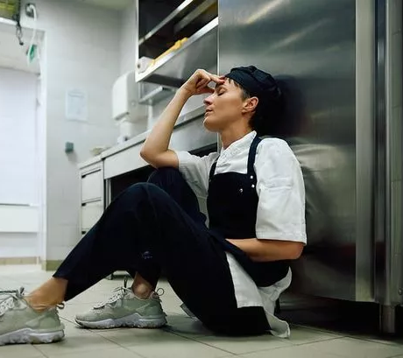
Root Causes of the Crisis
Poor work-life balance
Emotional labour
High pressure and a culture
Manager –specific stress

Slide 5

Impact on Business Operations
High staff turn over
Unsustainable costs
Reduced productivity

Slide 6

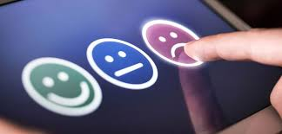
Impact on Guest experience
Reduced service quality
Impaired guest interactions
Operational instability

Slide 7


Industry responses: Major Chains
Hilton: "Care for All" & "Thrive" platforms, plus the "Wellthy" caregiving service.
Marriott: "TakeCare" program for physical and emotional wellness.

Slide 8
Industry Responses: Small&Medium Business
Focus on low-cost, high-impact strategies:
Manager Training: Empower managers to model and enforce work-life boundaries.
Peer Support: Train "Wellness Champions" or Mental Health First Aiders (MHFA).
Resource Curation: Direct staff to free resources (e.g., The Burnt Chef Project).

Slide 9

A 3-Step Plan for Change
Moving from short-term fixes to long-term structural transformation.

Slide 10

The 3-Step Recommendation Plan
Build
Build an Open Culture
Invest in
Invest in Supportive Leadership
Provide
Provide Accessible Resources

Slide 11

Questions?
Thank you for your patience

Slide 12
Reference list
Chikwe, A. C. (2009). The impact of employee turnover: the case of leisure, tourism and hospitality industry. Consortium Journal of Hospitality & Tourism.
Fernandez, K. (2019). Critically Reviewing Literature: A Tutorial for New Researchers. Australasian Marketing Journal (AMJ). DOI:10.1016/j.ausmj.2019.05.001.
Grandey, A. A., & Gabriel, A. S. (2015). Emotional labor at a crossroads: Where do we go from here?. Annual Review of Organizational Psychology and Organizational Behavior, 2(1), 323-349.
Greenberg, N. and Goddberg, G. (2024) Follow the evidence: how to reap the rewards of effective workplace mental health support training.Available at: https://www.britsafe.org/safety-management/2024/follow-the-evidence-how-to-reap-the-rewards-of-effective-workplace-mental-health-support-training (Accessed: 3.11.2025).
Gruenwald, H. (2024). Work-Life Balance In the Hotel Industry. DOI:10.13140/RG.2.2.34297.99689.
Hu, F., Wen, J, and Kozak, M. (2024). Mental health research in tourism and hospitality: a horizon 2050 paper. Tourism Review. Doi:80. 10.1108/TR-11-2023-0788.
Khanna, A. (2014). Work Life Balance in Hospitality Industry: A Conceptual Framework. Asian Journal of Research in Business Economics and Management. DOI:10.5958/2249-7307.2014.01005.6.
Leach, A. (2024) Mental health in Hospitality, a crisis we need to be talking about. Available at: https://www.planday.com/resources/articles/talking-about-mental-health-in-hospitality/ (Accessed: 1.11.2025)
Luthy, B. (2025) Key Hospitality Data & Industry Statistics to Watch for 2025. Available at: https://hospitalityinsights.ehl.edu/hospitality-industry-statistics (Accessed: 1.11.2025)
Macmillan, T. (2024)Why Managers Need Work-Life Balance. Available at: https://www.linkedin.com/pulse/why-managers-need-work-life-balance-tim-macmillan-jdd0e/ (Accessed: 2.11.2025).
Manansala, J.C. (2025) Assessing the Mental Health Needs of Employees: A Foundation for Enhanced Workplace Wellness Programs in Publishing. International Journal of Research and Innovation in Social Science. DOI:10.47772/IJRISS.2025.909000653.
Naeem, M., Ozuem, W., Howell, K., and Ranfagni, S. (2023). A Step-by-Step Process of Thematic Analysis to Develop a Conceptual Model in Qualitative Research. International Journal of Qualitative Methods.doi.org/10.1177/16094069231205789
Nejad, L. and Thomson, K. (2022). Mental Health in Hospitality: The need for industry-specific solutions. Doi:10.13140/RG.2.2.18501.93928.
Nicholls, C. (2025) Burnout ‘just part of the job’, say hospitality employees. Available at: https://www.thecaterer.com/news/burnout-just-part-of-the-job-say-hospitality-employees (Accessed: 1.11.2025).
Nicholls, H. (2025) Service with a smile: Mental health crisis deepens in hospitality sector. Available at:https://www.conference-news.co.uk/news/mental-health-crisis-deepens-in-hospitality-sector-as-burnout-and-understaffing-hit-alarming-highs/ (Accessed: 1.11.2025).
Singh, A., Srivastava, S., Mehmood, K., and Misra, R. (2025). Inclusive Leadership Unveiled: Driving CSR and Innovation Through a Moderated Mediation Framework. Corporate Social Responsibility and Environmental Management. DOI:10.1002/csr.70046.
Trant, E.(2023) Hospitality hardest hit by staff financial wellbeing crisis. Available at: https://www.thehrdirector.com/business-news/financial/hospitality-hardest-hit-staff-financial-wellbeing-crisis/ (Accessed: 1.11.2025)
Üngüren, E, and Arslan, S. (2021). The effect of role ambiguity and role conflict on job performance in the hotel industry: The mediating effect of job satisfaction. Tourism & Management Studies. DOI:10.18089/tms.2021.170104.
Walton, J. (2024) Over half of hospitality managers claim company and staff are suffering. Available at: https://www.cateringinsight.com/over-half-of-hospitality-managers-claim-company-and-staff-are-suffering/ (Accessed: 2.11.2025)
Yang, Z. (2025). Impact mechanism of inclusive leadership on employees’ workplace wellbeing in service enterprises: a chain mediation model of relational identification and job embeddedness. Frontiers in Psychology. DOI:10.3389/fpsyg.2025.1679002
Zhang, B., Huang, J., Zhang, P. and Yu, C. (2024). The Practice of Employee Assistance Program in Small and Medium-Sized Enterprises in The Internet Era Based on Harmonious Society. International Journal of Finance and Investment. DOI:10.54097/vc66aw98.
I certify that no artificial intelligence (AI) tools were used in the research or development of this assignment. I certify that I have not claimed any content generated by AI as my own. I affirm that I have copies of the notes, drafts, and other materials I utilised; I have been said to present these as proof.

