Slide 1
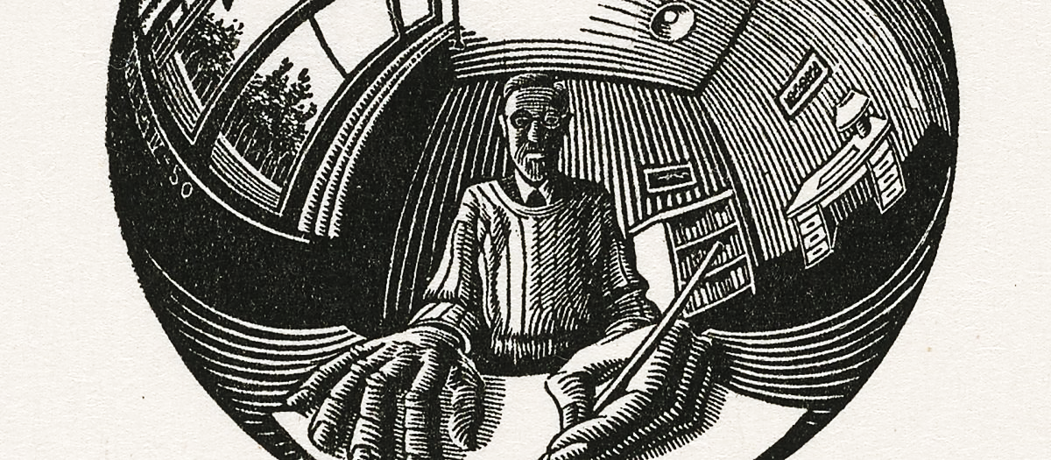
HPEN5/6034 Glancingly from the side: Writing the Short story
.

Slide 2
the provenance & meaning of the short story
- The folk tale
- The fairy story
Oral /communal/
archetypes /moral
- The novella
- The short story
Written/ individual/
the marginalised/ the unfair
- The epic
- the lyric
Written/ class/
archetypes /moral
- The novel
- The essay
Written/ individual/
the marginalised/ the unfair

Slide 3
FRANK O’CONNOR, THE LONELY VOICE
The novel can still adhere to the classical concept of civilised society, of man as an animal who lives in a community, as in Jane Austen and Trollope it obviously does; but the short story remains by its very nature remote from the community – romantic, individualistic, and intransigent. (20)
One can put this crudely by saying that the form of the novel is given by the length; in the short story the length his given by the form… A great short story is not necessarily short at all, and the conception of the short story as a miniature art is inherently false. Basically the difference between the short story and the novel is not one of length. It is a difference between pure and applied storytelling, and in case someone has still failed to get the point, I am not trying to decry applied storytelling. Pure storytelling is more artistic, that is all, and in storytelling I am not sure how much art is preferable to nature. (26)

Slide 4
There is no form of society to which any character in it could possibly attach himself and regard as normal. In discussions of the modern novel we have come to talk of … the novel without a hero. In fact, the short story has never had a hero. What it has instead is a submerged population group… That submerged population changes its character from writer to writer, from generation to generation. It may be Gogol’s officials, Turgenev’s serfs, Maupassant’s prostitutes, Chekhov’s doctors and teachers, Sherwood Anderson’s provincials, always dreaming of escape.
…
Always in the short story there is this sense of outlawed figures wandering about on the fringes of society, superimposed sometimes on symbolic figures whom they caricature and echo – Christ, Socrates, Moses… As a result there is in the short story at its most characteristic something we do not often find in the novel – and intense awareness of human loneliness. . Indeed, it might be truer to say that while we often read a familiar novel again from companionship, we approach the short story in a very different mood. It is more akin to the mood of Pascal’s saying: Le silence éternel de ces espaces infinis m’effraie (Lonely Voice, 17-19)

Slide 5
..the product of a critical, scientific age, and we recognize the merits of a short story much as we recognize the merits of a novel – in terms of plausibility. By this I do not mean verisimilitude – that we can get from a newspaper report – but an ideal action worked out in terms of verisimilitude. As we shall see, there are dozens of ways of expressing verisimilitude – as many as there are great writers – but no way of explaining its absence, no way of saying, ‘At this point the character’s behaviour becomes completely inexplicable.’ Almost from its beginnings the short story, like the novel, abandoned devices of a public art in which the storyteller assumed the mass assent of an audience to his wildest improvisations… It began and continues to function as a private art intended to satisfy the standards of the individual, solitary, critical reader.
(Lonely Voice, 13-14)

Slide 6
There would be no one to live for during those coming years; she would live for herself. There would be no powerful will bending hers in that blind persistence with which men and women believe they have a right to impose a private will upon a fellow-creature. A kind intention or a cruel intention made the act seem no less a crime as she looked upon it in that brief moment of illumination.
And yet she had loved him--sometimes. Often she had not. What did it matter! What could love, the unsolved mystery, count for in the face of this possession of self-assertion which she suddenly recognized as the strongest impulse of her being!
"Free! Body and soul free!" she kept whispering.
Kate Chopin, ‘The Story of An Hour’ (1894)

Slide 7
Where does the short story come from?
All else that’s come before it has its root in myth or history or theology or (in the case of Boccaccio), as we get closer to our own age, what we might identify as anthropology or sociology or psychology. These older tales and stories seem to have an end other than the satisfaction of pure aesthetics—whether it is to prove a point about morality or history or the lives of city people trapped in a country setting during a time of plague. (Cheuse)
---------
The short story emerged in a blitzkrieg of 19th-century magazine publishing, reached its apotheosis with Chekhov, and became one of the great 20th-century art forms.
William Boyd

Slide 8
…you can easily sense the shape and form of the short story that has come down to the current generation of fiction writers over all the generations from Hemingway and Joyce and Chekhov. Even if some of the writers have not read any of these writers—difficult to imagine but always possible—they have read, and clearly will have found use in, the work of writers who have. I know this sounds tautological, but the freedom of the contemporary short story evolved in much the same way that modern Western political revolutions evolved—if not directly from the American Revolution, then from subsequent revolutions, such as the French Revolution, that looked to the American event as epoch-making. That’s how I see the Hemingway short story, as epoch-making, with, to use Ezra Pound’s valuable paradigm from his ABC of Reading, Chekhov as the inventor and Hemingway as the master of the form. The shock wave of Hemingway’s mastery reverberating around the world, with undertones and deep resonances of Chekhov, has brought us to where we stand today, as readers and writers alike.
Alan Cheuse, ‘The Form Read Round the World: American Short Fiction and World’

Slide 9
it might be wise to stop for a moment and meditate on the brevity of the history of the modern story. It’s a blink of the eye compared to the long gaze of the epic. Ever since the advent of the Homeric epics with their anecdotes and tale-like narratives within the larger poem, what we call “tales”—accounts or brief narratives of an event, sometimes delivered with imaginative flair—as opposed to stories, have been in plentiful supply, from the Bible to Chaucer to Boccaccio. In those brief narratives embedded in narrative poems, the source remains self-evident—all belong to the overall narration. In Boccaccio, we read tales recounted to us by the narrator. Folk tales come to us out of that great mist we think of, because it is easy to do so, as the popular culture of the time.
What distinguishes all this traditional short fictional narrative from the modern short story? The nature of the art work itself. The anecdote, the fable, the folk tale—all would entertain us and, ultimately, call our attention to some moral problem or founding event in what we take to be the world of gods and history. The modern story writer, from Poe onward, seeks to create a work of short fiction that, like a lyric poem, has no immediate tie to the culture in which the writer works or to the history of his or her time. All reference to the everyday world comes by way of analogy only. The art story, as I would like to call it from here on out, is a discrete creation that possesses its own aesthetic, by which it stands or falls. We connect it to actual life in the same way we do a poem or a painting—as I mentioned, by analogy.
Florence Goyet, The Classic Short Story, 1870-1925: Theory of a Genre, Open Book Publishers, 2014

Slide 10
I lingered before her stall, though I knew my stay was useless, to make my interest in her wares seem the more real. Then I turned away slowly and walked down the middle of the bazaar. I allowed the two pennies to fall against the sixpence in my pocket. I heard a voice call from one end of the gallery that the light was out. The upper part of the hall was now completely dark.
Gazing up into the darkness I saw myself as a creature driven and derided by vanity; and my eyes burned with anguish and anger.
James Joyce, ‘Araby’, Dubliners

Slide 11
Edgar Allan Poe defined [ the short story] through its effect on the reader , stressing the necessity of both the unity and the intensity of this artificial product of human art. The end of the 19th century, to the contrary, proclaims its essential simplicity. Critics, theoreticians and writers (often one and the same) insist firmly that the short story should renounce all artifice, and that it should sell simple things simply. ( .The Classic Short Story., p.14 )
The short story format is particularly suited to the fantastic. In the whole course of this book, we shall see that fantastic storeys and storeys of madness make a peculiar use of the features of the short story, and in many ways deconstruct the very system of the genre. ... In the realist story, every feature is pushed to its extreme to the point where it becomes almost abstract. Characters are prodigiously what they are, to the extent that they are boarding on the prodigy. In the fantastic story, the high intensity descriptions will cross that border. Here the subject will be not so much the characters in themselves, but rather the sensations and emotions they feel
(Goyet)
,

Slide 12
ALTHOUGH Bertha Young was thirty she still had moments like this when she wanted to run instead of walk, to take dancing steps on and off the pavement, to bowl a hoop, to throw something up in the air and catch it again, or to stand still and llaugh at -nothing, - at nothing simply.
What can you do if you are thirty and, turning the corner of your own street, you are overcome, suddenly by a feeling of bliss swallowed a bright piece of that late afternoon sunn and it burned in your bosom, sending out a little shower of sparks into every particle, into every finger and toe? . . .
Oh, is there no way you can express it without being "drunk and disorderly" ? How idiotic civilisation is! Why be given a body if yo u have to keep it shut up in a case like a rare, rare fiddle?
"No, that about the fiddle is not quite what I mean," she thought, running up the steps and feeling in her bag for the key – she’d forgotten it -, as usual – and rattling the letter box. It’s not what I mean, because– “
” Thank you Mary,” and she went into the hall. “ Is nurse back?”
Yes, M'm."
"And has the fruit come?"
"Yes, M'm. Everything's come."
"Bring the fruit up to the dining-room, Ill arrange it before I go upstairs.”
It was dusky in the dining coat; she could not bear the tight clasp of it another moment, and the cold air fell on her arms.
But in her bosom there was still that bright glowing place, that shower of little sparks coming from it. It was almost unbearable. She hardly dared to breathe for fear of fanning it higher, and yet she breathed deeply, deeply. She hardly dared to look into the cold mirror–but she did look, and it gave her back a woman, radiant, with smiling lips, with big, dark eyes and an air of listening, waiting for something . . . divine to happen . . . that she knew must happen . . . infallibly.
Mary brought in the fruit on a tray and with it a glass bowl, and a blue dish, very lovely, with a strange sheen on it as though it had been dipped in milk.
Katharine Mansfield , ‘Bliss’

Slide 13
discussion

