Slide 1
BA (Hons) International Hotel Management
Module Title: Contemporary Themes in the Hotel and
Hospitality Sector
Module code: BMIH6001
Student Name: Masuma Yesmin
Student ID: 2028061

Slide 2


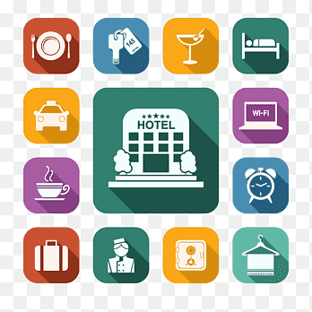
Introduction
The chosen theme for this presentation is industry response for shocks and recovery. The hospitality sector was one of the industries which the global health crisis COVID-19 pandemic struck hardest, with widespread closures, reduced travel and changing customer behaviour.
At the beginning of the pandemic, hotels in the UK experienced an 95% drop in bookings (Statista, 2024)
These challenges highlighted the importance of effective recovery strategies of the industry to foster long-term resilience.

Slide 3
Literature Review
The pandemic shut businesses down, crippled revenue and put hygiene and safety at the top of my mind.
Consumers began to demand local and socially distanced experiences (Zheng et al., 2020).
As an industry response for recovery, digital adoption surged, with contactless services, mobile apps, and automation becoming mainstream in most industries (Tuomi et al., 2021).
Businesses adapted by pivoting to takeaway services, meal kits, and stringent health protocols to continue operating.

Slide 4

PESTLE Analysis — Political Factor
Lockdowns and travel restrictions imposed by the Government had a significant impact on hospitality business.
They made strides to recover in a state of political uncertainty that complicated their operations.
Temporary recovery strategies came in the form of government’s hospitality council, like furlough schemes and business grants, which necessitated ongoing adaptation.

Slide 5
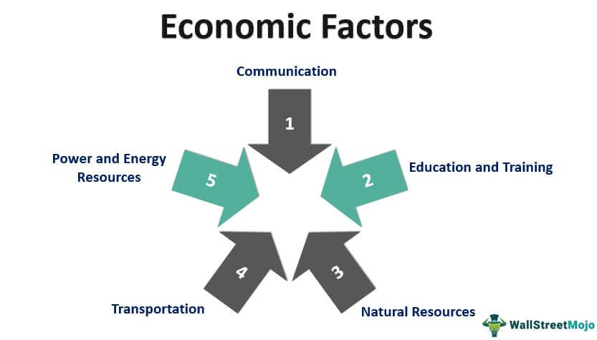
PESTLE Analysis–Economy Impact
The economic downturn cut consumer spending on travel, dining , and tourism.
The hospitality sector in the UK lost more than 660,000 jobs in 2020 (BBC, 2020). This creates a very unstable workforce and forces a shortage of skills.
VAT cuts, financial aid, and government interventions had their effects, making it possible for businesses to survive.
Cost-cutting approaches — from trimming headcount to renegotiated leases to revenue diversification — went mainstream.

Slide 6

PESTLE Analysis – Social Aspects
Shoppers sought out safety, hygiene and socially distanced environments.
Domestic travel, self-drive holidays, and private accommodation came into demand.
A greater emphasis on wellness and sustainability drove demand for well-being services.

Slide 7

PESTLE Analysis – Technology
Contactless check-ins, mobile ordering, and AI-powered assistants became the new normal."
Customer engagement through virtual events, online reservations, and digital marketing became vital as a response from the industry.
Technology helped to drive operational efficiency and improve safety and customer satisfaction.

Slide 8

Even businesses had to follow new rules about health and safety, sanitation, and capacity.
▪ Businesses had to follow new rules about health and safety, sanitation, and capacity.
Operational changes increased compliance costs and legal complications.
PESTLE Analysis – Effect on Legal Framework

Slide 9

PESTLE Analysis - Environmental Impact
The pandemic created new sustainability awareness, leading to eco-friendly initiatives.
Less production meant less energy consumption and waste.
Green practices were embraced by so many hospitality push-pulls, from reducing plastic to focusing on local produce (Diaz-Farina, Díaz-Hernández and Padrón-Fumero, 2023).

Slide 10

Industry Responses and Strategies for Recovery
Many UK hospitality brands have had a digital transformation, hybrid service models, and sustainability initiatives on their agendas.
Key priorities were cost management strategies, flexible booking policies, and adapting to new regulations (Gov. UK, 2020).
As a recovery strategy from the shock, technology was leveraged by businesses to better engage with customers and to improve digital marketing.

Slide 11
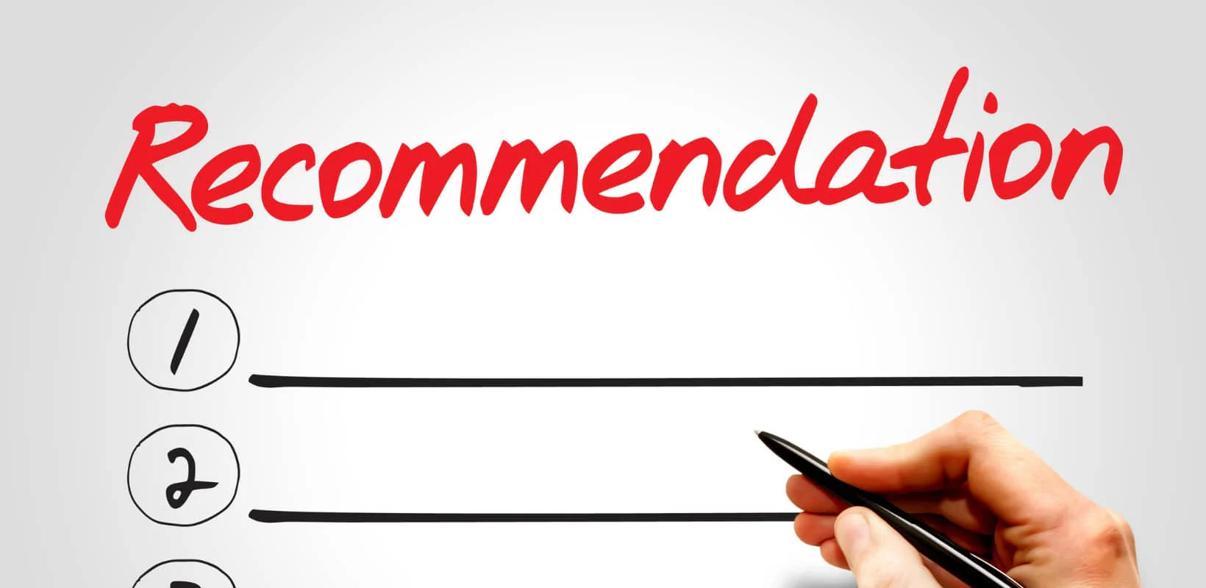
Conclusion and Recommendations
If COVID-19 brought one single thing to the hospitality industry, it was the possibility of serious upside-down and the need for responsiveness.
Focus on digital transformation, sustainability, and crisis preparedness in recovery strategies.
They will need future policies to foster innovation, work force resilience, and regulatory certainty for better industry response to such global health crisis.
To thrive in the long run, they will need to be adaptable, gain consumer trust, and embed sustainable business practices.

Slide 12
References
BBC (2020) ‘Covid: “A fifth” of hospitality sector jobs lost in 2020’. BBC News 17 November. Available at: https://www.bbc.com/news/business-54972940 (Accessed: 18 January 2025).
Diaz-Farina, E., Díaz-Hernández, J.J. and Padrón-Fumero, N. (2023) ‘Analysis of hospitality waste generation: Impacts of services and mitigation strategies. Annals of Tourism Research Empirical Insights 4(1), p. 100083. Available at: https://www.sciencedirect.com/science/article/pii/S2666957922000519.
Gov.UK (2023) Hospitality strategy: Reopening, recovery, resilience. Available at: https://www.gov.uk/government/publications/hospitality-strategy-reopening-recovery-resilience/hospitality-strategy-reopening-recovery-resilience (Accessed: 17 January 2025).
Statista (2024) Change in number of hotel bookings UK 2022. Available at: https://www.statista.com/statistics/1339613/change-in-monthly-number-of-hotel-bookings-in-the-uk/ (Accessed: 17 January 2025).
Tuomi, A., Tussyadiah, I. and Ashton, M. (2021) ‘Covid-19 and Instagram: Digital Service Innovation in Top Restaurants’. Information and Communication Technologies in Tourism 2021, pp. 464–475. doi: https://doi.org/10.1007/978-3-030-65785-7_45.
Zheng, D., Luo, Q. and Ritchie, B.W. (2021) ‘Afraid to Travel after COVID-19? Self-protection, Coping and Resilience against Pandemic “travel Fear”’. Tourism Management 83, p. 104261. Available at: https://www.sciencedirect.com/science/article/pii/S0261517720301874.

