Slide 1

Conventions

Slide 2
Itinerary
Recap Questions
Naming
Organisation
Structure
Constructs
OOP

Slide 3

Recap Questions
What is a variable ?
What is an array ?
What is a function ?
Name a conditional construct
Name an iterative construct

Slide 4

Naming Conventions; Variables
Variables
  Descriptive
  Cannot start with a numeric value
  Camel Case

Slide 5
Naming Conventions; Functions
Functions
  Indicative
  Concise
  Capitalised first letter of each word

Slide 6
Naming Conventions Files
Files
  Capitalised first letter
  Extensions appropriate for the content type

Slide 7
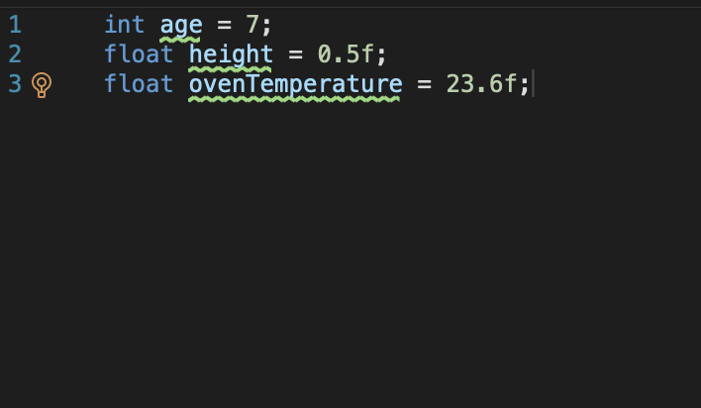
Variable Names

Slide 8
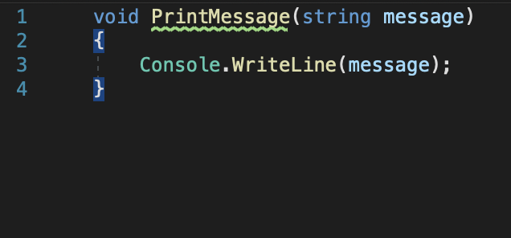
Function Names

Slide 9
Files in C#
There are many different types of files in C#
  The solution file – a container for many different projects
  The project file – a container for the program you are currently working on
  The source file – contains a ’.cs’ extension and a name. The default one here is program.cs
  Almost all source files in C# have a ‘.cs’ file extension

Slide 10

Program.cs
Our current focus - Console applications
All programs in C# contain a program.cs file. This is where.
This is where the start point to the program sits
We can add functions here

Slide 11
Pre-Processor
Normally the term pre-processor is only discussed for the C language
C# contains macros that can be used with the pre-processor
The visual studio IDE permits the use of macros for code formatting
We have already seen one of these (#region)

Slide 12
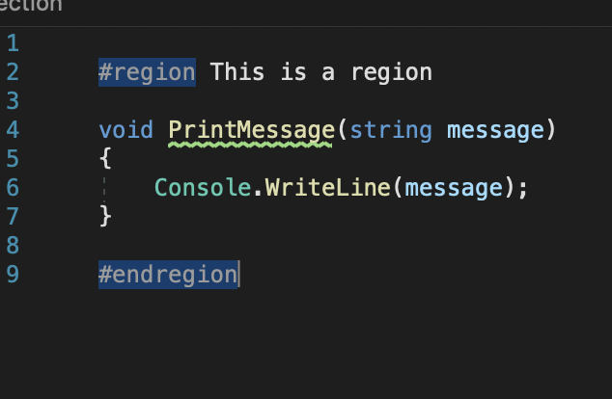
Use of #region

Slide 13

A note on convention
Convention is important:
  This makes the code more structured
  This makes the code more readable
  Helps with maintainability

Slide 14
Why are files important
Files allow for the separation of code into neat groups
This is the same trick we used with the grouping of instructions into functions
This helps with readability and maintainability

Slide 15
Recap on Data
Storing data in a program can be achieved in many different ways
So far, we have seen
Variables
Arrays
There are yet more ways to organize and store data in c#

Slide 16
Remember Arrays ?
Arrays permit the storage of many elements of data
The caveat with an array is that it will permit the storage of only one type of data

Slide 17
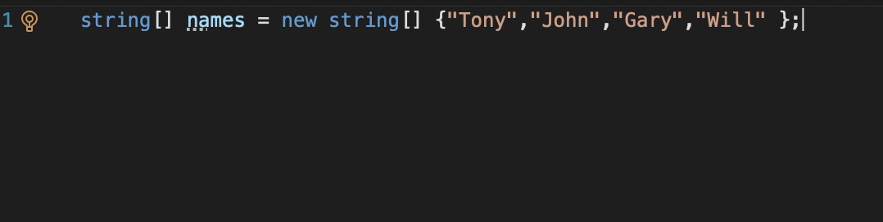
Array example

Slide 18
Other options
There are instances where we may want to store many data attributes about a particular item
For this we can take many different routes:
Storage as many variables
A struct
An object

Slide 19
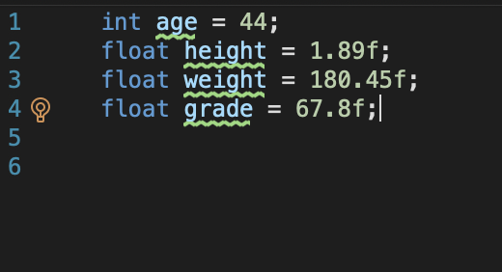
Variables Route

Slide 20
Structs
Grouped list of associated variables
Variables may be of different type / size
Provided type alias
Individual Entities

Slide 21
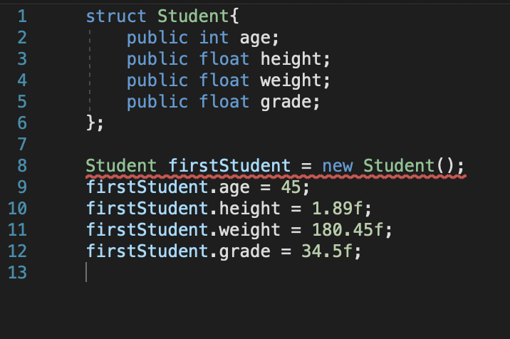
Struct example

Slide 22
Advantages of Structs
Different data types
Staggered in size
Easily created and referenced
Publicly accessible members by default
Make code a little more manageable

Slide 23
Struct Disadvantages
Publicly accessible by default
Hangover from C development

Slide 24
Object-Oriented Development
Is a programming paradigm
Non-procedural approach.
Contained entities called objects to store both data and provide functionality.
Prescriptive definitions given of the structure of what an object will contain (classes)

Slide 25
Object-Oriented Concepts
encapsulation
polymorphism
inheritance
abstraction
reuse

Slide 26
The elusive Object
Objects are slightly different concepts
They are still a container for data
They can however perform actions also

Slide 27

Classes
A class can be considered a template for an object
A blueprint for the creation of an item
Computers don’t think like humans, it is the context applied to software by humans that adds the meaning

Slide 28
Class Elements
Constructor
Attributes/Variables
Methods/Functions
Access Modifiers

Slide 29
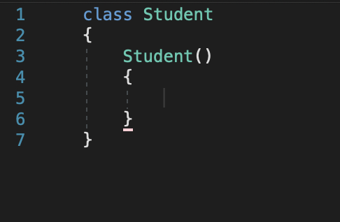
Constructor
The constructor is called for each object we create here we may
  Allocate memory required for the object
  Set variables
  Pre-process inputs to create the class
Note that there is no return type, the constructor gives back the object is has created.
The constructor can be overloaded (we can have multiple versions which accept different parameters).

Slide 30
Attributes
Attributes
  Aka member variables
    As this name suggests they are variables which are part of the class

Slide 31
Methods
Methods
  Aka member functions
    Functions which operate on the class

Slide 32
Classes #2
Think of a real-world entity:
  A car
What attributes or properties can we say a car has ?
  A manufacturer / make
  A model
  A size
  A colour
What actions can this real world entity perform ?

Slide 33
Classes and objects
The concept of object orientation permits the realization of these entities in our software
Having a means of representing real world entities it turns out is useful
Think about our student example
A student is not just a number

Slide 34
The Student
A student has many properties or attributes:
A name
A number
A year of study
A pathway code
An age
A student can also perform actions:
Attend
Submit work
View grades
Respond to questions

Slide 35
Functionality and Data
The use of this approach resembles what could be considered smaller subsets of programs
Fortunately c# permits the neat packaging of this into different files
A class can be contained within the program.cs file or a separate file created for it
The aim of this is once again for maintainability

