Slide 1
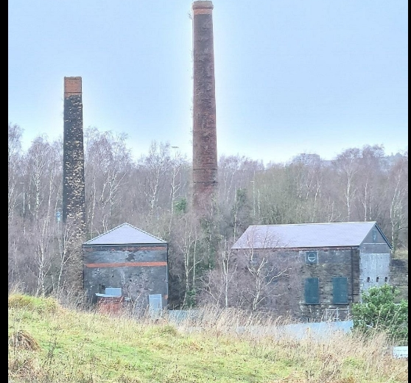

Hafod-Morfa copperworks
Carol Rafferty
2517512

Slide 2
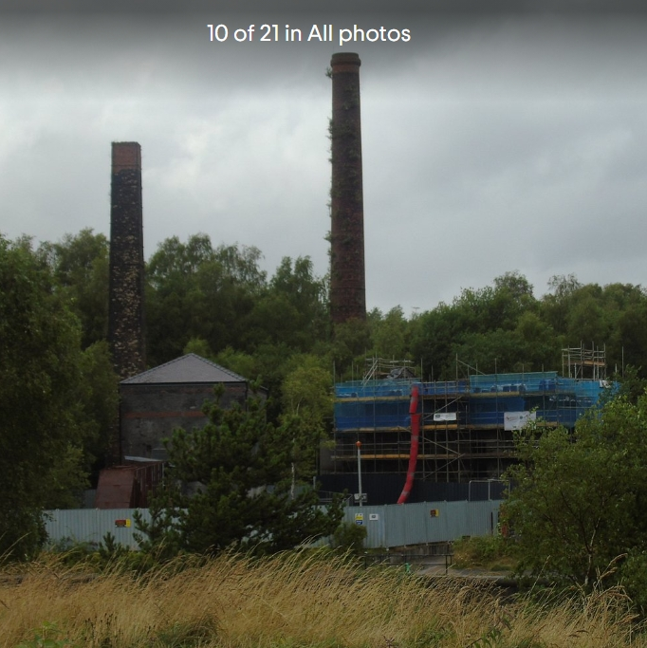

Introduction
Swansea is located on Wales south coast, Following the River Tawe, the Lower Swansea Valley developed into one of Britain's greatest industrial regions during the Industrial Revolution.
During the 18th and 19th centuries, the Lower Swansea Valley district of Hafod served as a major hub for heavy industry and copper smelting.

Slide 3
production
Copper ore was smelted in coal-fired furnaces to extract the meta,
It was then refined and shaped into sheets or plates. (Evans & Saunders, 2012).
Skilled workers ran the furnaces and machines, while others helped with supporting tasks, keeping production running smoothly for local and global trade.
There were stages to the operations:
Smelting is the process of removing copper from ore.
Refining is the process of cleaning the metal.

Slide 4
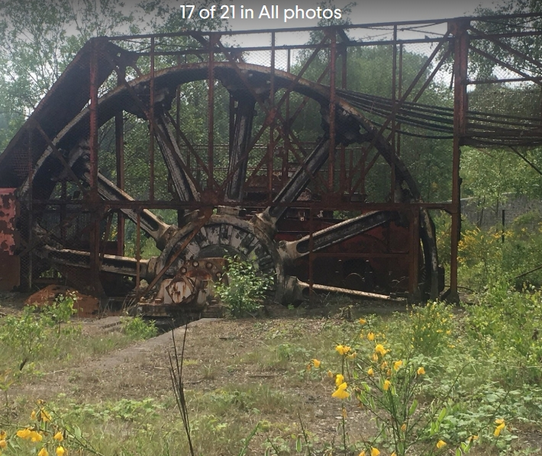
Steam Power and the Industrial
Revolution
Large volumes of coal were needed as fuel for steam engines. South Wales was perfect for industrial growth because of its enormous coal deposits. The need for metals like copper, which were used in machinery, shipbuilding, and later electrical technologies.

Slide 5
smelting
Welsh smelting was used to create copper, To get rid of impurities and sulphur, ship-imported copper ore was first crushed and melted down. After that, it was heated in furnaces that burnt coal, separating the copper from slag, Before being refined into copper, (Tylecote, 1992). which is roughly 98-99% pure and then cast into ingots or rolled into sheets and bars for industrial usage, the material underwent multiple processes of roasting and smelting to raise the copper content.

Slide 6
Coal Formation
South Wales coalfield were used to power the furnaces(Encyclopaedia Britannica, 2023).
Bituminous coal (steam coal) the main type.
Anthracite coal – a harder coal that burned very hot and clean

Slide 7
Environment and Social Impacts
Industrial activity had major environmental impacts. The Lower Swansea Valley became heavily polluted with smoke, chemical waste, and slag heaps, damaging vegetation and rivers. At the same time, industrial growth led to rapid population increases, overcrowded housing, and difficult working conditions for many workers.

Slide 8
conclusion
Hafod Played a significant role in Swansea's industrial past. Swansea's growth was helped by the copper industry, which also earned the city the name "Copperopolis." It was perfect for international trade and copper smelting because of its closeness to the port and coal mines. Even though the business created pollution and challenging working conditions, it also gave many locals jobs. The location is still a significant reminder of Swansea's industrial past today.

Slide 9
Reference
References (APA 7th Edition)
Davies, J. (2007). A history of Wales (2nd ed.). Penguin.
Encyclopaedia Britannica. (2023). Coal.
https://www.britannica.com/science/coal-fossil-fuel
Evans, C., & Saunders, A. (2012). Copperopolis: Landscapes of the early industrial period in Swansea. Royal Commission on the Ancient and Historical Monuments of Wales.
National Museum Wales. (n.d.). Copper industry in Swansea.
https://museum.wales
Natural Resources Wales. (n.d.). The South Wales coalfield and geology.
https://naturalresources.wales
Royal Commission on the Ancient and Historical Monuments of Wales. (n.d.). Hafod-Morfa Copperworks, Swansea.
https://rcahmw.gov.uk
Tylecote, R. F. (1992). A history of metallurgy (2nd ed.). Institute of Materials.
Williams, C. (1990). Capitalism, community and conflict: The South Wales coalfield 1898–1947. University of Wales Press.

