Slide 1
An investigation into the “minimalistic approach” of software development to help users.
By Keelan rochard

Slide 2
Introduction
To summarise, the main areas the report will show is the background research of minimalism design. Then the report will show the research methods and planning techniques the project will use. Finally, the report will display design elements of the project as well as the implementation and reflection of how the project could be produced more efficiently.
Notes:
This research project will be carried out over the next several months and will determine if minimalistic design in user interfaces is the way forward. This project has decided to use this theory as it is somewhat original and after some basic searches it is not found as a common or proven theory. This will be done through extensive research on what minimalistic design is to provide background research and find an effective definition, where you can find minimalistic design over various different examples over the globe in different environments. Also a comparison of two or more systems will be used to prove this theory, one with minimalistic design implemented to test against real-time users and discover if the hypothesis can be determined true, false or something else entirely. The project will also use a research method to lay out how the project will be structured. This will most likely be the research onion as it is a solid methodology to follow with various paths the project can take. The actions that will take place during the project’s generation is to use user testing and questionnaires to tell if the new system meets the user’s satisfaction and faster serving time than the current system, proving or disproving the theory. This action also allows the use of primary data to be collected and which can be qualitative and quantitative data to draw a clear conclusion that the user liked the minimalistic approach or not

Slide 3
The purpose
The purpose of generating this question was that It had not seemed to be answered before me. The question is also an intriguing one as it an have various different aspects differed the conclusion I found.

Slide 4
Aims and objectives
I believe that I met my aim and objectives. The aim I needed to meet was:
To test if a till with minimalistic approach to UI was more effective than a till without minimalistic design.
The objectives I needed to meet were:
To build a till system that is useable
To build a till system that reduces the amount of buttons on the screen
To build a till system with a log on function
To build a till system that has an appropriate colour scheme
To build a till system with ease of use

Slide 5
Research methodology
Research onion
Timeboxing

Slide 6
Findings
indeed the minimalistic approach was faster
The employees enjoyed the system
The system fit the atheistic of minimalistic design

Slide 7
Findings literature review
What minimalistic design was through artists perspective
Charts of how people will use a screen through their senses
How logos, phones and applications use minimalistic design
How it I used in the world of computing.

Slide 8
proof of findings – data table
No. of items purchased | Total price | Payment type | Total time serving
1 | £0.80 | Cash | 10 seconds
3 | £2.1 | card | 25 seconds
4 | £4.5 | card | 20 seconds
2 | £2.2 | Cash | 30 seconds
4 | £5.3 | Cash | 50 seconds
4 | £4.9 | Card | 45 seconds
3 | £4.7 | Cash | 35 seconds
3 | £4.6 | cash | 20 seconds
Table without minimalistic design
No. of items purchased | Total price | Payment type | Total time serving
2 | £1.80 | cash | 20 seconds
5 | £3.6 | card | 30 seconds
8 | £4.5 | Card | 50 seconds
2 | £1.7 | Cash | 25 seconds
3 | £2.5 | Cash | 45 seconds
3 | £2.4 | Card | 40 seconds
4 | £3.7 | Card | 15 seconds
2 | £2.2 | Cash | 20 seconds
Table with minimalistic design

Slide 9
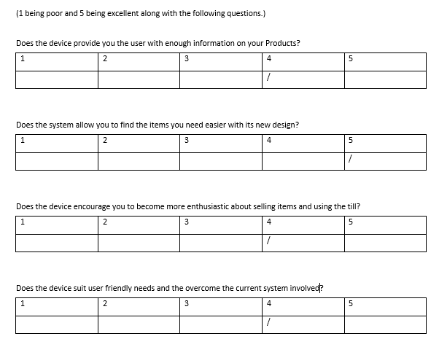
Proof of findings – questionnaire

Slide 10
Demonstration
https://youtu.be/mbhA0sRf-bg

Slide 11
Questions
Are there any questions that were not answered in the slides bove?

Slide 12
Thank you for listening!

