Slide 1
BMSK4004
Problem Solving and Decision Making
Laura James
Introduction
CertHE Skills for the Workplace

Slide 2
Aims & Objectives
AIM: To enable learners to make effective decisions to solve complex problems in the workplace.
Objectives - At the end of this module the learner will:
Be able to analyse a complex problem in the context of the workplace
Be able to apply decision making techniques when assessing possible solutions
Be able to plan how to implement the solution

Slide 3
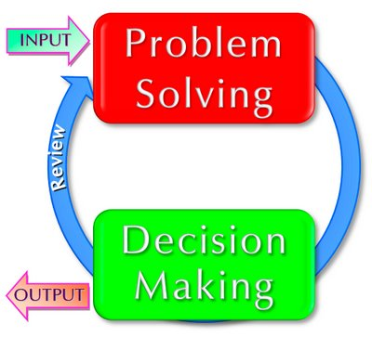
Problem solving & decision making

Slide 4
Problem Solving
Definition?
A problem can be defined as a circumstance where there is a gap between the situation as you perceive it and what you believe the situation should be
or
A perceived gap between the existing state and a desired state, or a deviation from the norm, standard or status quo.

Slide 5

Definition of decision making?
Decision Making is the act of choosing between two or more courses of action.

Slide 6

Problem Solving…
Problem solving is a task best performed b y teams and is reliant on effective communication
In your groups, discuss this statement.
Is it true? False? Why?
Be prepared to discuss your conclusions with the rest of the class.
Notes:
Best performed by teams. This doesn’t mean individuals cannot solve problems, but it lends itself to teams because…
More skills, more knowledge, different experiences, different perspectives, mix of natural team roles (Plant, RI, Implementer, Team Workers, etc.,, mutual support, motivating environment (should be!), split the tasks according to skills set/experience, etc., ensure problem is within scope of team responsibilities, and more.

Slide 7
Problem Solving
Knowledge
of people, tasks and organisational influences (policy/ objectives/procedure)
Skills
in identifying, analysing and finding solutions to problems
Judgement
to assist in decision-making throughout the problem-solving process.

Slide 8
Diagnosing Problems
The first stage in the problem-solving process is recognising a problem exists:
Many day-to-day problems can easily be resolved by taking decisive action
Problems that are more complex often require lengthy deliberation.
Notes:
Can anyone think of an example?

Slide 9
Problems can be diagnosed through
Continuously monitoring performance
Listening to subordinates
Observing subordinates’ behaviour
Establishing the cause of the problem

Slide 10
What next?
Decide to do nothing
Keep the problem under surveillance and review it (later date)
Contain the problem
Find a solution

Slide 11
Initial Analysis
Gather information
Define the scope
Define the Impact
Determine consequences

Slide 12
Problem Solving –
Continuous Improvement
Problem Solving is a key component of Continuous Systematic Improvement
Continuous Systematic Improvement is central to an organisation’s ability to be competitive and successful
Why is this?
Discuss this in your groups
Notes:
Any organisation that is not improving is standing still – if you stand still, others can overtake you…..and you are, in fact, going backwards!

Slide 13

Answer……
Any organisation that is not improving is standing still – if you stand still, others can overtake you…..and you are, in fact, going backwards!

Slide 14
Individually..
Identify three problems that you face in your work (current or previous)…. And what decisions you take/took to solve these problems…..

