Slide 1
LCHS4007 – DIGITAL SKILLS AND RESEARCH METHODS
Muneebah Zahir (2519618)
Naila Akhtar (2522162)
Sheila Maiza Do Espirito Santo Pereira Robalo (2525238)
Lecturer: Paul Clayton

Slide 2





Microsoft 365
A cloud-powered productivity platform with access to all the latest productivity apps (Microsoft, 2026).
M365 will allow Greenfield Home Care Agency to:
Improve work efficiency across all staff and teams
Some of the many applications include:
Improve communication between all staff
Improve digital safety across the organisation

Slide 3
How exactly will M365 improve efficiency?
‘Microsoft Excel isn’t just a programme for spreadsheets, it’s an essential tool for modern businesses.’ (Charlesworth, 2024)
What can be improved?
Rota’s
Sorting / Filtering data
Inventory tracking
Accessible data
Using excel is crucial as it has many resources that cover a range of different jobs making it the best choice for many companies. This is very important for greenfield home care agency as it will allow staff to complete tasks with ease (Charlesworth, 2024)

Slide 4
Without Excel:
Time consuming
Making changes can be slow and also lead to mistakes (double booking, missing shifts etc.)
Inaccurate pay
Not accessible
Bigger teams of staff is harder to handle
Time efficient
Ready to use templates (Microsoft, 2026)
Reports
Charts / graphs (Microsoft 2026)
Managers can use this and see where and what needs improving
Tracking
Inventory tracking (Highlight what's low in stock)
Track previous changes and who made them
Drop down menus
Can highlight inconsistencies in schedules
Calculation features (Microsoft, 2026)
Accessibility
Accessible data (Microsoft, 2026)
Hyperlinks
Offline capabilities
Stock reports
Can easily make changes if something comes up
Authorised personal can make changes (Microsoft, 2026)
Resident monitoring
Conditional Formatting (Microsoft, 2026)
Keyboard shortcuts (Microsoft, 2026)
Encryption / passwords (Microsoft, 2026)

Slide 5
Pros & Cons
Templates - easier to get started (Microsoft, 2026)
Well known (many tutorials)
Data analysis + management (Microsoft, 2026)
Many uses (scheduling, medical logs, inventory tracking etc.)
Available offline
Collaboration features (Microsoft, 2026)
M365 – compatibility with the other apps
Manual error (Microsoft, 2026)
Risk of unauthorised access (Microsoft, 2026)
Newer specified apps
Real time collaboration issues
Advanced features need extra training (Microsoft, 2026)
Bigger files can lead to slower processing or even crash the file (Microsoft, 2026)

Slide 6
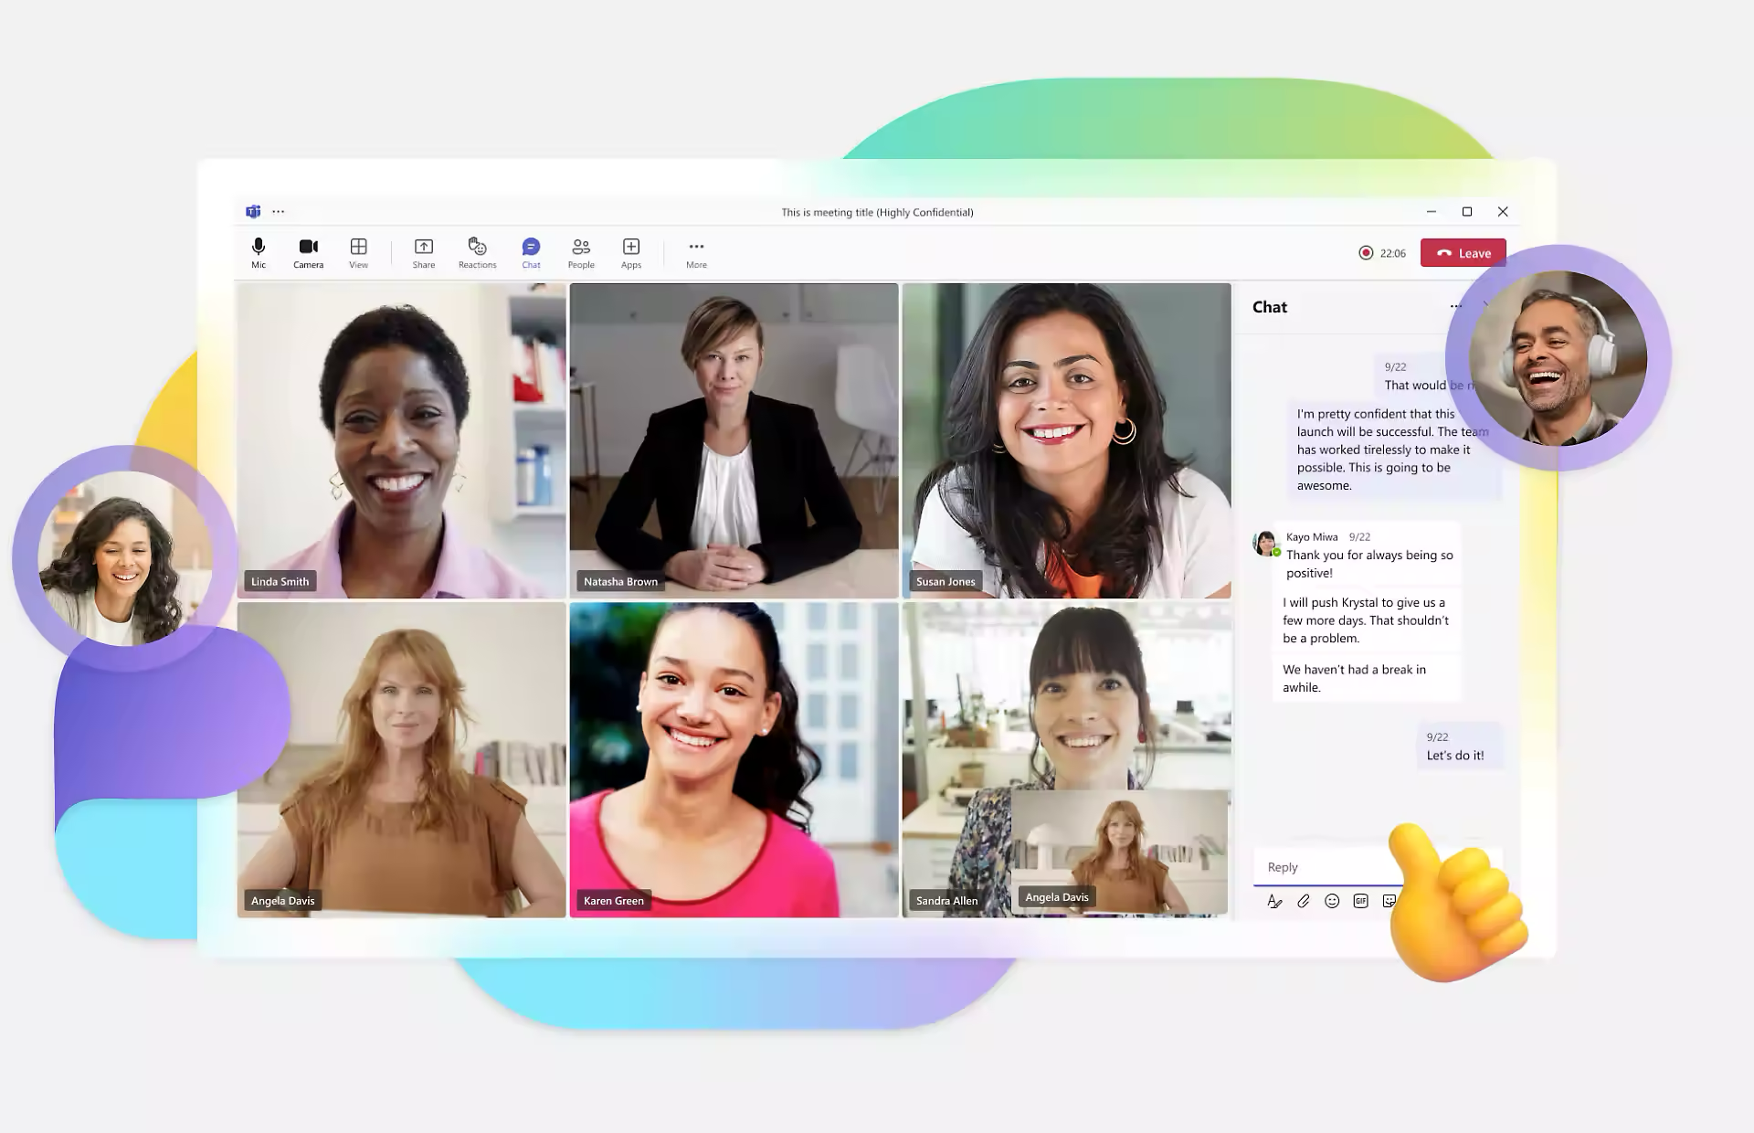
Teams - Communication
According to (Microsoft 2025), Teams is the main communication platform within Microsoft 365.
It allows:
Instant messaging
Video calls
File sharing
It’s especially useful for an organisation like Greenfield as it allows communication between staff working across multiple locations.
Because care workers rarely work in the same place together, it allows effective collaboration that reduces confusion and delays.
Image from Microsoft website: (Microsoft, 2024).

Slide 7
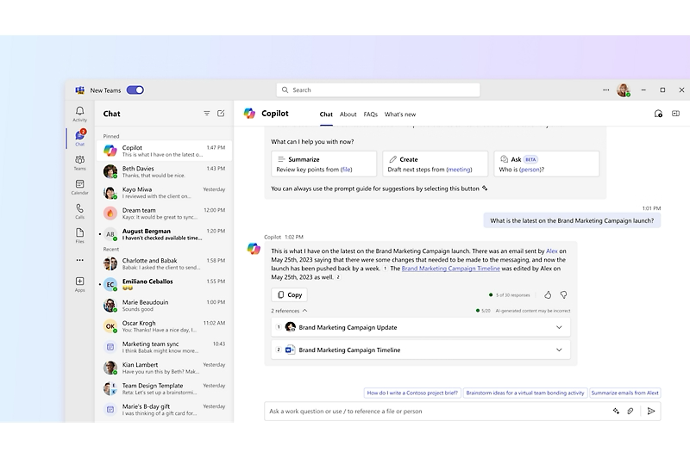
Teams - Communication
Due to the instant messaging feature in Microsoft teams, they would be able to:
Collaborate with colleagues across multiple locations (either in the field or the main office) in real time, giving live updates on their client's status.
Improve productivity by reducing the delays that come with other methods of communication.
Stay connected from any device, making it accessible to all staff.
This would help improve responsiveness and support a care strategy that’s focused on the client (Houghton, 2024).
Image from Microsoft website: (Microsoft, 2024).

Slide 8
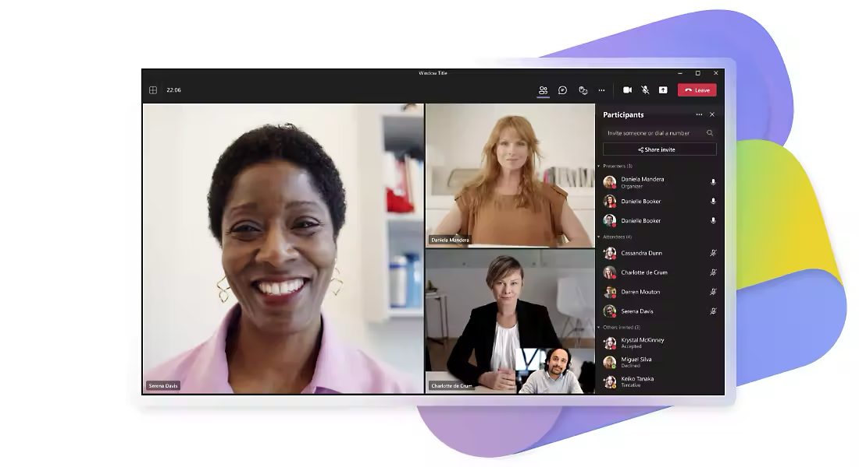
Teams - Communication
Another important Teams feature is the ability to conduct video calls.
This is useful because:
It connects staff across all locations instantly, and more efficiently than through text.
Increases productivity by reducing the need to travel and show up for meetings in person.
Offers more control and privacy with secure meeting features (meeting recordings, blurring background effect and participant control)
This would massively help Greenfield as it would allow staff to consult doctors and colleagues instantly and share their information securely to the appropriate person (Houghton, 2024).
Image from Microsoft website: (Microsoft, 2024).

Slide 9
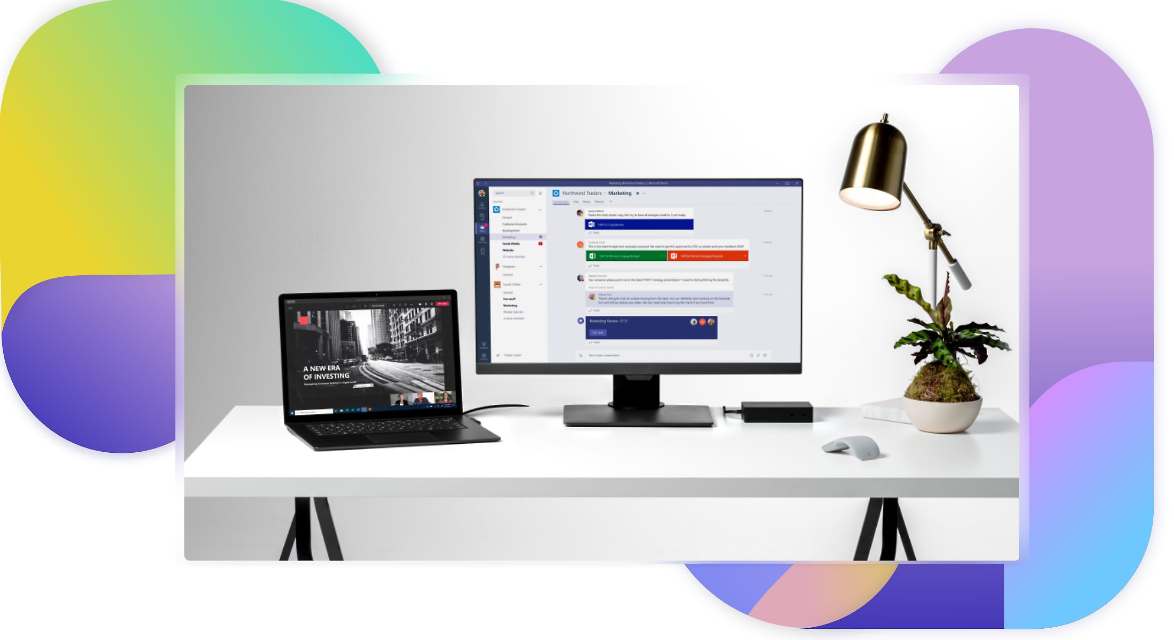
Teams - Communication
To ensure private and secure communication, the file sharing feature is extremely important. It allows staff to:
Store and share documents securely across any location.
Allows editing in real time, which lets you collaborate more effectively.
Improves the management of sensitive information by keeping files organised and accessible.
File sharing allows care home staff access schedules, plans and reports instantly. This improves the management of resident information and ensures everyone stays informed (Praburam, 2025).
Image from Microsoft website: (Microsoft, 2024).

Slide 10
Teams - Evaluation
Advantages
Improves communication and collaboration between staff across different locations (Houghton, 2024).
Is extremely accessible, allowing staff to use basic functions and work from any device with little training.
Increases productivity by allowing messaging, video calls and file sharing from one platform (Houghton, 2024).
Organised channels and shared documents also support more effective management (Houghton, 2024).
Increased security to protect confidential and sensitive information (Praburam, 2025).
Disadvantages
A strong and stable internet connection is needed to work effectively (Fusion Connect, 2024).
The number of features and notifications can become overwhelming for some people (Mindaugas Gluchovskis, 2023).
Proper training may be required to make full use of all the features and tools.
Communication can be disrupted by technical issues or outages (Praburam, 2025).
If Teams is used on unmanaged and unsanctioned devices; it can risk having sensitive information leaked (Chouffani, 2019).

Slide 11
DIGITAL SAFETY AT GREENFIELD AND WHY IT’S IMPORTANT
Key Points:
Greenfield stores personal and medical data about older adults
Staff use Microsoft 365, email, and cloud systems daily
This increases the risk of data breaches and cyber attacks
Why It Matters:
Data breaches can cause legal penalties and loss of patient trust
Healthcare data is highly targeted by cybercriminals (NHS Digital, 2023)
Digital safety protects patients, staff, and the organisation (NHS Digital, 2023; Microsoft, 2024)

Slide 12
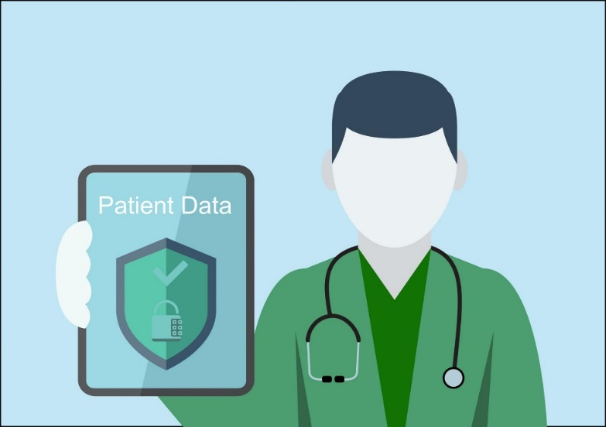
GOAL 1: SECURE ACCESS
Goal:
Only approved personnel should be allowed access to the digital systems of Greenfield.
Actions:
Use passwords that are long (12 or more characters, symbols, numbers).
Allow Multi-Factor Authentication (MFA)
Screen lock when not in use.
Drop system access on the departure of staff.
Justification:
There is a decrease in unauthorised access to sensitive healthcare data because of strong access controls.
(Microsoft, 2024; GDPR, 2018)

Slide 13
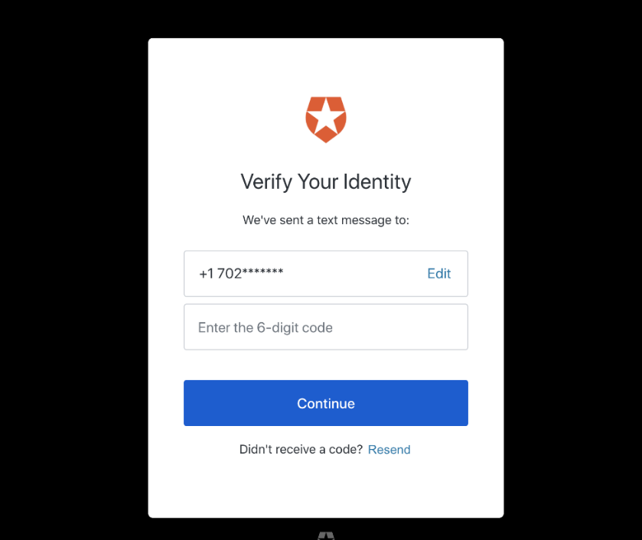
GOAL 2: EMAIL AWARENESS
Goal:
Minimise phishing cyber threats.
Actions:
Do not open suspicious links or attachments.
Paying attention to the address of cheque senders.
Send suspicious emails to IT.
Full course cyber awareness training.
Justification:
Major security breaches in organisations are caused by human error.
(Parsons et al., 2017; NHS Digital, 2023)

Slide 14
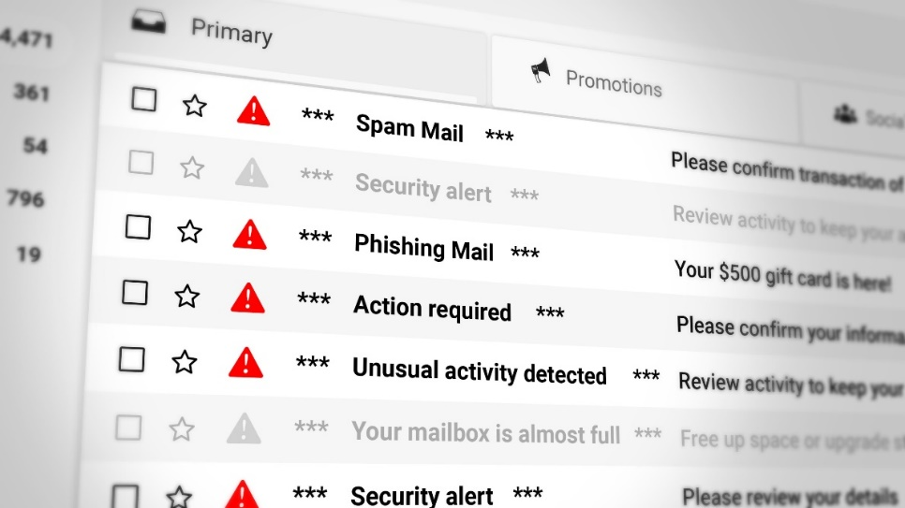
GOAL 3: DATA MANAGEMENT
Goal:
Securely keep and distribute patient records.
Actions:
Only use OneDrive and SharePoint.
Limit access to files by authorised employees.
Indicate files that are sensitive by labelling them as confidential.
Delete old records securely.
Justification:
Compliance and minimisation of data loss. Secure cloud systems help to minimise data loss.
(Microsoft, 2024; GDPR, 2018)

Slide 15

GOAL 4: CONFIDENTIALITY & COMPLIANCE
Goal:
Make sure that patient data is legally and ethically handled.
Actions:
Adhere to GDPR principles of data protection.
One should not use open Wi-Fi during record access.
Talk to the patient about it behind closed doors.
Sign confidentiality documents.
Justification:
Healthcare organisations have a legal obligation to protect personal and health information.
(European Union, 2018; NHS Digital, 2023)

Slide 16
DIGITAL SAFETY CHECKLIST
Area | Action | Status
Secure Access | MFA enabled for all staff | ⬜
Secure Access | Strong passwords in use | ⬜
Email Safety | Phishing training completed | ⬜
Data Management | OneDrive used for records | ⬜
Compliance | GDPR training completed | ⬜
Managers review on a monthly basis to ascertain that safety standards are met.
(Microsoft, 2024)

Slide 17
BENEFITS FOR GREENFIELD
Organisational Benefits:
Improved patient trust
Minimised security risks in cyberspace.
Strong legal compliance
Improved employee proficiency in technology.
Academic Support:
Good online safety rules enhance the data security and quality of services in healthcare.
(Parsons et al., 2017; NHS Digital, 2023)

Slide 18
References – (part 3 put together later)
European Union (2018) General Data Protection Regulation (GDPR). Available at: https://gdpr.eu [Accessed 31 Jan. 2026].
Microsoft (2024) Security Best Practices for Microsoft 365. Available at: https://learn.microsoft.com [Accessed 31 Jan. 2026].
NHS Digital (2023) Data Security and Protection Toolkit. Available at: https://www.dsptoolkit.nhs.uk [Accessed 31 Jan.2026].
Parsons, K. Calic,D. Pattinson,M. Butavicius,M. McCormac,A. Zwaans,T. (2017) ‘The Human Aspects of Information Security’, Computers & Security, 67, pp. 15–30 [Accessed 31 Jan. 2026].

Slide 19
References
https://www.microsoft.com/en-us/microsoft-365/excel/spreadsheets#:~:text=Enhanced%20collaboration%20features,automate%20tasks%20and%20provide%20recommendations. What is a spreadsheet? Accessed 8th feb
https://www.linkedin.com/learning/excel-for-healthcare-practical-applications-and-skills/why-excel-is-relevant-to-healthcare?u=77966930 why excel is still relevant to healthcare. 10/11/2024 accessed 8th feb - Wuraola Oyewusi
https://support.microsoft.com/en-gb/office/what-is-microsoft-365-847caf12-2589-452c-8aca-1c009797678b (What is m365 - 1st slide) 1st feb
https://kaplan.co.uk/blog/features/is-microsoft-excel-still-relevant (why excel – 2nd slide) 1st feb

Slide 20
Reference list
Chouffani, R. (2019). Microsoft Teams has HIPAA collaboration compliance benefits, risks. [online] Search Unified Communications. Available at: https://www.techtarget.com/searchunifiedcommunications/tip/Microsoft-Teams-has-HIPAA-collaboration-compliance-benefits-risks [Accessed 28 Jan. 2026].
Fusion Connect (2024). End-user Tips for Improving Microsoft Teams Performance. [online] Fusionconnect.com. Available at: https://www.fusionconnect.com/blog/end-user-tips-for-improving-microsoft-teams-performance [Accessed 28 Jan. 2026].
Houghton, S. (2024). Benefits of Microsoft Teams For Small Business & Enterprise. [online] Aztechit.co.uk. Available at: https://www.aztechit.co.uk/blog/microsoft-teams-benefits [Accessed 28 Jan. 2026].
Microsoft (2025). Microsoft Teams. [online] www.microsoft.com. Available at: https://www.microsoft.com/en-us/microsoft-teams/group-chat-software [Accessed 28 Jan. 2026].
Mindaugas Gluchovskis (2023). 5 Ways Feature Fatigue Will Negatively Impact Team Collaboration. [online] eLearning Industry. Available at: https://elearningindustry.com/ways-feature-fatigue-will-negatively-impact-team-collaboration [Accessed 28 Jan. 2026].
Praburam (2025). ClickUp. [online] ClickUp. Available at: https://clickup.com/blog/microsoft-teams-pros-and-cons [Accessed 28 Jan. 2026].
.

