Slide 1
Cyflwyno the
Gwasanaeth Gyrfaoedd
Introducing the
Careers Service

Slide 2
Ail-Cyflwyno: EICH Gwasanaeth Gyrfaoedd
Re-Introduction:
YOUR
Careers Service

Slide 3
Eitem | Rh. / No. | Item
Pwy ydym ni? | 1 | Who we are?
Mynediad gwasanaeth | 2 | Accessing the service
Pam rydym yn bodoli? | 3 | Why we exist?
Hyn y gallwn eich helpu gyda (& sut)? | 4 | What we can help you with (& how)?
Yr hyn na allwn ni eich helpu gyda? | 5 | What we can’t help you with?
Gwybodaeth pellach | 6 | Further information

Slide 4
Pwy ydym ni? | 1 | Who we are?

Slide 5
Tim Gyrfaoedd: Caerfyrddin Careers Team: Carmarthen
Role title & Email add. | Enw /Name Ffon/Phone | Teitl rôl & cyf. Ebost
Careers Adviser mark.thomas@uwtsd.ac.uk | Mark.Thomas 01267 676830 Myddfai | Ymgynhorydd Gyrfaoedd mark.thomas@pcydds.ac.uk
Student Services Receptionist studentservices@uwtsd.ac.uk | Lucy Wigley 01267 676830 | Croesawydd Gwas. Myfyrwyr gwasanaethaumyfyrwyr@pcydds.ac.uk
GO Wales Project Manager angela.evans@uwtsd.ac.uk | Angela Evans 01267 225158 | Rheolwr Prosiect GO Wales angela.evans@pcydds.ac.uk
Graduate Outcomes Manager lynsey.Williams@uwtsd.ac.uk | Lynsey Williams 01267 676813 | Rheolwr Canlyn. Graddedigion lynsey.williams@pcydds.ac.uk

Slide 6
Tim Gyrfaoedd: Caerfyrddin Careers Team: Carmarthen
Role title & Email add. | Enw /Name Ffon/Phone | Teitl rôl & cyf. Ebost
Careers Adviser mark.thomas@uwtsd.ac.uk | Mark.Thomas 01267 676830 | Ymgynhorydd Gyrfaoedd mark.thomas@pcydds.ac.uk
 | SBS SA1 IQ Building Llys Glas
 | Val.Davidge@uwtsd.ac.uk 01792 481222 Llys Glas

Slide 7
Tim Gyrfaoedd: Caerfyrddin Careers Team: Carmarthen
Role title & Email add. | Enw /Name Ffon/Phone | Teitl rôl & cyf. Ebost
Careers Adviser mark.thomas@uwtsd.ac.uk | Mark.Thomas 01267 676830 | Ymgynhorydd Gyrfaoedd mark.thomas@pcydds.ac.uk
 | SBS SA1 IQ Building Llys Glas
 | Val.Davidge@uwtsd.ac.uk 01792 481222 Llys Glas

Slide 8
Mynediad gwasanaeth | 2 | Accessing the service

Slide 9









By libberry's Clipart, CC0 1.0

Slide 10
Pam rydym yn bodoli? | 3 | Why we exist?

Slide 11
Cyflogadwyedd Employability
"A set of achievements, understandings and personal attributes that make individuals more likely to gain employment and to be successful in their chosen occupations".
Peter Knight & Mantz Yorke
(HEFCE/DfES ESECT group)

Slide 12
Hyn y gallwn eich helpu gyda (&sut)? | 4 | What we can help you with (& how)?

Slide 13
Hyn y gallwn
eich helpu gyda (&sut)?
Cyngor a Chyfarwyddyd Gyrfa. Gwybodaeth & Addysg Gyrfaoedd
Datblygu syniadau Yrfaoedd
Ymchwilio a chymharu opsiynau
Ceisiadau swyddi:
Strategaeth
‘Ar-spec’
CVs, ffurflenni cais & cyfweld
GO Wales / Profiad gwaith
Swyddi/Swyddi gwag
Astudio ôl-raddedig: Dewis/Ymgeisio
What we can
help you with & how?
Careers Advice & Guidance
Careers Information & Education
Generating Careers ideas
Researching & comparing options
Job applications:
Strategy
Speculative
CVs, Forms & Interviewing
GO Wales / Work experience
Jobs/Vacancies
Post-Grad. Study: options/applics.

Slide 14
Dyma sut This is how
Yn gefnogol
Yn gyfeillgar
Ddim yn barnu
Yn annibynnol
Yn gyfrinachol
Ymarferwyr Cyngor a Chyfarwyddyd Gyrfaoedd â chymwysterau/hyffor. Proffes.
Defnydd anghyfyngedig
Supportive
Friendly
Non-judgemental
Independent
Confidential
Professionally qualified and trained Careers Advice & Guidance practitioners
Unlimited use

Slide 15
Llinell Amser Timeline
L4
L5
Lleoliadau & Apwyntiadau 1-i-1
L6
Ceisiadau, CV, Cyfweld yn effeithiol, proffesiynoldeb, portread
Student Services Induction > Employability Principles
Placements & 121 Appointments
Cynefino Gwasanaethau Myfyrwyr > Egwyddorion Cyfloga.
Applications, CV, interviewing, professionalism, portrayal

Slide 16
Llinell Amser Timeline
L4
L5
Lleoliadau & Apwyntiadau 1-i-1
L6
Ceisiadau, CV, Cyfweld yn effeithiol, proffesiynoldeb, portread
Student Services Induction > Employability Principles
Placements & 121 Appointments
Cynefino Gwasanaethau Myfyrwyr > Egwyddorion Cyfloga.
Applications, CV, interviewing, professionalism, portrayal

Slide 17
Yr hyn na allwn ni eich helpu gyda? | 5 | What we can’t help you with?

Slide 18
ni allwn ... | can’t ...
Ysgrifennu neu wirio sillafu / gramadeg eich CV, cais neu ddatganiad personol
Dweud beth dylech chi ei wneud â’ch bywyd OND ...
ni’n helpu chi wneud hyn!
Ymchwilio i’r holl opsiynau drosoch chi OND ... rydym ni’n eich helpu chi i gael y sgiliau i wneud hyn
Cynghori ynghylch rheolau Fisâu a Mewnfudo DU
Write or spell/grammar check your CV, application or personal statement
Tell you what you should do with your life BUT …
we help you do this!
Research all your options for you BUT ….. we help you acquire the skill to do this
Advise on UKVI rules

Slide 19
Gwybodaeth pellach | 6 | Further information

Slide 20


www.gowales.co.uk
Programme is for young students under 25 on higher education courses in Wales who find it challenging to secure good quality career relevant work experience. We organise:
Work …. Shadowing, Tasters & Placements
To find out more about the Programme & eligibility, contact your university careers service:
Rhaglen ar gyfer myfyrwyr ifanc o dan 25 ar gyrsiau addysg uwch yng Nghymru sy’n cael cryn her sicrhau profiad gwaith perthnasol o ansawdd da. Rydyn ni’n trefnu:
Cyfleoedd .... cysgodi, blasu & lleoliadau gwaith
Am mwy o wybodaeth am y Rhaglen & meini prawf, cysylltwch gyda eich gwasanaethau gyrfaoedd:
Angela Evans / 01267 225158 / angela.evans@uwtsd.ac.uk

Slide 21
Beth yw’r Arolwg Hynt Graddedigion? What is the Graduate Outcomes Survey?
Yn eich arolygu 15 mis ar ôl graddio
Canlyniadau'n rhoi gwybodaeth ddefnyddiol
Surveys you 15 months after Graduation
Results provide
useful information
Notes:
1. 16/17 is the final DLHE survey
2. Currently the DLHE is undertaken by each HEP who either undertake the survey in-house or out-source to a third party. The Graduate Outcomes Survey will be centralised and undertaken by a third party contractor working in collaboration with HESA and the HEP.
N.B. Next slide shows details of the cohorts that make up the survey, and the survey dates.

Slide 22
O fewn PCYDDS From within UWTSD
http://www.gowales.co.uk/hafan.html
http://lifedesign.uwtsd.ac.uk/cy/
http://www.tsdsu.co.uk/
https://businesswales.gov.wales/bigideas/cy
http://www.gowales.co.uk/main.html
http://lifedesign.uwtsd.ac.uk/
http://www.tsdsu.co.uk/
https://businesswales.gov.wales/bigideas/

Slide 23
Cwestiynau?
Questions?

Slide 24
Egwyddorion Cyflogadwyedd
Gyrfaol allweddol
Key
Career Employability Principles

Slide 25
Cyflwyniad | 1 | Introduction

Slide 26
Eitem | Rh. / No. | Item
Cyflwyniad | 1 | Introduction
Egwyddorion Cyflogadwyedd Confensiynol | 2 | Conventional Employability Principles
Rhwystrau Canfyddedig | 3 | Perceived Barriers
Fy Nghyngor I | 4 | My advice
Gwefan Gyrfaoedd | 5 | Careers website
Gwybodaeth pellach | 6 | Further information

Slide 27
Egwyddorion Cyflogadwyedd Confensiynol | 2 | Conventional Employability principles

Slide 28
Pam? Why?

Slide 29
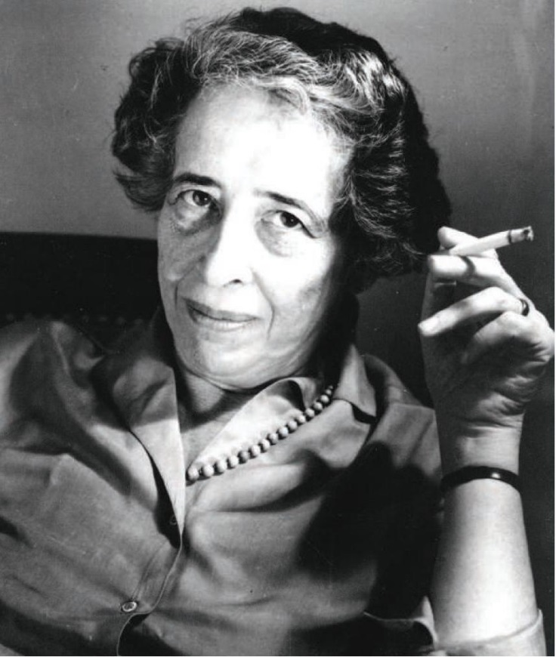
Pam? Why?
Attribution 2.0 Generic (CC BY 2.0)

Slide 30
Pam? Why?
Canlyniad sefydliad dynol yw cydraddoldeb.
Ni chawn ein geni yn gyfartal.
Hannah Arendt (Theorydd Gwleidyddol), 1906 - 1975
Canlyniad sefydliad dynol & arweiniad Gyrfaoedd yw Cyflogadwyedd. Ni chawn ein geni yn cyflogadwy. Anon (Ymgynghorydd Gyrfaol, PCYDDS), 2018
'Equality is the result of human organization. We are not born equal'.
Hannah Arendt (Political Theorist), 1906-1975
'Employability is the result of human Careers guidance. We are not born Employable'.
Anon (UWTSD Careers Adviser), 2018
Attribution 2.0 Generic (CC BY 2.0)

Slide 31
Rhwystrau Canfyddedig | 3 | Perceived Barriers

Slide 32

By libberry's Clipart, CC0 1.0
Gorlwytho gwybodaeth?
Information overload?

Slide 33
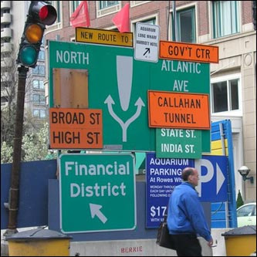

Slide 34
‘Llwybr gyrfa’ ‘Career paths’
NID yn syml
Zig zag
Cam yn ôl cyn 2 ‘mlaen
Ardal / Th-opp structure
Lle mae'r cyfleoedd?
Llwybrau lluosog
Yn ddryslyd
Gofynion mynediad
NOT straightforward
Zig zag
Step back / 2 fwd
Geog area/opp struct.
Where are most opps?
Multiple routes
Confusing
Entry requirements

Slide 35
Automated

Slide 36
‘PROSPECTS
FOR GRADUATES IMPROVE’
THES

Slide 37
‘PROSPECTS FOR GRADUATES LOOK
BLEAK’
Financial Times

Slide 38
‘Employers report rosy outlook for graduates.’
The Guardian

Slide 39
'Working class graduates kept out of highly-paid jobs’
The Independent

Slide 40
‘New campaign to improve careers advice’
The Guardian

Slide 41
Good degree. No job.
London Evening Standard

Slide 42
‘Graduates told: only the young and stylish need apply’
The Guardian

Slide 43
‘Careers services push girls into doing ‘women’s’ work.’
.
Western Morning News

Slide 44
‘Careers services biased towards the rich.’
.
Scottish Herald

Slide 45
‘A telly good idea –
4 out of 5 get their career advice from TV shows.’
The Daily Star

Slide 46
Fy nghyngor I | 4 | My advice

Slide 47
Mythau, celwydd & cyfryngau
Myths, lies & media
Negatifrwydd sydd yn dominyddu fel mae anghysondebau
Ond nid wastad yn wir
Gwir, canfyddiad a pharhad
Data
Chwistrellwr myth
Negativity dominates as do anomalies
But not always true
Truth, perception & perpetuation
Data
Myth busters

Slide 48
Osgowch Do avoid
'Y cwestiwn'
‘Egni negyddol'
‘Cadw lan a’r Joneses‘
Tybiaethau a chanfyddiadau anghywir
Poeni ychwanegol
Teimlo ‘dim ond fi’
‘The question’
‘Negative energy’
‘Keeping up with the Joneses’
Incorrect assumptions and perceptions
Over worrying
Feeling it’s just you

Slide 49
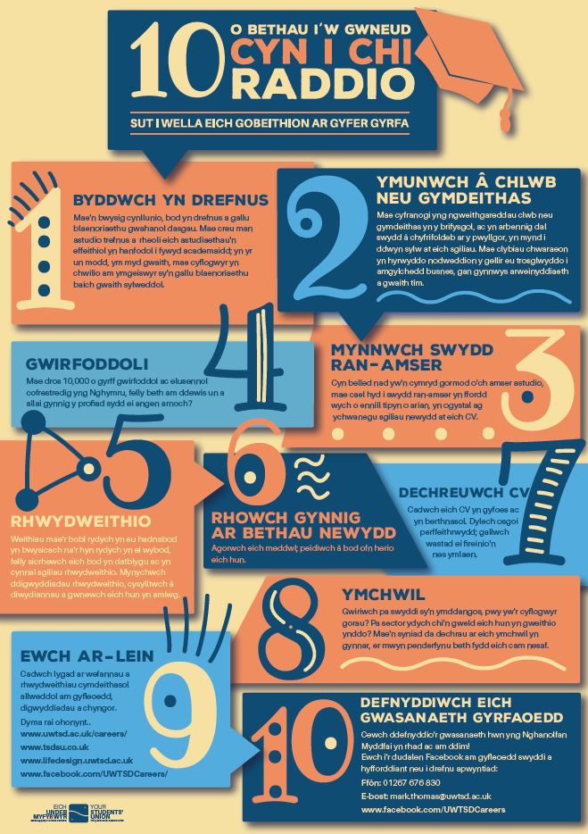


Slide 50
‘Wneudabledd’ ‘Doability’
“Well, the harder I practice, the luckier I seem to get”
Gary Player, 2002.

Slide 51
YOUR Careers Service exists to help you make sense of all these things …
the big picture, the decision making and the detail of how to get there via application.
CC2.0 general NNECAPA Photo Library

Slide 52
Mae EICH Gwasanaeth Gyrfaoedd yn bodoli i'ch helpu i wneud synnwyr o hyn oll …
y darlun mawr,
y broses benderfynu a manylion sut i gyrraedd yno trwy ymgeisio.
CC2.0 general NNECAPA Photo Library

Slide 53
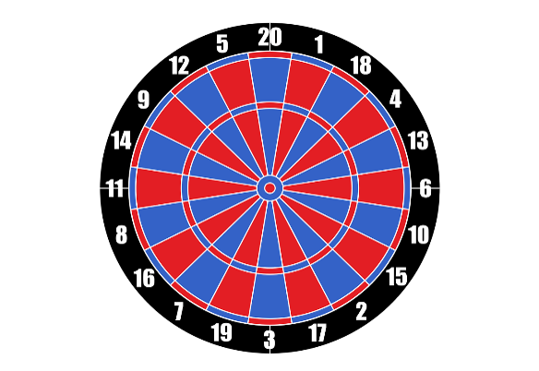
CC0 No attribution required

Slide 54
If you struggle with where to start …
'It doesn’t matter where you start.
Only that you begin’
(Robert Sharma, Leadership expert)
CC0 No attribution required

Slide 55

Hmmm wozzis?
sniff sniff … hmm
CC2.0 general Annaheathen

Slide 56
Hmmm bethyw-wn?
sniff sniff … hmm
CC2.0 general Annaheathen

Slide 57
Cwis
Data
Cyrchfanau
Data
Destination
Quiz

Slide 58
What do graduates do?
Author Laura Greaves Published October 2018 ura Greaves
Published October 2018
Key findings
The latest edition of What do graduates do? reveals a graduate labour market in relatively good health. Of the 254,495 UK-domiciled first-degree graduates who responded to the survey:
AAA% of graduates were in employment six months after graduating
.
.
.
.
.

Slide 59
What do graduates do?
Author Laura Greaves Published October 2018 ura Greaves
Published October 2018
Key findings
The latest edition of What do graduates do? reveals a graduate labour market in relatively good health. Of the 254,495 UK-domiciled first-degree graduates who responded to the survey:
AAA% of graduates were in employment six months after graduating
Only BBB% were unemployed - the lowest rate since the CCCC survey
.
.
.

Slide 60
What do graduates do?
Author Laura Greaves Published October 2018 ura Greaves
Published October 2018
Key findings
The latest edition of What do graduates do? reveals a graduate labour market in relatively good health. Of the 254,495 UK-domiciled first-degree graduates who responded to the survey:
AAA% of graduates were in employment six months after graduating
Only BBB% were unemployed - the lowest rate since the CCCC survey
DDD% of employed graduates were in a professional-level job (up from DDD%)
.
.

Slide 61
What do graduates do?
Author Laura Greaves Published October 2018 ura Greaves
Published October 2018
Key findings
The latest edition of What do graduates do? reveals a graduate labour market in relatively good health. Of the 254,495 UK-domiciled first-degree graduates who responded to the survey:
AAA of graduates were in employment six months after graduating
Only BBB% were unemployed - the lowest rate since the CCCC survey
DDD% of employed graduates were in a professional-level job (up from DDD%)
EEE% of graduates went on to full- or part-time further study
.

Slide 62
What do graduates do?
Author Laura Greaves Published October 2018 ura Greaves
Published October 2018
Key findings
The latest edition of What do graduates do? reveals a graduate labour market in relatively good health. Of the 254,495 UK-domiciled first-degree graduates who responded to the survey:
AAA of graduates were in employment six months after graduating
Only BBB% were unemployed - the lowest rate since the CCCC survey
DDD% of employed graduates were in a professional-level job (up from DDD%)
EEE% of graduates went on to full- or part-time further study
The average salary for graduates in full-time employment in the UK was £FFFFFF

Slide 63
What do graduates do?
Author Laura Greaves Published October 2018 ura Greaves
Published October 2018
Key findings
The latest edition of What do graduates do? reveals a graduate labour market in relatively good health. Of the 254,495 UK-domiciled first-degree graduates who responded to the survey:
74.3% of graduates were in employment six months after graduating
Only 5.1% were unemployed - the lowest rate since the 1979 survey
73.9% of employed graduates were in a professional-level job (up from 71.4%)
21.5% of graduates went on to full- or part-time further study
The average salary for graduates in full-time employment in the UK was £22,399

Slide 64
Gwybodaeth pellach | 5 | Further information

Slide 65
PCYDDS UWTSD
www.pcydds.ac.uk/gyrfaoedd/
http://www.gowales.co.uk/hafan.html
http://lifedesign.uwtsd.ac.uk/cy/
http://www.pcydds.co.uk/
https://businesswales.gov.wales/bigideas/cy
www.uwtsd.ac.uk/careers/
http://www.gowales.co.uk/main.html
http://lifedesign.uwtsd.ac.uk/
http://www.tsdsu.co.uk/
https://businesswales.gov.wales/bigideas/

Slide 66
www.gowales.co.uk
Programme is for young students under 25 on higher education courses in Wales who find it challenging to secure good quality career relevant work experience. We organise:
Work …. Shadowing, Tasters & Placements
To find out more about the Programme & eligibility, contact your university careers service:
Rhaglen ar gyfer myfyrwyr ifanc o dan 25 ar gyrsiau addysg uwch yng Nghymru sy’n cael cryn her sicrhau profiad gwaith perthnasol o ansawdd da. Rydyn ni’n trefnu:
Cyfleoedd .... cysgodi, blasu & lleoliadau gwaith
Am mwy o wybodaeth am y Rhaglen & meini prawf, cysylltwch gyda eich gwasanaethau gyrfaoedd:
Angela Evans / 01267 225158 / angela.evans@uwtsd.ac.uk

Slide 67
Beth yw’r Arolwg Hynt Graddedigion? What is the Graduate Outcomes Survey?
Notes:
1. 16/17 is the final DLHE survey
2. Currently the DLHE is undertaken by each HEP who either undertake the survey in-house or out-source to a third party. The Graduate Outcomes Survey will be centralised and undertaken by a third party contractor working in collaboration with HESA and the HEP.
N.B. Next slide shows details of the cohorts that make up the survey, and the survey dates.

Slide 68
Beth yw’r Arolwg Hynt Graddedigion? What is the Graduate Outcomes Survey?
Yn eich arolygu 15 mis ar ôl graddio
Surveys you 15 months after Graduation
Notes:
1. 16/17 is the final DLHE survey
2. Currently the DLHE is undertaken by each HEP who either undertake the survey in-house or out-source to a third party. The Graduate Outcomes Survey will be centralised and undertaken by a third party contractor working in collaboration with HESA and the HEP.
N.B. Next slide shows details of the cohorts that make up the survey, and the survey dates.

Slide 69
Beth yw’r Arolwg Hynt Graddedigion? What is the Graduate Outcomes Survey?
Yn eich arolygu 15 mis ar ôl graddio
Canlyniadau'n rhoi gwybodaeth ddefnyddiol
Surveys you 15 months after Graduation
Results provide
useful information
Notes:
1. 16/17 is the final DLHE survey
2. Currently the DLHE is undertaken by each HEP who either undertake the survey in-house or out-source to a third party. The Graduate Outcomes Survey will be centralised and undertaken by a third party contractor working in collaboration with HESA and the HEP.
N.B. Next slide shows details of the cohorts that make up the survey, and the survey dates.

Slide 70
Cwestiynau?
Questions?

