Slide 1
Contemporary issues in Marketing
Social media
Name: Muhammad Cassamo
Student number: 1550196

Slide 2
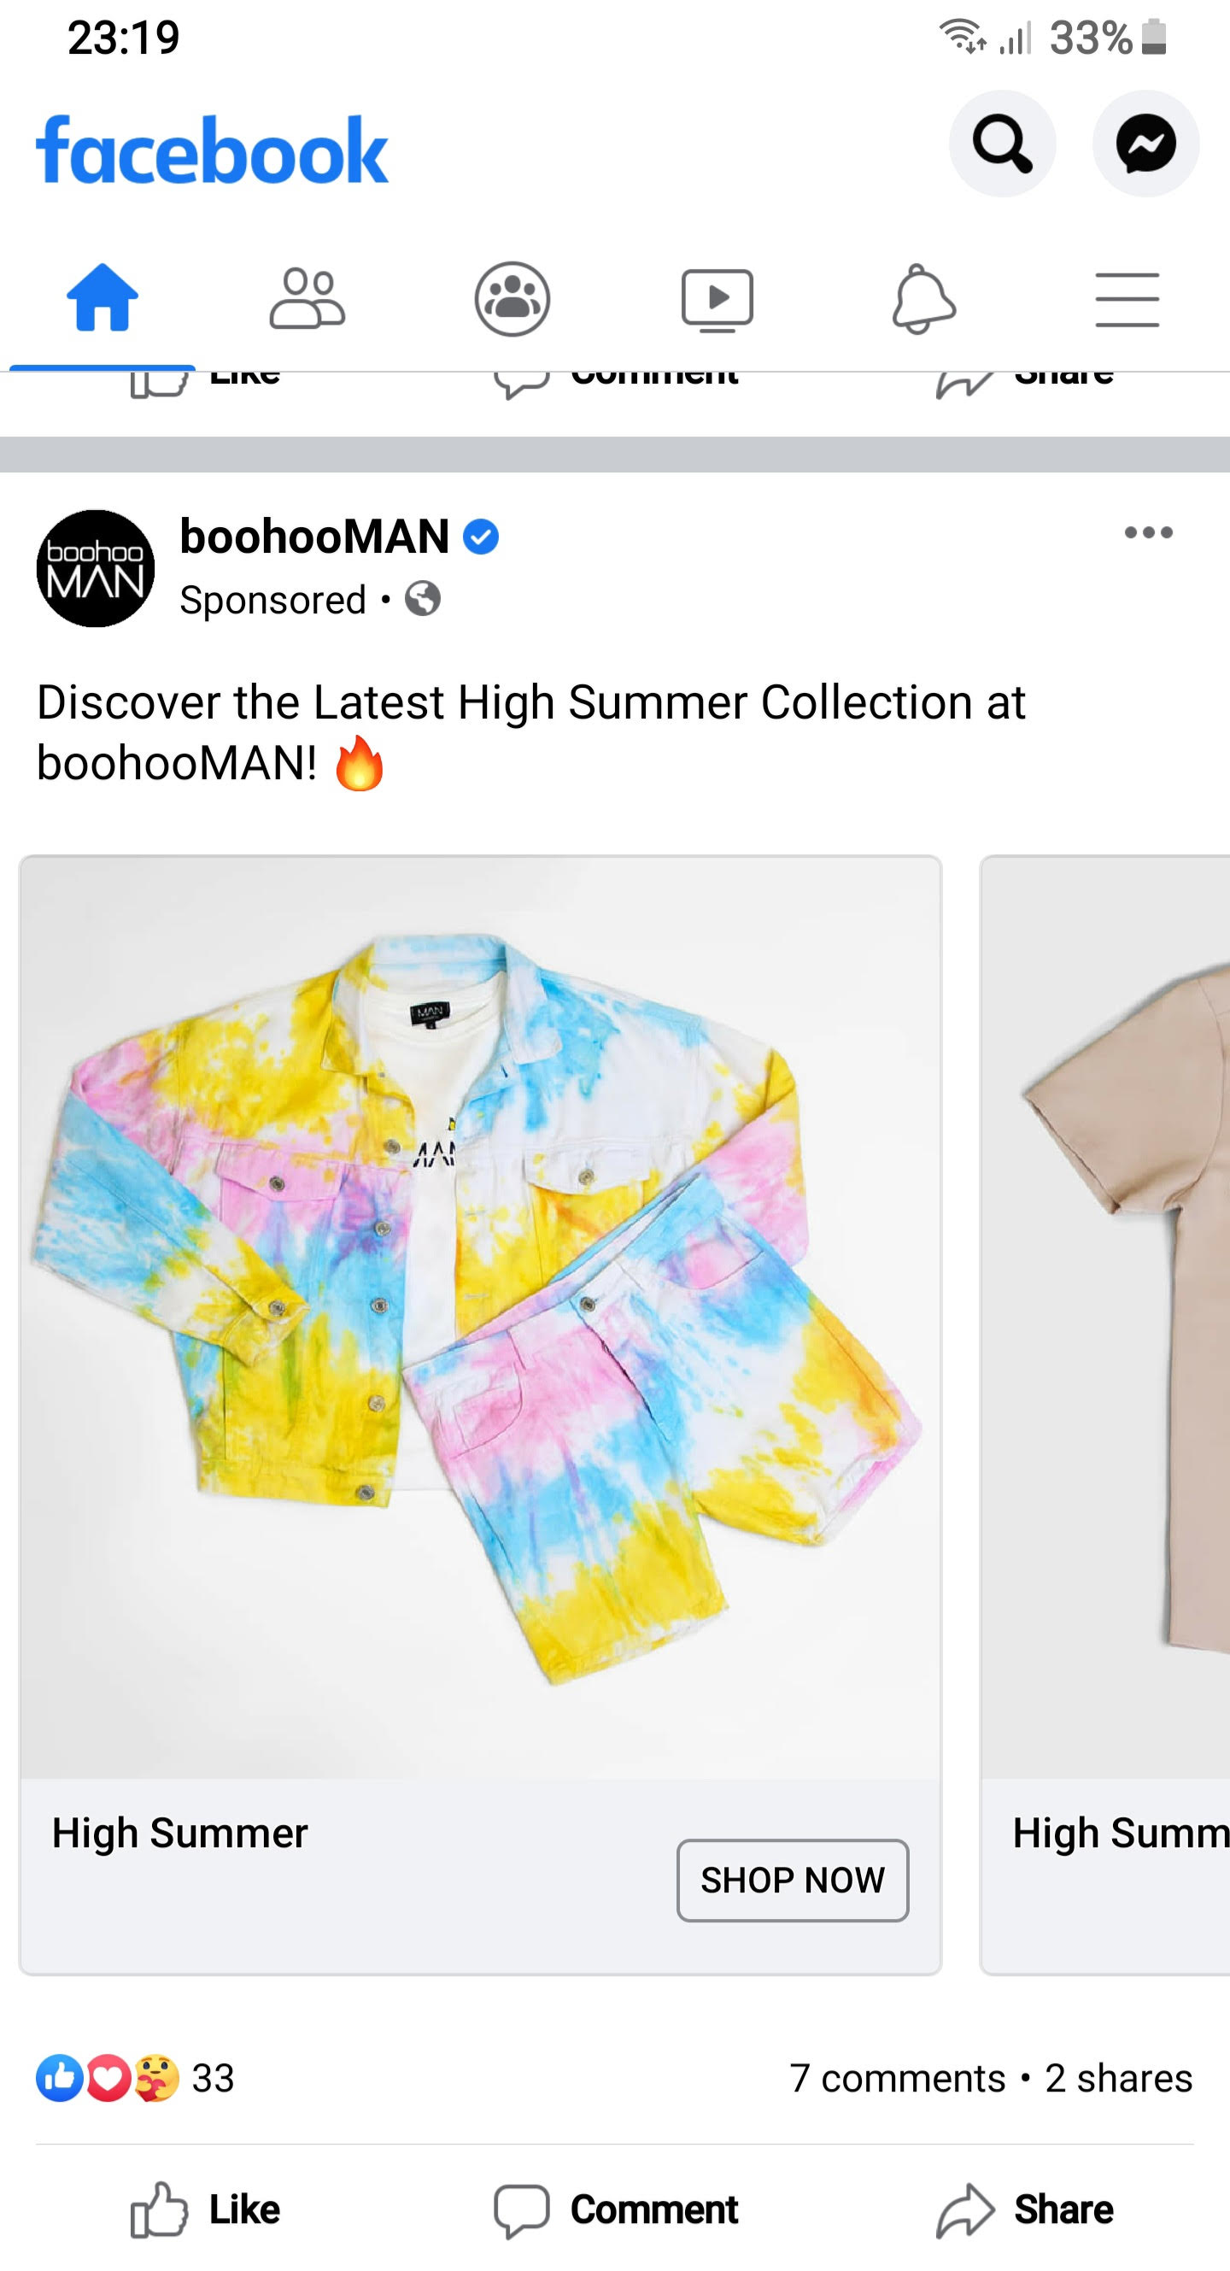
Introduction
There is no doubt that Social Media Marketing is an important tool to create, develop, maintain and attract new audiences. Whenever we scroll through Social Media there is always a page or a demonstration of a product that is popping up on our feeds enticing us with last minute discounts and exclusive products.
Brian Solis a Digital Analyst from Silicon Valley said that:
“Social media is about sociology and psychology more than technology.”
This quote paints a pretty accurate picture of the type of marketing strategy should be implemented to guarantee a profitable rate of sales through this platform based on what product should be targeted to what demographic.

Slide 3
Figures
74% of consumers have a more positive brand impression after interacting
with a company through social media.
Purchase likelihood increases 51% after a customer clicks the “like” button.
When they receive good customer service, social media users tell three
times as many people about it as do nonusers of social media.
83% of people who complained about a given company on Twitter “liked or
loved” a response by the company.
90% of consumers trust product reviews from people they know; 70% trust
reviews from people they don’t know.
40% of social media users “like” businesses in order to receive special
discounts and promotions.
Facebook fans of a brand spend twice as much as those who are not
Facebook fans.
(Tom Funk., 2013)

Slide 4
Opportunities
Having in mind these figures it is more and more important for companies to capitalise on the time spent by people online to:
Build brand awareness,
Show authenticity,
Communicate authority,
Encourage engagement,
Provide support
Grow affordability
Akin to how someone would treat a friend request on facebook based on you know who they are, you like them and there is some sort of bond between you brands get pretty much the same treatment when it comes to consumer choice.

Slide 5
What the experts say
I-ping Chiang wrote a piece in the International Journal of Electronic Commerce Studies entitled “Exploring the benefits of Social Media Marketing for brands and communities” where he says that “According to an eMarketer report, the number of brand marketers committing a budget to paid social media advertising has been increasing by 1% to 2% yearly.” (Chiang, 2019)
This shows that based on the figures shown on the slide before regarding the time spent by people online companies are already tapping into the potential of Social Media in order to convert sales to a more targeted audience (bearing in mind that Social Media analytical filters help with this a lot)
Bonnie Sainsbury a Digital Business Strategist/Marketing advisor from Vancouver said that:
“Social media will help you build up loyalty of your current customers to the point that they will willingly, and for free, tell others about you.”
Social Media Marketing if done correctly can be self sustaining to a certain extent providing companies can actually translate data from Social Media Marketing sales to show how effective it has been.

Slide 6
What the experts say 2
“Although scholars and marketers are aware already of the significance of social media marketing, there are no definitive empirical data that can be used to determine whether social media marketing actually creates brand benefits or increases product sales” (Chiang, 2019)
Consumers show unique patterns of behaviour towards brands when interacting online, they expect quick responses to questions, quick replies to any complaints and find out about each other`s experiences before buying a product of experience.
Despite not having the support of empirical data it is crucial for brands to strengthen more and more their presence on social media (sales, interaction, problem resolution etc.) bearing in mind that we live in a tech savvy society and long gone are the days of phone and email complaints.

Slide 7
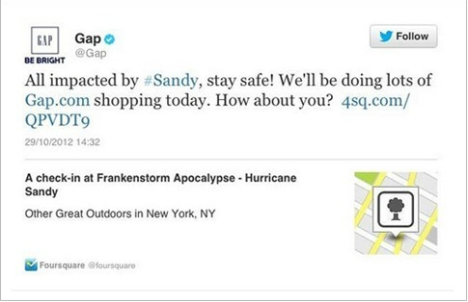
Issues
Like many business aspects Social Media Marketing has some science behind it, when a company decides to set foot onto the Social Media field it must do so with essential tools to ensure peak delivery of service and support such as a dedicated team, consistent response deadlines, strong support platform and be able to empathise and relate to customers issues.
Below is an example of Social Media Marketing gone wrong.
In 2012 during Hurricane Sandy GAP decided to tweet that they were offering free shipping despite people going through such a big disaster and failed to appreciate that people`s priorities were to keep safe or evacuate their homes.

Slide 8
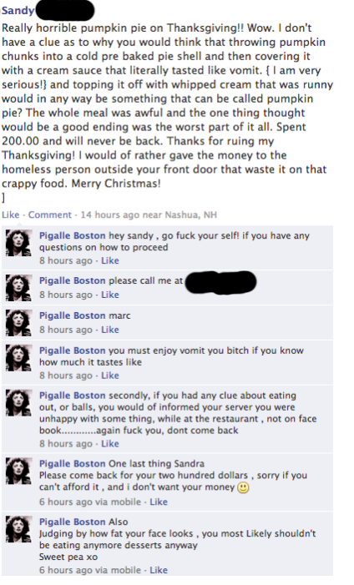
Issues 2
The example next shows a very bad example of how a customer complaint should be handled, whoever handled this complaint took a very defensive and reactive stance judging by the content and barrage of abuse given to the customer.
This in turn will be seen and shared by millions of people damaging the reputation of the business possibly to an irreversible stage of repair.
Apart from these two examples brands face other risks such as come across as “annoying” when users get bombarded with constant ads, there are even options on most ads to hide due to it being repetitive, misleading etc so it can go against the company`s intention of “convincing” the user to buy and end up alienating due to the constant ads coming up.

Slide 9
RECOMMENDATIONS
Some of the recommendations for businesses that want to maintain a strong presence on Social media and convert clicks and scrolls into actual sales and customer loyalty could be:
Invest in specialised teams that are only focused on the Social media platforms content, engagement and support
Work with Social media companies to help potential customers access shopping pages according to their needs and wants by creating pages dedicated to shopping and filtered by content and interests.
Control the algorithm to release sales and new products based on a spaced timeframe rather searches on the internet.
Focus on substance vs content advertisement e.g. draw people to social/environmental causes via purchases.
Create loyalty by rewarding shared posts e.g. sign up and share the page and get 10% off a purchase within the next 48 hours.

Slide 10
References
1. Review42. 2020. How Much Time Do People Spend On Social Media In 2020?. [online] Available at: <https://review42.com/how-much-time-do-people-spend-on-social-media/#:~:text=The%20average%20US%20adult%20spends,was%20142%20minutes%20a%20day.> [Accessed 28 June 2020].
2. Chiang, I., 2019. Exploring the Benefits of Social Media Marketing for Brands and Communities. International Journal of Electronic Commerce Studies, 10(2), pp.113-140.
3. Chiang, I., 2019. Exploring the Benefits of Social Media Marketing for Brands and Communities. International Journal of Electronic Commerce Studies, 10(2), pp.113-140.
4. P. A. Pavlou, Consumer acceptance of electronic commerce: Integrating trust and risk with the technology acceptance model.
International journal of electronic commerce, 7(3), 101-134, 2003.
https://doi.org/10.1080/10864415.2003.11044275

