Slide 1

Designing, Delivering & Evaluating L&D
Week 2 – L&D Strategy and Establishing Learning Needs

Slide 2
The aim of this session is to:
Evaluate, select and apply a range of approaches and processes for establishing learning and development needs at organisational, group/team, occupational and individual levels in collaboration with relevant stakeholders
At the end of the session you will be able to:
1 | Recognise the business strategy of your organisation and whether your HRD strategy is aligned.
2 | Identify the sources of information used to define learning needs at organisational, team and individual levels.
3 | Identify organisational, team and individual learning needs in the context of your organisation.

Slide 3
Session Overview
1 | HRD Strategy
2 | Establishing Learning Needs
3 | Sharing & Learning - Review of your organisations practice
4 | Prep aration for next week - How do People Learn?

Slide 4
Strategy
What do we mean by strategy?
Long term direction of the organisation e.g. product markets, geographical location
Driving the organisation forward to achieve sustained competitive advantage e.g. through new products, services or better value
Determining the scope of the organisations activities e.g. remain in one sector or diversify?
Matching internal resources and activities to the environments in which the organisation operates to achieve strategic fit (SWOT)

Slide 5

HRD Strategy
An HRD Strategy should…..
Reflect and reinforce the approach within the broader HRM strategy
Link with other strategies e.g. reward
Reflect the overarching business strategy
Drive success towards the business strategy
(CIPD, 2016)

Slide 6
HRD Strategy
What is the business strategy of your organisation?
What is the strategic culture of your organisation?
What are the main aims of the HRD strategy?
Does the HRD strategy align to the organisational strategy?
Organisational Strategy and HRD in your organisation

Slide 7
HRD Strategy
Stakeholders
Senior management/the board
Line managers
Operational managers
Individual members of staff
Trade unions or staff representatives
In large organisations where there are different divisions and functions it may be appropriate to involve a cross section of stakeholders
(CIPD, 2016)

Slide 8
Establishing Learning Needs
How will organisational, team and individual learning needs be analysed?
What budget and resources will be allocated?
What kinds of learning methods will be used?
How will learning be evaluated?
Translating Strategy Into Action

Slide 9

Establishing Learning Needs
Assessment of prevailing levels of knowledge skill and attitude, and on any current or anticipated gaps
Systematic gathering of data
Consideration of statutory requirements
How are learning needs identified?

Slide 10
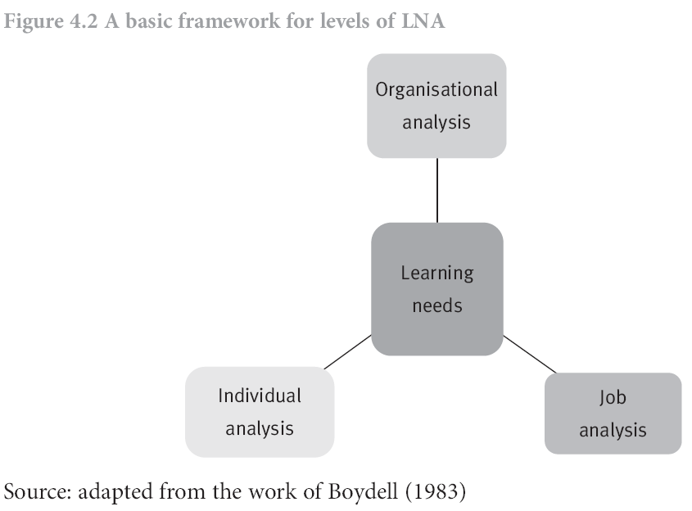
Establishing Learning Needs
Levels of learning needs analysis
Notes:
Organisation
To understand the amount of and types of learning needed to ensure that all employees have the right capabilities to deliver the organisation strategy
Department/team/project
New projects or opportunities, reorganisation, restructuring
Individual
Linking own personal learning to those of the business
What are the typical types of development needs at each level.

Slide 11
Establishing Learning Needs
Levels of learning needs analysis
Analysis of 3 levels needs to be considered in conjunction with each other
Needs to be agile, fast and responsive
CIPD suggest it should follow RAM
  Relevance : how does what we are currently doing and what we plan to do meet new opportunities and challenges for the business?
  Alignment: ensuring that delivery meets objectives
  Measurement: measure and evaluate learning interventions

Slide 12
Establishing Learning Needs
Different types of learning needs
Level of business benefit | Organisational need | Group needs | Individual needs
Implementing – doing things well | Meeting current organisational objectives | Working together to meet existing targets and standards | Being competent at the level of existing requirements
Improving- doing things better | Setting higher objectives, and reaching them | Continuous improvement teams | Having and using systematic continuous improvement skills and processes
Innovating – doing new and better things | Changing objectives and strategies | Working across boundaries to create new relationships and new products and services | Being able to work differently and more creatively with a shared sense of purpose

Slide 13
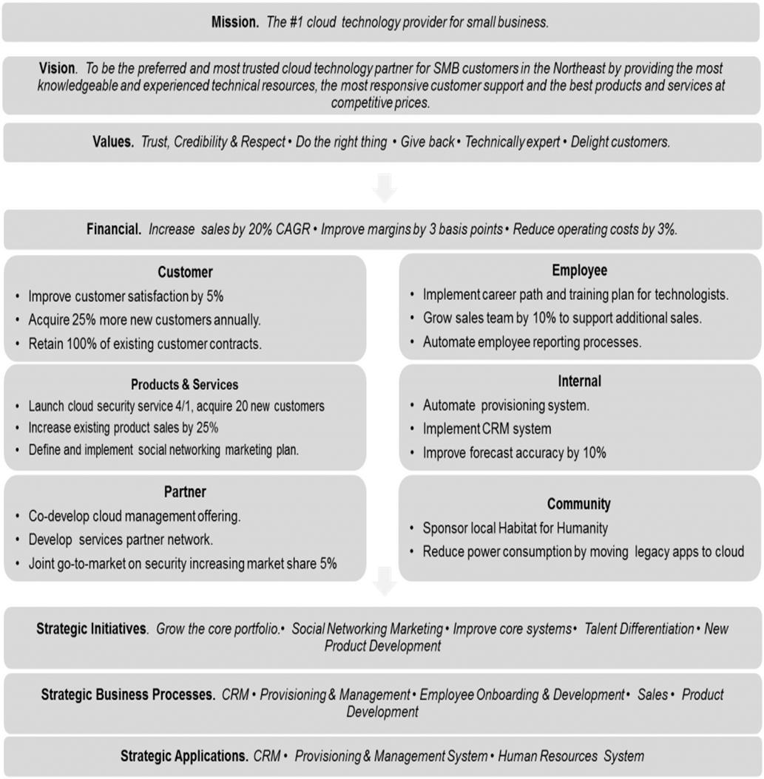

Slide 14
Establishing Learning Needs
Organisational Level
What sources of data are there?
Collection of hard eg. Information on MIS, market share and soft data e.g. surveys/opinions
Data collected from external and internal sources, analysed through PESTLE/SWOT analysis
Organisational goals and objectives
Human resource plan e.g. demographic data on retirement
Critical incident analysis
Gap analysis
Business plans and strategies
Performance management systems e.g. appraisal
Notes:
How reliable is appraisal data in identifying org needs?

Slide 15
Establishing Learning Needs
Individual Level
Assessment/skills analysis/skills matrix
Appraisal
360 degree feedback
Assessment/development centre
Self assessment
Exit interviews
Notes:
Example of 360, CDP and skills profile.

Slide 16
Establishing Learning Needs
Using the results
A report of overall training needs for the organisation will form the basis of the Learning and Development strategy
Evaluate and prioritise who you want to train and how best to reach them
Established how employees will best accept and integrate training and their preferred learning methods
Evaluate current learning and training – what can be done in-house, budget and time available
Take a decision on what type of training and learning fits your needs best

Slide 17
Establishing Learning Needs
HRD professionals might be tempted to curtail the level and depth of the LNA phase – ‘the cart before the horse’ (Goldstein & Ford,2002)
Time lag between a decision being taken to undertake a LNA and the subsequent learning intervention being designed and delivered.
Gaining commitment and agreement with the LNA process can be challenging
Limitations of TNA/LNA

Slide 18
Bringing it all together
An effective HRD strategy can deliver the capabilities, competencies and skills required to support sustainable success
The systematic identification of learning and development needs is a key aspect to ensuring effective provision of learning.

Slide 19
The aim of this session was to:
Evaluate, select and apply a range of approaches and processes for establishing learning and development needs at organisational, group/team, occupational and individual levels in collaboration with relevant stakeholders
You should now be able to:
1 | Recognise the business strategy of your organisation and whether your HRD strategy is aligned.
2 | Identify the sources of information used to define learning needs at organisational, team and individual levels.
3 | Identify organisational, team and individual learning needs in the context of your organisation.
Next week...

Slide 20
Activity: Peer Teaching
Based on this week’s Multiple Intelligences activity, as a group of up to 5 design an activity or a resource to engage your fellow students in learning about a given topic related to the process of learning. Be prepared to present this work in next week’s tutorial. You will be required to present your activity or resource in a 15-minute time slot in next week's tutorial.
Notes:
Remaining time for prep plus first 90 minutes of nexts week session.

Slide 21
How People Learn
An example using the theory of Mutiple Intelligences.

Slide 22
How do people learn?
The theoretical foundations of the practice of DDE:
Constructivist learning
Social Learning
Adult Learning Theory
Organisational Learning
Critique of Learning Styles

