Slide 1
LCBB5013
Entrepreneurship
Week 4
Developing an Effective Business Model

Slide 2
What is a business model?

Slide 3
Business Models
Business Model
  A business model is a firm’s plan or recipe for how it creates, delivers, and captures value for its stakeholders.
  The proper time to develop a business model is following the feasibility analysis stage and prior to fleshing out the operational details of the company.
  A firm’s business model is integral to its ability to succeed both in the short and long term.

Slide 4
General Categories of Business
Models (1 of 5)
Standard Business Models
  The first category is standard business models.
  Standard business models depict existing plans or recipes firms can use to determine how they will create, deliver, and capture value.
  There are a number of standard or common business models, which are shown on the next two slides.

Slide 5
General Categories of Business
Models (2 of 5)
Standard Business Models: Explainer Video
Business Model | Representative Companies
Advertising Business Model | Google, Facebook
Auction Business Model | eBay, uBid
Bricks and Clicks Business Model | Apple, Barnes & Noble
Franchise Business Model | 24 Hour Fitness, Panera Bread
Freemium Business Model | Dropbox, Evernote
Low-Cost Business Model | Southwest Airlines, Warby Parker
Manufacturer/Retailer Business Model | Apple, Fitbit, Tesla Motors
Peer-to-Peer Business Model | Airbnb, Uber

Slide 6
General Categories of Business
Models (3 of 5)
Standard Business Models
Business Model | Representative Companies
Razor and Blades Business Model | Game Consoles and Games, Printers and Ink Cartridges
Subscription Business Model | Birchbox, Blue Apron, Netflix
Traditional Retailer Business Model | Whole Foods Markets, Zappos

Slide 7
General Categories of Business
Models (4 of 5)
Disruptive Business Models
  The second category is disruptive business models.
  Disruptive business models, which are rare, are ones that do not fit the profile of a standard business model.
  They are impactful enough that they disrupt or change the way business is conducted in an industry or an important niche within an industry.
  The next slides depict four business models that were disruptive when they were introduced.

Slide 8
General Categories of Business
Models (5 of 5)
Disruptive Business Models
Business Model | Company or Companies That Introduced It
Direct-to-Consumer Computer Sales (which allowed consumers to customize their computers) | Dell
Online Text Ads on Search Engines (allowed advertisers to place ads for products that searchers were already searching for) | Yahoo, Google
Software as a Service (SaaS) (By moving software to the cloud, allowed users to access the software and their data from anywhere there was an Internet connection) | Salesforce.com
Cloud-based Service to Connect Riders and People Willing to Provide Rides (Provided riders with an app that connects them with the owners of private cars) | Uber, Lyft

Slide 9
Barringer/Ireland Business Model Template (1 of 2)
Barringer/Ireland Business Model Template
  Although not everyone agrees precisely on the components of a business model, many agree that a successful business model has a common set of attributes.
  These attributes can be laid out in a visual framework or template so it is easy to see the individual parts and their interrelationships.
  The Barringer/Ireland Business Model Template is shown in the next slide.

Slide 10
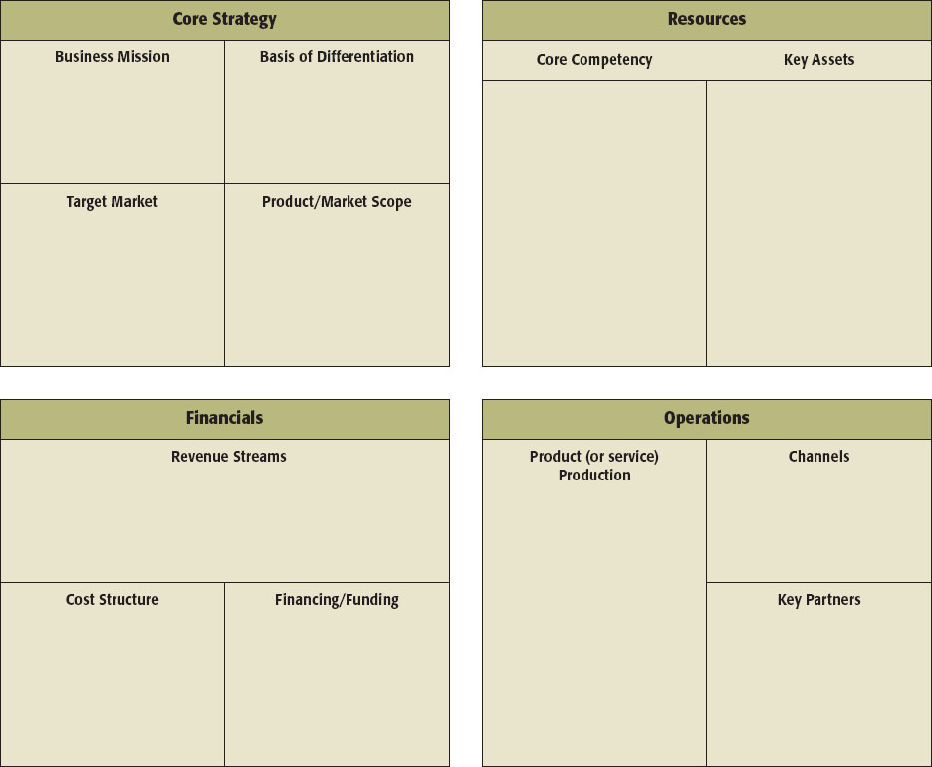
Barringer/Ireland Business Model Template (2 of 2)
Figure 4.2 Barringer/Ireland Business Model Template

Slide 11
Core Strategy (1 of 5) – Relevant to Assessment
Core Strategy
  The first component of the business model is core strategy.
  A core strategy describes how the firm plans to compete relative to its competitors.
  The primary elements of core strategy are:
    Business Mission
    Basis of Differentiation
    Target Market
    Product/Market Scope

Slide 12
Core Strategy (2 of 5)
Business Mission
  A business’s mission or mission statement describes why it exists and what its business model is supposed to accomplish.
  If carefully written and used properly, a mission statement can articulate a business’s overarching priorities and act as its financial and moral compass.
  A well-written mission statement is something that a business can continually refer back to as it makes important decisions in other elements of its business model.

Slide 13
Core Strategy (3 of 5)
Basis of Differentiation
  It’s important that a business clearly articulate the points that differentiate its product or service from competitors.
  A company’s basis of differentiation is what causes consumers to pick one company’s products over another’s.
  It is what solves a problem or satisfies a customer need.
  It is best to limit a company’s basis of differentiation to two to three key points.
  Make sure that your points of differentiation refer to benefits rather than features.

Slide 14
Core Strategy (4 of 5)
Target Market
  The identification of the target market in which the firm will compete is extremely important.
  A target market is a place within a larger market segment that represents a narrow group of customers with similar interests.
  A firm’s target market should be made explicit in the business model template.

Slide 15
Core Strategy (5 of 5)
Product/Market Scope
  A company’s product/market scope defines the products and markets on which it will concentrate.
  Most firms start with a narrow (or limited) product/market scope, and pursue adjacent product and market opportunities as the company grows and becomes more financially secure.
  In completing the business model template, a company should be very clear about its initial product/market scope and project 3-5 years in the future in terms of anticipated expansion.

Slide 16
Resources (1 of 3)
Resources
  The second component of a business model is resources.
  Resources are the inputs a firm uses to produce, sell, distribute, and service a product or service.
  A firm’s most important resources, both tangible and intangible, must be both difficult to imitate and hard to find a substitute for.
    This stipulation is necessary for an individual company’s business model to be competitive over the long term.

Slide 17
Resources (2 of 3)
Core Competencies
  A core competency is a specific factor or capability that supports a firm’s business model and sets it apart from rivals.
  A core competency can take on various forms, such as technical know-how, an efficient process, a trusting relationship with customers, expertise in product design, and so forth.
  Most start-ups will list two to three core competencies in their business model template.

Slide 18
Resources (3 of 3)
Key Assets
  Key assets are the assets that a firm owns that enable its business model to work. The assets can be physical, financial, intellectual, or human.
    Physical assets include physical space, equipment, vehicles, and distribution networks.
    Intellectual assets include resources such as patents, trademarks, copyrights, and trade secrets, along with a company’s brand and its reputation.
    Financial assets include cash, lines of credit, and commitments from investors.
    Human assets include a company’s founder or founders, its key employees, and its advisors.

Slide 19
Financials
Financials
  The third component of a firm’s business model focuses on its financials.
  This is the only section of a firm’s business model that describes how it earns money—thus, it is extremely important.
  For most businesses, the manner in which it makes money is one of the most fundamental aspects of its business model.

Slide 20
Operations
Operations
  The final quadrant in a firm’s business model focuses on operations.
  Operations are both integral to a firm’s overall business model and represent the day-to-day heartbeat of a firm.
  This section focuses on how a firm’s products and/or services are produced.
  A company’s channels describe how it delivers its product or service to its customers.

Slide 21
Individual Activity
Consider the chosen business idea for your assignment, try to evaluate below points and share with tutor:
A Business Mission
Basis of Differentiation (USP)
Target Market
Core Competencies and Key Assets e.g. no of people required and physical space
Channels, Key Partners, and a brief Production plan

Slide 22
Sources
Barringer, B., Ireland, D., (2019) Entrepreneurship: Successfully Launching New Ventures. Sixth edition; Global edition. Harlow, England: Pearson.
Business Disruptors (2017) Business Model Innovation – Amazon, Spotify and Tinder. Available at https://youtu.be/avWVPaJFgFk (Accessed: 12th October 2020)
Valuetainment (2020) 10 Business Models for Every Entrepreneur. Available at https://youtu.be/6dKIOSe2A2o (Accessed: 12th October 2020).

